Slide 1

Fantasy Football
Draft BIP Model
Jacob Norman

Slide 2
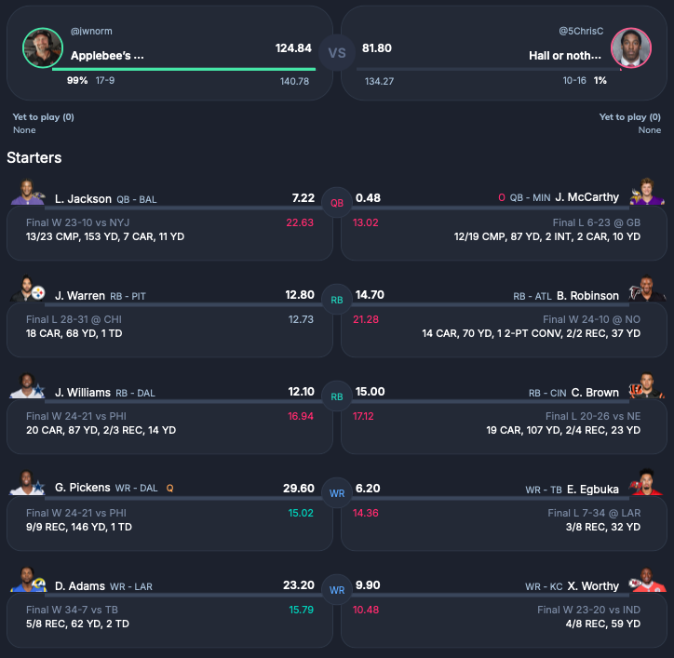
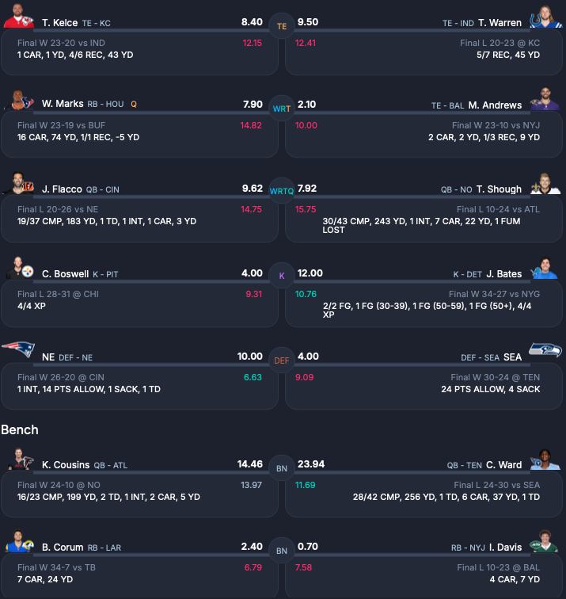
What is fantasy football?

Slide 3
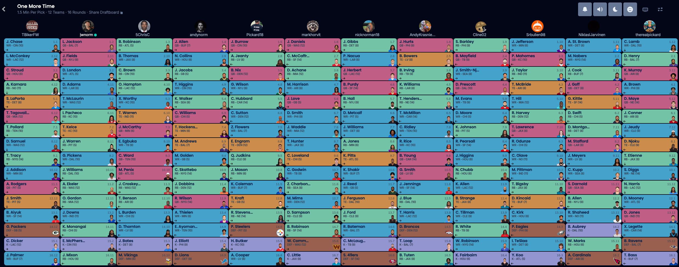
How do teams get players?

Slide 4
Objectives
Model the fantasy football draft problem as a binary integer programming (BIP) model;
Compare results against actual data through Week 13 of the NFL season; and
Conduct a series of scenario analyses by adjusting various parameters.

Slide 5
Model Definition

Slide 6
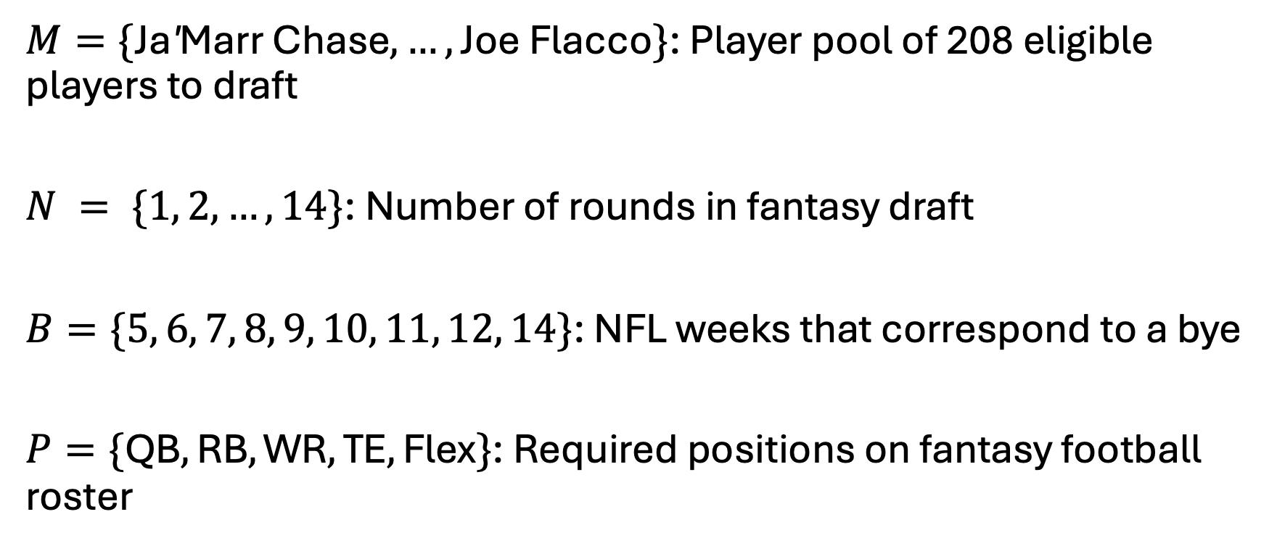
Sets
$M=\{\text{Ja}\text{′}\text{Marr} \text{Chase},…, \text{Joe} \text{Flacco}\}$: Player pool of 208 eligible players to draft
$N = \{1, 2, …, 14\}$: Number of rounds in fantasy draft
$B=\{5, 6, 7, 8, 9, 10, 11, 12, 14\}$: NFL weeks that correspond to a bye
$P=\{\text{QB}, \text{RB}, \text{WR}, \text{TE}, \text{Flex}\}$: Required positions on fantasy football roster

Slide 7
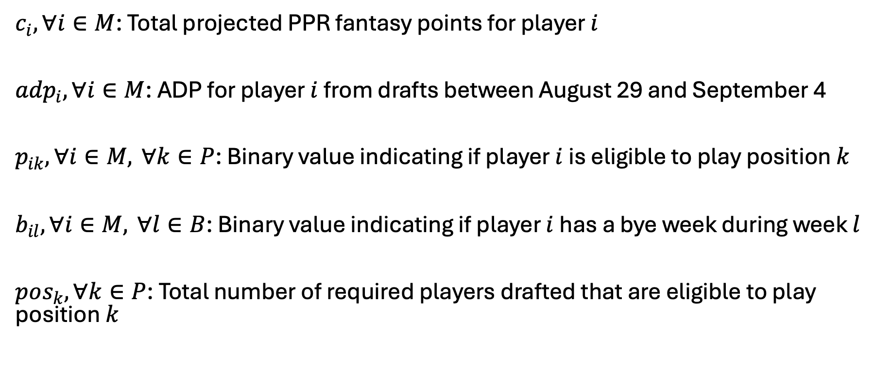
Parameters
$c_{i}, ∀i∈M$: Total projected PPR fantasy points for player $i$
${adp}_{i}, ∀i∈M$: ADP for player $i$ from drafts between August 29 and September 4
$p_{ik}, ∀i∈M, ∀k∈P$: Binary value indicating if player $i$ is eligible to play position $k$
$b_{il}, ∀i∈M, ∀l∈B$: Binary value indicating if player $i$ has a bye week during week $l$
$pos_{k}, ∀k∈P$: Total number of required players drafted that are eligible to play position $k$

Slide 8
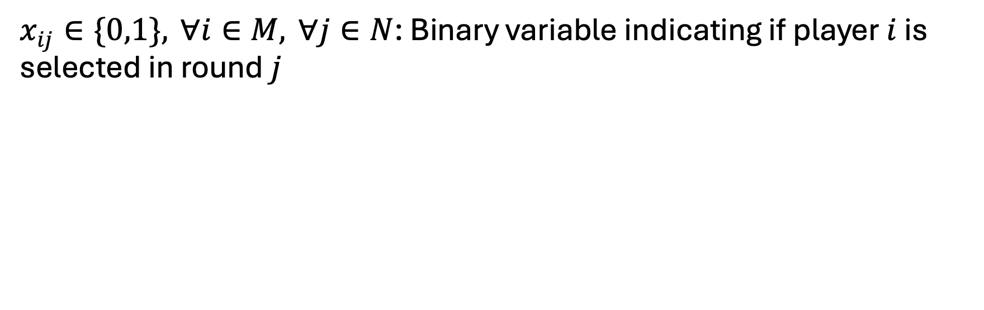
Decision Variables
$x_{ij}∈\{0,1\}, ∀i∈M, ∀j∈N$: Binary variable indicating if player $i$ is selected in round $j$

Slide 9
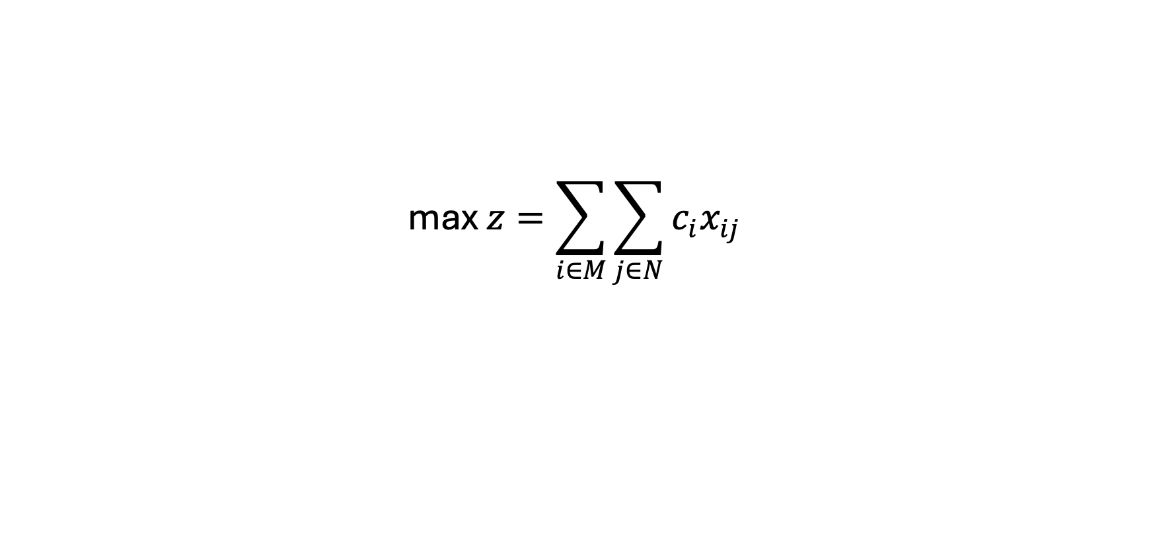
Objective Function
$$\text{max} z=\sum_{i∈M}{\sum_{j∈N}{c_{i}x_{ij}}}$$

Slide 10
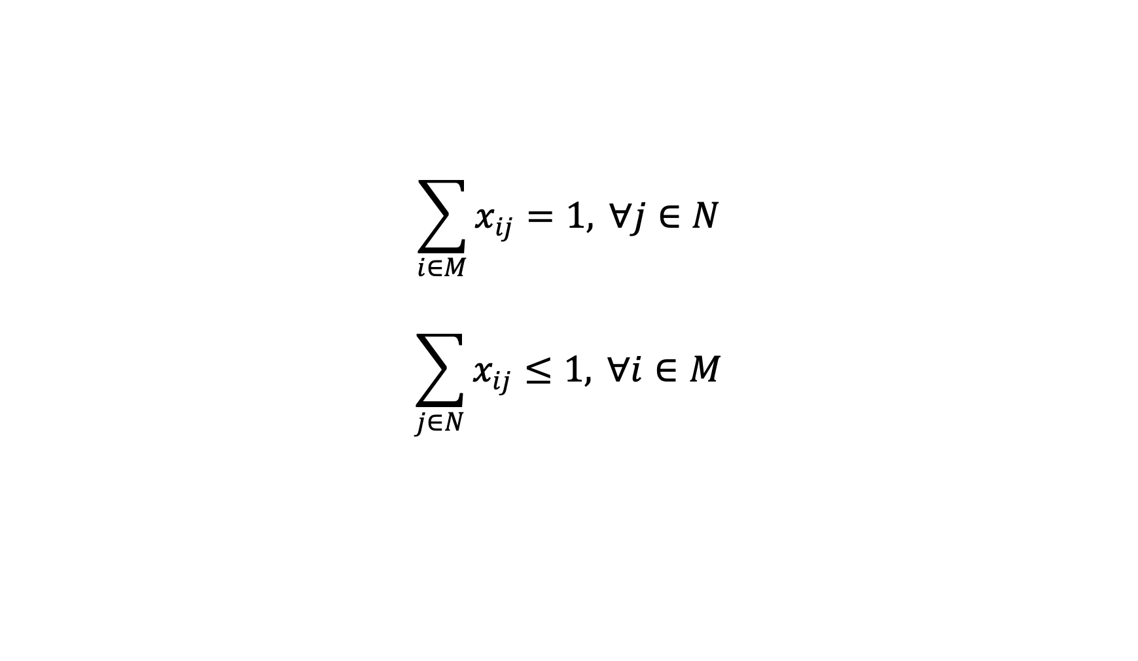
Assignment Constraints
$$\sum_{i∈M}{x_{ij}}=1, ∀j∈N$$
$$\sum_{j∈N}{x_{ij}}≤1, ∀i∈M$$

Slide 11
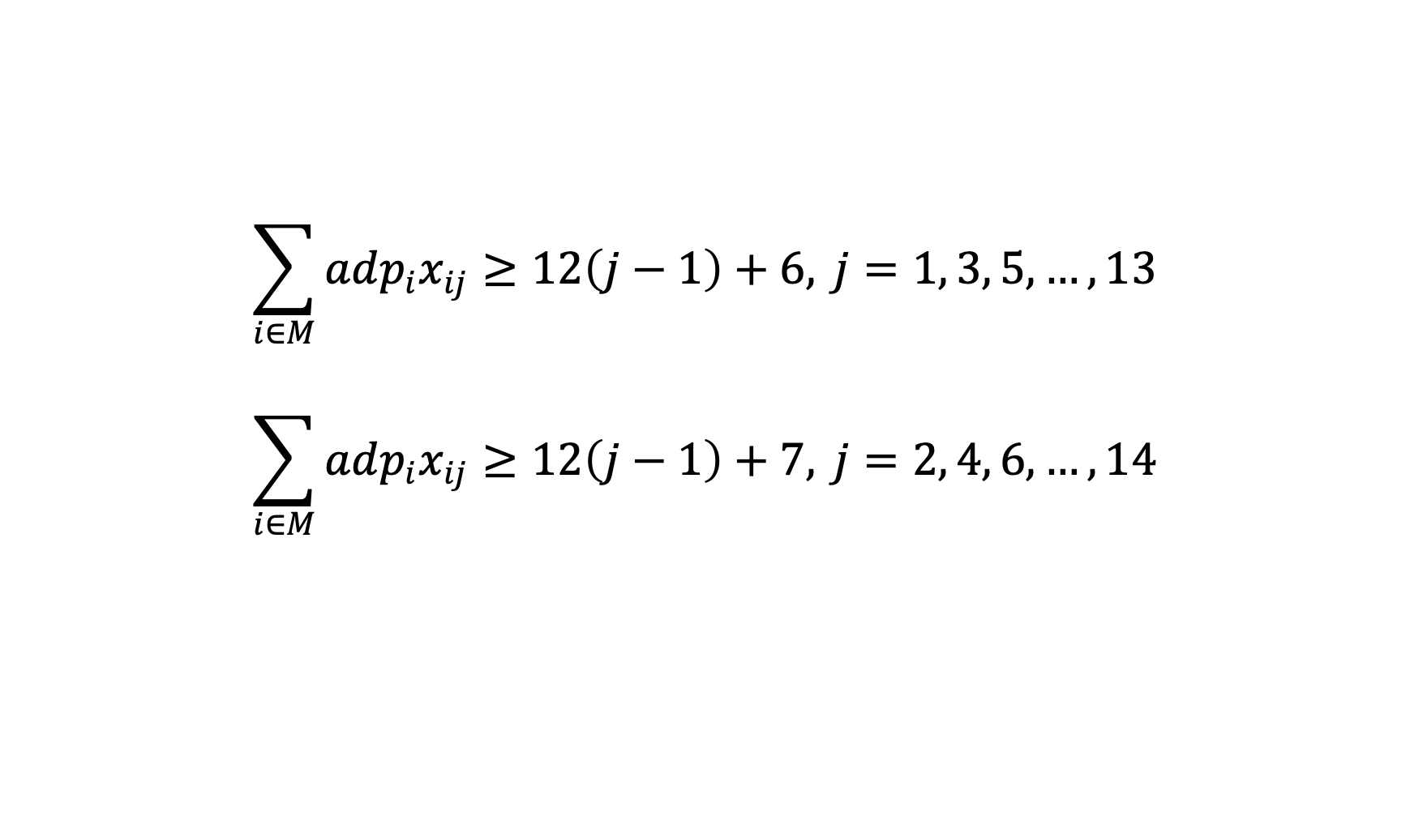
Snake Draft Enforcement Constraints
$$\sum_{i∈M}{adp_{i}x_{ij}}≥12\left(j−1\right)+6, j=1, 3, 5,…, 13$$
$$\sum_{i∈M}{adp_{i}x_{ij}}≥12\left(j−1\right)+7, j=2, 4, 6,…, 14$$

Slide 12
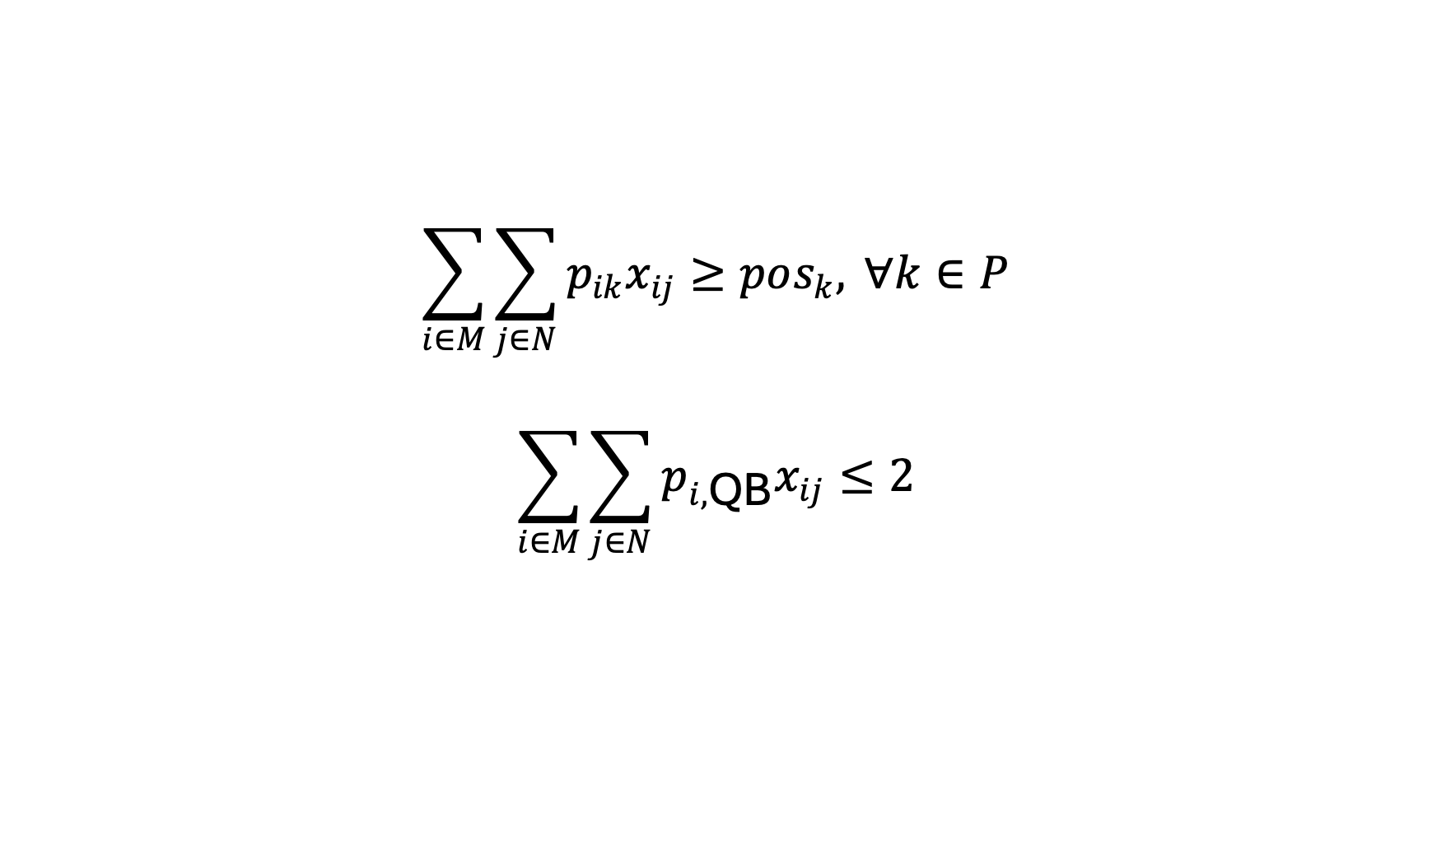
Positional Requirement Constraints
$$\sum_{i∈M}{\sum_{j∈N}{p_{ik}x_{ij}}}≥pos_{k}, ∀k∈P$$
$$\sum_{i∈M}{\sum_{j∈N}{p_{i,\text{QB}}x_{ij}}}≤2$$

Slide 13
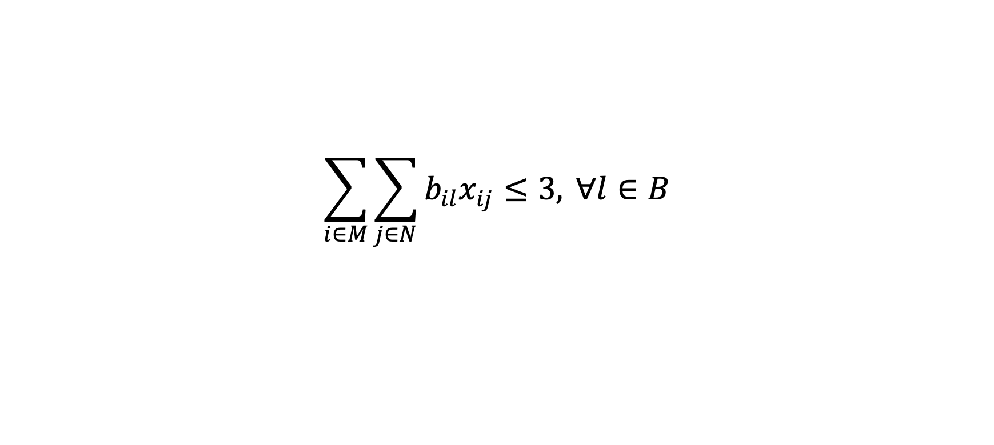
Bye Week Constraints
$$\sum_{i∈M}{\sum_{j∈N}{b_{il}x_{ij}}}≤3, ∀l∈B$$

Slide 14
Base Model Optimal Solution
Optimal value: 3,436 points
HiGHS solver (via Julia)
  0.1 seconds solve time
  1 node explored
  105 LP iterations
Draft RBs early, wait on QBs and TEs

Slide 15
True Model Optimal Solution
Intuition: Roster that would be selected with perfect forecast
Optimal value: 2,951 points
Base model achieves 59.5 percent of this value

Slide 16
Scenario Analysis

Slide 17
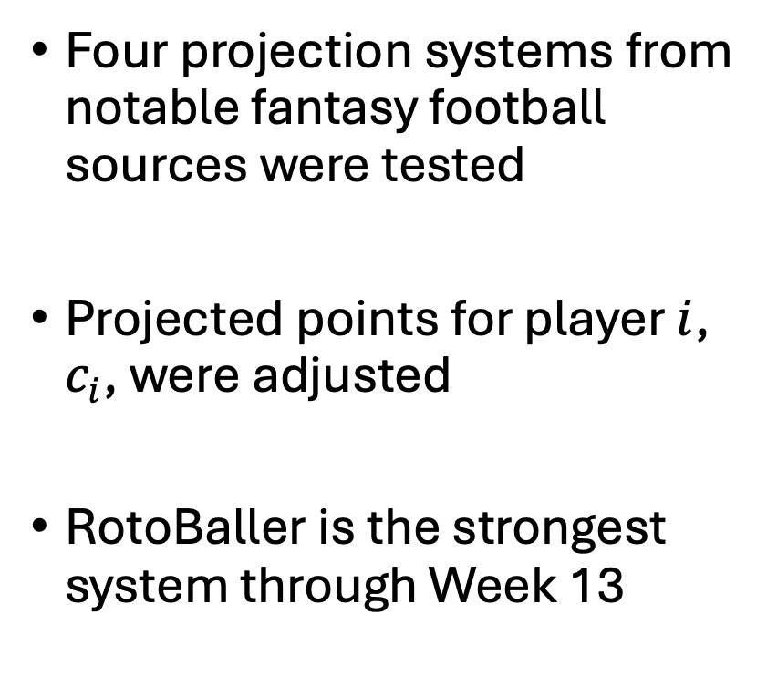
Projection System Used
Four projection systems from notable fantasy football sources were tested
Projected points for player $i$, $c_{i}$, were adjusted
RotoBaller is the strongest system through Week 13
* Parameter setting in base model

Slide 18
Starting Draft Position
Beginning, middle, and end of first round were tested
Snake draft enforcement constraints for even rounds were updated
Sixth position results in the most points through Week 13
* Parameter setting in base model

Slide 19
Other Key Findings
Draft players at their ADP or later; overvaluing players results in significantly lesser roster value
The fewer points awarded per reception place more value on running backs
Contrary to current discourse, tight ends still hold enough positional value to remain on rosters if that constraint is relaxed

Slide 20
Advantages & Limitations
Primary assumption: player draft values are deterministic
Model only as useful as projections that power it
Difficult to successfully model more complex elements of a fantasy league: injuries, start-sit decisions, waiver wire additions
Fantasy football draft BIP model should be utilized as a strategic guide rather than a firm predictive tool

Slide 21
References
Ciely, J. (2025, September 3). Fantasy football 2025 cheat sheet generator: Customizable rankings and projections tool [Dataset]. The Athletic. https://www.nytimes.com/athletic/6432965/2025/06/19/fantasy-football-2025- rankings-projections-cheat-sheet/
National Fantasy Championship. (2025). Average draft position [Dataset]. National Fantasy Championship. Retrieved November 18, 2025, from https://nfc.shgn.com/adp/football
numberFire. (2025, August). Fantasy football printable cheat sheet: Top 200 players for 12-team PPR league [Dataset]. FanDuel. https://www.fanduel.com/research/fantasy-football-printable-cheat-sheet-top-200-players-for- 12-team-ppr-league-2025
Pro Football Focus. (2025a, September 1). 2025 fantasy football rankings builder [Dataset]. Pro Football Focus. https://www.pff.com/news/fantasy-football-rankings-builder-2025
Pro Football Focus. (2025b) Fantasy football stats [Dataset]. Pro Football Focus. Retrieved December 2, 2025, from https://www.pff.com/fantasy/stats
RotoBaller. (2025). Free fantasy football draft cheat sheet (2025) [Dataset]. RotoBaller. Retrieved November 19, 2025, from https://www.rotoballer.com/free-fantasy-football-draft-cheat-sheet

Slide 22
Questions?

