Slide 1

Home Run Variable Selection in Major League Baseball
Jacob Norman
ISE537
Dr. Fang
2024 December 1

Slide 2
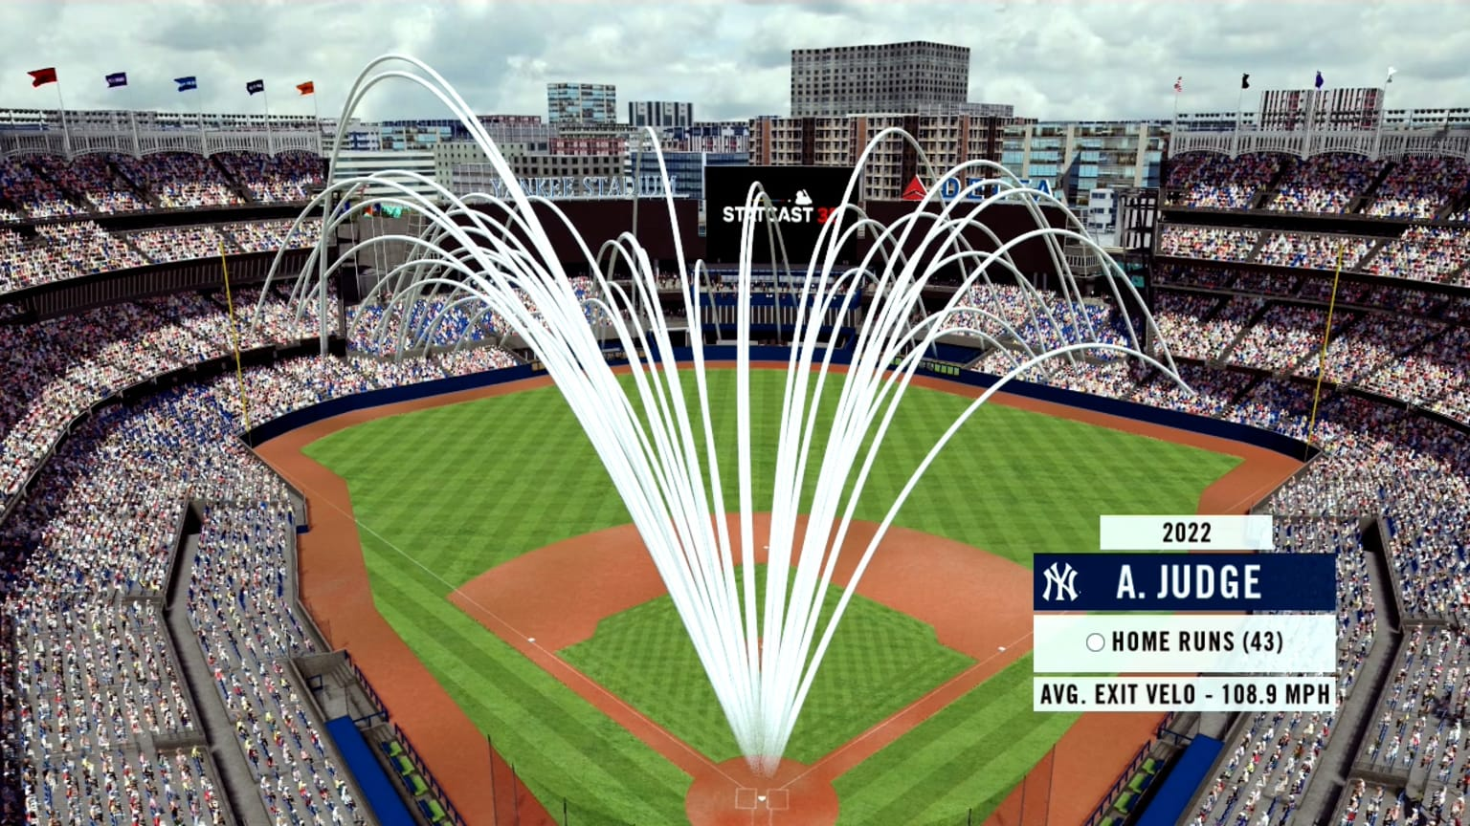
Introduction

Slide 3
Problem Statement
What are the key physical and environmental factors that influence whether a base hit is a home run in Major League Baseball (MLB)?

Slide 4


Data

Slide 5
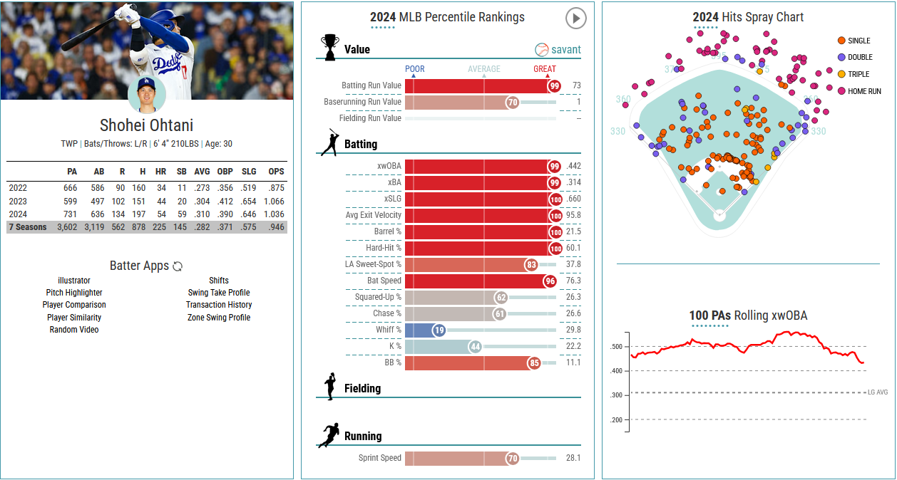

Slide 6
Hitting
Launch speed
Pitching
Effective speed
Release position
Environment
Month
Launch angle
Bat speed
Swing length
Hit location
Release speed
Release extension
Release spin rate
Spin axis
Arm angle
Horizontal and vertical movement

Slide 7

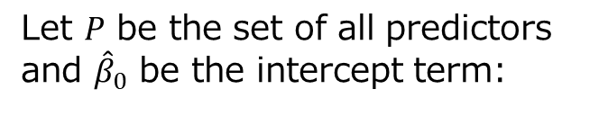
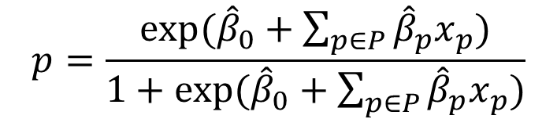
Model
$$p=\frac{exp⁡({\hat{β}}_{0}+\sum_{p∈P}{{\hat{β}}_{p}x_{p}})}{1+exp⁡({\hat{β}}_{0}+\sum_{p∈P}{{\hat{β}}_{p}x_{p}})}$$
Let $P$ be the set of all predictors and ${\hat{β}}_{0}$ be the intercept term:
Variable Selection Methods:
Naïve
Forward Selection
Backward Elimination
LASSO
Elastic Net

Slide 8
Analysis
 | AIC | BIC | Deviance | Accuracy
Full | 6,535 | 6,758 | 6,481 | 0.949
Naïve | 6,550 | 6,607 | 6,536 | 0.948
Forward (AIC) | 6,530 | 6,637 | 6,504 | 0.949
Backward (AIC) | 6,519 | 6,651 | 6,487 | 0.949
Stepwise (BIC) | 6,548 | 6,598 | 6,536 | 0.948
LASSO | 6,537 | 6,685 | 6,501 | 0.9492
Elastic Net | 6,543 | 6,716 | 6,501 | 0.949

Slide 9
Results
Hitting
Pitching
Environment
 | launch_speed | launch_angle | bat_speed | swing_length | hit_coord_x | hit_coord_y | effective_speed | release_speed | release_spin_rate | extension | spin_axis | arm_angle | release_pos_x | release_pos_y | release_pos_z | pfx_x | pfx_z | plate_x | plate_z | vx0 | vy0 | vz0 | ax | ay | az | month
Naive | X | X |  | X |  | X | X |  |  |  |  |  |  |  |  |  |  |  |  |  | X
Forward Selection (AIC) | X | X | X | X |  | X | X |  |  |  |  |  | X |  |  |  |  |  | X | X |  |  |  | X | X | X
Backward Elimination (AIC) | X | X | X | X |  | X | X |  |  |  |  |  |  | X | X |  |  | X |  |  | X | X | X | X | X | X
Stepwise (BIC) | X | X |  | X |  | X | X
LASSO | X | X | X | X | X | X | X |  | X | X |  | X |  |  | X |  | X | X | X |  |  |  | X | X |  | X
Elastic Net | X | X | X | X | X | X | X |  | X | X | X | X | X |  | X |  | X | X | X |  |  |  | X | X | X | X

Slide 10
Conclusion
Swing Dynamics Most Important
Deterministic predictors: launch angle and exit velocity
Effective Pitch Velocity
Impact of pitch on result can be boiled down to a single field
Suggests batter has more control over outcome than pitcher
Future Opportunities
Include categorical factors such as pitch type and ballpark
Pull in all 115 possible predictors
Release point plays an impact in how fast the ball is perceived by the batter
Swing length is most important of new the bat tracking metrics

Slide 11
References
Baseball Savant, MLB
Statcast Search (data)
Statcast Search CSV Documentation
Statcast Glossary
Statcast Park Factors Leaderboard
Statcast Arm Angle Leaderboard
Shohei Ohtani Player Page

