Slide 1
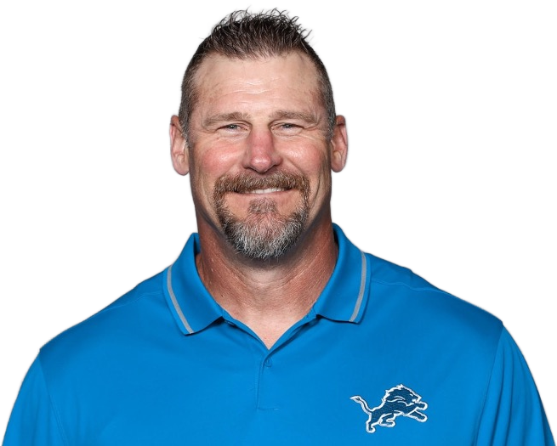
The Dan Campbell Effect
Fourth Down Decision-Making in the National Football League
Jacob Norman | ST 540-601

Slide 2

Motivation
League rules are designed to foster consistent parity among NFL franchises
Teams have embraced on-field analytics in an effort to gain a competitive advantage
Fourth downs can be the most consequential plays in a game in terms of impacting expected win probability

Slide 3
What is a fourth down?
Fourth down is the final opportunity for an offense to continue their drive towards to opponent's end zone
Traditional strategy has leaned towards conservative decision making, essentially treating third down as the last chance
New age thinking is to maximize win expectancy, which often means extending a drive to score more points

Slide 4
Research Gap
Dan Campbell became the head coach of the Detroit Lions in 2021, implementing aggressive fourth down tactics
Successfully conversions are praised, while failed ones are criticized as reckless
Is the media narrative that Campbell changed fourth down strategy leaguewide true?

Slide 5
Data
Play-by-play data was sourced from nflverse using nflfastR, supplemented with nflplotR for enhanced visuals
Completed fourth down plays from the last 25 seasons
Over 90,000 rows
16 numerical, 4 indicator, and 1 categorical columns
For performance reasons, more complex models utilized the last 10 seasons of play-by-play data

Slide 6
Bayesian Methods
STAN was used to fit a series of GLMMs via the brms package in R, with convergence verified via trace plots
Model 1: Logistic regression with beta likelihood (fixed)
Priors: Flat, Gaussian, gamma (sd)
Model 2: Logistic regression with Bernoulli likelihood (mixed)
Priors: Flat, Gaussian, horseshoe, gamma (sd)

Slide 7
M1 Results: The Dan Campbell Effect
The Campbell covariate is associated with a 0.367 increase in the log-odds of a conversion attempt proportion in an NFL season
While the results were moderately sensitive to prior, Campbell always remained a significant predictor

Slide 8
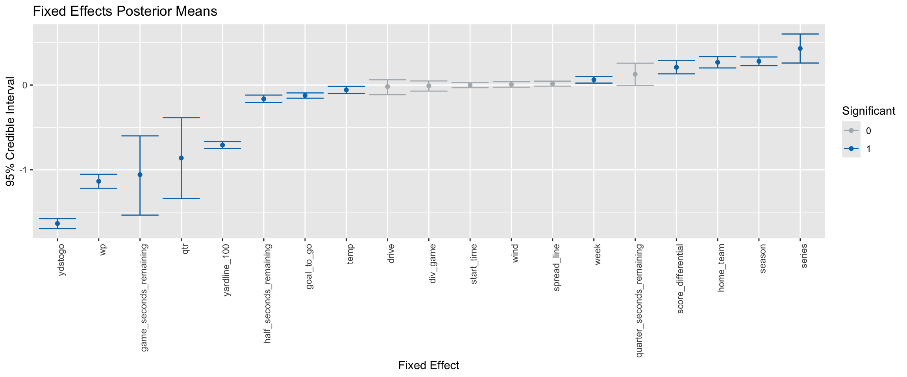
M2 Results: Fixed Effects
Response: Likelihood of attempting a fourth down conversion
Few very significant covariates, majority have a negative relationship with the response.

Slide 9
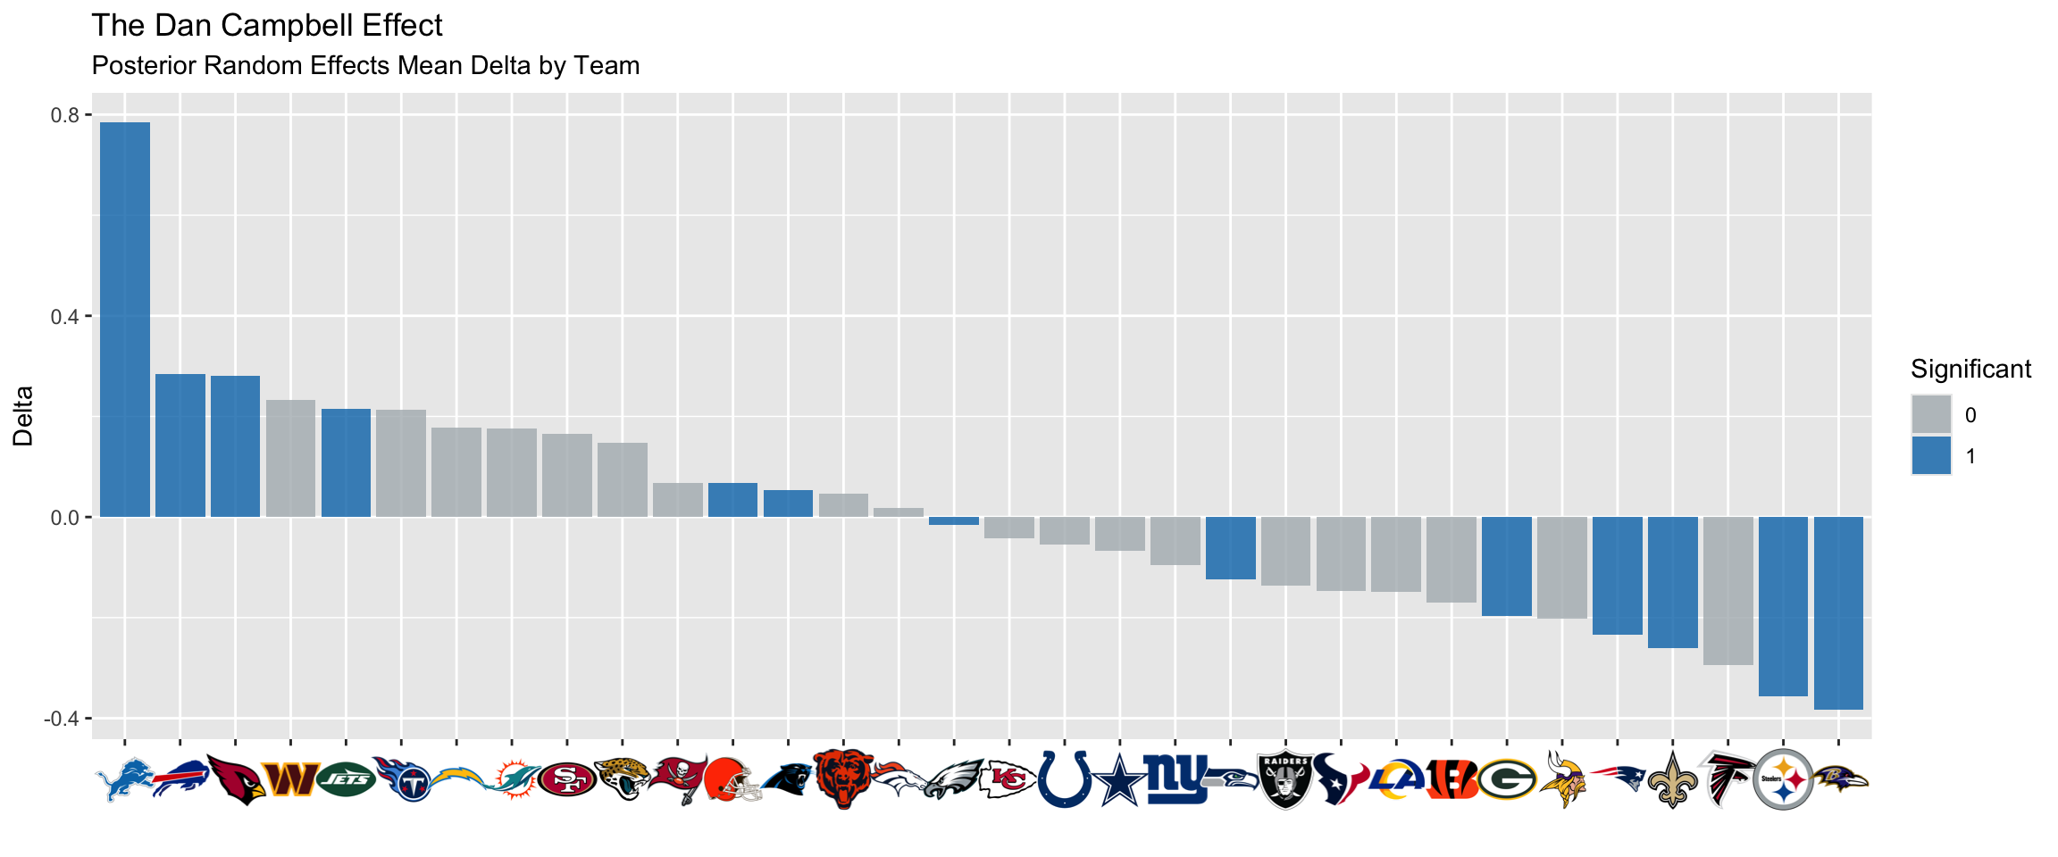
M2 Results: Random Effect Delta
Response: Likelihood of attempting a fourth down conversion
Difference in random effects by team before versus after Campbell became a head coach.

Slide 10
Key Findings
Strong evidence that conversion attempts are increasing over time
Dan Campbell is associated with an increase in the proportion of fourth down conversion attempts since 2021
Impact is not universal, more pronounced for some teams
Traditional fourth down strategy is still reinforced by significance of variables such as yards to go, goal to go, and win probability
Wind was not nearly as significant as one might assume

Slide 11
Strengths and Opportunities
All models were fit on a significant amount of data, which lessens the impact of prior information
Computational performance limited the number of model fits that could be efficiently ran
As a Detroit Lions fan, I have a clear bias towards this research and could potentially be overstating significance of my findings
Would like to extend analysis to also investigate fourth down conversion success rate with additional models

Slide 12
References
Bürkner, P.-C. (n.d.). brms: Bayesian regression models using Stan. Retrieved April 30, 2026, from https://paulbuerkner.com/ brms/index.html
nflfastR. (n.d.). nflfastR: Fast and tidy NFL data. Retrieved April 30, 2026, from https://nflfastr.com/index.html
Stan Development Team. (n.d.). Stan documentation. Retrieved April 30, 2026, from https://mc-stan.org/docs/
Wikipedia contributors. (2025). Beta regression. Retrieved April 30, 2026, from https://en.wikipedia.org/wiki/Beta_regression

Slide 13
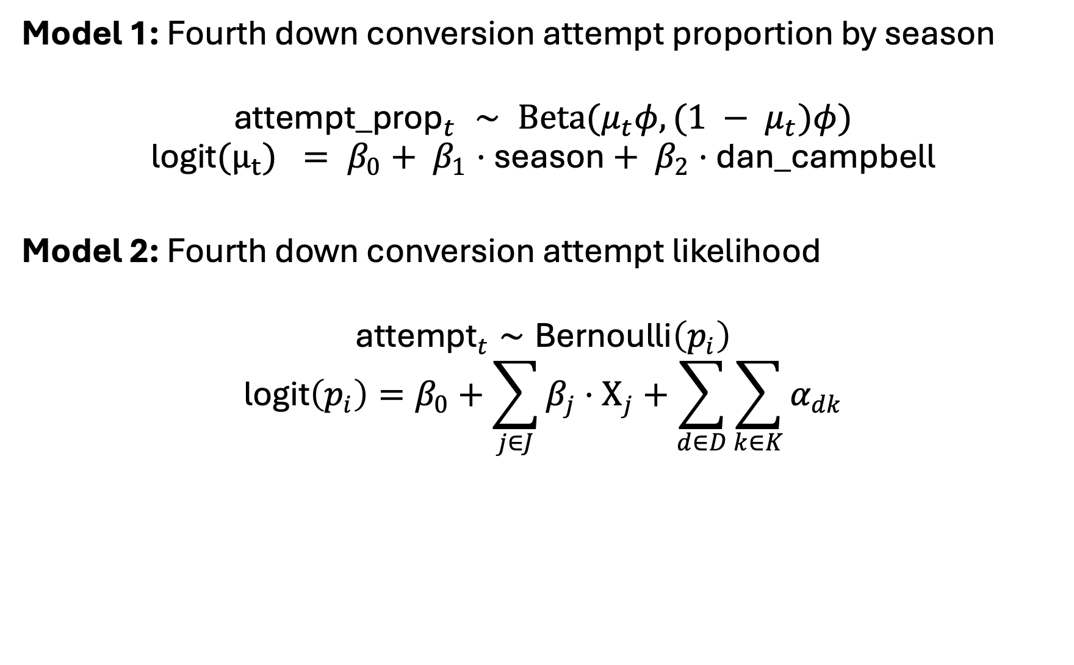
Models
Model 1: Fourth down conversion attempt proportion by season
$${\text{attempt}\text{_}\text{prop}}_{t} ∼ \text{Beta}(μ_{t}φ, (1 − μ_{t})φ)$$
$$\text{logit}(μ_{t}) = β_{0}+ β_{1}⋅\text{season}+ β_{2}⋅\text{dan}\text{_}\text{campbell}$$
Model 2: Fourth down conversion attempt likelihood
$${\text{attempt}}_{t}∼\text{Bernoulli}\left(p_{i}\right)$$
$$\text{logit}\left(p_{i}\right)=β_{0}+\sum_{j∈J}{β_{j}}⋅{\text{X}}_{j}+\sum_{d∈D}{\sum_{k∈K}{α_{dk}}}$$
J = fixed effects, D = Dan Campbell binary indicator, K = team

Slide 14
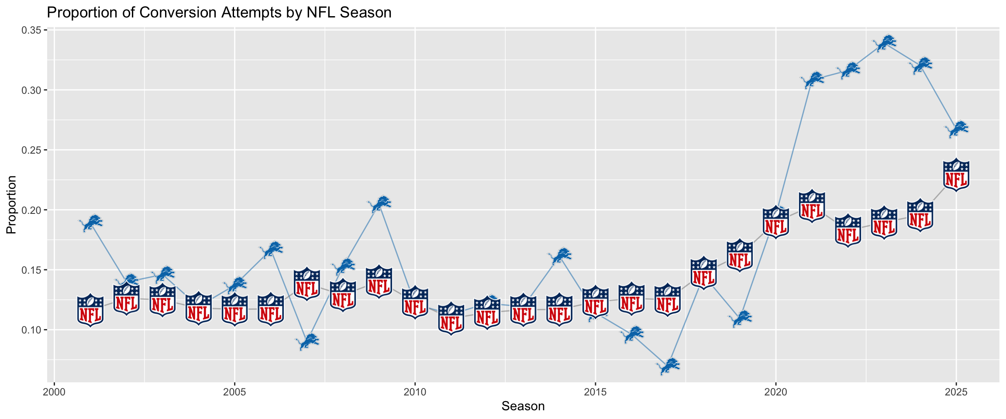
Proportion of Conversion Attempts by Season

