Slide 1

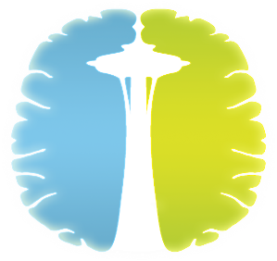
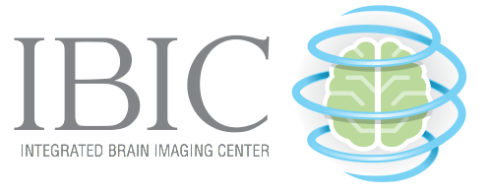
Using Resting-State Functional Connectivity to Detect Uncomplicated Mild Traumatic Brain Injury in U.S. Military Populations
Josh Wolfe¹
Psychology Undergraduate Honors Advisor: Tara Madhyastha^{1,2}
EVOLVE Study PI: Christine Mac Donald³
University of Washington
¹Psychology, ²Radiology, ³Neurological Surgery
Notes:
Introduce Self
Psychology
Under the guidance of Dr. Tara Madhyastha in the departments of Radiology and Psychology with the collaboration of Dr. Christine Mac Donald in the department of Neurological Surgery at Harbor View
Segway into research title
A lot to unpack, so I will briefly go over what these different concepts are
!) thank you, this is work that I did with my honors thesis adviser using data that was provided by Christine

Slide 2

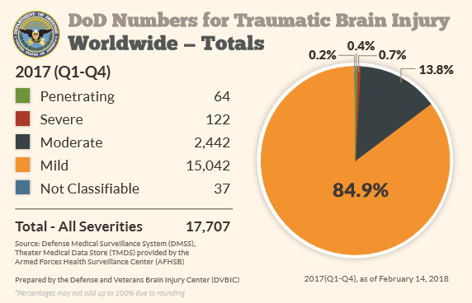
Concussion/Mild TBI (mTBI)
Definition
Loss of Consciousness <30 minutes
Alteration of Consciousness <24 hours
Post Traumatic Amnesia <24 hours
Notes:
Introduce what TBI is
Common causes
Falls
Motor vehicle collisions
Sports injuries
In general physical blows to the head
Common symptoms
Confusion
Dizziness
Fatigue
Long term outcomes
Higher rates of depression
PTSD
Neurobehavioral issues
Possible increased risk of dementia
Three different severity levels
Severe
moderate
Mild
We’re most interested in mTBI. Which is the least severe and as such it can be difficult to detect and accurately diagnose
Lack of brain lesions
Nonspecific symptoms
May just look like sleep deprivation
Current methods of detection
Self-report and issues with confusion/memory loss
Segway into tools to try and detect mTBI
neuroimaging
Include cartoon of someone getting hurt
Many types of brain activity don’t show actual damage and yet there are long term symptoms
Our goal is to develop a method to detect whether or not someone is ok
Blue head: https://mhwcenter.org/crisis-hotline-approach-is-changing-the-way-we-deal-with-stress/mild-traumatic-brain-injury/

Slide 3

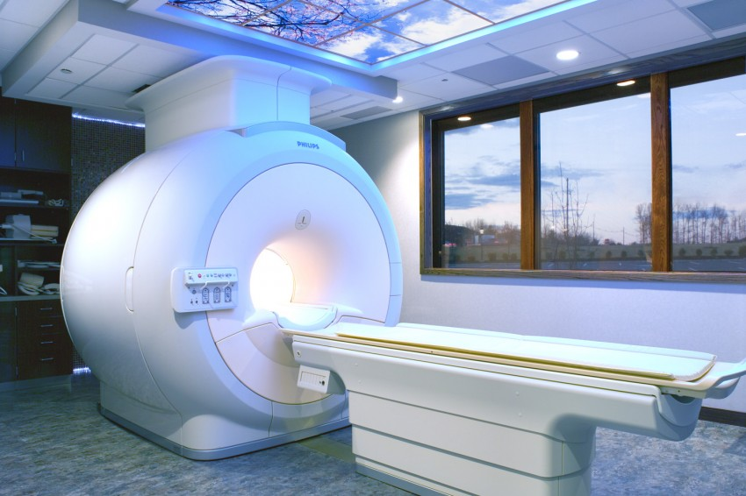

Magnetic Resonance Imaging (MRI)
mTBI Diagnosis
Treatment
All Clear
Notes:
Introduce MRI
Powerful electromagnet that uses magnetic fields to align and measure molecules in the body.
Can be done relatively quick with some MRI scans lasting only a few minutes
Some benefits
High resolution imagery
Allows us to view both soft and hard tissue
What’s really great
Allows us to view brain activity by measuring iron concentrations found in blood
This is called fMRI
With fMRI we can look at different networks such as the DMN
Explain this in the conext of our study
Use animations and flow chart
MRI: https://4rai.com/blog/why-the-3-tesla-mri-is-the-best-scanner-for-diagnostic-imaging
Brain: https://www.sciencelearn.org.nz/images/1104-transverse-view-of-the-brain

Slide 4
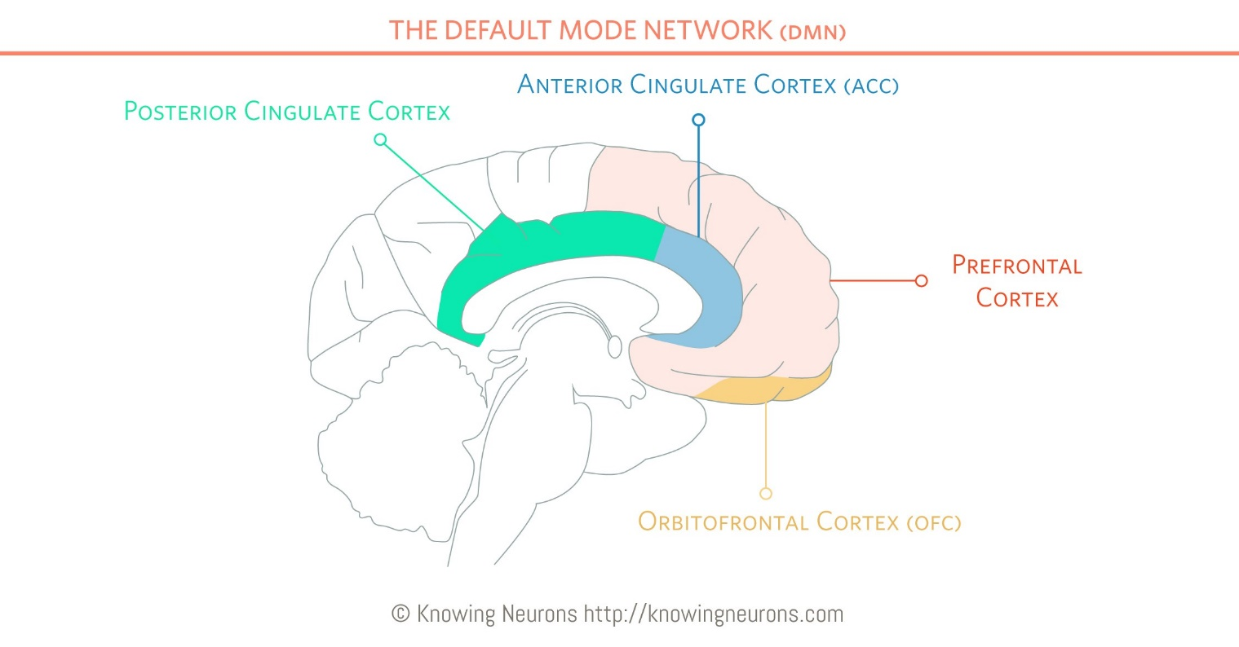
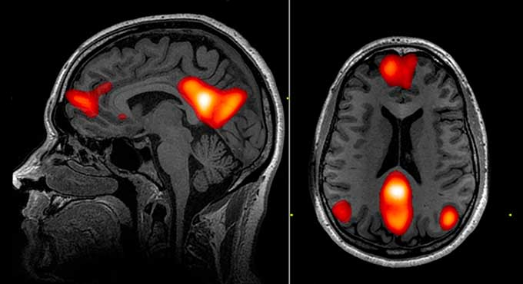
Default Mode Network (DMN)
Notes:
Introduce the DMN
The brain is organized into networks
Is the brain network that is associated with intrinsic thought
Or a brain at rest (not sleeping)
One of the most active resting-state networks
Key hub is the PCC
Day dreaming
If TBI were to disrupt brain activity this would be a major network that we can use to try and detect differences in
DMN: https://reliawire.com/default-mode-network/

Slide 5
Our Study
The What
The Why
Goal
Use resting-state fMRI to detect mTBI
mTBI is notoriously difficult to detect
Nonspecific Symptoms
Lack of positive results on scan
With Who
U.S. Military
254 members of the U.S. Military from combat theatres in the Middle East
Notes:
Our study set out to look for disruptions in the DMN in an effort to detect mTBI in our sample
This goal is driven by the need for a biomarker to aid in mTBI diagnosis
As mentioned before, the symptoms can often be vague and the lack of lesions in mTBI make sourcing a new biomarker important for arcuate and reliable diagnosis
Our sample consisted 254 active U.S. military members that came from the combat theatre in the middle east between 2010 and 2013
The key question of our research is whether resting state fMRI can distinguish a difference in resting-state functional connectivity between blast TBI and non-blast control groups. We hypothesized that resting state functional connectivity will differ between the blast TBI and non-head-injured controls
To do this, we employed two different methods and broke our sample into four comparison groups

Slide 6
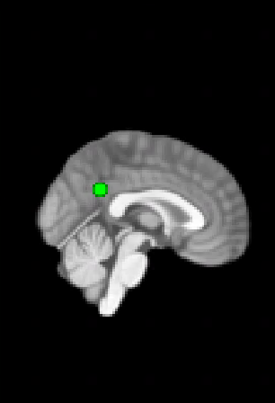
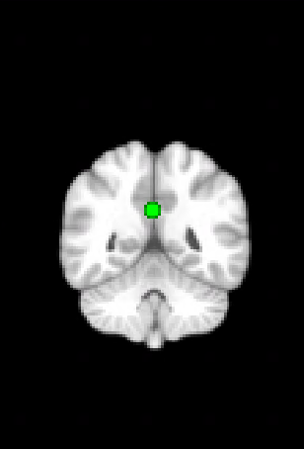
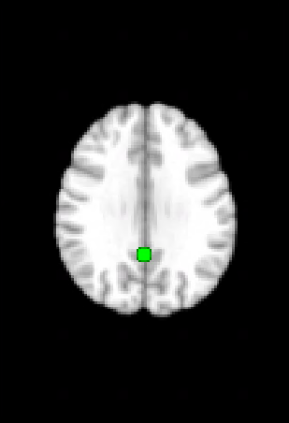
Methods: Seed Analysis
Comparison Groups
Posterior Cingulate Cortex Seed
Blast TBI
TBI and blast exposure
Non-Blast TBI
TBI with no blast exposure
Blast Control
Blast exposure with no TBI
Non-Blast Control
Neither TBI nor blast exposure
Notes:
Our four groups consisted of a variation of TBI, exposure to blast, and controls
Blast exposure is exposure to the shockwave associated with explosions
The first method was a seed analysis
Using a region of the brain previously identified as a hub of the DMN
We measured the correlations between this this specific area to the whole brain
This gave us a connectivity map
These connectivity maps were then compared amongst our four groups to see if there were any group differences in the DMN,
https://journals.plos.org/plosone/article/figure?id=10.1371/journal.pone.0106609.g001

Slide 7
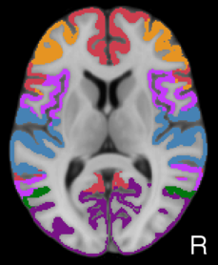
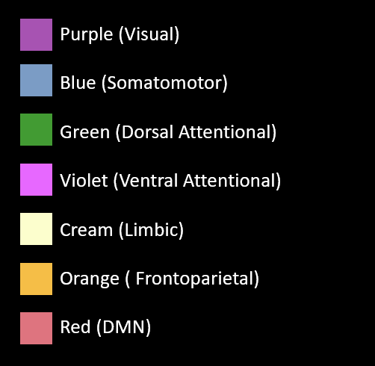
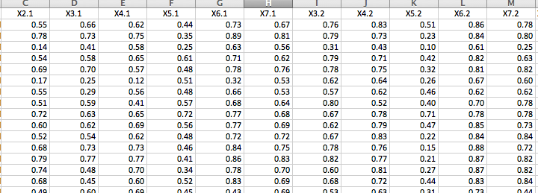
Methods: Yeo Parcellation
7 Network Approach
Network Correlation tables
Notes:
Our second study used the same four comparison groups with a Yeo parcellation
The Yeo parcellation breaks brain activity up into 7 distinct networks and computes the correlation of each network pair
In our case we were most interested in looking for differences in correlation strengths between the DMN and the other 6 networks
The reason we used this analysis was that it allowed us to compared the networks of our groups compared to the networks of a completely unrelated and healthy sample.
This is comparison to a standardized group is more akin to a clinical type diagnosis than our other method
The seed analysis was the DMN but there are a bunch of other networks we wanted to look at
Reduce correlation table numbers
Explain what it means for two networks to be highly correlated
Distraction because dmn and attentional networks are crossed
Blue head: https://mhwcenter.org/crisis-hotline-approach-is-changing-the-way-we-deal-with-stress/mild-traumatic-brain-injury/
DMN: https://reliawire.com/default-mode-network/

Slide 8
Results
Seed Analysis
7 Network Yeo Parcellation
Notes:
Both the seed analysis and the Yeo parcellation yield no significant results for our primary analysis

Slide 9
Conclusion
Resting-state fMRI may not yet be suitable for early detection of mTBI
Continuing Questions
Could the pattern of the different network correlations be significant amongst groups
Questions?
Notes:
In conclusion
Resting-state fMRI may not be suitable for detection of mTBI
However
Other literature has found that there are disruptions when using other methods
Our lack of findings may come from the way we chose to identify networks
Or from the heterogeneity of our sample the and heterogeneity of mTBI
All is not lost
Further work with the Yeo parcellation can be done
It’s plausible that while no two networks we significantly different in their correlation strengths, the entire profile of correlation strengths may show a pattern.
A Key in a lock
Thanks for listening to my presentation
Any questions?
1 ) for each slide have memorized a strong opening
Don’t use “so”
Memorize the words that I’m going to start with in order to avoid “so”
2) we were hoping to plop someone in a scanner and detect mTBI without any other symptoms

