Slide 1

Naïve Bayes and Support Vector Machine Email Spam Filter
A Machine Learning Classification Approach using the Enron Email Database

Slide 2
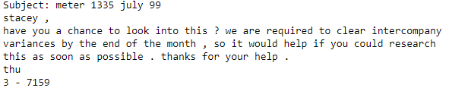
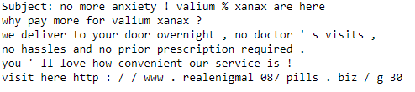
What is spam?
Ham
Typical User to User or Solicited Email
Not Spam
Spam
Unsolicited Communication
Junk mail

Slide 3
The Data
Enron Dataset
Email Server from Enron released after an investigation by the U.S. Federal Government
Contains ~600,000 emails written to and by the employees of Enron
This dataset has been previously broken up into ham and spam for academic purposes
http://www2.aueb.gr/users/ion/data/enron-spam/

Slide 4
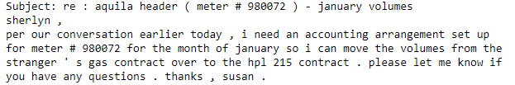
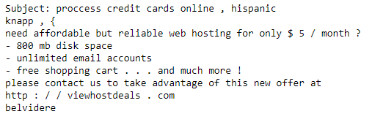
The goal
Apply and compare multiple Machine Learning Techniques to detect spam using Python
To classify spam from ham
Spam is an ever increasing and evolving problem
Compare and contrast Naïve Bayes and SVM classification performance

Slide 5
Primary Algorithms
Naïve Bayes
Support Vector Machine
Multinomial
Popular for semantic classification
Uses term frequency
Bernoulli
Popular for semantic classification
Uses term occurrence
Support Vector
Non-linear classification
Linear Support Vector
Linear Classification

Slide 6
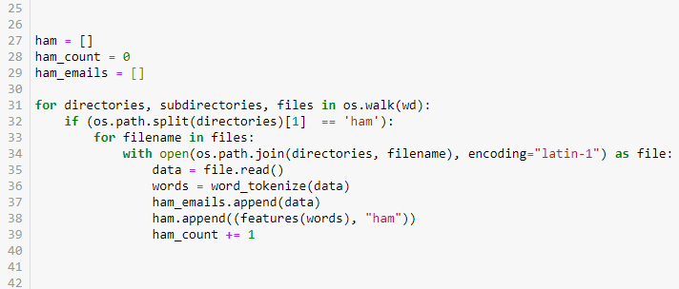
The Approach
Data Format and Integration
Code
Individual emails in text file
Emails previously labeled and sorted into spam and ham directories
Use Python to read in each file into separate ham and spam datasets

Slide 7
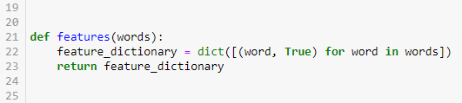
Breaking down the data
Email into data
Code
Each word is “tokenized”
Words are organized into dictionaries
Removes duplicate words
Resulting in ham and spam dictionaries

Slide 8
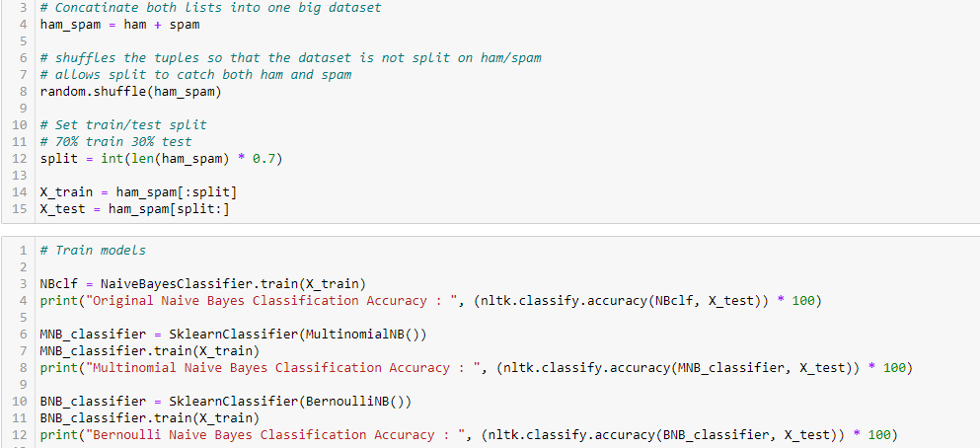
Training the models
Data organization and training
code
Ham and spam datasets merged and shuffled
Allows for extraction of good ham/spam assortment for training and testing
Utilize Scikit-learn and nltk packages to train, test, and analyze models
MultinomialNB()
BernoulliNB()
etc

Slide 9
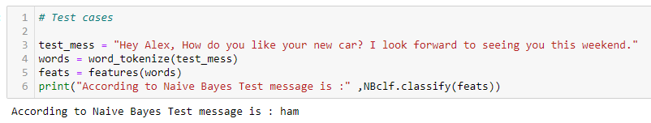
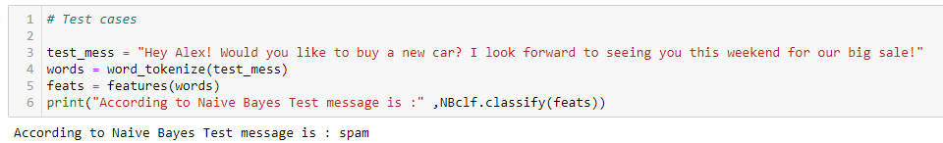
Example
Ham
Spam

Slide 10
Results
70% Training with 30% Testing

Slide 11
Results cont.
10% Training 90% Testing
1% Training 99% Testing

Slide 12
Conclusion
Multinomial Naïve Bayes Classification is had the greatest accuracy across the board
SVC models did better than the Bernoulli Naïve Bayes model in limited training data scenarios
Multinomial seems effective for spam filtering and other possible semantic classification purposes
Example:
Social media sentiment analysis
Future work
Further analysis of model metrics

