Slide 1
MCUpdates
By Nicholas Cali, Aidan Minnihan, William Sassi, Jason Wong, Hazel Zhang (Group 5)

Slide 2

What is MCUpdates?
MCUpdates is a website for news regarding the films within the MCU. It will provide recent news regarding the movie series, as well as pages providing information on the characters and movies within the series. The movie page will provide links to each movie’s individual page, which will include the release date, total gross, audience score on Rotten Tomatoes, and plot synopsis. The character page will list off the primary characters within the MCU and provide links to each of their own individual pages; within these pages, the character’s actor, films they appeared in, and a brief bio regarding them will be listed along with a picture of the character. The news page will provide the latest news regarding the development of films within the MCU and links to articles that go more in depth about the news. Finally, the main page will provide a timer that counts down to the next Marvel movie (Black Widow)’s release date, that being May 1st, 2020.

Slide 3
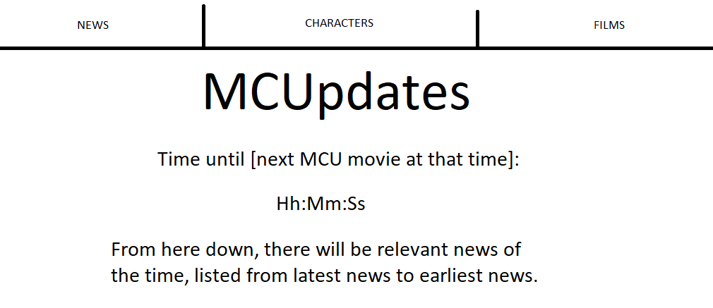
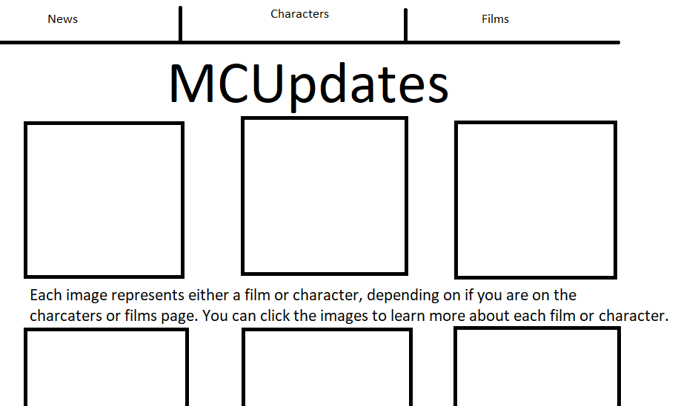
Original Rough Outline
Characters / Films Page (the two will share similar layouts with different information)

Slide 4

Video:

Slide 5
HTML, CSS, and JAVASCRIPT
Using div instead of tables
Content pages use <article> tag for content
Pages use headers and footers for aesthetics and functionality
CSS controls background image, and adapts layout, text size, and image size for mobile and tablet users
CSS is also used for positioning images and text using flexboxes
Javascript controls timer on main page that counts down to next MCU film.

Slide 6
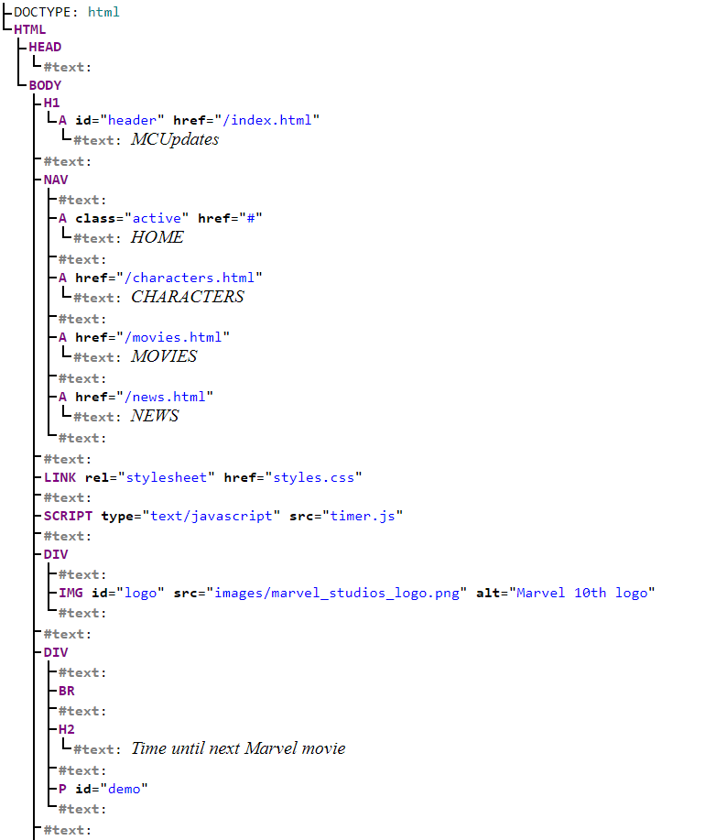
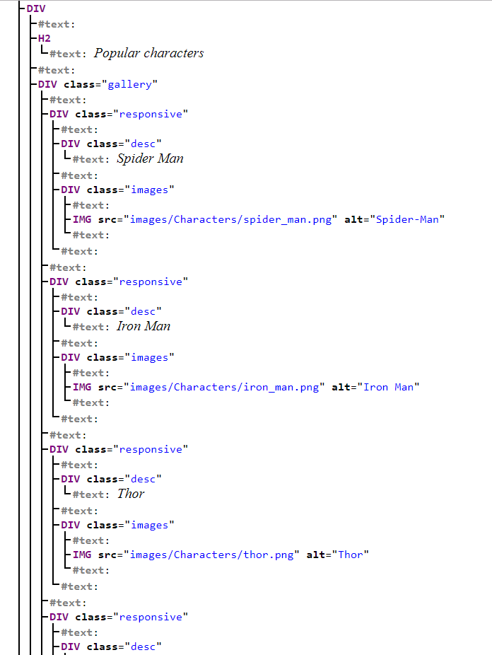
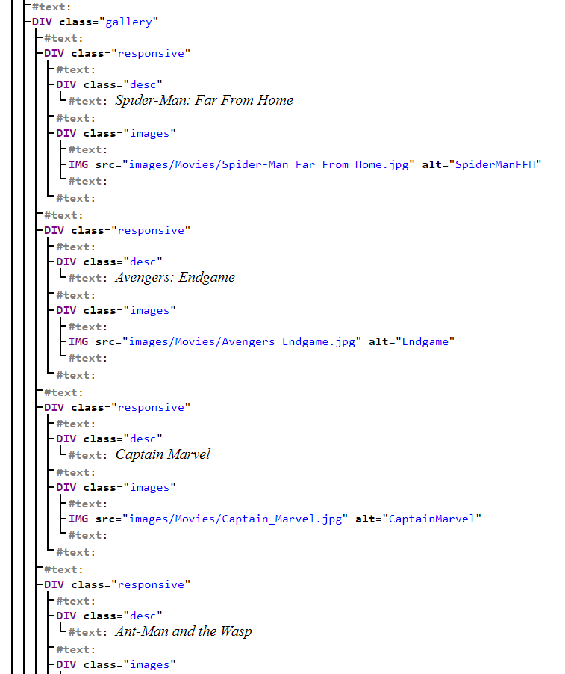
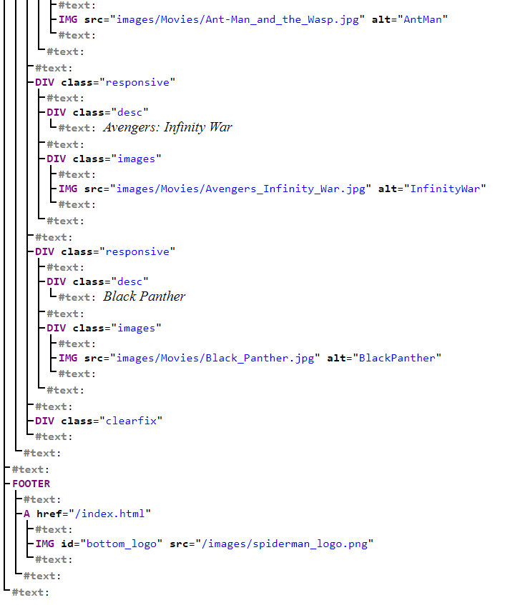
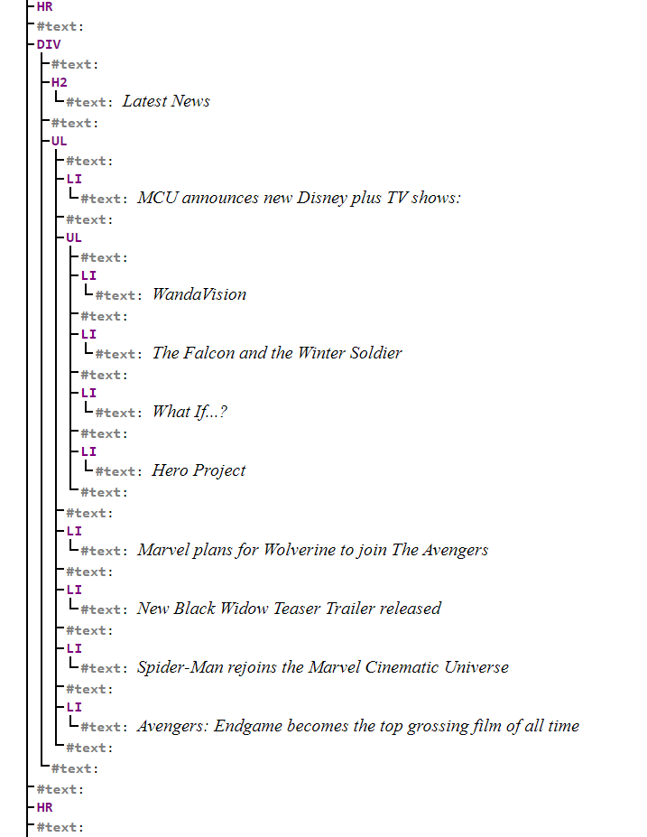
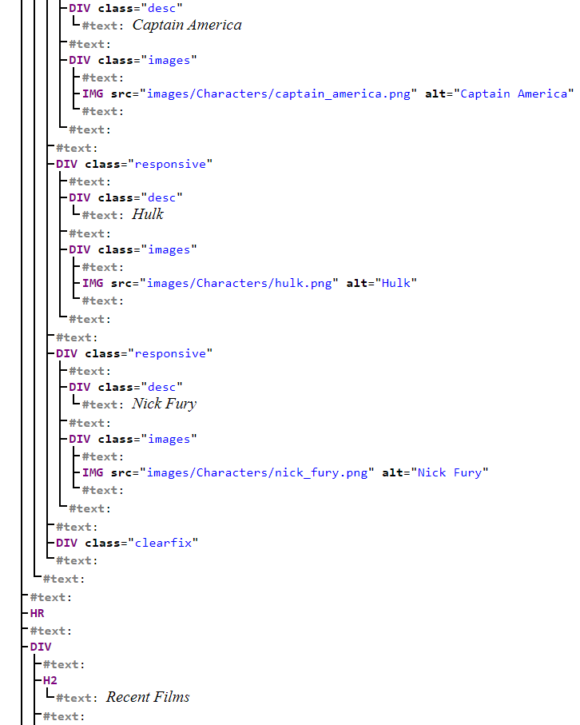
DOM (index)

Slide 7
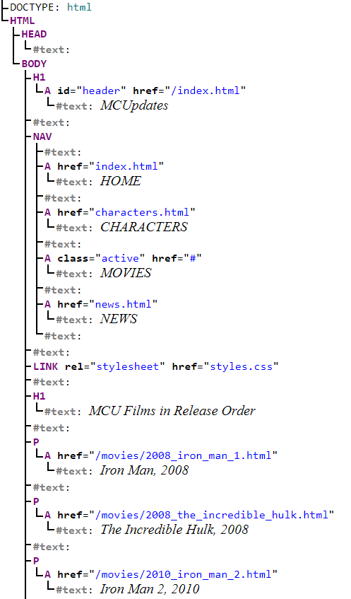
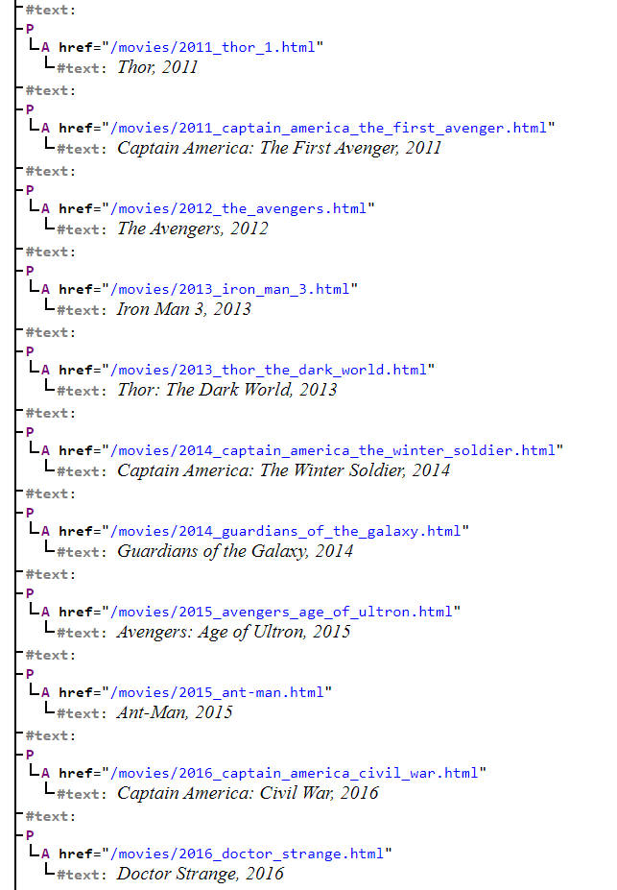
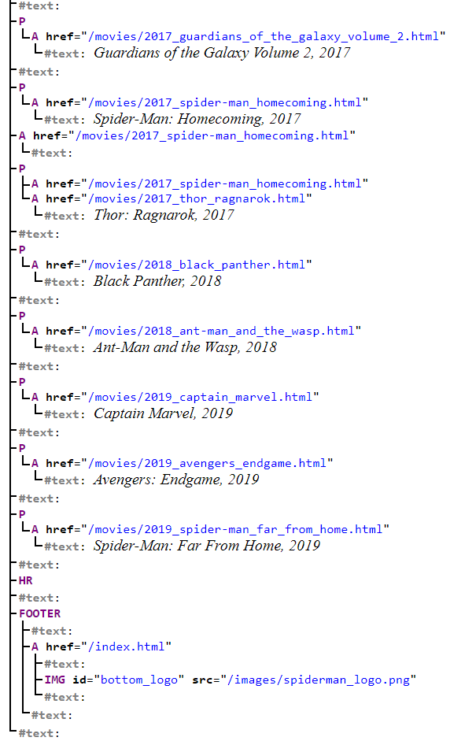
DOM (Movies)

Slide 8
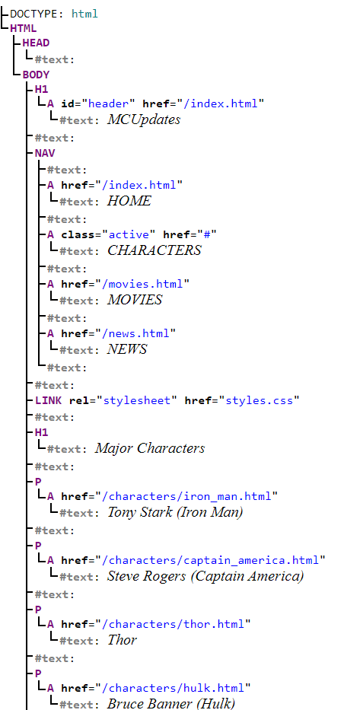
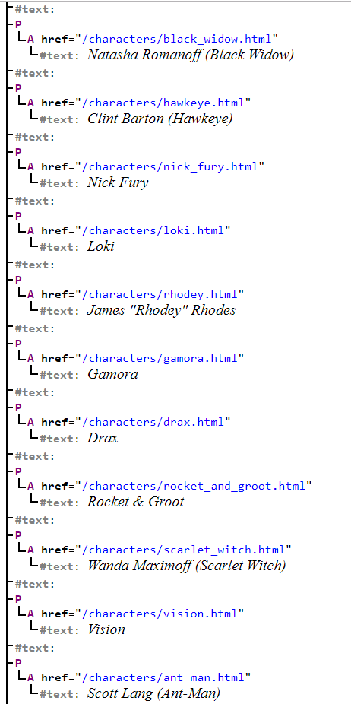
DOM (Characters)

Slide 9
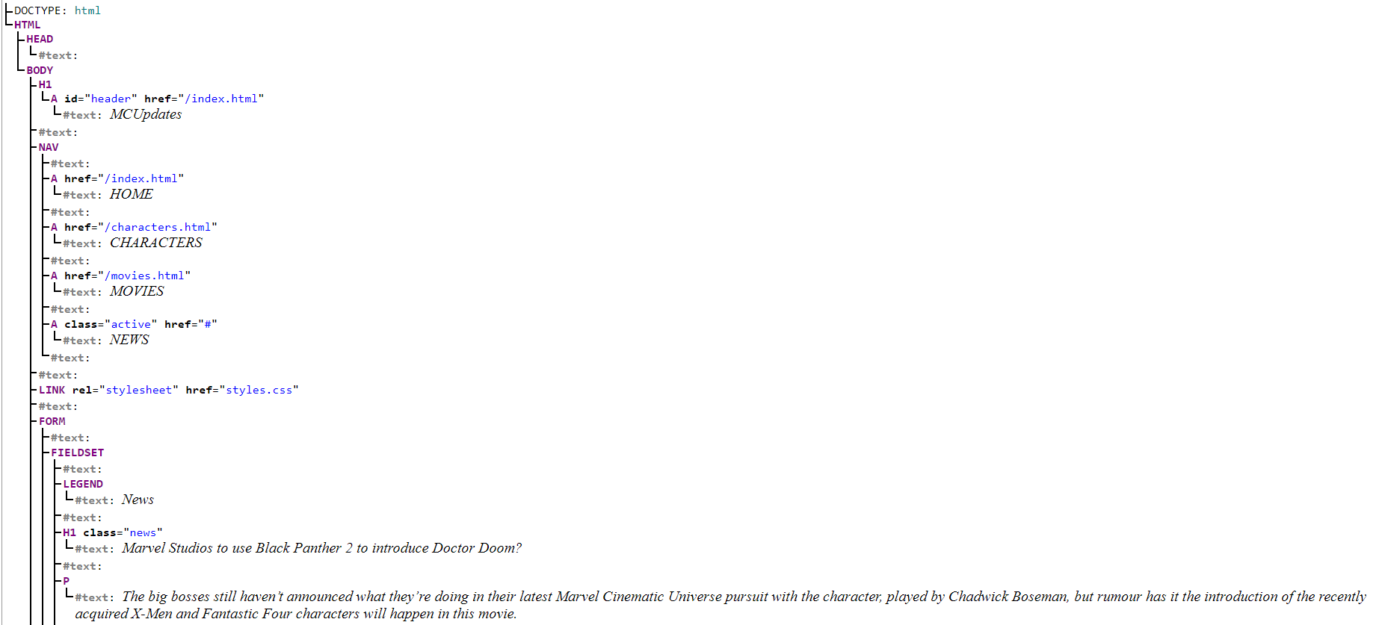
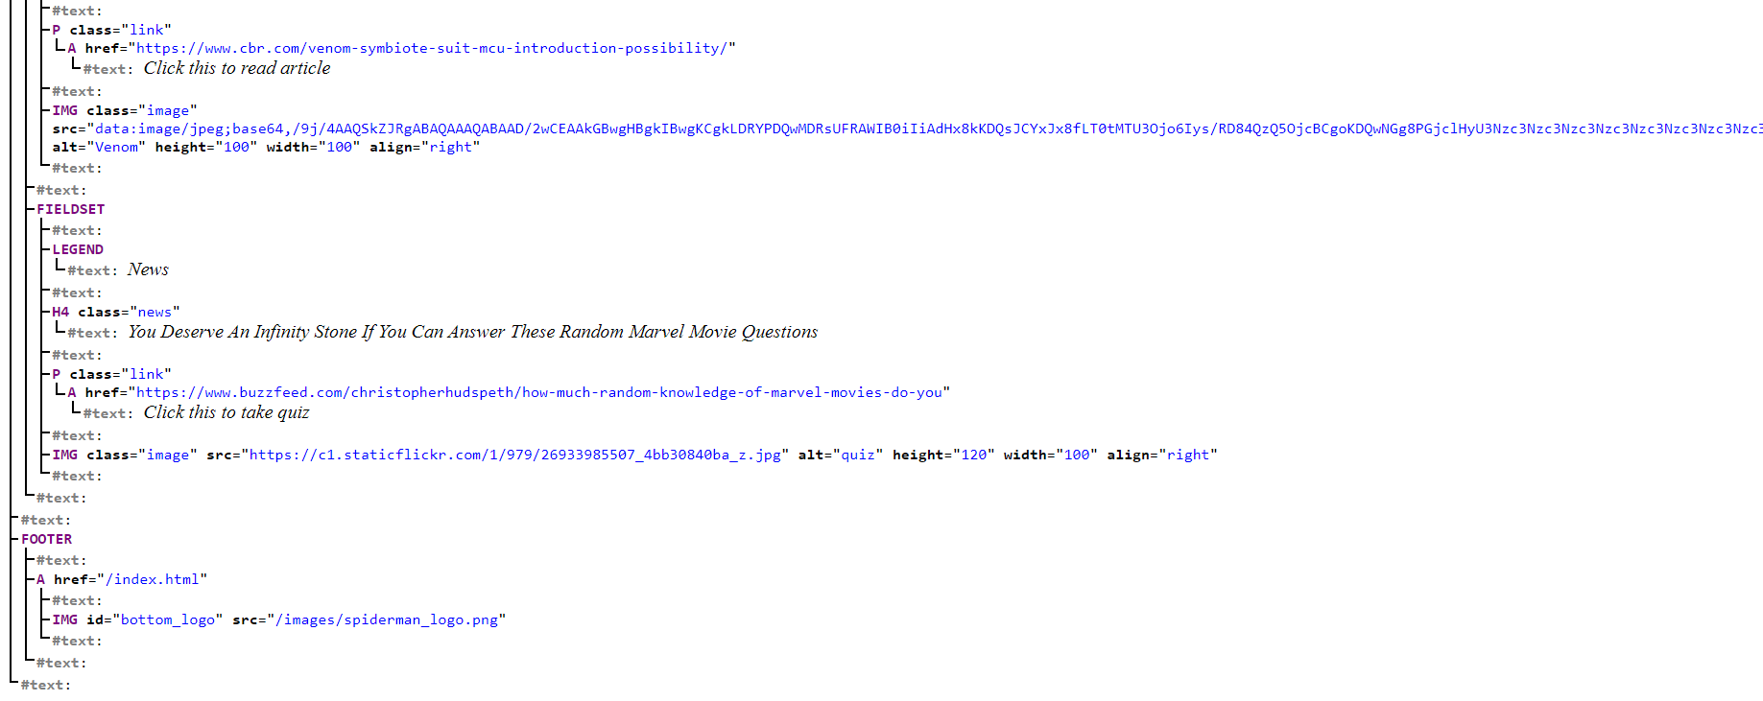
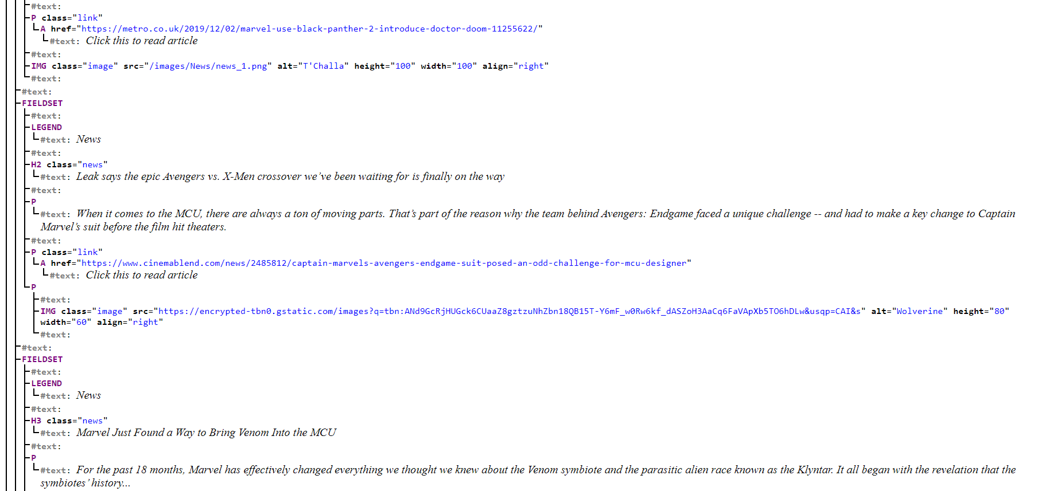
DOM (News)

Slide 10
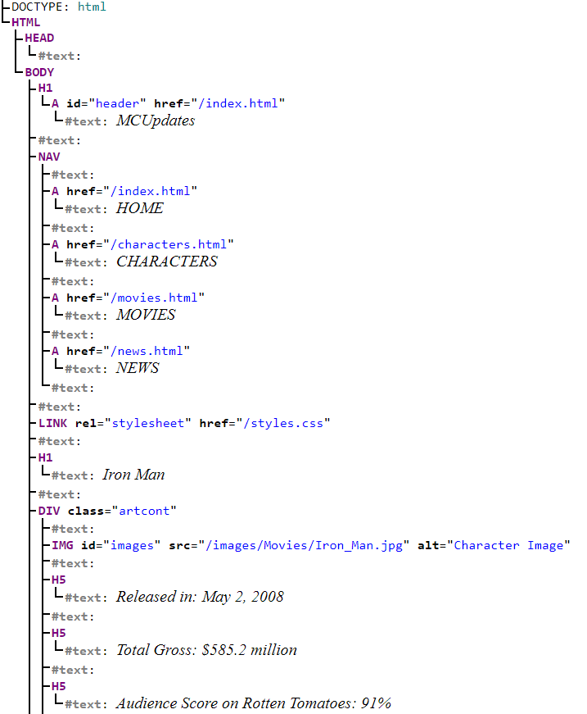
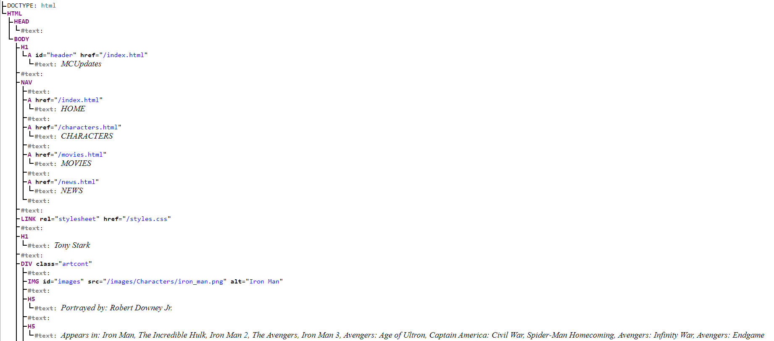
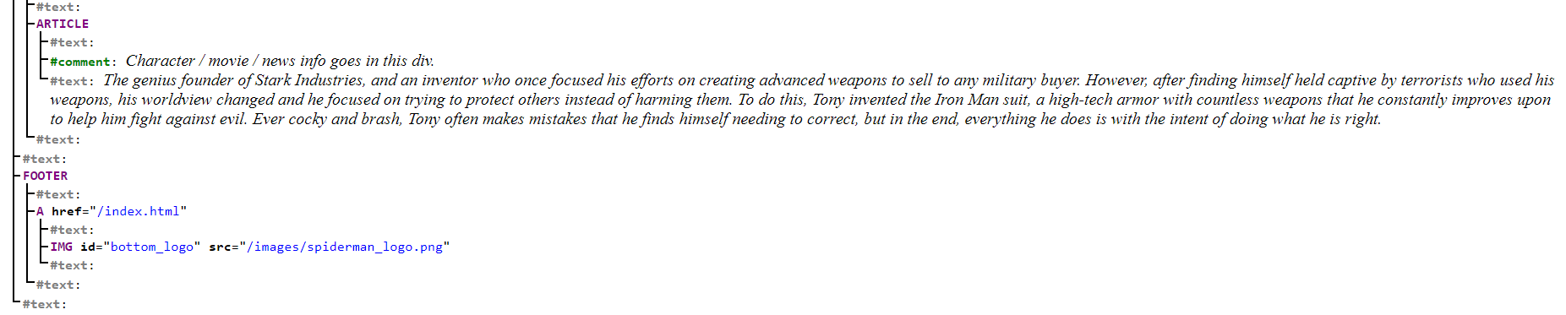
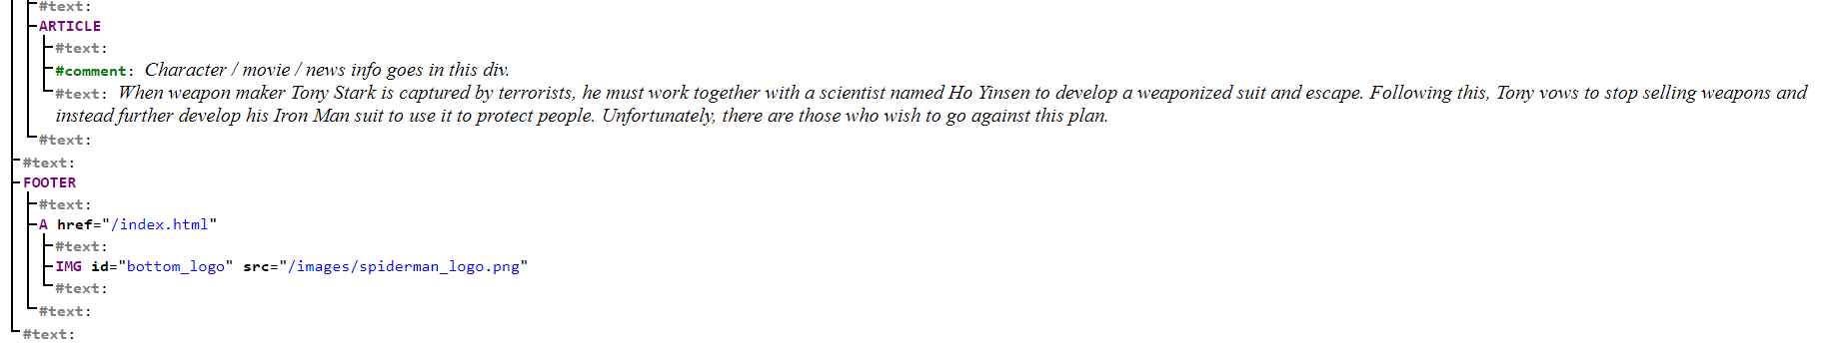
DOM (Individual Character & Movie Examples)

Slide 11
Contributions of each team member
Aidan: Character/Movie Bios, CSS, HTML content
Nick: Character/Movie Bios, CSS, HTML content
Jason: Javascript Timer, CSS, HTML content, GitHub leader
Will: CSS, content page framework, HTML content
Hazel: CSS, HTML content

Slide 12

GitHub
https://github.com/jwong1MHS/MCUpdates

