Slide 1
Status of Opportunity Youth in South King County
Updated May 2020
Luluva Lakdawala
Jacob Prebys
Jason Wong
Figure 1 (see comments)
Notes:
Figure 1: (n.d.). Retrieved from https://www.google.com/search?safe=strict&hl=en&tbs=simg:CAQSiQEJXooiceOCqZkafgsQsIynCBpiCmAIAxIomxKcBpwSnga2B7cH5AHtAfoJ4wGxOrA9rD2dNK09uz_1fPKs9sj2ZNBowU-

Slide 2
Outline
EDA
VISUALIZATIONS
EXPLANATION
Project Goal: Update current status of Opportunity Youth
Who are the Opportunity Youth?
Figure 2 (see comments)
Notes:
Figure 2:<div>Icons made by <a href=“https://www.flaticon.com/authors/freepik” title=“Freepik”>Freepik</a> from <a href=“https://www.flaticon.com/” title=“Flaticon”>www.flaticon.com</a></div>

Slide 3

DATASET USED:
ACS
PUMS
PUMAs
Figure 3. (see comments)
Notes:
Figure 3. ”Icons made by US Census Bureau from www.census.gov”

Slide 4
process
Choose variables
Find correct pumas
Sort data
Visualizations
Conclusion

Slide 5
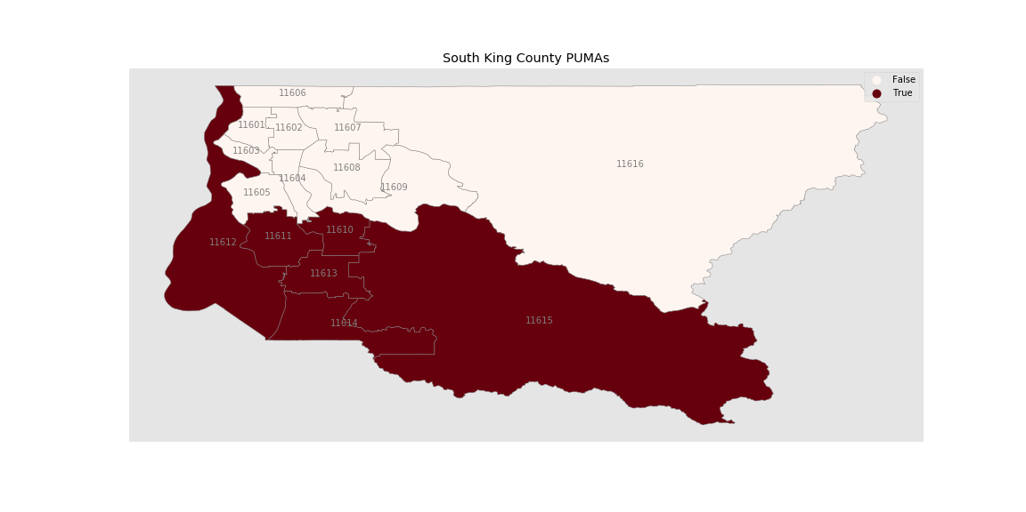
SOUTH KING COUNTY PUMAs

Slide 6
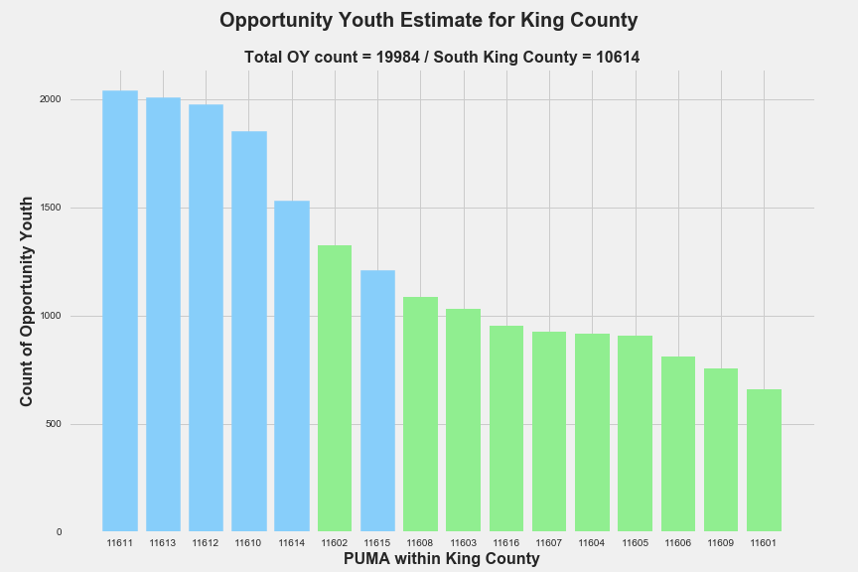
Greater number of OY in south king county
Notes:
A

Slide 7
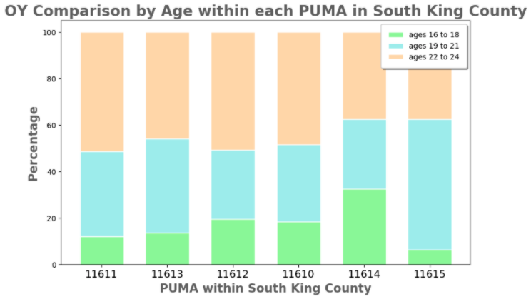
South pUMAS by age

Slide 8
2017 OPPORTUNITY STATUS BY AGE
 | 16-18 |  | 19-21 |  | 22-24 |  | CURRENT TOTALS |  | 2016
TOTAL POPULATION | 100% | 30,141 | 100% | 25,486 | 100% | 30,256 | 100% | 85,883 | 139,735
Opportunity Youth | 6% | 1,815 | 15% | 3,902 | 16% | 4,897 | 12% | 10,614 | 18,817
Working Without Diploma | 15% | 4,377 | 6% | 1,630 | 6% | 1,705 | 9% | 7,712 | 5,513
Not an Opportunity Youth | 80% | 23,949 | 79% | 19,954 | 78% | 23,654 | 79% | 67,557 | 115,405
OPPORTUNITY YOUTH | 100% | 1,815 | 100% | 3,902 | 100% | 4,897 | 100% | 10,614 | 18,817
No Diploma | 50% | 916 | 29% | 1112 | 28% | 1349 | 32% | 3377 | 5,639
HS Diploma or GED | 43% | 781 | 56% | 2176 | 44% | 2135 | 48% | 5092 | 7,401
Some College, no Degree | 7% | 118 | 13% | 521 | 20% | 1000 | 15% | 1639 | 3,608
Degree(Associates or higher | 0% | 0 | 2% | 93 | 8% | 413 | 5% | 506 | 2,169

Slide 9
EVALUATION
Opportunity youth has decreased to a total of 10,614.
PUMA with the greatest number of oy
Factors
Travel Time
Children
1028 out of 5,665 female OY have given birth with the past 12 months
Cognitive
1182 out of 10,614 OY have cognitive difficulty
Notes:
According to the dataset 1,028 opportunity youth have given birth within that past 12 months. The total number of female OY in South King County is 5,665.
There are 1 OY out of 44

Slide 10
SOURCES
US Census Bureau. (2020, April 22). About the Survey. Retrieved from https://www.census.gov/programs-surveys/acs/about.html
US Census Bureau. (2020, April 17). PUMS Documentation. Retrieved from https://www.census.gov/programs-surveys/acs/technical-documentation/pums.html
Yohalem, N., Cooley, S. 2016. “Opportunity Youth in the Road Map Project Region”. Community Center for Education Results. Available at: https://bit.ly/2P2XRF3
Anderson, T., Braga, B., Derrick-Mills, T., Dodkowitz, A., Peters, E., Runes, C., and Winkler, M. 2019. “New Insights into the Back on Track Model’s Effects on Opportunity Youth Outcomes”. Urban Institute. Available at: https://bit.ly/2BuCLr1
THANK YOU!
Luluva Lakdawala -- luluayusuf@gmail.com
Jacob Prebys -- jakers991@gmail.com
Jason Wong – jwong853@gmail.com

