Slide 1



Getting started with EF Core https://github.com/jwooley/EfCore https://jwooley.github.io/
Jim Wooley
www.ThinqLinq.com
https://jwooley.github.io/
Twitter: @JimWooley

Slide 2
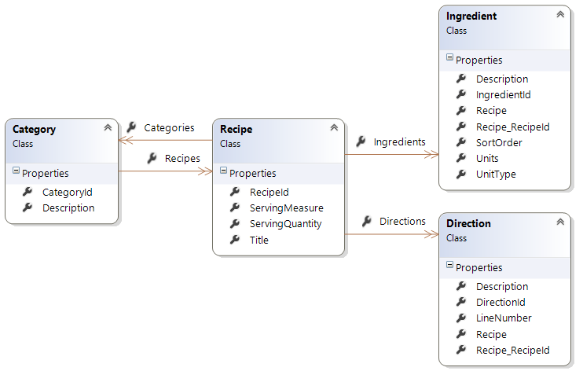
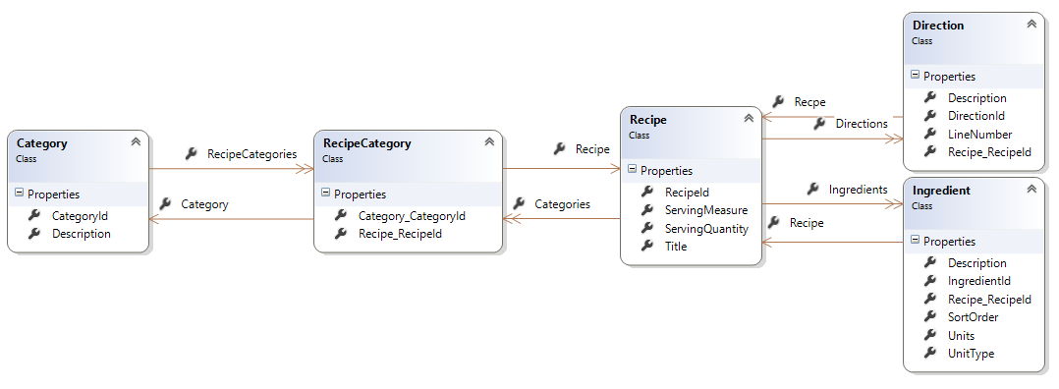
Demo Data Model

Slide 3
Demo
Getting started

Slide 4
Configuration
<ItemGroup>
<PackageReference Include="Microsoft.EntityFrameworkCore.SqlServer" Version="2.1.0" />
<PackageReference Include="Microsoft.EntityFrameworkCore.Tools" Version="2.1.0" />
</ItemGroup>
<ItemGroup>
<DotNetCliToolReference Include="Microsoft.EntityFrameworkCore.Tools.DotNet" Version="2.0.0" />
</ItemGroup>

Slide 5
Construction
public class RecipeContext : DbContext
{
public DbSet<Recipe> Recipes { get; set; }
protected override void OnConfiguring(DbContextOptionsBuilder optionsBuilder)
{
optionsBuilder
.UseSqlServer(@"Server=.;Database=Recipe;Trusted_Connection=True;");
}
}
// ASP.Net
public void ConfigureServices(IServiceCollection services)
{
services.AddDbContext<RecipeContext>(options =>
options.UseSqlServer(Configuration.GetConnectionString("RecipeDb")));
services.AddDbContextPool<RecipeContext>(options =>
options.UseSqlServer(ConnectionString)); //(EF 2)
}

Slide 6
Migrations
Add-Migration {name}
Remove-Migration {name}
Update-Database
Script-Migration
dotnet ef migrations add {name}
dotnet ef migrations remove
dotnet ef database update
dotnet ef database script
Notes:
Powershell – Windows only. Dotnet – cross plat

Slide 7
Scaffolding
>dotnet ef dbcontext scaffold
"data source=.;initial catalog=NWind;integrated security=true;"
Microsoft.EntityFrameworkCore.SqlServer
-o Models
-c NorthwindContext
-a
-startup-project ..\MigrationsConsole
>Scaffold-DbContext
-Connection "data source=.;initial catalog=NWind;integrated security=true;"
-Provider Microsoft.EntityFrameworkCore.SqlServer
-OutputDir Models
-Context NorthwindContext
-DataAnnotations
https://ef.readthedocs.io/en/latest/miscellaneous/cli/powershell.html
Notes:
dotnet ef --startup-project ..\MigrationsConsole dbcontext scaffold "data source=.;initial catalog=recipecore;integrated security=true;" Microsoft.EntityFrameworkCore.SqlServer -o Models -c RecipeContext –a -f

Slide 8
Performance

Slide 9
EF vs Dapper Customer.ToList()

Slide 10
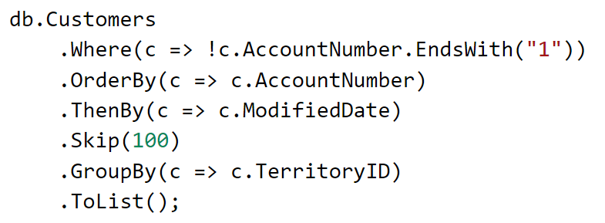
Complex Query?

Slide 11
Demo
Performance

Slide 12
Shadow Properties
protected override void OnModelCreating(ModelBuilder modelBuilder)
{
modelBuilder.Entity<Blog>()
.Property<DateTime>("LastUpdated");
}
context.Entry(myBlog).Property("LastUpdated").CurrentValue = DateTime.Now;
https://docs.efproject.net/en/latest/modeling/shadow-properties.html

Slide 13
Logging
public class RecipeLoggingProvider : ILoggerProvider
{
public ILogger CreateLogger(string categoryName)
{
return new RecipeLogger();
}
public void Dispose() { }
private class RecipeLogger : ILogger
{
public IDisposable BeginScope<TState>(TState state)
{
return null;
}
public bool IsEnabled(LogLevel logLevel)
{
return logLevel >= LogLevel.Error;
}
public void Log<TState>(LogLevel logLevel, EventId eventId, TState state, Exception exception,
Func<TState, Exception, string> formatter)
{
Console.WriteLine(formatter(state, exception));
}
}
}
EF 6:
Context.Database.Log(text => Console.WriteLine(text));
https://docs.efproject.net/en/latest/miscellaneous/logging.html

Slide 14
Providers
Microsoft SQL Server
SQLite
Npgsql (PostgreSQL)
MySQL – Official, Pomelo, Sapient Guardian
Microsoft SQL Server Compact Edition
IBM Data Servers
InMemory (for Testing)
Devart (MySQL, Oracle, PostgreSQL, SQLite, DB2, SQL Server, and more)
Oracle (Coming Soon) (not yet available)
https://docs.efproject.net/en/latest/providers/

Slide 15
In Memory Provider
var options = new DbContextOptionsBuilder<BloggingContext>()
.UseInMemoryDatabase(databaseName: "Add_writes_to_database")
.Options;
using (var context = new BloggingContext(options))
{
var service = new BlogService(context);
service.Add("http://sample.com");
}
using (var context = new BloggingContext(options))
{
Assert.AreEqual(1, context.Blogs.Count());
Assert.AreEqual("http://sample.com", context.Blogs.Single().Url);
}
https://docs.efproject.net/en/latest/miscellaneous/testing.html

Slide 16
EF Core 2
EF.Functions.Like(“%value%”)
Owned entities and table splitting
Global Query Filters
DbContext Pooling
Manually Compiled Queries
String Interpoliation in FromSql
Database Scalar Functions
https://github.com/aspnet/EntityFramework/wiki/Roadmap#ef-core-20

Slide 17
Core 2.0 - EF.Functions
var brownies =
from recipe in dc.Recipes
where EF.Functions.Like(recipe.Title, "%brownie%")
select recipe.Title;

Slide 18
EF Core 2.0 – Owned Entities
modelBuilder.Entity<Customer>() .OwnsOne(c => c.WorkAddress);
public class Customer
{
public int CustomerId { get; set; }
public Address WorkAddress { get; set; }
}
public class Address
{
public string Line { get; set; }
public string PostalOrZipCode { get; set; }
public string StateOrProvince { get; set; }
public string CityOrTown { get; internal set; }
}

Slide 19
EF 2.0 - Global Query Filters
modelBuilder.Entity<Recipe>().HasQueryFilter(r => !r.IsDeleted);

Slide 20
EF 2.1 features
Lazy Loading
Parameters in entity constructors
Value conversions
Server side GroupBy
Data Seeding
Query types
Include for derived tpes
System.Transactions
Optimized correlated sub-queries
OwnedAttribute
CLI integrated in core SDK
State change events
FromSql code analyzer
https://blogs.msdn.microsoft.com/dotnet/2018/05/30/announcing-entity-framework-core-2-1/

Slide 21
Comparison
EF6
EDMX
Lazy Loading
EF Core
Scaffolding
Migrations
TPT/TPC
Complex/Value types
Many-many
Batch updates
Providers
Spatial
Complex LINQ
Stored procs
GroupBy
Dotnet Core/UWP
Shadow Properties
Performance Optimizations
Field mapping
https://docs.efproject.net/en/latest/efcore-vs-ef6/index.html

Slide 22
Links
http://docs.efproject.net
http://github.com/aspnet/EntityFramework
https://ef.readthedocs.io/en/latest/
EF Core Roadmap - http://bit.ly/efcoreroadmap
https://github.com/rowanmiller/Demo-EFCore
https://blogs.msdn.microsoft.com/dotnet/2016/10/25/announcing-entity-framework-core-1-1-preview-1/
https://blogs.msdn.microsoft.com/dotnet/2017/08/14/announcing-entity-framework-core-2-0/

Slide 23
Getting started with EF Core https://github.com/jwooley/EfCore
Jim Wooley
www.ThinqLinq.com
https://jwooley.github.io/
Twitter: @JimWooley

