Slide 1



Getting started with EF Core https://github.com/jwooley/EfCore https://jwooley.github.io/
Jim Wooley
www.ThinqLinq.com
https://jwooley.github.io/
Twitter: @JimWooley

Slide 2
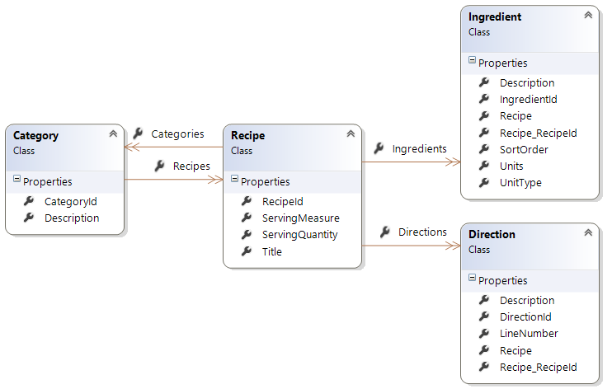
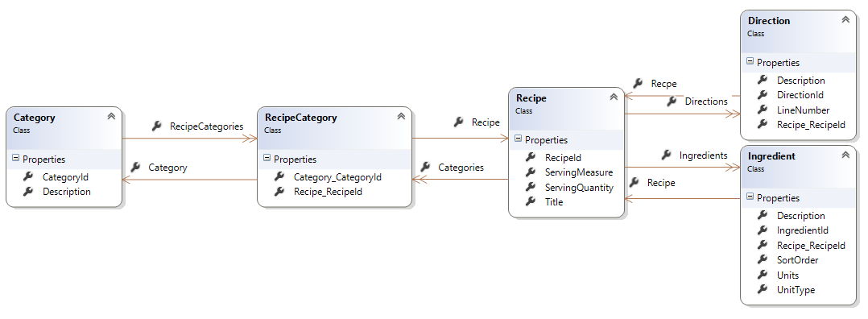
Demo Data Model

Slide 3
Demo
Getting started

Slide 4
Configuration
<ItemGroup>
<PackageReference Include="Microsoft.EntityFrameworkCore.SqlServer" Version="2.0.0" />
<PackageReference Include="Microsoft.EntityFrameworkCore.Tools" Version="2.0.0" />
</ItemGroup>
<ItemGroup>
<DotNetCliToolReference Include="Microsoft.EntityFrameworkCore.Tools.DotNet" Version="2.0.0" />
</ItemGroup>

Slide 5
Construction
public class RecipeContext : DbContext
{
public DbSet<Recipe> Recipes { get; set; }
protected override void OnConfiguring(DbContextOptionsBuilder optionsBuilder)
{
optionsBuilder
.UseSqlServer(@"Server=.;Database=Recipe;Trusted_Connection=True;");
}
}
// ASP.Net
public void ConfigureServices(IServiceCollection services)
{
services.AddDbContext<RecipeContext>(options =>
options.UseSqlServer(Configuration.GetConnectionString("RecipeDb")));
services.AddDbContextPool<RecipeContext>(options =>
options.UseSqlServer(ConnectionString)); //(EF 2)
}

Slide 6
Migrations
Add-Migration {name}
Remove-Migration {name}
Update-Database
Script-Migration
dotnet ef migrations add {name}
dotnet ef migrations remove
dotnet ef database update
dotnet ef database script
Notes:
Powershell – Windows only. Dotnet – cross plat

Slide 7
Scaffolding
>dotnet ef dbcontext scaffold
"data source=.;initial catalog=NWind;integrated security=true;"
Microsoft.EntityFrameworkCore.SqlServer
-o Models
-c NorthwindContext
-a
-startup-project ..\MigrationsConsole
>Scaffold-DbContext
-Connection "data source=.;initial catalog=NWind;integrated security=true;"
-Provider Microsoft.EntityFrameworkCore.SqlServer
-OutputDir Models
-Context NorthwindContext
-DataAnnotations
https://ef.readthedocs.io/en/latest/miscellaneous/cli/powershell.html
Notes:
dotnet ef --startup-project ..\MigrationsConsole dbcontext scaffold "data source=.;initial catalog=recipecore;integrated security=true;" Microsoft.EntityFrameworkCore.SqlServer -o Models -c RecipeContext –a -f

Slide 8
Key Consierations
Providers
Platforms
Performance

Slide 9
Performance

Slide 10
EF vs Dapper Customer.ToList()

Slide 11
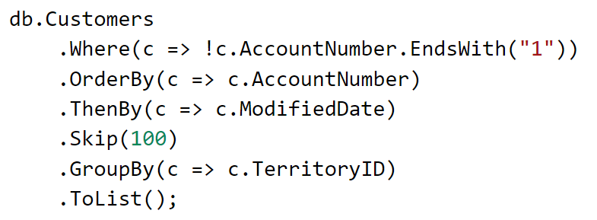
Complex Query?

Slide 12
Demo
Performance

Slide 13
Shadow Properties
protected override void OnModelCreating(ModelBuilder modelBuilder)
{
modelBuilder.Entity<Blog>()
.Property<DateTime>("LastUpdated");
}
context.Entry(myBlog).Property("LastUpdated").CurrentValue = DateTime.Now;
https://docs.efproject.net/en/latest/modeling/shadow-properties.html

Slide 14
Logging
public class RecipeLoggingProvider : ILoggerProvider
{
public ILogger CreateLogger(string categoryName)
{
return new RecipeLogger();
}
public void Dispose() { }
private class RecipeLogger : ILogger
{
public IDisposable BeginScope<TState>(TState state)
{
return null;
}
public bool IsEnabled(LogLevel logLevel)
{
return logLevel >= LogLevel.Error;
}
public void Log<TState>(LogLevel logLevel, EventId eventId, TState state, Exception exception,
Func<TState, Exception, string> formatter)
{
Console.WriteLine(formatter(state, exception));
}
}
}
EF 6:
Context.Database.Log(text => Console.WriteLine(text));
https://docs.efproject.net/en/latest/miscellaneous/logging.html

Slide 15
Providers
Microsoft SQL Server
SQLite
Npgsql (PostgreSQL)
MySQL – Official, Pomelo, Sapient Guardian
Microsoft SQL Server Compact Edition
IBM Data Servers
InMemory (for Testing)
Devart (MySQL, Oracle, PostgreSQL, SQLite, DB2, SQL Server, and more)
Oracle Sample coming in 2.1
CosmosDB in 2.1
https://docs.efproject.net/en/latest/providers/

Slide 16
In Memory Provider
var options = new DbContextOptionsBuilder<BloggingContext>()
.UseInMemoryDatabase(databaseName: "Add_writes_to_database")
.Options;
using (var context = new BloggingContext(options))
{
var service = new BlogService(context);
service.Add("http://sample.com");
}
using (var context = new BloggingContext(options))
{
Assert.AreEqual(1, context.Blogs.Count());
Assert.AreEqual("http://sample.com", context.Blogs.Single().Url);
}
https://docs.efproject.net/en/latest/miscellaneous/testing.html

Slide 17
EF Core 2
EF.Functions.Like(“%value%”)
Owned entities and table splitting
Global Query Filters
DbContext Pooling
Manually Compiled Queries
String Interpoliation in FromSql
Database Scalar Functions
https://github.com/aspnet/EntityFramework/wiki/Roadmap#ef-core-20

Slide 18
Core 2.0 - EF.Functions
var brownies =
from recipe in dc.Recipes
where EF.Functions.Like(recipe.Title, "%brownie%")
select recipe.Title;

Slide 19
EF Core 2.0 – Owned Entities
modelBuilder.Entity<Customer>() .OwnsOne(c => c.WorkAddress);
public class Customer
{
public int CustomerId { get; set; }
public Address WorkAddress { get; set; }
}
public class Address
{
public string Line { get; set; }
public string PostalOrZipCode { get; set; }
public string StateOrProvince { get; set; }
public string CityOrTown { get; internal set; }
}

Slide 20
EF 2.0 - Global Query Filters
modelBuilder.Entity<Recipe>().HasQueryFilter(r => !r.IsDeleted);

Slide 21
EF Core 2.1
Lazy loading
Value conversions
Server side GroupBy
Seed data
Mapping to views
System.Transactions
Improved correlated subqueries
Cosmos DB provider (preview)
Sample Oracle provider
https://blogs.msdn.microsoft.com/dotnet/2018/02/02/entity-framework-core-2-1-roadmap/

Slide 22
Comparison
EF6
EDMX
Lazy Loading
EF Core
Scaffolding
Migrations
TPT/TPC
Complex/Value types
Many-many
Batch updates
Providers
Spatial
Complex LINQ
Stored procs
GroupBy
Dotnet Core/UWP
Shadow Properties
Performance Optimizations
Field mapping
https://docs.efproject.net/en/latest/efcore-vs-ef6/index.html

Slide 23
Links
http://docs.efproject.net
http://github.com/aspnet/EntityFramework
https://ef.readthedocs.io/en/latest/
EF Core Roadmap - http://bit.ly/efcoreroadmap
https://github.com/rowanmiller/Demo-EFCore
https://blogs.msdn.microsoft.com/dotnet/2016/10/25/announcing-entity-framework-core-1-1-preview-1/
https://blogs.msdn.microsoft.com/dotnet/2017/08/14/announcing-entity-framework-core-2-0/

Slide 24
Getting started with EF Core https://github.com/jwooley/EfCore
Jim Wooley
www.ThinqLinq.com
https://jwooley.github.io/
Twitter: @JimWooley

