Slide 1
Entity Framework Performance Monitoring and Tuning
Jim Wooley
Senior Delivery Principal, Slalom
www.ThinqLinq.com
@JimWooley
https://github.com/jwooley/RecipeWebApi
https://github.com/jwooley/EfCore
https://jwooley.github.io/

Slide 2
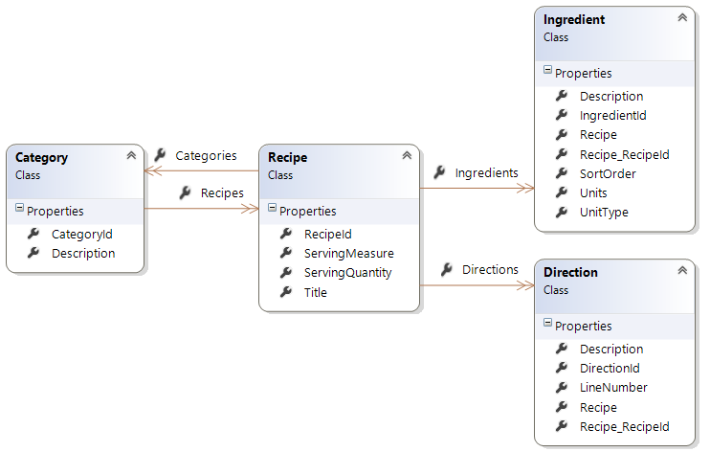
Demo Data Model

Slide 3
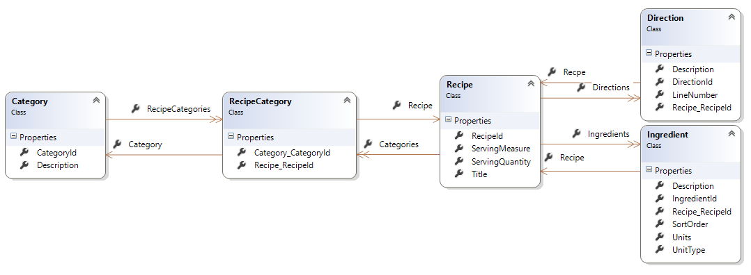
Demo Data Model

Slide 4

Which is better
EF
Stored Proc
EXEC sRecipeSearch @searchText=‘Chocolate’
from recipe in Recipes
where recipe.Title.Contains(‘Chocolate’)
select recipe
Declare @search nvarchar(4000)
Set @search = 'Select * from Recipes where recipes.Title like ''%' + @searchText + '%'''
select @search
EXEC sp_executesql @search
Declare @SearchText nvarchar(2000) = ‘%Chocolate%’
Select RecipeId, Title
From Recipes
Where Title Like @SearchText
*EF does support Stored Procs when necessary

Slide 5
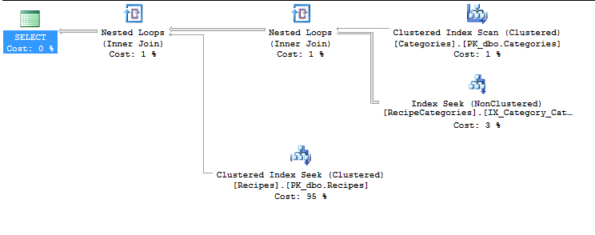
Assumes normal Database Tuning

Slide 6

Work with your indexes not against them
Covering indexes vs table scan
Load only the fields you need
Prefer set based operations
Beware of Includes
Type coercions

Slide 7
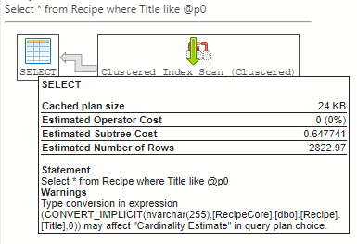
Implicit Type Coersion

Slide 8
Indexes with Code Only
public class Category
{
// Properties
public long CategoryId { get; set; }
[StringLength(50)]
[Index]
public string Description { get; set; }
// Children
public virtual ICollection<Recipe> Recipes { get; set; }
}
Notes:
public class Blog
{
[Index("IdAndRating", 1)]
public int Id { get; set; }
public string Title { get; set; }
[Index("RatingIndex")]
[Index("IdAndRating", 2, IsUnique = true)]
public int Rating { get; set; }
public virtual ICollection<Post> Posts { get; set; }
}

Slide 9
Indexes with Code Only Migrations
CreateTable(
"Posts",
c => new
{
PostId = c.Int(nullable: false, identity: true),
Title = c.String(maxLength: 200),
Content = c.String(),
BlogId = c.Int(nullable: false),
})
.PrimaryKey(t => t.PostId)
.ForeignKey("Blogs", t => t.BlogId, cascadeDelete: true)
.Index(t => t.BlogId)
.Index(p => p.Title, unique: true);

Slide 10
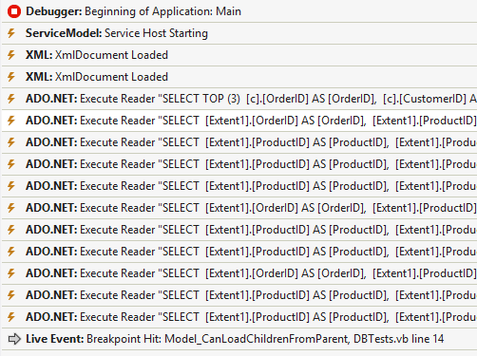
Profile
SQL Profiler
Intellitrace
Context.Database.Log
EFProf
OrmProfiler
MiniProfiler
Azure Data Studio
Application Insights

Slide 11
Logging
Logging in Core 3:
public static readonly ILoggerFactory ContextLoggerFactory
= LoggerFactory.Create(builder => builder.AddConsole());
protected override void OnConfiguring(DbContextOptionsBuilder optionsBuilder)
=> optionsBuilder.UseLoggerFactory(ContextLoggerFactory);
Core 5:
protected override void OnConfiguring(DbContextOptionsBuilder optionsBuilder)
=> optionsBuilder.LogTo(Console.WriteLine);
Loggin in Core 2:
protected override void OnConfiguring(DbContextOptionsBuilder optionsBuilder)
{
IServiceCollection serviceCollection = new ServiceCollection();
serviceCollection.AddLogging(builder => builder
.AddConsole()
.AddFilter(level => level >= LogLevel.Information)
);
var loggerFactory = serviceCollection.BuildServiceProvider().GetService<ILoggerFactory>();
optionsBuilder.UseSqlServer(“cn",
options =>
{
options.EnableRetryOnFailure(maxRetryCount: 3);
options.MaxBatchSize(100);
})
.UseLoggerFactory(loggerFactory)
.UseLazyLoadingProxies();
}
EF 6:
Context.Database.Log(text => Console.WriteLine(text));
https://docs.microsoft.com/en-us/ef/core/miscellaneous/logging

Slide 12
Core 2 + TagWith
var brownies =
from recipe in dc.Recipes.TagWith("Testing Tag With")
where EF.Functions.Like(recipe.Title, "%brownie%")
select recipe.Title;

Slide 13
Demo
Monitoring and tuning

Slide 14
Performance EF 6 vs EF Core

Slide 15
EF vs EFCore vs Dapper Customer.ToList()

Slide 16
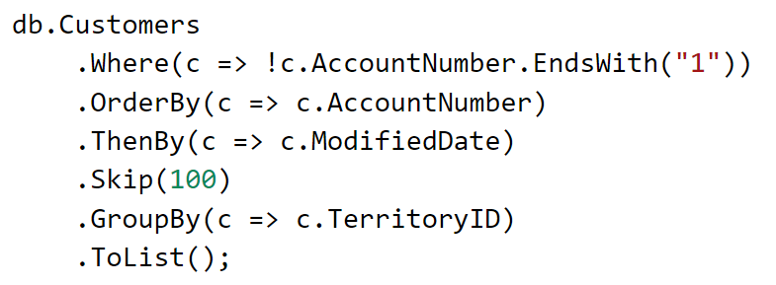
Complex Query?

Slide 17
Demo
Monitoring and tuning – EF Core

Slide 18
Comparing EF Versions
var brownies =
from r in dc.Recipes
where r.Title.Contains(“Brownie")
select new
{
r.Title,
Category = r.Categories.FirstOrDefault().Description,
Ingredients = r.Ingredients.OrderBy(i => i.SortOrder),
Directions = r.Directions.OrderBy(d => d.LineNumber)
.Select(d => d.Description)
};

Slide 19
EF 6.x
SELECT
[UnionAll1].[Id] AS [C1],
[UnionAll1].[RecipeId] AS [C2],
[UnionAll1].[CategoryId] AS [C3],
[UnionAll1].[Id1] AS [C4],
[UnionAll1].[C2] AS [C5],
[UnionAll1].[Title] AS [C6],
[UnionAll1].[Description] AS [C7],
[UnionAll1].[C1] AS [C8],
[UnionAll1].[Id2] AS [C9],
[UnionAll1].[SortOrder] AS [C10],
[UnionAll1].[Units] AS [C11],
[UnionAll1].[UnitType] AS [C12],
[UnionAll1].[Description1] AS [C13],
[UnionAll1].[RecipeId1] AS [C14],
[UnionAll1].[C3] AS [C15]
FROM (SELECT
CASE WHEN ([Extent4].[Id] IS NULL) THEN CAST(NULL AS int) ELSE 1 END AS [C1],
[Filter1].[Id] AS [Id],
[Limit1].[RecipeId] AS [RecipeId],
[Limit1].[CategoryId] AS [CategoryId],
[Limit1].[Id] AS [Id1],
1 AS [C2],
[Filter1].[Title] AS [Title],
[Limit1].[Description] AS [Description],
[Extent4].[Id] AS [Id2],
[Extent4].[SortOrder] AS [SortOrder],
[Extent4].[Units] AS [Units],
[Extent4].[UnitType] AS [UnitType],
[Extent4].[Description] AS [Description1],
[Extent4].[RecipeId] AS [RecipeId1],
[Extent4].[SortOrder] AS [SortOrder1],
CAST(NULL AS varchar(1)) AS [C3],
CAST(NULL AS bigint) AS [C4]
FROM (SELECT [Extent1].[Id] AS [Id], [Extent1].[Title] AS [Title]
FROM [dbo].[Recipe] AS [Extent1]
WHERE [Extent1].[Title] LIKE N’%Brownie%' ) AS [Filter1]
OUTER APPLY (SELECT TOP (1)
[Extent2].[RecipeId] AS [RecipeId],
[Extent2].[CategoryId] AS [CategoryId],
[Extent3].[Id] AS [Id],
[Extent3].[Description] AS [Description]
FROM [dbo].[RecipeCategory] AS [Extent2]
INNER JOIN [dbo].[Category] AS [Extent3] ON [Extent3].[Id] = [Extent2].[CategoryId]
WHERE [Filter1].[Id] = [Extent2].[RecipeId] ) AS [Limit1]
LEFT OUTER JOIN [dbo].[Ingredient] AS [Extent4] ON [Filter1].[Id] = [Extent4].[RecipeId]
UNION ALL
SELECT
2 AS [C1],
[Filter3].[Id] AS [Id],
[Limit2].[RecipeId] AS [RecipeId],
[Limit2].[CategoryId] AS [CategoryId],
[Limit2].[Id] AS [Id1],
2 AS [C2],
[Filter3].[Title] AS [Title],
[Limit2].[Description] AS [Description],
CAST(NULL AS bigint) AS [C3],
CAST(NULL AS int) AS [C4],
CAST(NULL AS varchar(1)) AS [C5],
CAST(NULL AS varchar(1)) AS [C6],
CAST(NULL AS varchar(1)) AS [C7],
CAST(NULL AS bigint) AS [C8],
CAST(NULL AS int) AS [C9],
[Extent8].[Description] AS [Description1],
[Extent8].[LineNumber] AS [LineNumber]
FROM (SELECT [Extent5].[Id] AS [Id], [Extent5].[Title] AS [Title]
FROM [dbo].[Recipe] AS [Extent5]
WHERE [Extent5].[Title] LIKE N'%Brownie%' ) AS [Filter3]
OUTER APPLY (SELECT TOP (1)
[Extent6].[RecipeId] AS [RecipeId],
[Extent6].[CategoryId] AS [CategoryId],
[Extent7].[Id] AS [Id],
[Extent7].[Description] AS [Description]
FROM [dbo].[RecipeCategory] AS [Extent6]
INNER JOIN [dbo].[Category] AS [Extent7] ON [Extent7].[Id] = [Extent6].[CategoryId]
WHERE [Filter3].[Id] = [Extent6].[RecipeId] ) AS [Limit2]
INNER JOIN [dbo].[Direction] AS [Extent8] ON [Filter3].[Id] = [Extent8].[RecipeId]) AS [UnionAll1]
ORDER BY [UnionAll1].[Id] ASC, [UnionAll1].[RecipeId] ASC, [UnionAll1].[CategoryId] ASC, [UnionAll1].[Id1] ASC, [UnionAll1].[C1] ASC, [UnionAll1].[SortOrder1] ASC, [UnionAll1].[C4] ASC

Slide 20
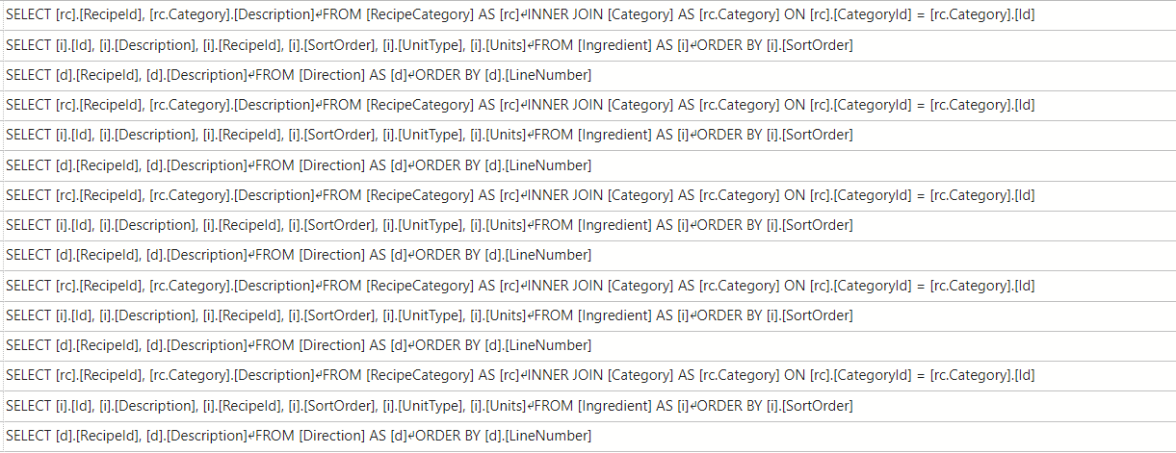
EF Core 1

Slide 21
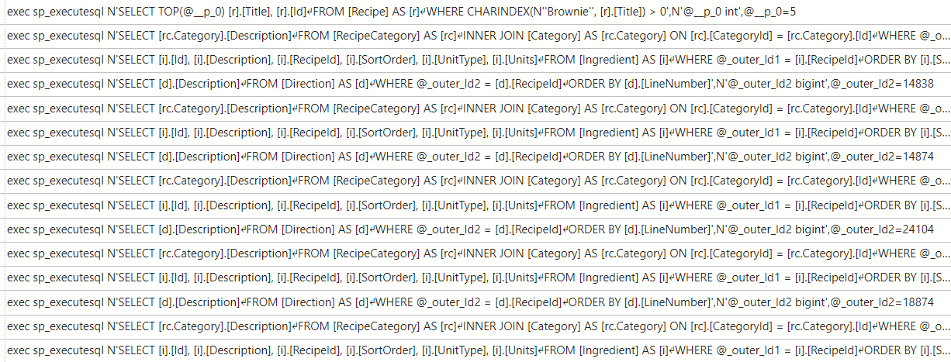
EF Core 1.1

Slide 22
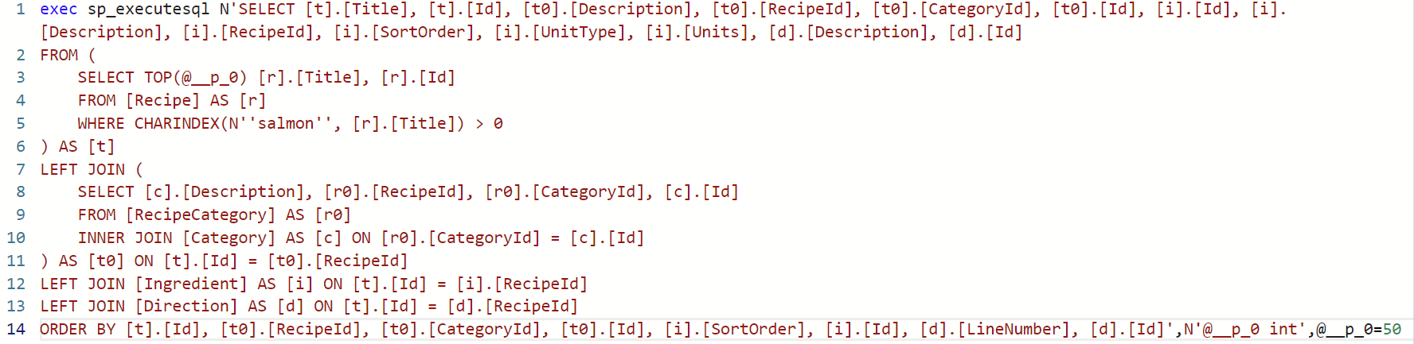
EF Core 3.0

Slide 23
EF Core 5
exec sp_executesql N'SELECT [t].[Title], [t].[Id], [t0].[Description], [t0].[CategoryId], [t0].[RecipeId], [t0].[Id], [t1].[Id], [t1].[Description], [t1].[RecipeId], [t1].[SortOrder], [t1].[UnitType], [t1].[Units], [t2].[Description], [t2].[Id]
FROM (
SELECT TOP(@__p_0) [r].[Title], [r].[Id]
FROM [Recipe] AS [r]
WHERE [r].[Title] LIKE N‘’%Brownie%''
) AS [t]
LEFT JOIN (
SELECT [c].[Description], [r0].[CategoryId], [r0].[RecipeId], [c].[Id]
FROM [RecipeCategory] AS [r0]
INNER JOIN [Category] AS [c] ON [r0].[CategoryId] = [c].[Id]
) AS [t0] ON [t].[Id] = [t0].[RecipeId]
LEFT JOIN (
SELECT [i].[Id], [i].[Description], [i].[RecipeId], [i].[SortOrder], [i].[UnitType], [i].[Units]
FROM [Ingredient] AS [i]
) AS [t1] ON [t].[Id] = [t1].[RecipeId]
LEFT JOIN (
SELECT [d].[Description], [d].[Id], [d].[LineNumber], [d].[RecipeId]
FROM [Direction] AS [d]
) AS [t2] ON [t].[Id] = [t2].[RecipeId]
ORDER BY [t].[Id], [t0].[CategoryId], [t0].[RecipeId], [t0].[Id], [t1].[SortOrder], [t1].[Id], [t2].[LineNumber], [t2].[Id]',N'@__p_0 int',

Slide 24
EF Core 8
exec sp_executesql N'SELECT [t].[Title], [t].[Categories], [t].[Id], [i].[Id], [i].[Description], [i].[RecipeId], [i].[SortOrder], [i].[UnitType], [i].[Units], [d].[Description], [d].[Id]
FROM (
SELECT TOP(@__p_0) [r].[Title], [r].[Categories], [r].[Id]
FROM [RecipeSimple] AS [r]
WHERE [r].[Title] LIKE ‘’%Brownie%''
) AS [t]
LEFT JOIN [Ingredient] AS [i] ON [t].[Id] = [i].[RecipeId]
LEFT JOIN [Direction] AS [d] ON [t].[Id] = [d].[RecipeId]
ORDER BY [t].[Id], [i].[SortOrder], [i].[Id], [d].[LineNumber]',N'@__p_0 int',@__p_0=50

Slide 25
Context Pooling
builder.Services.AddDbContextPool<RecipeContext>(
b => b.UseSqlServer(myConnectionString));

Slide 26
EF Core 2 EF Functions
from recipe in dc.Recipes
where EF.Functions.Like(recipe.Title, brownie)
select recipe.Title;

Slide 27
Compiled Query
private static Func<RecipeContext, string, IEnumerable<Recipe>>
FilteredRecipes =>
EF.CompileQuery((RecipeContext cn, string filter) =>
cn.Recipes.Where(r => r.Title.Contains(filter)));
public void GetRecipes()
{
using var dc = new RecipeContext();
var recipes = FilteredRecipes(dc, "Brownie");
}

Slide 28
EF Core 6 – Compiled Models
dotnet ef dbcontext optimize -output-dir CompiledRecipes --namespace CompiledRecipes
https://learn.microsoft.com/en-us/ef/core/performance/advanced-performance-topics?tabs=with-di%2Cexpression-api-with-constant#compiled-models

Slide 29
EF Core 7 Bulk Updates
await dc.Recipes
.Where(r => r.Title.StartsWith("Demo"))
.ExecuteUpdateAsync(r =>
r.SetProperty(
r1 => r1.Title,
r1 => r1.Title + "Demo Updated" ));
await dc.Recipes
.Where(r => r.Title.StartsWith("Demo"))
.ExecuteDeleteAsync();

Slide 30
EF 8 – JSON – Contains
public class person
{
public string Name { get; set; }
public string[] Races { get; set; }
}
LINQ
string[] testRaces = { “Asian”, “Hawaiian” };
var query = dc.Persons
.Where(p => p.Races.Any(r => testRaces.Contains(r)))
.Select(p => p.Name);
SQL
SELECT [p].[Name]
FROM [Person] AS [p]
WHERE EXISTS (
SELECT 1 FROM OpenJson(@__testRaces_0) AS [b]
WHERE EXISTS (
SELECT 1 FROM OpenJson([p].[Races]) AS [b0]
WHERE [b0].[value] = [b].[value]))

Slide 31
Load values once
ToList
AsEnumerable
First
Single
Find
Aggregate/Count/Sum/Min/Max

Slide 32

Lazy Loaded Children
Includes
Anonymous Type
Notes:
Demo with logging/first in loop

Slide 33
Misc
Filter before ToList
Sort before Paging
Prefer Any over Count>0
Don’t Any()/Count then iterate
Unit of work for saves
Break context up with large models
Beware of type coercion/computed values

Slide 34

Things you can’t do with EF (out of the box)
OR/M != ETL
Full Text Index
Query hints
Unique Constraints
Xpath
Multiple Results
BulkCopy

Slide 35

EF Performance Questions?
https://github.com/jwooley/RecipeWebApi
https://github.com/jwooley/EfCore
https://jwooley.github.io/
Jim Wooley
www.ThinqLinq.com
@jimwooley

