Slide 1
Entity Framework Performance Monitoring and Tuning
Jim Wooley
Senior Delivery Principal, Slalom
www.ThinqLinq.com
@JimWooley
https://github.com/jwooley/RecipeWebApi
https://github.com/jwooley/EfCore
https://jwooley.github.io/

Slide 2
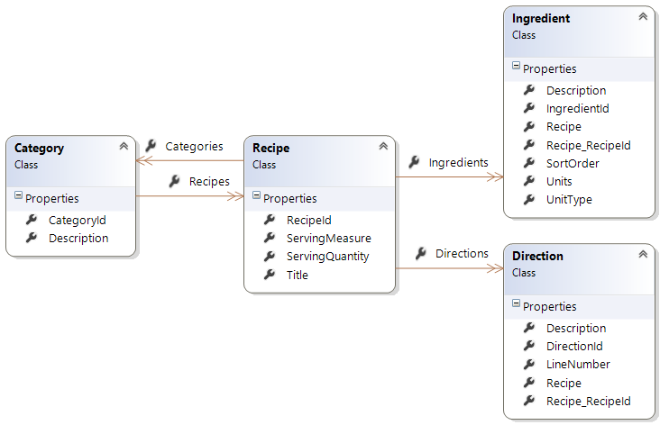
Demo Data Model

Slide 3
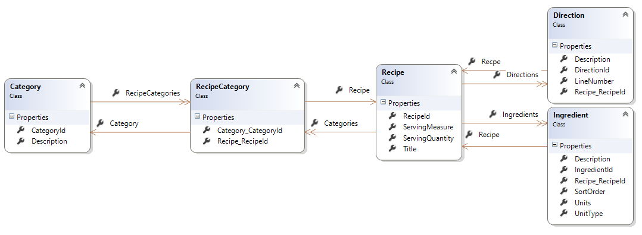
Demo Data Model

Slide 4

Which is better
EF
Stored Proc
EXEC sRecipeSearch @searchText=‘Chocolate’
from recipe in Recipes
where recipe.Title.Contains(‘Chocolate’)
select recipe
Declare @search nvarchar(4000)
Set @search = 'Select * from Recipes where recipes.Title like ''%' + @searchText + '%'''
select @search
EXEC sp_executesql @search
Declare @SearchText nvarchar(2000) = ‘%Chocolate%’
Select RecipeId, Title
From Recipes
Where Title Like @SearchText
*EF does support Stored Procs when necessary

Slide 5
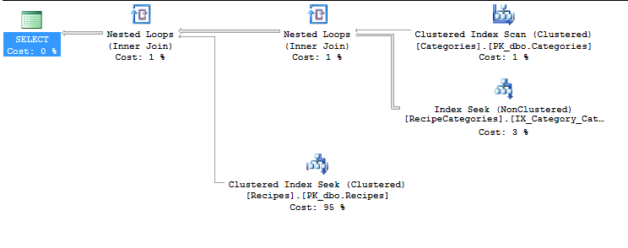
Assumes normal Database Tuning

Slide 6

Work with your indexes not against them
Covering indexes vs table scan
Load only the fields you need
Prefer set based operations
Beware of Includes
Type coercions

Slide 7
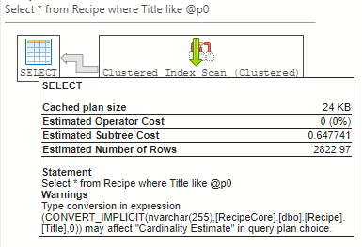
Implicit Type Coersion

Slide 8
Indexes with Code Only
public class Category
{
// Properties
public long CategoryId { get; set; }
[StringLength(50)]
[Index]
public string Description { get; set; }
// Children
public virtual ICollection<Recipe> Recipes { get; set; }
}
Notes:
public class Blog
{
[Index("IdAndRating", 1)]
public int Id { get; set; }
public string Title { get; set; }
[Index("RatingIndex")]
[Index("IdAndRating", 2, IsUnique = true)]
public int Rating { get; set; }
public virtual ICollection<Post> Posts { get; set; }
}

Slide 9
Indexes with Code Only Migrations
CreateTable(
"Posts",
c => new
{
PostId = c.Int(nullable: false, identity: true),
Title = c.String(maxLength: 200),
Content = c.String(),
BlogId = c.Int(nullable: false),
})
.PrimaryKey(t => t.PostId)
.ForeignKey("Blogs", t => t.BlogId, cascadeDelete: true)
.Index(t => t.BlogId)
.Index(p => p.Title, unique: true);

Slide 10
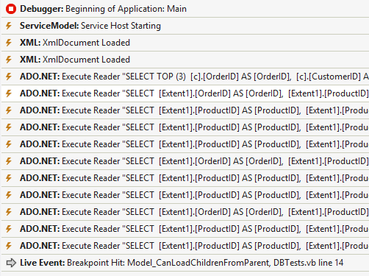
Profile
SQL Profiler
Intellitrace
Context.Database.Log
EFProf
OrmProfiler
MiniProfiler
Azure Data Studio

Slide 11
Logging
Logging in Core 3:
public static readonly ILoggerFactory ContextLoggerFactory
= LoggerFactory.Create(builder => builder.AddConsole());
protected override void OnConfiguring(DbContextOptionsBuilder optionsBuilder)
=> optionsBuilder.UseLoggerFactory(ContextLoggerFactory);
Core 5:
protected override void OnConfiguring(DbContextOptionsBuilder optionsBuilder)
=> optionsBuilder.LogTo(Console.WriteLine);
Loggin in Core 2:
protected override void OnConfiguring(DbContextOptionsBuilder optionsBuilder)
{
IServiceCollection serviceCollection = new ServiceCollection();
serviceCollection.AddLogging(builder => builder
.AddConsole()
.AddFilter(level => level >= LogLevel.Information)
);
var loggerFactory = serviceCollection.BuildServiceProvider().GetService<ILoggerFactory>();
optionsBuilder.UseSqlServer(“cn",
options =>
{
options.EnableRetryOnFailure(maxRetryCount: 3);
options.MaxBatchSize(100);
})
.UseLoggerFactory(loggerFactory)
.UseLazyLoadingProxies();
}
EF 6:
Context.Database.Log(text => Console.WriteLine(text));
https://docs.microsoft.com/en-us/ef/core/miscellaneous/logging

Slide 12
Core 2 + TagWith
var brownies =
from recipe in dc.Recipes.TagWith("Testing Tag With")
where EF.Functions.Like(recipe.Title, "%brownie%")
select recipe.Title;

Slide 13
Demo
Monitoring and tuning

Slide 14
Performance EF 6 vs EF Core

Slide 15
EF vs Dapper Customer.ToList()

Slide 16
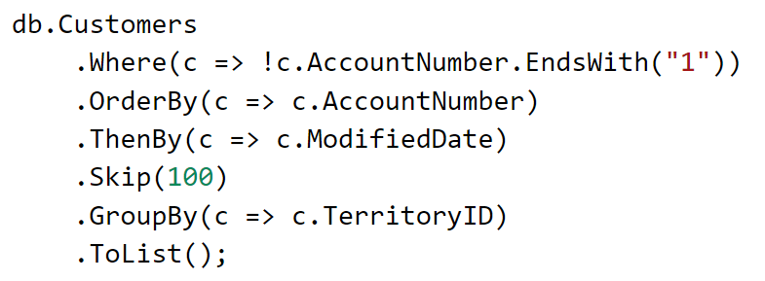
Complex Query?

Slide 17
Demo
Monitoring and tuning – EF Core

Slide 18
Load values once
ToList
AsEnumerable
First
Single
Find
Aggregate/Count/Sum/Min/Max

Slide 19

Lazy Loaded Children
Includes
Anonymous Type
Notes:
Demo with logging/first in loop

Slide 20
Misc
Filter before ToList
Sort before Paging
Prefer Any over Count>0
Don’t Any()/Count then iterate
Unit of work for saves
Break context up with large models
Beware of type coercion/computed values

Slide 21

Things you can’t do with EF (out of the box)
OR/M != ETL
Full Text Index
Query hints
Unique Constraints
Xpath
Multiple Results
BulkCopy

Slide 22

EF Performance Questions?
https://github.com/jwooley/RecipeWebApi
https://github.com/jwooley/EfCore
https://jwooley.github.io/
Jim Wooley
www.ThinqLinq.com
@jimwooley

