Slide 1



C# Language enhancements, .Net Compiler Platform (Roslyn) And You https://github.com/jwooley/RoslynAndYou https://jwooley.github.io/
Jim Wooley
www.ThinqLinq.com
Twitter: @JimWooley

Slide 2
Agenda
What is Roslyn?
Language Enhancements
Code Analytics, Refactorings
Build a Diagnostic with Code Fix

Slide 3

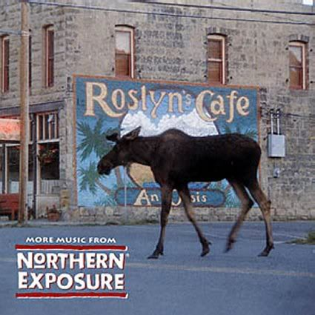
What is Roslyn?

Slide 4
C# History (before Roslyn)
2002
2005
2008
2010
2012
2013
2015
C# 1/VB7
C# 2: Generics, Iterators, Anonymous Delegates, Nullable, Partial, co/contravariance
C# 3: LINQ, Lambda, Anonymous, AutoProp, Extension Methods, Expression
C# 4: Parallel, Dynamic, optional params, named arguments, embedded interop
C# 5: Async, Caller info
Roslyn
???

Slide 5
Roslyn Language Enhancements: C# 6
Await in Catch/ Finally
Null propagation
#pragma
Getter only auto property
Dictionary Initializer
Nameof operator
Partial Modules
Exception Filters
Partial Interface
Auto property initializer
#Region inside methods
Using Static
String interpolation
Parameterless struct ctor
Line continuation comments
Multiline string literals

Slide 6
C#7
Named Tuples
Binary Literals
static void Main(string[] args)
{
object[] numbers = { 0b1, 0b10, new object[] { 0b10, 0b100, 0b1000 }, 0b1000_0, 0b1000_00 };
(int sum, int count) Tally(IEnumerable<object> list)
{
var r = (sum:0, count:0);
foreach (var v in list)
{
switch(v)
{
case int i:
r.sum += i, r.count++;
break;
case IEnumerable<object> l when l.Any():
var t1 = Tally(l);
r.s += tl.sum; r.c += tl.count;
break;
case null:
break;
}
}
return r;
}
var result = Tally(numbers);
Console.WriteLine($"Sum: {result.sum} Count: {result.count}");
}
Digit Separators
Local Functions
Pattern Matching

Slide 7
C# Post Roslyn
2015
2016
2017
2018
C# 6: Static imports, prop initializers, null propagator, string interpolation, nameof
C# 7.0: Out variables, tuples, pattern matching, local functions, ref locals and returns
C# 7.1: Async main, default literal, inferred tuple names, reference assembly gen
C# 7.2: ref semantics with value types, non-trailing named args, numeric literals, private protected
2018
C# 7.3: tuple equality, constraints, expression variables, custom fixed, ref reassignment
2019
C# 8.0: Default interface members, nullable reference types, async streams, switch expressions, ranges
https://docs.microsoft.com/en-us/dotnet/csharp/whats-new/
https://github.com/dotnet/roslyn/blob/master/docs/Language%20Feature%20Status.md

Slide 8
C# 8.0
Safe
Nullable and non-nullable reference types help you write safer code
Declare your intent more clearly
Modern
Async streams for modern workloads like cloud & IoT communication
Easily work with cloud scale datasets using indexes and ranges
Productive
Write less code using patterns
Protect data with readonly members
Improved using statements for resource management
Notes:
Most features of C# 8.0 capture a common action with new syntax, avoiding the bugs that come from having to write and maintain the longer version you would have had before.
C# 8.0 embraces modern development because the operations that get new syntax are ones with emerging importance in the modern developer landscape, like working with cloud scale datasets and asynchronous communication.
<CLICK>

Slide 9
Support modern cloud scenarios
Async enumerables
More patterns in more places
Default interface members
Indices and Ranges

Slide 10
Increase your productivity
Using statement
Static local functions
Readonly members
Null coalescing assignment
Unmanaged constraint
Interpolated verbatim strings

Slide 11
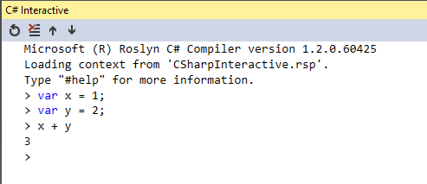
C# Scripting / Interactive
var script = CSharpScript.Create<int>("int x = 1;")
.ContinueWith("int y = 2;")
.ContinueWith("x + y");
Assert.AreEqual(
3,
(int)(await script.RunAsync()).ReturnValue);

Slide 12

Opening up the compiler
AST
AST
AST
CSC/VBC
IL

Slide 13
Out of the Box Refactorings
Code Fixes (30)
Refactorings (13)
Add Await
Add Async
Change Return Type
Change To Yield
Convert To Async
Convert To Iterator
Add Missing Reference
Add Using
Fully Qualify
Generate Method
Add Constructor Parameters from members
Change Signature
Encapsulate Field
Extract Interface
Extract Method
Generate Constructor from members
Generate default constructors
Inline temporary
Introduce Variable
Invert If
Simplify Lambda
Microsoft.CodeAnalysis.Internal.Log

Slide 14
Third Party Code Fixes
Roslyn Analyzers
Code Cracker
DotNetAnalyzers
StyleCop
AsyncUsageAnalyzers
TSqlAnalyzer
DotNetDoodle
RoslynDiagnostics
AzureAnalytics
Wintellect.Analyzers
Xunit.Analyzers

Slide 15
Building your own Diagnostic with Code Fix
public class TestControllerMisnamed : Controller
{
public TestControllerMisnamed() {}
public ActionResult Index()
{
return View();
}
}

Slide 16
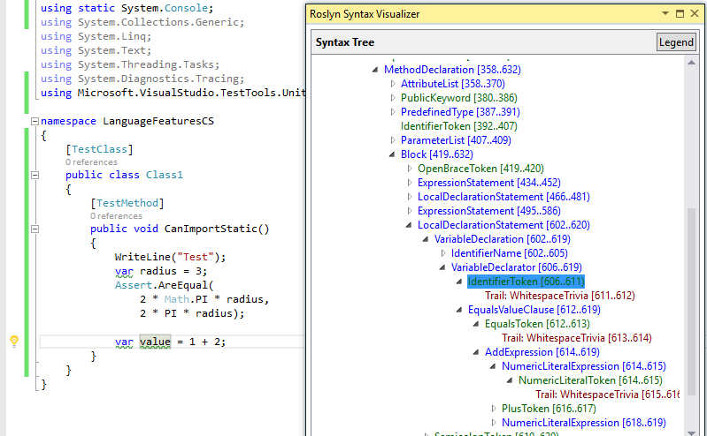
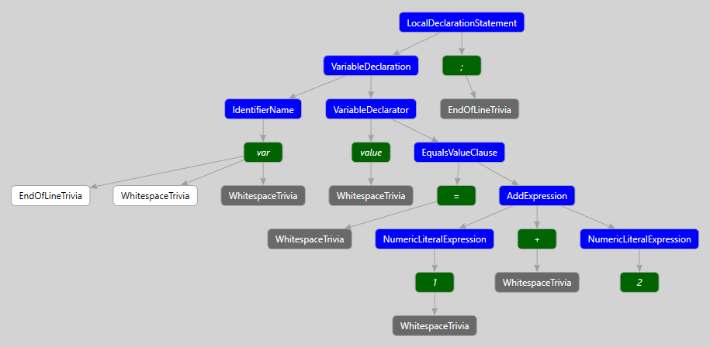
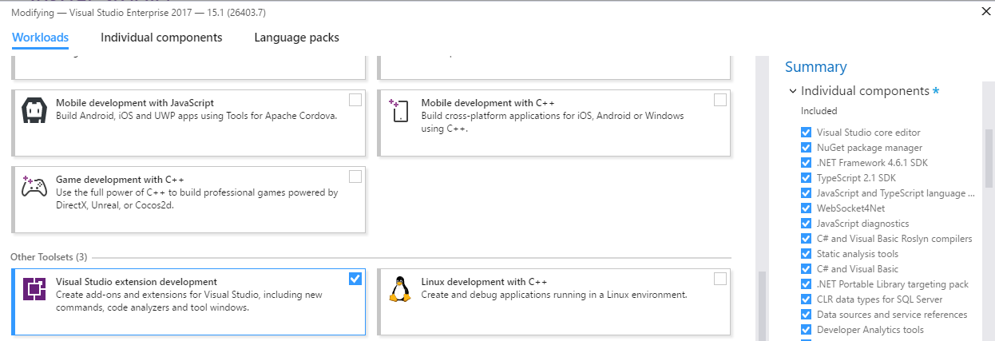
Building your own Fix
ExpressionSyntax
SyntaxToken
SyntaxTrivia
var value = 1 + 2;
var equalsValue =
SyntaxFactory.EqualsValueClause(
SyntaxFactory.BinaryExpression(
SyntaxKind.AddExpression,
SyntaxFactory.LiteralExpression(
SyntaxKind.NumericLiteralExpression, SyntaxFactory.Literal(1)),
SyntaxFactory.LiteralExpression(
SyntaxKind.NumericLiteralExpression,SyntaxFactory.Literal(2))
));
var typeSyntax =
SyntaxFactory.VariableDeclaration(
SyntaxFactory.ParseTypeName("var"),
new SeparatedSyntaxList<VariableDeclaratorSyntax>()
.Add(SyntaxFactory.VariableDeclarator(“value")
.WithInitializer(equalsValue)))
.NormalizeWhitespace(" ")
.WithAdditionalAnnotations(Formatter.Annotation);
var declaration = SyntaxFactory.LocalDeclarationStatement(typeSyntax);

Slide 17
Custom Diagnostic - Analyzer
private void Analyzer(SymbolAnalysisContext context)
{
var symbol = (INamedTypeSymbol)context.Symbol;
if (symbol.BaseType == null) return;
if ((symbol.BaseType.Name == "Controller"
|| symbol.BaseType.Name == "ApiController")
&& !symbol.Name.EndsWith("Controller"))
{
var diagnostic = Diagnostic.Create(
Rule, symbol.Locations[0], symbol.Name);
context.ReportDiagnostic(diagnostic);
}
}
[DiagnosticAnalyzer(LanguageNames.CSharp)]
public class WebApiControllerNamingConventionAnalyzer : DiagnosticAnalyzer
{
string DiagnosticId = “WA0001";
string Description = "Controller type should end in 'Controller'";
string MessageFormat = "Type name '{0}' does not end in Controller";
internal const string Category = "Naming";
private static DiagnosticDescriptor Rule = new DiagnosticDescriptor(
DiagnosticId, Description, MessageFormat, Category,
DiagnosticSeverity.Warning, true);
// Add implementation
}

Slide 18
Custom Diagnostic - CodeFixProvider
[ExportCodeFixProvider("ControllerNameCodeFixProvider", LanguageNames.CSharp)]
public class ControllerNameCodeFixProvider : CodeFixProvider
{
public override ImmutableArray<string> GetFixableDiagnosticIds()
{
return ImmutableArray.Create(DiagnosticId);
}
public override async Task ComputeFixesAsync(CodeFixContext context)
{
var root = await context.Document.GetSyntaxRootAsync(
context.CancellationToken).ConfigureAwait(false);
var diagnostic = context.Diagnostics.First();
var diagnosticSpan = diagnostic.Location.SourceSpan;
var declaration = root.FindToken(diagnosticSpan.Start)
.Parent.AncestorsAndSelf()
.OfType<TypeDeclarationSyntax>().First();
context.RegisterFix(
CodeAction.Create("Ensure type ends in 'Controller'",
c => MakeEndInControllerAsync(context.Document, declaration, c)),
diagnostic );
}
private async Task<Document> MakeEndInControllerAsync(
Document document,
TypeDeclarationSyntax typeDecl,
CancellationToken cancellationToken)
{
var identifierToken = typeDecl.Identifier;
var originalName = identifierToken.Text;
var nameWithoutController = Regex.Replace(
originalName, "controller", String.Empty, RegexOptions.IgnoreCase);
var newName = nameWithoutController + "Controller";
var newIdentifier = SyntaxFactory.Identifier(newName)
.WithAdditionalAnnotations(Formatter.Annotation);
var newDeclaration = typeDecl.ReplaceToken(identifierToken, newIdentifier);
var root = await document.GetSyntaxRootAsync();
var newRoot = root.ReplaceNode(typeDecl, newDeclaration);
var newDocument = document.WithSyntaxRoot(newRoot);
return newDocument;
}

Slide 19
Roslyn Resources
Github: https://github.com/dotnet/roslyn
Dotnet: https://github.com/dotnet
Reference Source: http://source.roslyn.io/
Code Cracker: http://code-cracker.github.io/
LLILC (LLVM for .NET Core): https://github.com/dotnet/llilc
Hand’s on Labs: https://github.com/jwooley/RoslynLabs
This presentation: https://github.com/jwooley/RoslynAndYou

Slide 20
C# Language Enhancements, Roslyn And You https://github.com/jwooley/RoslynAndYou https://jwooley.github.io/
Jim Wooley
www.ThinqLinq.com
Twitter: @JimWooley

