Slide 1
C# Roslyn and You
https://www.slideshare.net/jimwooley/improving-code-quality-with-roslyn-analyzers
https://github.com/jwooley/CSVersions
https://github.com/jwooley/Analyzers
https://github.com/jwooley/RoslynLabs

Slide 2




About Jim
Sr Delivery Principal
Microsoft MVP
Slalom
Developer Tools
03
Author
@JimWooley
LINQ in Action
https://jwooley.github.io
https://github.com/jwooley/Analyzers
http://www.thinqlinq.com
Notes:
Click the icon and navigate to your photo on your computer
Crop and position photo as desired
Go to the Arrange drop down menu > choose “send to back” to reveal text

Slide 3
Agenda
C# past present and future
C# Scripting
Static Analysis and Code Styles
Source Generators
Hack

Slide 4
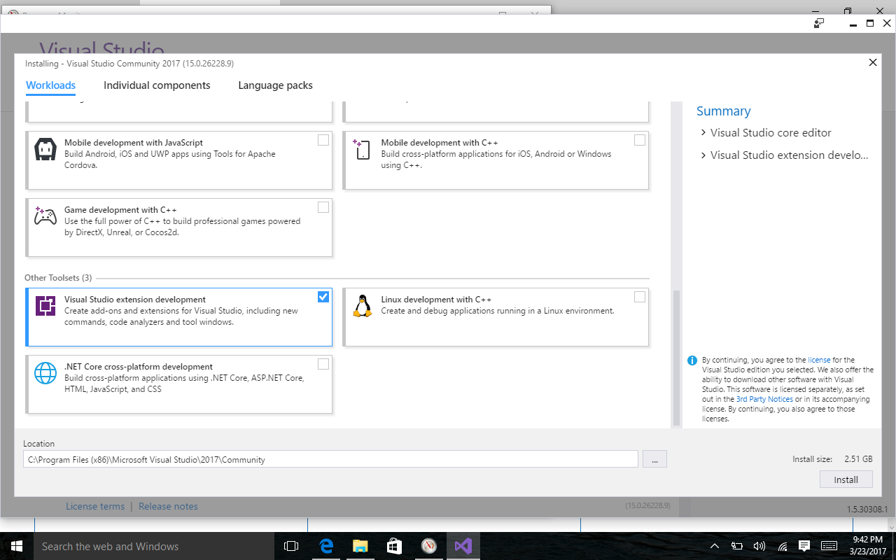
Prerequisite
https://visualstudio.microsoft.com/downloads/
Individual Components:
.NET Compiler Platform SDK
DGML Editor

Slide 5
C# History (before Roslyn)
2002
2005
2008
2010
2012
2013
2015
C# 1/VB7
C# 2: Generics, Iterators, Anonymous Delegates, Nullable, Partial, co/contravariance
C# 3: LINQ, Lambda, Anonymous, AutoProp, Extension Methods, Expression
C# 4: Parallel, Dynamic, optional params, named arguments, embedded interop
C# 5: Async, Caller info
Roslyn
???

Slide 6
Roslyn Language Enhancements
Await in Catch/ Finally
Null propagation
#pragma
Getter only auto property
Dictionary Initializer
Nameof operator
Partial Modules
Exception Filters
Partial Interface
Auto property initializer
#Region inside methods
Using Static
String interpolation
Parameterless struct ctor
Line continuation comments
Multiline string literals

Slide 7
C# Post Roslyn
2015
12/2016
2017
2017
C# 6: Static imports, prop initializers, null propagator, string interpolation, nameof
C# 7.0: Out variables, tuples, pattern matching, local functions, ref locals and returns
C# 7.1: Async main, default literal, inferred tuple names, reference assembly gen
C# 7.2: ref semantics with value types, non-trailing named args, numeric literals, private protected
2018
C# 7.3: tuple equality, constraints, expression variables, custom fixed, ref reassignment
2019
C# 8.0: Default interface, nullable reference types, async streams, generic attributes, ranges
https://docs.microsoft.com/en-us/dotnet/csharp/whats-new/
https://github.com/dotnet/roslyn/blob/master/docs/Language%20Feature%20Status.md

Slide 8
C# Post Roslyn
2020 C# 9
Top Level Statements
Extending Partial
Code Generators
Lambda discards
Static lambdas
Module Initializers
Target Type New
Records
Skip locals init
Native ints
Attributes on local functions
Function pointers
Pattern matching improvements
Target type conditional
Covariant returns
Extension GetEnumerator
https://docs.microsoft.com/en-us/dotnet/csharp/whats-new/

Slide 9
C# Post Roslyn
2021 C# 10
Record structs
File-scoped namespace declaration
Extended property patterns
Constant interpolated strings
Record types seal ToString
Deconstruction assignment and declaration
AsyncMethodBuilder attribute on methods
Global Using directives
https://docs.microsoft.com/en-us/dotnet/csharp/whats-new/csharp-10

Slide 10
C# Language Features
https://github.com/dotnet/roslyn/blob/main/docs/Language%20Feature%20Status.md

Slide 11
C# Scripting
https://github.com/dotnet/roslyn/blob/main/docs/wiki/Scripting-API-Samples.md

Slide 12
Static Analysis
Demos from https://github.com/jwooley/Analyzers

Slide 13
Lab 1 -
Using Visual Studio built in analyzers
https://github.com/jwooley/RoslynLabs
https://docs.microsoft.com/en-us/visualstudio/ide/create-portable-custom-editor-options
https://docs.microsoft.com/en-us/visualstudio/ide/editorconfig-naming-conventions

Slide 14
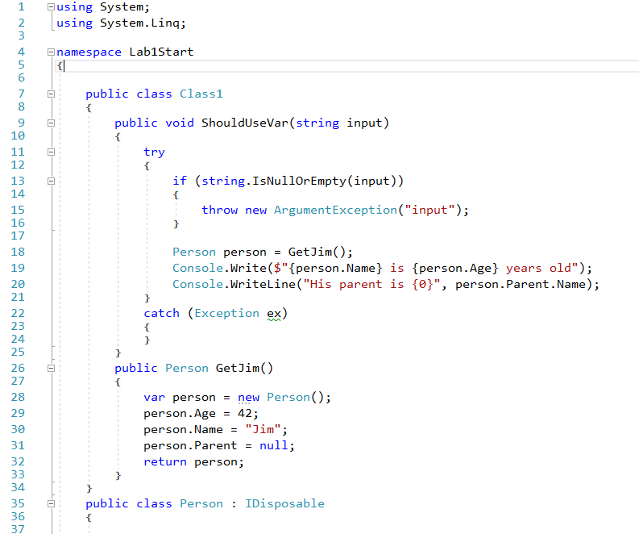
Clean Code?

Slide 15
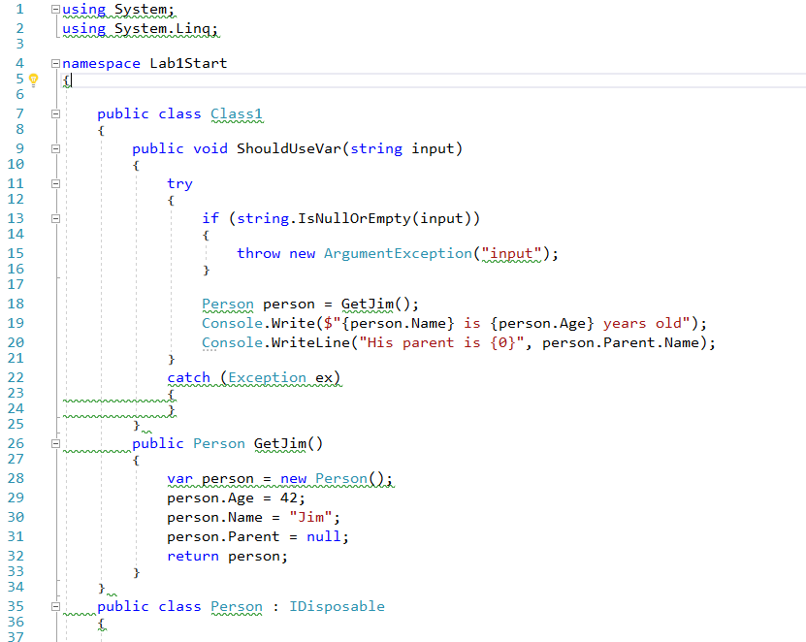
Not so clean

Slide 16
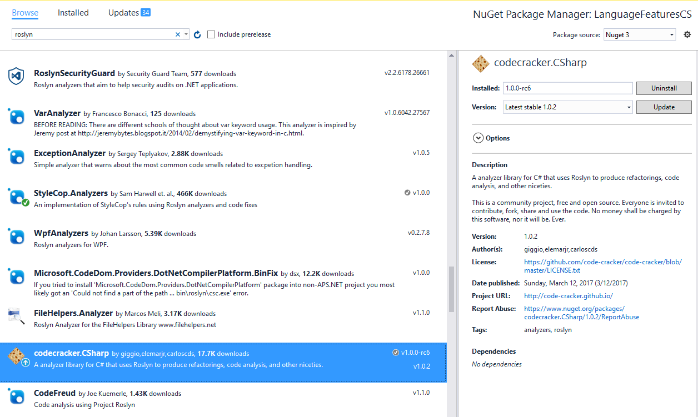
Adding Analyzer from Nuget

Slide 17
Demo
Using third party analyzers

Slide 18
Lab - 2
Using third party analyzers
https://github.com/jwooley/RoslynLabs

Slide 19
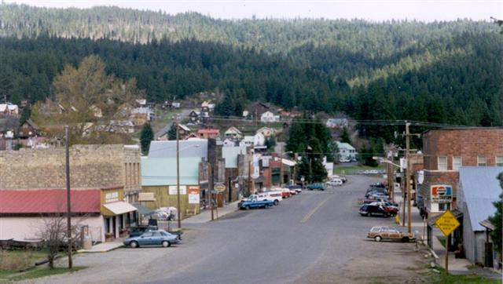
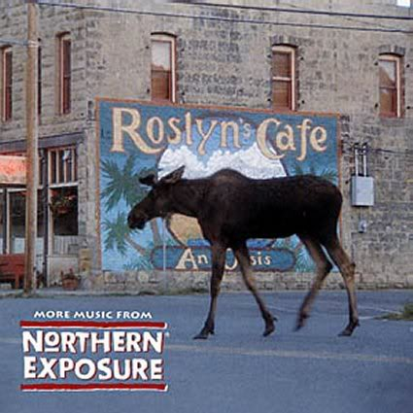
What is Roslyn?

Slide 20

Opening up the compiler
AST
AST
AST
CSC/VBC
IL

Slide 21
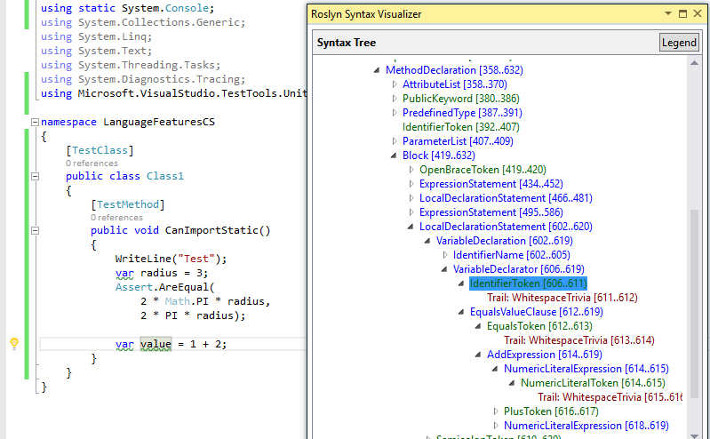
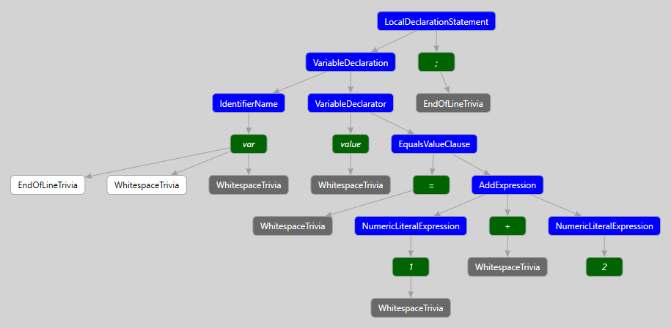
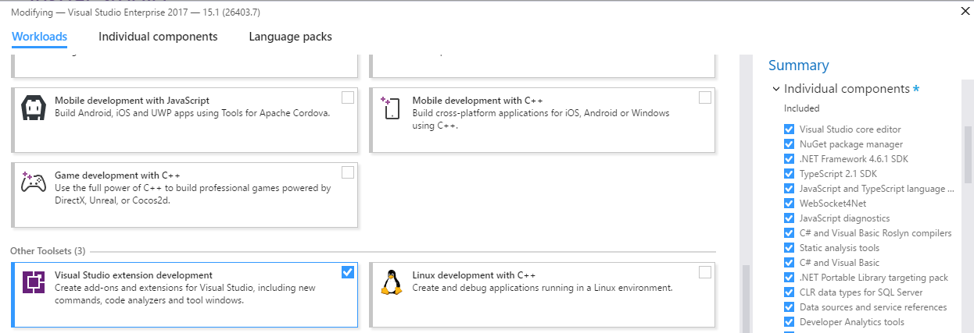
Building your own Fix
ExpressionSyntax
SyntaxToken
SyntaxTrivia
var value = 1 + 2;
var equalsValue =
SyntaxFactory.EqualsValueClause(
SyntaxFactory.BinaryExpression(
SyntaxKind.AddExpression,
SyntaxFactory.LiteralExpression(
SyntaxKind.NumericLiteralExpression, SyntaxFactory.Literal(1)),
SyntaxFactory.LiteralExpression(
SyntaxKind.NumericLiteralExpression,SyntaxFactory.Literal(2))
));
var typeSyntax =
SyntaxFactory.VariableDeclaration(
SyntaxFactory.ParseTypeName("var"),
new SeparatedSyntaxList<VariableDeclaratorSyntax>()
.Add(SyntaxFactory.VariableDeclarator(“value")
.WithInitializer(equalsValue)))
.NormalizeWhitespace(" ")
.WithAdditionalAnnotations(Formatter.Annotation);
var declaration = SyntaxFactory.LocalDeclarationStatement(typeSyntax);
http://roslynquoter.azurewebsites.net/

Slide 22
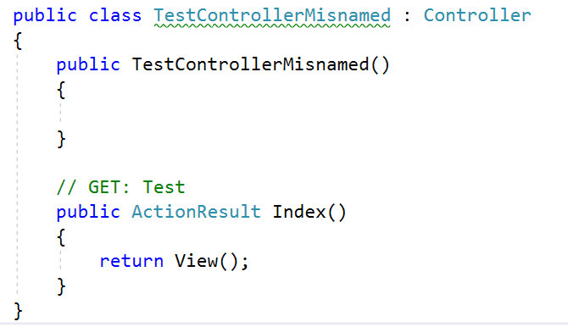
Detect domain specific errors

Slide 23
Creating your own Roslyn analyzer and Code Fix
[DiagnosticAnalyzer(LanguageNames.CSharp)]
public class WebApiControllerNamingConventionAnalyzer : DiagnosticAnalyzer
{
string DiagnosticId = “WA0001";
string Description = "Controller type should end in 'Controller'";
string MessageFormat = "Type name '{0}' does not end in Controller";
internal const string Category = "Naming";
private static DiagnosticDescriptor Rule = new DiagnosticDescriptor(
DiagnosticId, Description, MessageFormat, Category,
DiagnosticSeverity.Warning, true);
// Add implementation
}
private void Analyzer(SymbolAnalysisContext context)
{
var symbol = (INamedTypeSymbol)context.Symbol;
if (symbol.BaseType == null) return;
if ((symbol.BaseType.Name == "Controller"
|| symbol.BaseType.Name == "ApiController")
&& !symbol.Name.EndsWith("Controller"))
{
var diagnostic = Diagnostic.Create(
Rule, symbol.Locations[0], symbol.Name);
context.ReportDiagnostic(diagnostic);
}
}

Slide 24
Custom Diagnostic - CodeFixProvider
private async Task<Document> MakeEndInControllerAsync(
Document document,
TypeDeclarationSyntax typeDecl,
CancellationToken cancellationToken)
{
var identifierToken = typeDecl.Identifier;
var originalName = identifierToken.Text;
var nameWithoutController = Regex.Replace(
originalName, "controller", String.Empty, RegexOptions.IgnoreCase);
var newName = nameWithoutController + "Controller";
var newIdentifier = SyntaxFactory.Identifier(newName)
.WithAdditionalAnnotations(Formatter.Annotation);
var newDeclaration = typeDecl.ReplaceToken(identifierToken, newIdentifier);
var root = await document.GetSyntaxRootAsync();
var newRoot = root.ReplaceNode(typeDecl, newDeclaration);
var newDocument = document.WithSyntaxRoot(newRoot);
return newDocument;
}
public override async Task ComputeFixesAsync(CodeFixContext context)
{
var root = await context.Document.GetSyntaxRootAsync(
context.CancellationToken).ConfigureAwait(false);
var diagnostic = context.Diagnostics.First();
var diagnosticSpan = diagnostic.Location.SourceSpan;
var declaration = root.FindToken(diagnosticSpan.Start)
.Parent.AncestorsAndSelf()
.OfType<TypeDeclarationSyntax>().First();
context.RegisterFix(
CodeAction.Create("Ensure type ends in 'Controller'",
c => MakeEndInControllerAsync(context.Document, declaration, c)),
diagnostic );
}
[ExportCodeFixProvider("ControllerNameCodeFixProvider", LanguageNames.CSharp)]
public class ControllerNameCodeFixProvider : CodeFixProvider
{
public override ImmutableArray<string> GetFixableDiagnosticIds()
{
return ImmutableArray.Create(DiagnosticId);
}

Slide 25
Lab - 3
Creating your own analyzer and code fix
https://github.com/jwooley/RoslynLabs

Slide 26
Lab 4 - Source Generators
Lab 4: https://github.com/jwooley/RoslynLabs
Docs: https://docs.microsoft.com/en-us/dotnet/csharp/roslyn-sdk/source-generators-overview
Samples: https://github.com/dotnet/roslyn-sdk/tree/main/samples/CSharp/SourceGenerators
Cookbook:https://github.com/dotnet/roslyn/blob/main/docs/features/source-generators.cookbook.md
Incremental Generators:
https://andrewlock.net/exploring-dotnet-6-part-9-source-generator-updates-incremental-generators/
Listing of Source Generators: https://github.com/amis92/csharp-source-generators

Slide 27
Roslyn Resources
Github: https://github.com/dotnet/roslyn
Language feature status: https://github.com/dotnet/roslyn/blob/master/docs/Language%20Feature%20Status.md
CSharpLang Proposals: https://github.com/dotnet/csharplang/tree/main/proposals
Dotnet: https://github.com/dotnet
Reference Source: http://source.roslyn.io/
Roslyn SDK: https://github.com/dotnet/roslyn-sdk
C# Playground: http://SharpLab.io
Roslyn Quoter: http://roslynquoter.azurewebsites.net/
This presentation:: https://github.com/jwooley/RoslynLabs

Slide 28
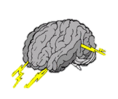
Hack -
Brainstorm Ideas
Creating your own analyzer and code fix
https://github.com/code-cracker/code-cracker
https://github.com/DotNetAnalyzers/StyleCopAnalyzers
https://github.com/JosefPihrt/Roslynator
https://github.com/dotnet/roslyn/wiki/C%23-Interactive-Walkthrough
https://github.com/dotnet/roslyn/blob/main/docs/wiki/Scripting-API-Samples.md

Slide 29
Q & A
Sr Delivery Principal
Microsoft MVP
Slalom Consulting
Developer Tools
03
Author
@JimWooley
LINQ in Action
https://github.com/jwooley/RoslynLabs
http://www.thinqlinq.com
Notes:
Click the icon and navigate to your photo on your computer
Crop and position photo as desired
Go to the Arrange drop down menu > choose “send to back” to reveal text

