Slide 1


Reactive Extensions for JavaScript
@JimWooley
http://www.ThinqLinq.com
Consultant

Slide 2
Reactive Framework
“Rx is a library for
composing asynchronous and
event-based operations using
observable collections.”

Slide 3
Reactive Framework
“RxJs is a library for
composing asynchronous and
event-based operations using
observable prototypes.”

Slide 4


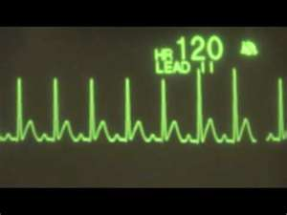


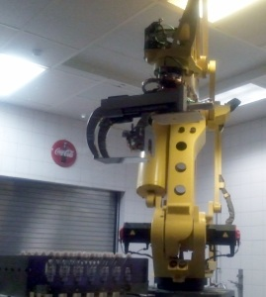

Observable Collection - Common Uses

Slide 5





Flavors of Rx
RxJs

Slide 6


Pulling with Enumerables
False
var query = from candy in bagOfCandies
where candy.HasNuts
group candy by candy.Name into GroupedCandies
select new {Name = GroupedCandies.Key, CandyCount = GroupedCandies.Count()};
foreach (var aggregate in query)
Move Next
Move Next
Move Next
Move Next

Slide 7

IEnumerator vs. IObserver
public interface IEnumerator
{
object Current { get; }
bool MoveNext();
void Reset();
}
Blocking
public interface IObserver<T>
{
void OnCompleted();
void OnError(Exception exception);
void OnNext(T value);
}

Slide 8
Pushing with Observables
var query = from candy in bagOfCandies
where candy.HasNuts
group candy by candy.Name into GroupedCandies
select new {Name = GroupedCandies.Key, CandyCount = GroupedCandies.Count()};
query.Subscribe(group => DoSomething(group));
OnCompleted
OnNext
OnNext
OnNext
OnNext
Subscribe
OnNext

Slide 9
LINQ for Javascript?
C# Query Syntax
var query = from c in Customers
where c.City == "Chattanooga“
select c.Name;
C# Lambda Syntax
var query = Customers
.Where(c => c.City == "Chattanooga")
.Select(c => c.Name);
JavaScript
var query = Customers
.Where(function (c) { return c.City === “Chattanooga” ; })
.Select(function (c) { return c.Name; });

Slide 10
Using Rx to query in Javascript
demo

Slide 11
Rx Observable Pattern
var obs = ...;
// query?
var sub = obs.Subscribe(
onNext : v => DoSomething(v),
onError : e => HandleError(e),
onCompleted : () => HandleDone);
sub.Dispose();

Slide 12
RxJs Observable Pattern
var obs = ...;
// query?
var sub = obs.Subscribe(
function(v) { DoSomething(v); },
function(e) { HandleError(e); },
function() { HandleDone(); });
sub.Dispose();

Slide 13
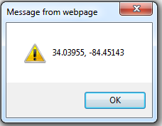
Observable.Create
var geo = Rx.Observable.Create(function (observer) {
var watchId = navigator.geolocation.watchPosition(
function (pos) { observer.OnNext(pos.coords); },
function (err) { observer.OnError(err); }
);
return function () {
navigator.geolocation.clearWatch(watchId);
};
});
var d = geo.Subscribe(function(pos) { alert(pos); });
…
d.Dispose();
8675309
8675309

Slide 14
RX.Observable.Prototype
Query
Flow
Generator
Select
Let
Where
Take
Skip
GroupBy
Flow
Scan
DistinctUntilChanged
Replay
SkipLast
TakeLast
Do
Catch
Finally
OnErrorResumeNext
Subscribe
Dematerialize
AsObservsable
Publish
StartsWith
Merge
MergeObservable
Concat
Zip
CombineLatest
Switch
SelectMany
TakeWhile
TakeUntil
SkipUntil
Prune
Time
TimeInterval
RemoveInterval
RemoveTimestamp
BufferWithTime
BufferWithCount
Throttle
Sample
Repeat
Retry
Timeout
Delay

Slide 15
Factory Generators
Rx.Observable.Range(0,5);
Rx.Observable.Return(“This is a single value”);
Rx.Observable.FromArray([“a”, “b”, “c”]);
Rx.Observable.Timer(1000,2000);
Rx.Observable.Create(function(subscriber) { return function() { unsub() }});
Rx.Observable.FromDOMEvent(Document.GetElementById(“image”), “mousemove”);
Rx.Observable.FromJQuery($(“div,, span”), “click”);
$(“div, span”).ToObservable(“click”);
Rx.Obsevable.XmlHttpRequest(url);

Slide 16
Demo
Generating Observables

Slide 17
Combining streams
SelectMany
Merge
Zip
Amb
CombineLatest
TakeUntil
TakeWhile
Combine
Switch
StartWith
Concat
SkipWhile

Slide 18
SelectMany
var ObservableY = ObservableX.SelectMany(function(x) { SomeGenerator(x); });
Ox
fx
fx
fx
Oy
Oy
Oy
Oy

Slide 19
TakeUntil
oX
oY
oX

Slide 20
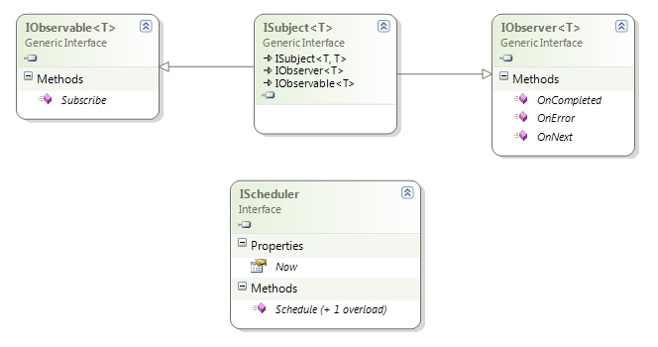
Rx Interfaces

Slide 21
Observable Events
First Class Objects
Standardize event model
Disposable
Supports DI
Mockable

Slide 22
Composing with Events
demo

Slide 23
Asynchronous Service Requests
Throttle
Translate
BingTranslator
ObservableX
TakeUntil

Slide 24
Asynchronous Services
demo

Slide 25
Why RxJs?
Reuse LINQ knowledge
Coordination of events/streams
Standardized events
State machine management
Async time related operations
Gesture Detection
Web Sockets?
???

Slide 26
Further Information
Rx Data Developer Center: http://msdn.microsoft.com/data/gg577609
Reactive Extensions Team Blog: http://blogs.msdn.com/rxteam
Channel9: http://channel9.msdn.com/Tags/Rx
Matt Podwysocki’s Blog:
http://weblogs.asp.net/podwysocki/archive/tags/Reactive+Framework/default.aspx

Slide 27
Call to Action
Get the bits
Shipped in Windows Phone 7 ROM
Install with NuGet
Download at MSDN Data Developer Center
Join the Community (MSDN forums)
http://social.msdn.microsoft.com/Forums/en-US/rx

Slide 28
Jim Wooley @jimwooley http://www.ThinqLinq.com
questions

Slide 29
Fill out your Surveys
reminder

