Slide 1




Rx In Action https://github.com/jwooley/RxSamples
Jim Wooley
www.ThinqLinq.com
Twitter: @JimWooley

Slide 2
Reactive Extensions
“Rx is a library for
composing asynchronous and
event-based programs using
observable collections.”

Slide 3



Pull vs Push – Audience Participation

Slide 4
Pull vs Push
From candy in bagOfCandies
Where Not candy.HasNuts
Group candy By Key = candy.Name into GroupedCandies
Select new {Key, CandyCount = GroupedCandies.Count}

Slide 5

IEnumerator vs. IObserver
public interface IEnumerator
{
object Current { get; }
bool MoveNext();
void Reset();
}
Blocking
public interface IObserver<T>
{
void OnCompleted();
void OnError(Exception exception);
void OnNext(T value);
}

Slide 6
Demo
Moving from Enumerable to Observable

Slide 7
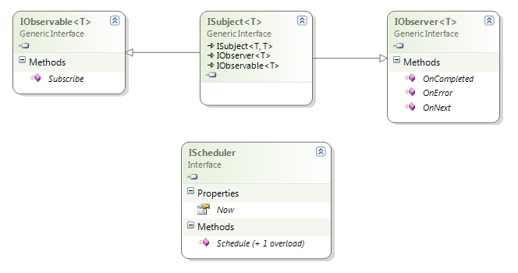
Rx Interfaces

Slide 8
Subscription Pipeline
var query = observable.Select(f); //build
var sub = query.Subscribe(handler); // subscribe
… handler.OnNext // receive
… handler.OnNext // data
… handler.OnNext
sub.Dispose(); // unsubscribe

Slide 9
Observable Events
First Class Objects
Disposable
Supports DI/IOC
Mockable

Slide 10
Composing with Events
demo

Slide 11

Cross the Streams?
https://rxmarbles.com/

Slide 12
Merge

Slide 13
Zip

Slide 14
Repeat

Slide 15
IO<T> TakeUntil(IO<T> source, IO<U> until)
IO<T>
IO<U>
IO<T>

Slide 16
Putting it all together
demo

Slide 17
Additional LINQ operators
Amb
Asynchronous
BufferWithCount
Catch
Concat
Defer
Delay
Do
Generate
Merge
OnErrorResumeNext
Repeat
Retry
Run
StartWith
Timeout

Slide 18





Flavors of Rx
Rx-Cpp
F#
Rx.RB
Rx.Py
Haskell - FRP
Rx-Perl
Reactive Scala/MongoDB
RxJava
RxPhp
RxJs

Slide 19






Common Uses

Slide 20
Resources
http://reactivex.io/
Source: https://github.com/dotnet/reactive
Paper.li: http://paper.li/jimwooley/1365169132
Free Ebook: http://www.introtorx.com/
RXJS: https://github.com/ReactiveX/rxjs
https://reaqtive.net/

Slide 21
Rx In Action Reactions? https://github.com/jwooley/RxSamples
Jim Wooley
www.ThinqLinq.com
Twitter: @JimWooley

