Slide 1

C# Source Generators
What, Why and How
Jim Wooley
Senior Principal,
Slalom

Slide 2
Metaprogramming Writing code that can generate, modify, or analyze other code. Instead of just solving problems directly, metaprograms operate on code itself—like a program that writes programs.
Code generation:
Reflection:
Macros:
Aspect oriented Attributes/Annotations:
Automatically producing source code based on templates or rules.
Inspecting and interacting with code structures (types, methods, etc.) at runtime.
Preprocessing code before compilation (common in languages like C or Lisp).
Adding metadata to code that can be used to influence behavior.

Slide 3
Metaprogramming in C#
Reflection:
Scripting:
Expression trees:
Attributes:
Enables runtime method invocation and property access.
Represent code as data structures for analysis or transformation.
Provide metadata that can be used by frameworks or tools.
Allows runtime inspection of types, methods, and properties.
These work at runtime. What if you want to generate code at compile time?

Slide 4

C# Source Generators: Compile-Time Metaprogramming
Introduced in C# 9 and .NET 5 that bring compile-time metaprogramming to the language.
Benefits
Run during development.
Increased runtime performance.
Generate new C# source files that are added to your project automatically.
Eliminate reflection.
Allow effective Ahead of Time (AOT) compilation and tree shaking.

Slide 5
Ahead of time compilation (AOT)
Improved Performance
Reduced Startup Time
Smaller deployment size through tree shaking
Requires no runtime evaluation/reflection.

Slide 6
Source Generators vs GenAI
 | C# Source Generators | Generative AI
Style | Deterministic | Non-Deterministic
Trigger | Runs during compilation and on related change | Runs on demand during code editing or via prompts
Purpose | Automate boilerplate code, improve performance | Assist with coding, debugging, learning, and productivity
Integration | Built into .NET ecosystem | IDE extensions (e.g., VS Code, Visual Studio, JetBrains)

Slide 7
LoggerMessage - .NET 6
public static partial class Log
{
[LoggerMessage(
EventId = 0,
Level = LogLevel.Critical,
Message = "Could not open socket to `{hostName}`")]
public static partial void CouldNotOpenSocket(ILogger logger, string hostName);
}
https://learn.microsoft.com/en-us/dotnet/core/extensions/logger-message-generator

Slide 8
GeneratedRegex - .NET 7
[GeneratedRegex(@"([\w\.\-]+)@([\w\-]+)((\.(\w){2,3})+)$",
RegexOptions.IgnoreCase, "en-US")]
private static partial Regex EmailRegex();
private static bool ValidateEmail(string text) => EmailRegex().IsMatch(text));
Method | Mean | Error | StdDev | Ratio
CompiledRegex | 86.92 ns | 0.572 ns | 0.447 ns | 1.00
SourceGenRegex | 57.81 ns | 0.860 ns | 0.805 ns | 0.66

Slide 9
System.Text.Json - .NET 8
[JsonSerializable(typeof(Person))]
internal partial class JsonContext : JsonSerializerContext
{ }
var person = new Person
{
FirstName = "Jim",
LastName = "Wooley”
};
var json = JsonSerializer.Serialize(person, JsonContext.Default.Person);
https://devblogs.microsoft.com/dotnet/performance-improvements-in-aspnet-core-8/

Slide 10
Blazor form validation - .Net 10
builder.Services.AddValidation();
[ValidatableType]
public class Order
{
public Customer Customer { get; set; } = new();
public List<OrderItem> OrderItems { get; set; } = [];
}
public class Customer
{
[Required(ErrorMessage = "Name is required.")]
public string? FullName { get; set; }
[Required(ErrorMessage = "Email is required.")]
public string? Email { get; set; }
public ShippingAddress ShippingAddress { get; set; } = new();
}
<DataAnnotationsValidator />

Slide 11
Third Party Source Generators
https://github.com/amis92/csharp-source-generators
Serialization
Json
Validation
Localization
Testing
Mocking
Patterns
Mediator
Command
Builder
Proxy
Visitor
Adapter
Dependency Injection
Console / CLI
Mappers
Communication
Graphics / Drawing
Enums
Functional Programming
Value
Immutability
Discriminated Unions
Domain Driven Design (DDD)
Metaprogramming
Webprogramming
Open Api
Razor / Blazor
XAML / WPF / Avalonia
INotifyPropertyChanged
MVVM
Database / ORM
Statically typed resources
configurations

Slide 12




Demo
Using Source Generators

Slide 13
Source Generator Design principals
Generators produce one or more strings that represent C# source code to be added to the compilation.
Explicitly additive only. Generators can add new source code to a compilation but may not modify existing user code.
Can produce diagnostics. When unable to generate source, the generator can inform the user of the problem.
May access additional files, that is, non-C# source texts.
Run un-ordered, each generator will see the same input compilation, with no access to files created by other source generators.
A user specifies the generators to run via list of assemblies, much like analyzers.

Slide 14
Building source generators
C# 9 / .Net 5
interface ISourceGenerator {
void Initialize(GeneratorInitializationContext context)
void Execute(GeneratorExecutionContext context)
}
C# 10 / .Net 6
interface IIncrementalGenerator {
void Initialize(IncrementalGeneratorInitializationContext context)
}

Slide 15

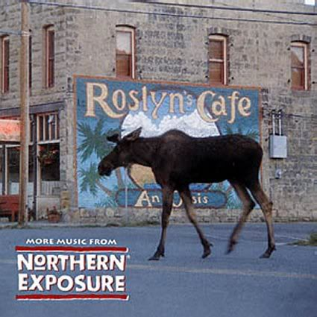
What is Roslyn?

Slide 16

Opening up the compiler
AST
AST
AST
CSC/VBC
IL

Slide 17
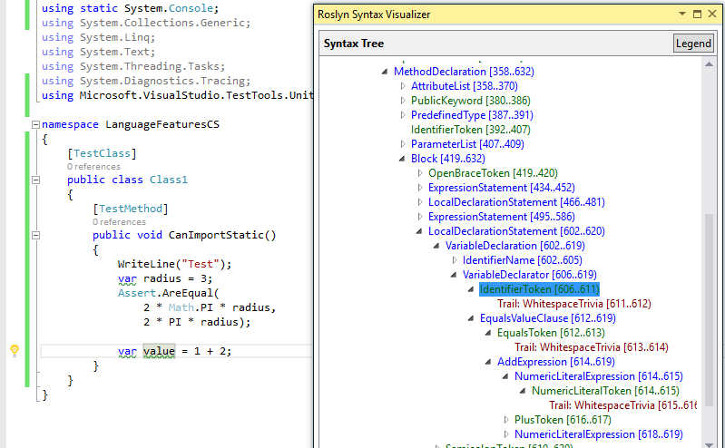
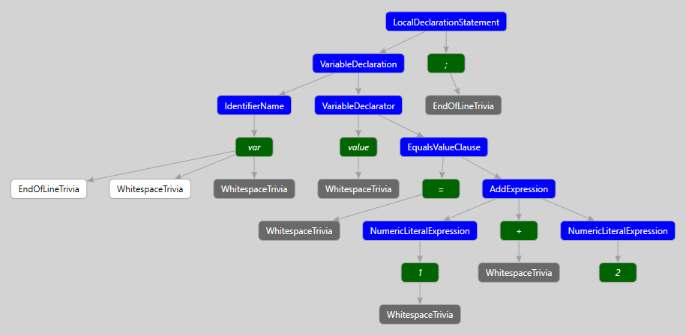
Undestanding Syntax
http://roslynquoter.azurewebsites.net/
ExpressionSyntax
SyntaxToken
SyntaxTrivia
var value = 1 + 2;
var equalsValue =
SyntaxFactory.EqualsValueClause(
SyntaxFactory.BinaryExpression(
SyntaxKind.AddExpression,
SyntaxFactory.LiteralExpression(
SyntaxKind.NumericLiteralExpression, SyntaxFactory.Literal(1)),
SyntaxFactory.LiteralExpression(
SyntaxKind.NumericLiteralExpression,SyntaxFactory.Literal(2))
));
var typeSyntax =
SyntaxFactory.VariableDeclaration(
SyntaxFactory.ParseTypeName("var"),
new SeparatedSyntaxList<VariableDeclaratorSyntax>()
.Add(SyntaxFactory.VariableDeclarator(“value")
.WithInitializer(equalsValue)))
.NormalizeWhitespace(" ")
.WithAdditionalAnnotations(Formatter.Annotation);
var declaration = SyntaxFactory.LocalDeclarationStatement(typeSyntax);

Slide 18
Demo
CSV Generator

Slide 19
Meta programming
Reduce repetitive tasks
Eliminate dynamic/reflection
Enable AOT
https://github.com/amis92/csharp-source-generators

Slide 20
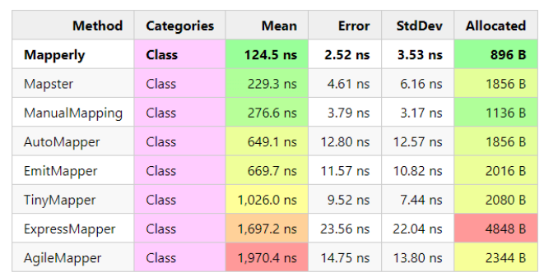
Runtime Performance Mapping
https://github.com/mjebrahimi/DotNet-Mappers-Benchmark

Slide 21
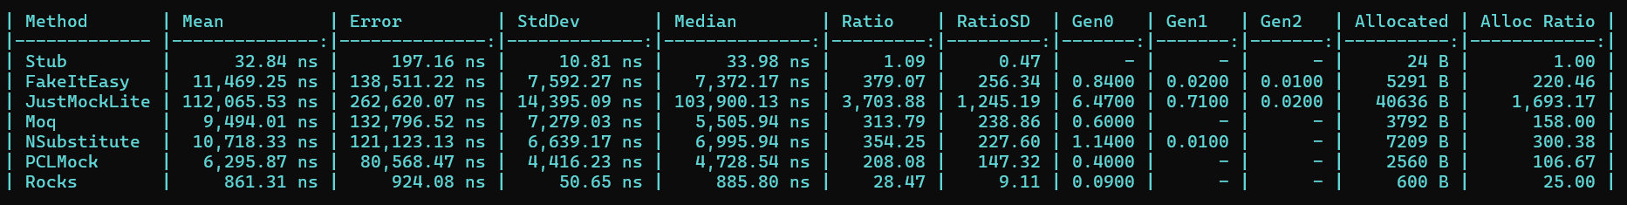
Runtime Performance Mocking
https://github.com/ecoAPM/BenchmarkMockNet

Slide 22

Source Generators
Docs https://docs.microsoft.com/en-us/dotnet/csharp/roslyn-sdk/source-generators-overview https://andrewlock.net/creating-a-source-generator-part-1-creating-an-incremental-source-generator/
Samples: https://github.com/dotnet/roslyn-sdk/tree/main/samples/CSharp/SourceGenerators https://github.com/amis92/csharp-source-generators
Cookbook: https://github.com/dotnet/roslyn/blob/main/docs/features/source-generators.cookbook.md https://github.com/dotnet/roslyn/blob/main/docs/features/incremental-generators.cookbook.md
Today’s Demo: https://github.com/jwooley/SourceGenerators

Slide 23
Roslyn Resources
Github: https://github.com/dotnet/roslyn
Language feature status: https://github.com/dotnet/roslyn/blob/master/docs/Language%20Feature%20Status.md
CSharpLang Proposals: https://github.com/dotnet/csharplang/tree/main/proposals
Dotnet: https://github.com/dotnet
https://github.com/dotnet/roslyn-sdk
https://github.com/jwooley/RoslynLabs

