Slide 1
NLP Team Project Final Presentation Predict Exchange-Rate with news articles
Team JJJ
Leader
20143592 최영재
20141261 송제웅

Slide 2
INDEX
1. Main Topic
2. Modified Factors
3. System Development
(1) Data Collection
(2) NLP Processing
(3) Machine Learning
4. Evaluation
5. Conclusion

Slide 3
1 Main Topic
Subject : Predict exchange rate by country according to period news
Detail :
The feelings of news by country, we predict the increase and decrease of exchange rates.
Assume:
If the news is positive, exchange rate will rise.
Notes:
코드 + 수집중인 사진 (주피터노트북)

Slide 4
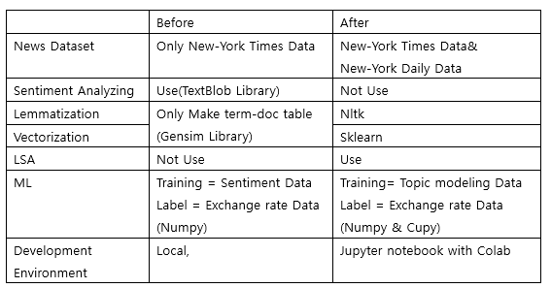
2 Modified Factors
Notes:
코드 + 수집중인 사진 (주피터노트북)

Slide 5
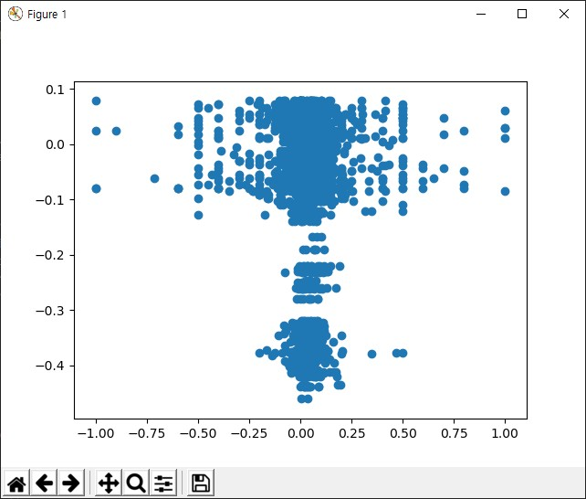
2 Modified Factors
Notes:
코드 + 수집중인 사진 (주피터노트북)

Slide 6
2 Modified Factors
Notes:
코드 + 수집중인 사진 (주피터노트북)

Slide 7
3 System Development
(1) Data Collection
(2) NLP Processing
(3) Machine Learning
Notes:
코드 + 수집중인 사진 (주피터노트북)

Slide 8
3-(1) Data Collection
The news articles by (period, country)
Where? New-York Times, New-York Daily News
Quantity? 3 years per each country, bind by week
How? Using “BeautifulSoup”, according to change URL
Periodic Exchange Rate
Where? Woori Bank
Quantity? 3 years per each country, bind by week
How? Using “Selenium”, for dynamic web crawling
Notes:
코드 + 수집중인 사진 (주피터노트북)

Slide 9
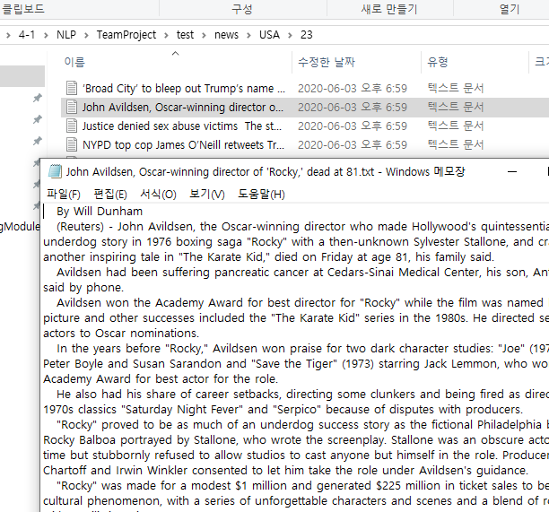
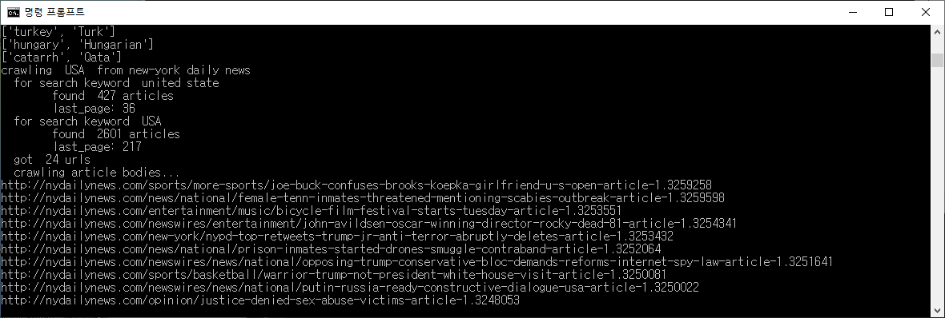
3-(1) Data Collection
Notes:
여기가 matrix 생겨먹은거

Slide 10
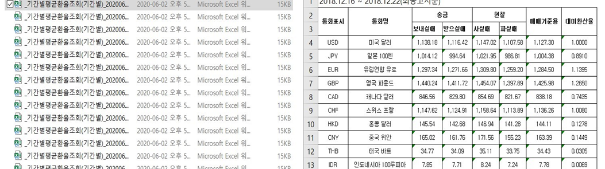
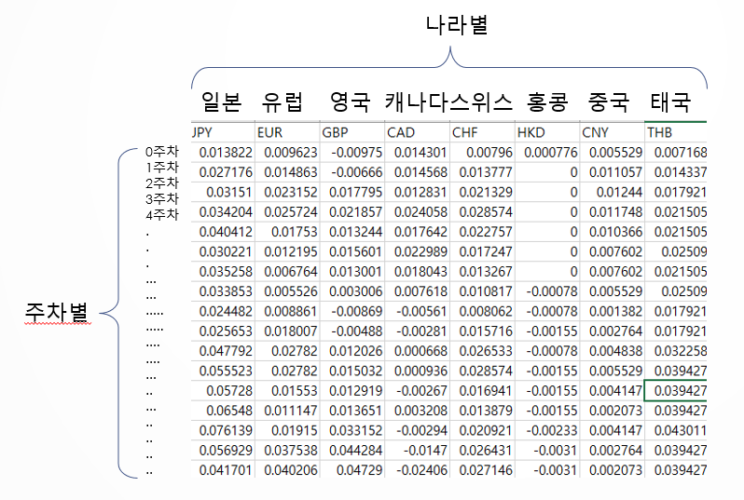
3-(1) Data Collection
Notes:
코드 + 수집중인 사진 (주피터노트북)

Slide 11
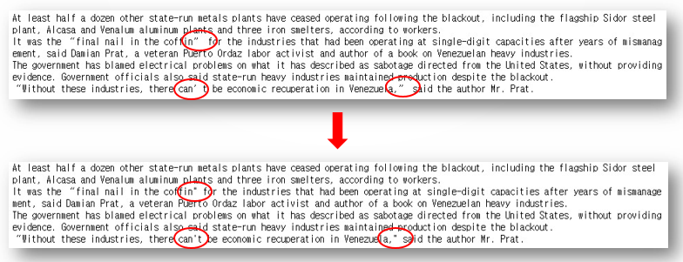
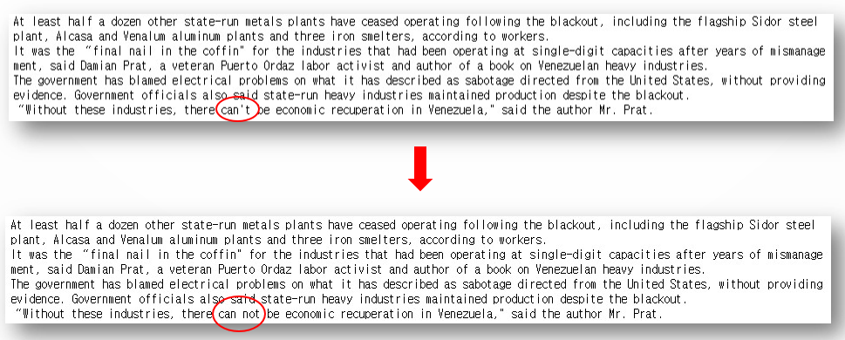
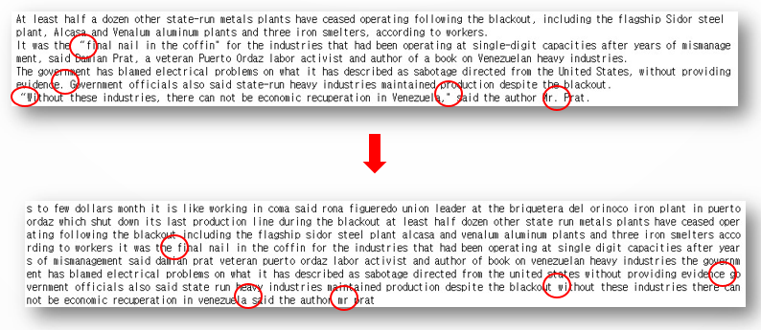
3-(2) NLP Processing
Pre Processing
Notes:
코드 + 수집중인 사진 (주피터노트북)

Slide 12
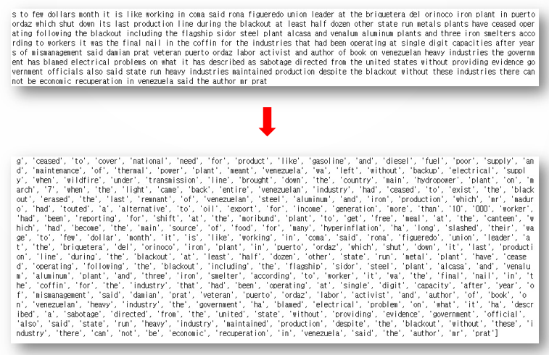
3-(2) NLP Processing
Stemming & Lemmatization
Notes:
코드 + 수집중인 사진 (주피터노트북)

Slide 13
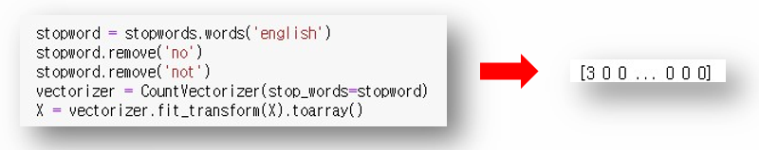
3-(2) NLP Processing
Removing Stop Words & Vectorization
Notes:
코드 + 수집중인 사진 (주피터노트북)

Slide 14
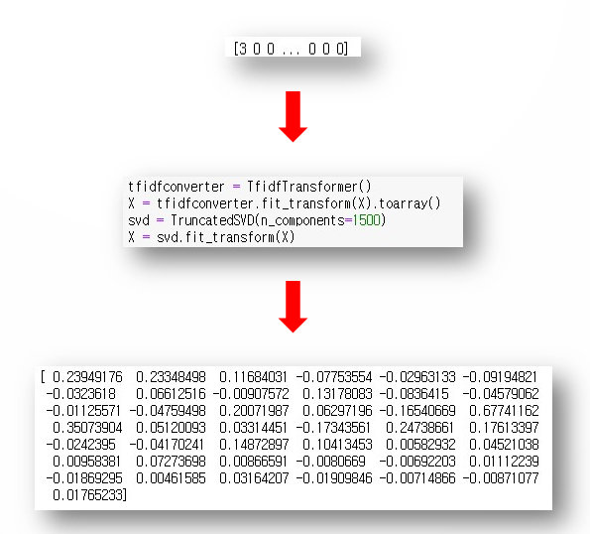
3-(2) NLP Processing
Topic Modeling with LSA using SVD
Notes:
코드 + 수집중인 사진 (주피터노트북)

Slide 15
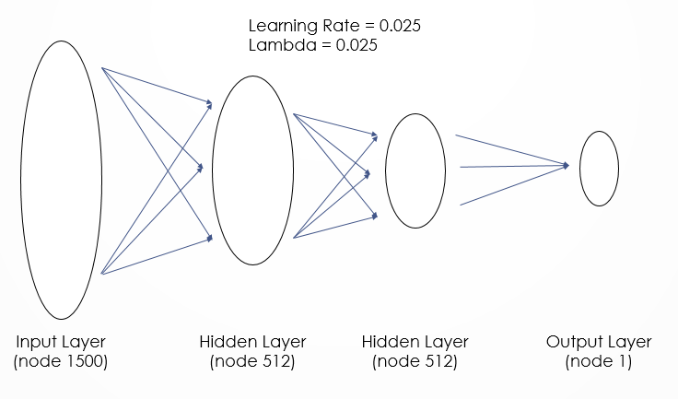
3-(3) Machine Learning
Model Design
Fully-Connected
Input Layer : 1500
Hidden Layer 1 : 512
Hidden Layer 2 : 512
Output Layer : 1
(binary classification)
Notes:
코드 + 수집중인 사진 (주피터노트북)

Slide 16
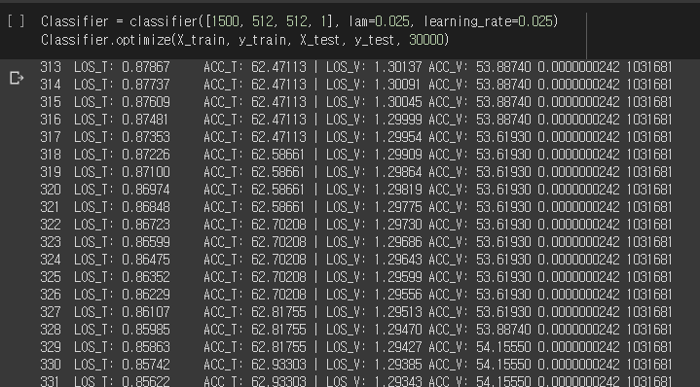
3-(3) Machine Learning
Model Training
Notes:
코드 + 수집중인 사진 (주피터노트북)

Slide 17
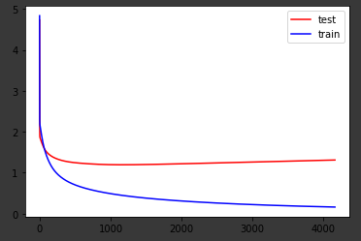
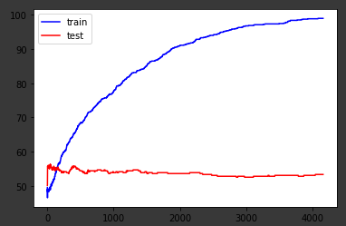
3-(3) Machine Learning
Training Results
Loss
Accuracy
Notes:
코드 + 수집중인 사진 (주피터노트북)

Slide 18
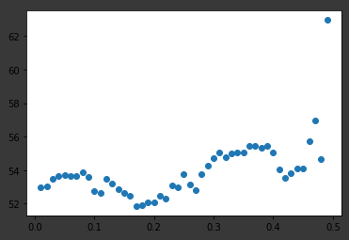
4 Evaluation
When should we invest?
0 : clearly negative
0.5 : ambiguous
1 : clearly positive
ambiguous
clear
Notes:
코드 + 수집중인 사진 (주피터노트북)

Slide 19
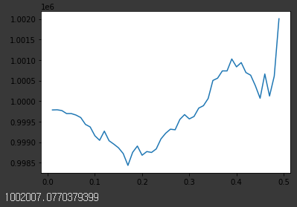
4 Evaluation
Simulating
1,000,000 won invested
If the prediction clearly positive,
model invests.
0.01% ~ 0.2007% revenue
ambiguous
clear
Notes:
코드 + 수집중인 사진 (주피터노트북)

Slide 20
5 Conclusion
Training Accuracy (100%) vs Testing Accuracy (53%)
-> the relationship is not Intuitive
But Testing Accuracy > 50%
-> there exists something...
-> smally dependent
Notes:
코드 + 수집중인 사진 (주피터노트북)

Slide 21
5 Conclusion
We Verified...
If the news is positive, exchange rate will rise.
We developed
The Investment Artificial Intelligence Model
Notes:
코드 + 수집중인 사진 (주피터노트북)

Slide 22
Thanks

