Slide 1


VectorAir
Fly Private with Your Network

Slide 2
Defining Customer Segmentation
Who is the Audience?
Demographics:
Psychographics:
35 – 55 yrs old
Male or Female
HHI between $200k and $550k
Owns home
Graduate degree
Lives in affluent area
Business owner, attorney, professional, etc.
Workaholic, but plays hard
Motivated to use by opportunity costs
Passion for friends and family
Free time spent at sporting events or country club
Would use service 2-3x per year

Slide 3

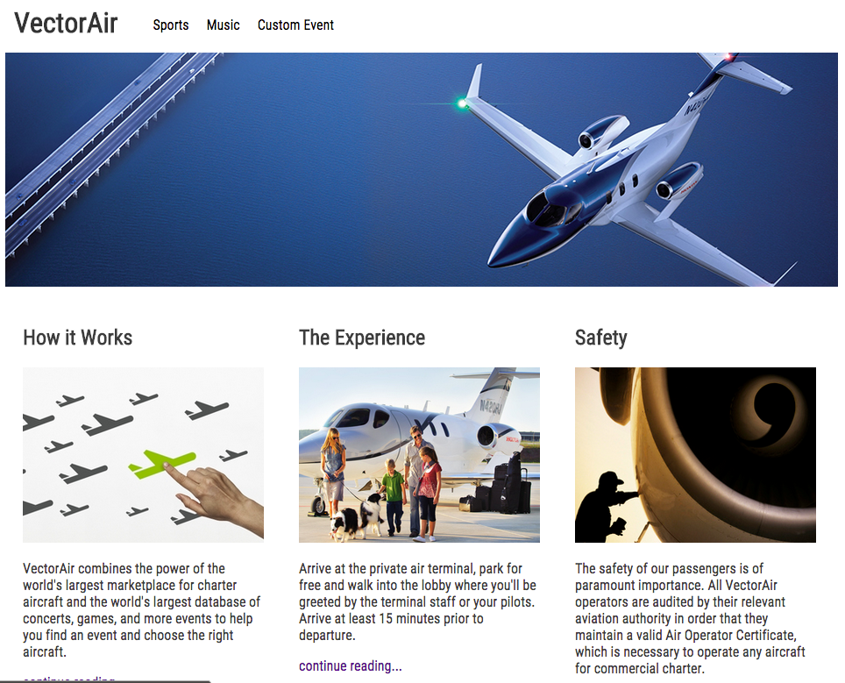
Website Tone
VectorAir.com
Extremely Easy
Professional
We’re selling a experience that should start when the user first visits the website. The website will be his or her first indication that this company is different.
The website will reflect the customers we seek to acquire. Refined and sophisticated with a flare for technology.
Fly Private...
With Your Network
Simplicity
No Jargon
The site will not have an overwhelming amount of information. In fact, I plan to reduce the initial information to just what is needed to persuade the user to click an action item.
Vector won’t use any industry jargon. The site will be designed for anybody to understand.

Slide 4
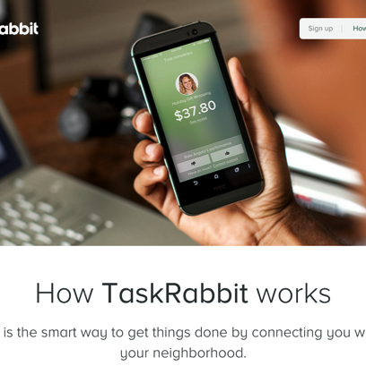
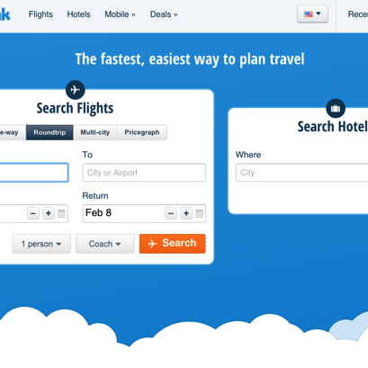
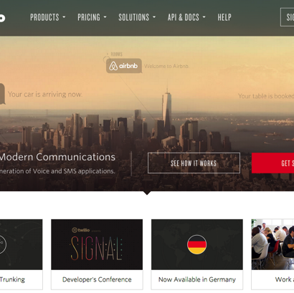

Inspiring Websites
extremly functional and sleek
Task Rabbit
HipMonk
Twilio
Google
Taskrabbit.com
Hipmonk.com
Twilio.com
Google.com
TaskRabbit is clean and was designed to support the company’s App. What I Like TaskRabbit is their ability to clearly explain their unique business model. Since my business model also unique, I really appreciate their efforts.
HipMonk attempts to create the ultimite user experince and provide valuable service. Everything is custom and intended to put a smile on their customers’ face. Even their 404 page has a daily joke.
This is a great example of a web design that contains a lot of information while providing a clean look and superior intuitive navitiaton.
With a simple homepage, Google also provides vast and deep amounts of inforamatino and extremely usefull information and tools behind the simplicity.

Slide 5
VectorAir Design
A clean and powerful design
Goals of the Website
This website should scream safistication and professionalism. The home page needs to be appealing to the disering eye and have a clear call to action. I want mimic the experience of flying on a private charter jet; an awesome experience that is flawless, unique, and gives the user/customer the “wow” factor. I also want this website to be representative of the aircraft that it uses; smart, clean and fun.
I am far from the final design, but I think I’m on the right path. While the homepage needs to be supurb with a unresistabel call-to-action, the backend of the website will be where most of the magic happens.
www.vectorair.com
Fly Private...
With Your Network

Slide 6
Stuggles with the Webpage
My biggest challenges
01
Design
02
Overcame
03
Developing
Typography
Image Sourcing
Floating
The Right Font Sizes
Concepts of UX
Clearing
The Right Color Scheme
Classes vs. IDs
Reset Feature
Unique Images
Semantics of CSS
Creating a Great UX
Classes vs. IDs

Slide 7
Takeaways from the Project
Typography
UX
I thought I understood font, but I am far from understanding the impact text has on the user for overall flow and readability of the website. I takes me a long time to choose the right typography. This is something I will definitely leave to an expert in the future.
Just designing the landing (index) page was a UX challenge. I have hundreds of pages yet to create. I think building the wireframes for the entire UX is ideal before continuing to build. Big takeaway!
Call-to-Action
After creating the site and seeing my wireframe come to life, I realized I was really missing the call-to-action I was really trying to achieve. Back to the drawing board or wireframes.
Style Guide
Before the site is officially built, I now understand the true importance creating and using a complete style guide before the site is built. A style guide will provide consistency and speed up the process in general.

Slide 8
VectorAir
Fly Private with Your Network
jplowman@vector.com
805.570.7439
www.vector.com

