Slide 1
Learn to GIT
Joseph Rauch
Lishi Mohapatra

Slide 2
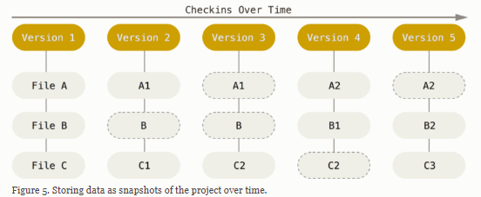
What is version control and why use it?
A version control system records changes to a file or set of files so you can recall specific versions later.
While often used for code, can be used for any file type. Meaning you can also track changes in your posters, presentations, and figures, then recall past versions if need be.
The log of file changes is similar to an experimentalist’s lab book. It tracks how the project has progressed (in terms of the code at least) and allows you to more easily track problems or go back to previous version of working code.

Slide 3
What is version control and why use it?
A version control system records changes to a file or set of files so you can recall specific versions later.
While often used for code, can be used for any file type. Meaning you can also track changes in your posters, presentations, and figures, then recall past versions if need be.
The log of file changes is similar to an experimentalist’s lab book. It tracks how the project has progressed (in terms of the code at least) and allows you to more easily track problems or go back to previous version of working code.
A distributed version control system also allows you to more easily collaborate with others on a project.
In addition, a distributed version control system can also serve as a backup in case something happens to your computer and you lose your data.

Slide 4
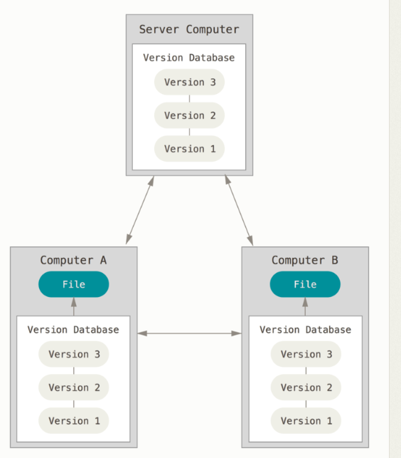
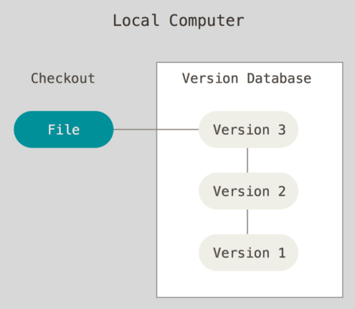
Solo work vs collaborations
Local version control
Distributed version control

Slide 5
Installing GIT
For mac and Windows, you can find installers at: http://git-scm.com/download
Configure GIT
The git config command in terminal allows you to configure git from the command line. Alternatively, you can open the .gitconfig file in your home directory and edit the configuration there.
git config --global user.name “John Smith”
git config --global user.email johnsmith@email.com
git config --global core.editor vim ‘C:/Program Files (x86)/Vim/vim74/vim.exe’
git config --list

Slide 6
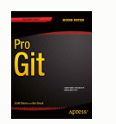
Help with GIT
The git documentation page: https://git-scm.com/doc
The reference manual is the official comprehensive document for all of git.
The Pro Book is a great place to get started and what this presentation was modeled on.
There are also videos, cheat sheets, and external links.
The help command used from the terminal. This is nice because it works offline.
git help <command> gives the full documentations for the command.
git <command> -h gives a short reference for available options.
Google ☺

Slide 7

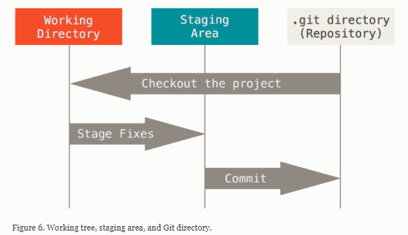
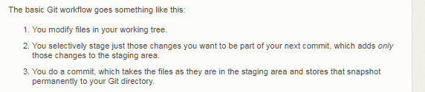
Local work!

Slide 8
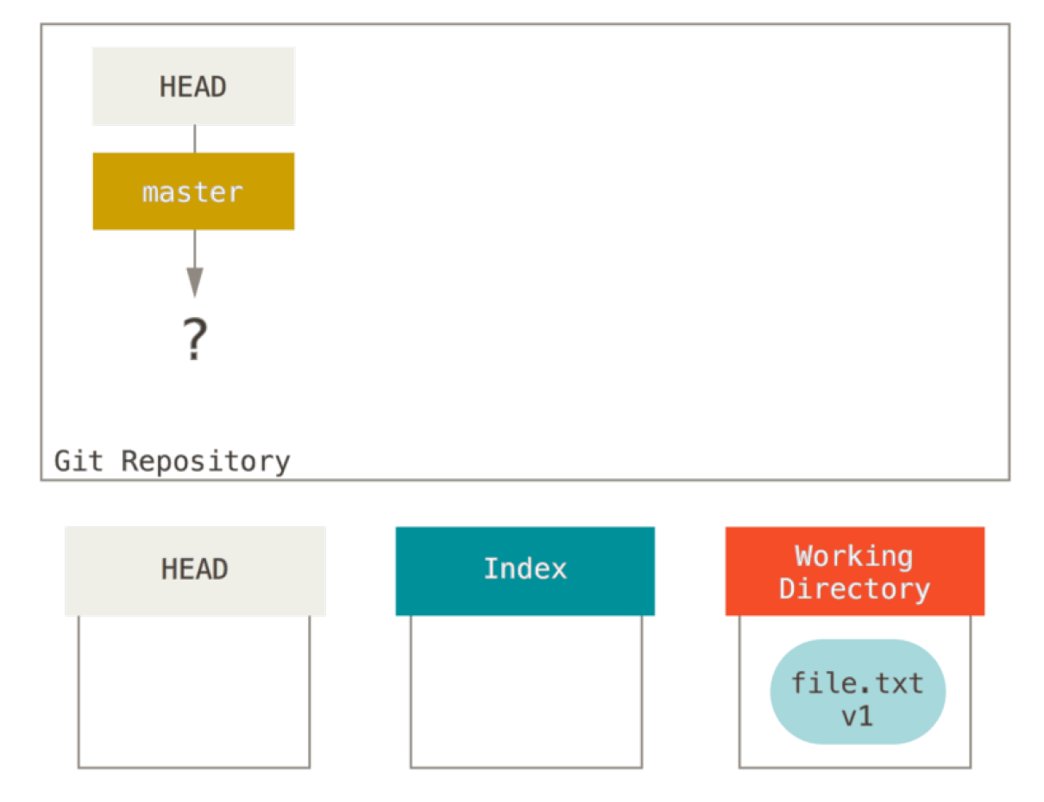
Start a project…
git init
git add <file>
git commit (-m “message” -v -a )
git status
git rm (-f)
git mv <file from> <file to>
Notes:
Make a new directory.
Write a short matlab script. Save it.
Initialize a git repository.
Mention not good practice to nest repos.
Mention configuring username and email.
Add the script to the repository.
Talk about tracked and untracked files.
Add a fake data file to the directory, but don’t track it.
Commit the addition/initial commit.
Talk about the –m option
Introduce git status
Run git status right after commit.
Make changes to the script.
Run git status again.
Add the script to staged area.
Run git status again.
Commit changes.
Talk about the lifecycle of the status of files.
Talk about good committing practices.
Committing completed code (break code into small chunks and commit each separately)
Commit in the imperative, telling what the code will do after the commit not what you’ve done.
Introduce a .gitignore file
Blank lines and lines starting with # are ignored
Standard glob patterns work (look at documentation for more information)

Slide 9
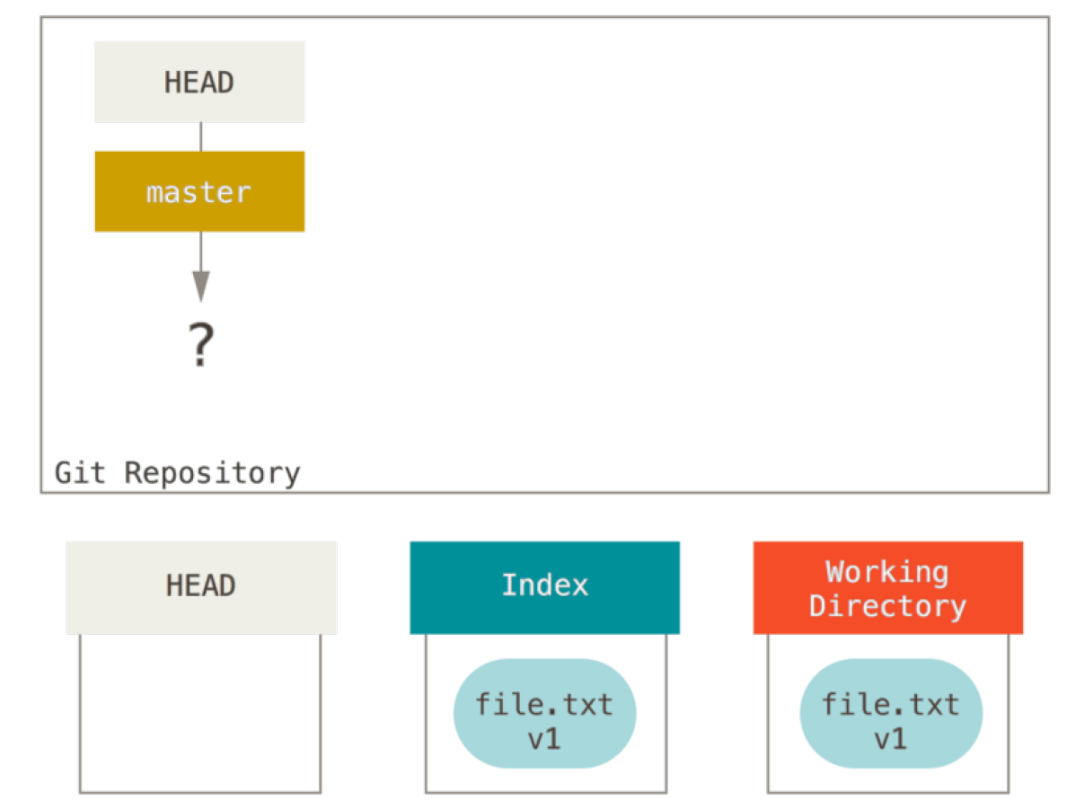
Start a project…
git init
git add <file>
git commit (-m “message” -v -a )
git status
git rm (-f)
git mv <file from> <file to>
Notes:
Make a new directory.
Write a short matlab script. Save it.
Initialize a git repository.
Mention not good practice to nest repos.
Mention configuring username and email.
Add the script to the repository.
Talk about tracked and untracked files.
Add a fake data file to the directory, but don’t track it.
Commit the addition/initial commit.
Talk about the –m option
Introduce git status
Run git status right after commit.
Make changes to the script.
Run git status again.
Add the script to staged area.
Run git status again.
Commit changes.
Talk about the lifecycle of the status of files.
Talk about good committing practices.
Committing completed code (break code into small chunks and commit each separately)
Commit in the imperative, telling what the code will do after the commit not what you’ve done.
Introduce a .gitignore file
Blank lines and lines starting with # are ignored
Standard glob patterns work (look at documentation for more information)

Slide 10
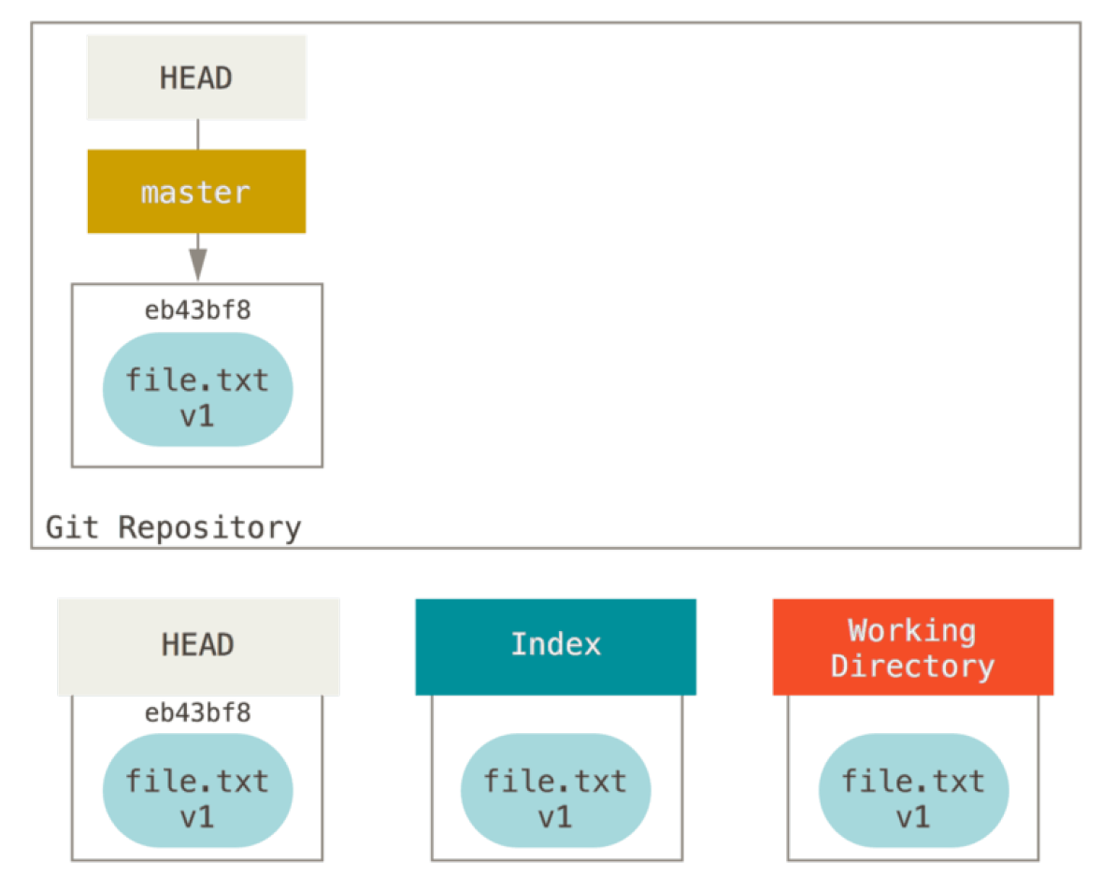
Start a project…
git init
git add <file>
git commit (-m “message” -v -a )
git status
git rm (-f)
git mv <file from> <file to>
Notes:
Make a new directory.
Write a short matlab script. Save it.
Initialize a git repository.
Mention not good practice to nest repos.
Mention configuring username and email.
Add the script to the repository.
Talk about tracked and untracked files.
Add a fake data file to the directory, but don’t track it.
Commit the addition/initial commit.
Talk about the –m option
Introduce git status
Run git status right after commit.
Make changes to the script.
Run git status again.
Add the script to staged area.
Run git status again.
Commit changes.
Talk about the lifecycle of the status of files.
Talk about good committing practices.
Committing completed code (break code into small chunks and commit each separately)
Commit in the imperative, telling what the code will do after the commit not what you’ve done.
Introduce a .gitignore file
Blank lines and lines starting with # are ignored
Standard glob patterns work (look at documentation for more information)

Slide 11
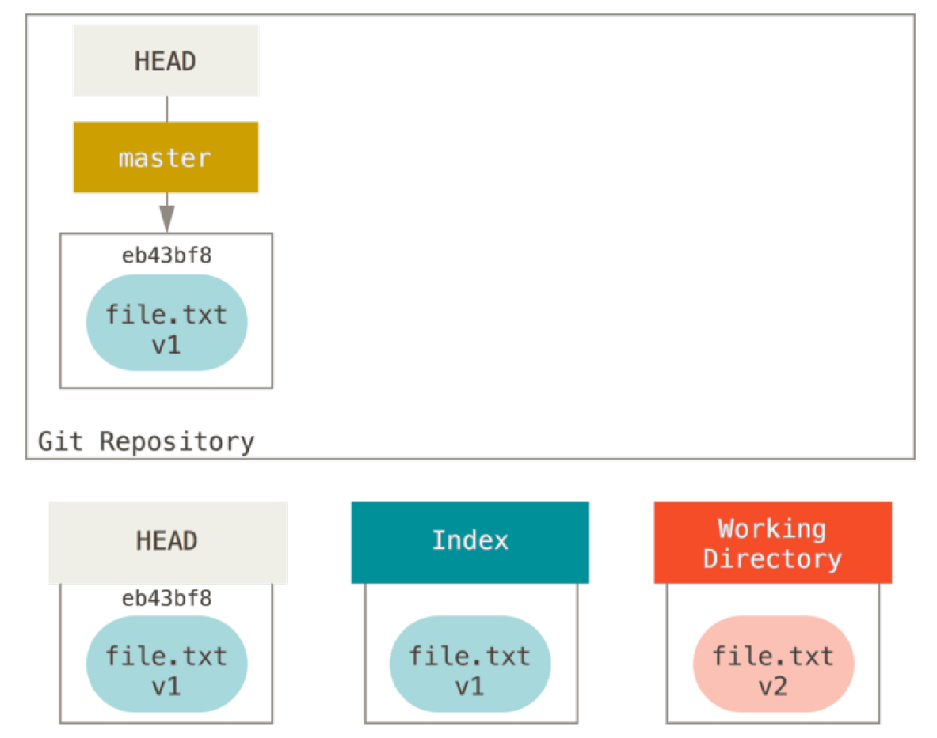
Start a project…
git init
git add <file>
git commit (-m “message” -v -a )
git status
git rm (-f)
git mv <file from> <file to>
Edit file
Notes:
Make a new directory.
Write a short matlab script. Save it.
Initialize a git repository.
Mention not good practice to nest repos.
Mention configuring username and email.
Add the script to the repository.
Talk about tracked and untracked files.
Add a fake data file to the directory, but don’t track it.
Commit the addition/initial commit.
Talk about the –m option
Introduce git status
Run git status right after commit.
Make changes to the script.
Run git status again.
Add the script to staged area.
Run git status again.
Commit changes.
Talk about the lifecycle of the status of files.
Talk about good committing practices.
Committing completed code (break code into small chunks and commit each separately)
Commit in the imperative, telling what the code will do after the commit not what you’ve done.
Introduce a .gitignore file
Blank lines and lines starting with # are ignored
Standard glob patterns work (look at documentation for more information)

Slide 12
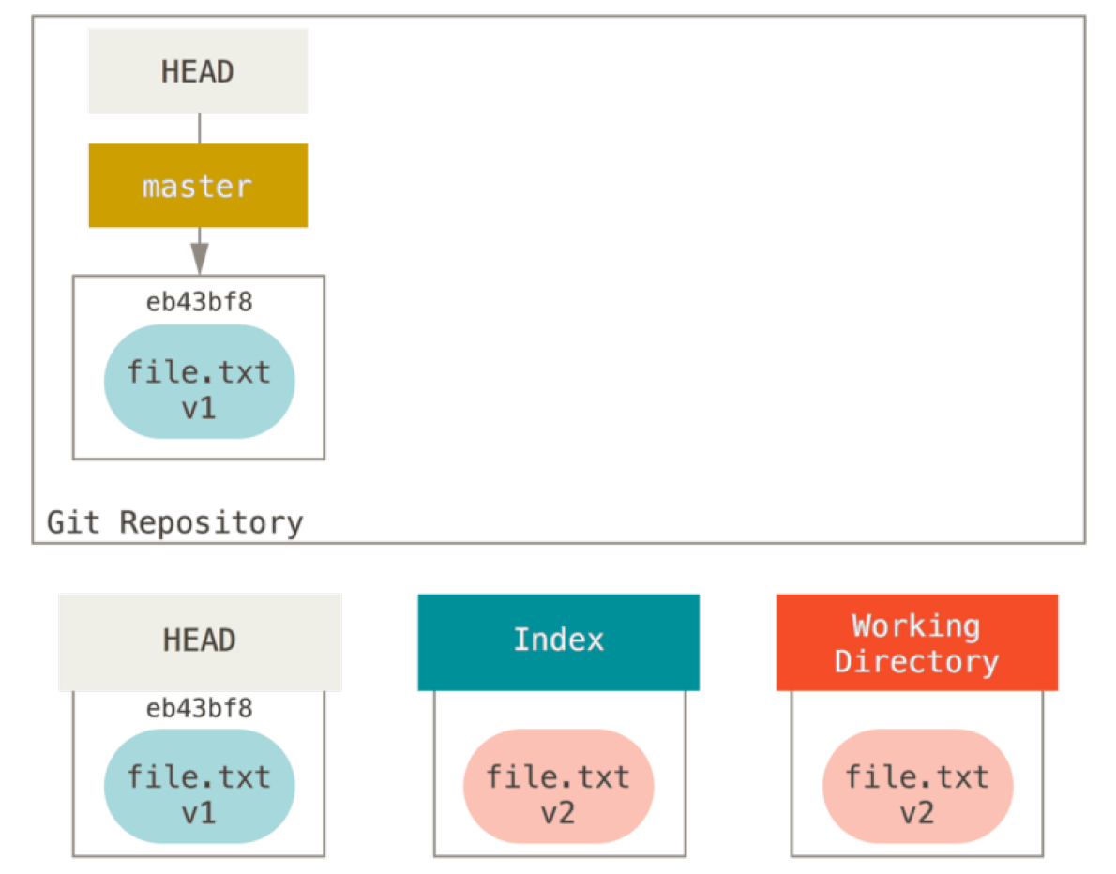
Start a project…
git init
git add <file>
git commit (-m “message” -v -a )
git status
git rm (-f)
git mv <file from> <file to>
Notes:
Make a new directory.
Write a short matlab script. Save it.
Initialize a git repository.
Mention not good practice to nest repos.
Mention configuring username and email.
Add the script to the repository.
Talk about tracked and untracked files.
Add a fake data file to the directory, but don’t track it.
Commit the addition/initial commit.
Talk about the –m option
Introduce git status
Run git status right after commit.
Make changes to the script.
Run git status again.
Add the script to staged area.
Run git status again.
Commit changes.
Talk about the lifecycle of the status of files.
Talk about good committing practices.
Committing completed code (break code into small chunks and commit each separately)
Commit in the imperative, telling what the code will do after the commit not what you’ve done.
Introduce a .gitignore file
Blank lines and lines starting with # are ignored
Standard glob patterns work (look at documentation for more information)

Slide 13
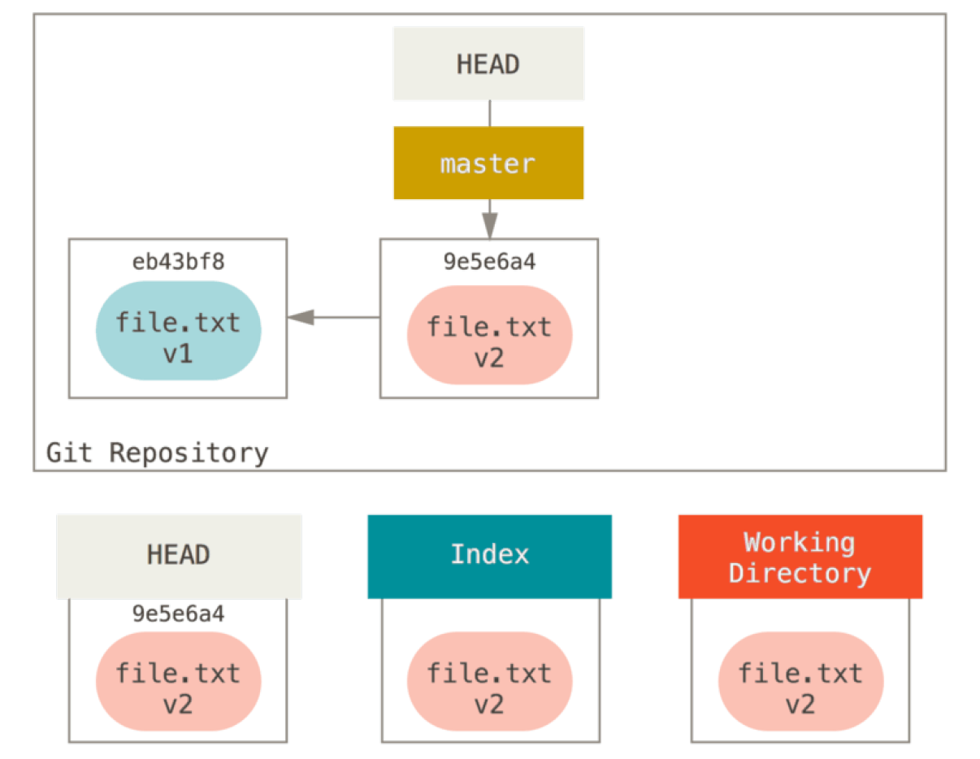
Start a project…
git init
git add <file>
git commit (-m “message” -v -a )
git status
git rm (-f)
git mv <file from> <file to>
Notes:
Make a new directory.
Write a short matlab script. Save it.
Initialize a git repository.
Mention not good practice to nest repos.
Mention configuring username and email.
Add the script to the repository.
Talk about tracked and untracked files.
Add a fake data file to the directory, but don’t track it.
Commit the addition/initial commit.
Talk about the –m option
Introduce git status
Run git status right after commit.
Make changes to the script.
Run git status again.
Add the script to staged area.
Run git status again.
Commit changes.
Talk about the lifecycle of the status of files.
Talk about good committing practices.
Committing completed code (break code into small chunks and commit each separately)
Commit in the imperative, telling what the code will do after the commit not what you’ve done.
Introduce a .gitignore file
Blank lines and lines starting with # are ignored
Standard glob patterns work (look at documentation for more information)

Slide 14
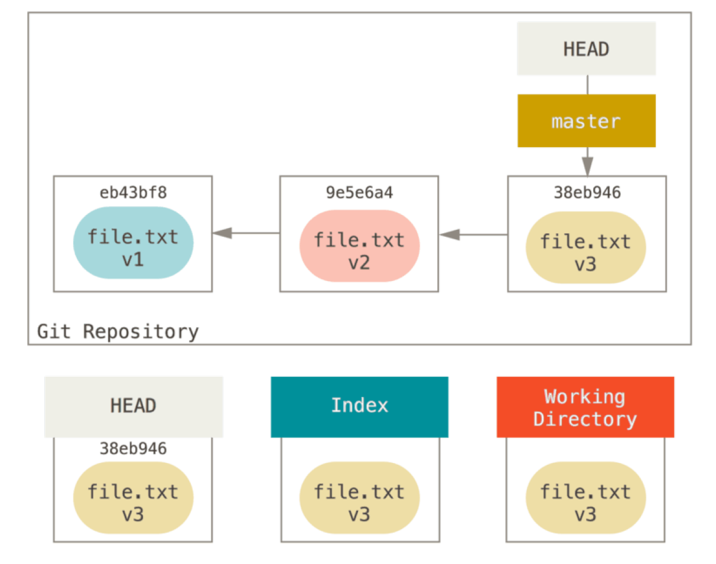
Start a project…
git init
git add <file>
git commit (-m “message” -v -a )
git status
git rm (-f)
git mv <file from> <file to>
Notes:
Make a new directory.
Write a short matlab script. Save it.
Initialize a git repository.
Mention not good practice to nest repos.
Mention configuring username and email.
Add the script to the repository.
Talk about tracked and untracked files.
Add a fake data file to the directory, but don’t track it.
Commit the addition/initial commit.
Talk about the –m option
Introduce git status
Run git status right after commit.
Make changes to the script.
Run git status again.
Add the script to staged area.
Run git status again.
Commit changes.
Talk about the lifecycle of the status of files.
Talk about good committing practices.
Committing completed code (break code into small chunks and commit each separately)
Commit in the imperative, telling what the code will do after the commit not what you’ve done.
Introduce a .gitignore file
Blank lines and lines starting with # are ignored
Standard glob patterns work (look at documentation for more information)

Slide 15
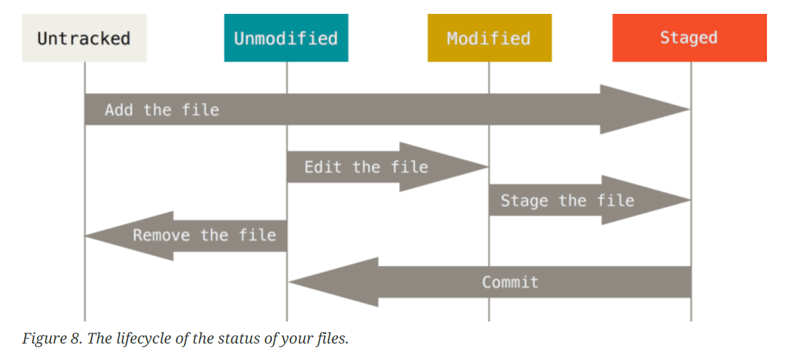
Start a project…
git init
git add <file>
git commit (-m “message” -v -a )
git status
git rm (-f)
git mv <file from> <file to>
Notes:
Make a new directory.
Write a short matlab script. Save it.
Initialize a git repository.
Mention not good practice to nest repos.
Mention configuring username and email.
Add the script to the repository.
Talk about tracked and untracked files.
Add a fake data file to the directory, but don’t track it.
Commit the addition/initial commit.
Talk about the –m option
Introduce git status
Run git status right after commit.
Make changes to the script.
Run git status again.
Add the script to staged area.
Run git status again.
Commit changes.
Talk about the lifecycle of the status of files.
Talk about good committing practices.
Committing completed code (break code into small chunks and commit each separately)
Commit in the imperative, telling what the code will do after the commit not what you’ve done.
Commit in small digestible chunks. Commit often.
Start with a single line with a simple description, no more than 50 characters (I normally do 80). Then include a more detailed description below a separating line.
Introduce a .gitignore file
Blank lines and lines starting with # are ignored
Standard glob patterns work (look at documentation for more information)

Slide 16
View and undo your project…
git log (-p -<n> --since=<“date”> --until=<“date”> -pretty=oneline, short, full, fuller --graph --author=<“name”> --grep=<“pattern”>)
git commit --amend
git reset HEAD <file>
git checkout -- <file>
Notes:
We should talk about the git log options, as this is why good commit messages is so important! However, it can be hard to demonstrate this with a new repository that is so small.
A good example for amend here is committing and forgetting to add a file or something.
Reset removes a staged file from the staging area.
We can modify two files, but then realize we want to commit them separately.
Checkout -- undoes the uncommitted modifications.
Important to note that these changes are gone forever since they were never committed.

Slide 17
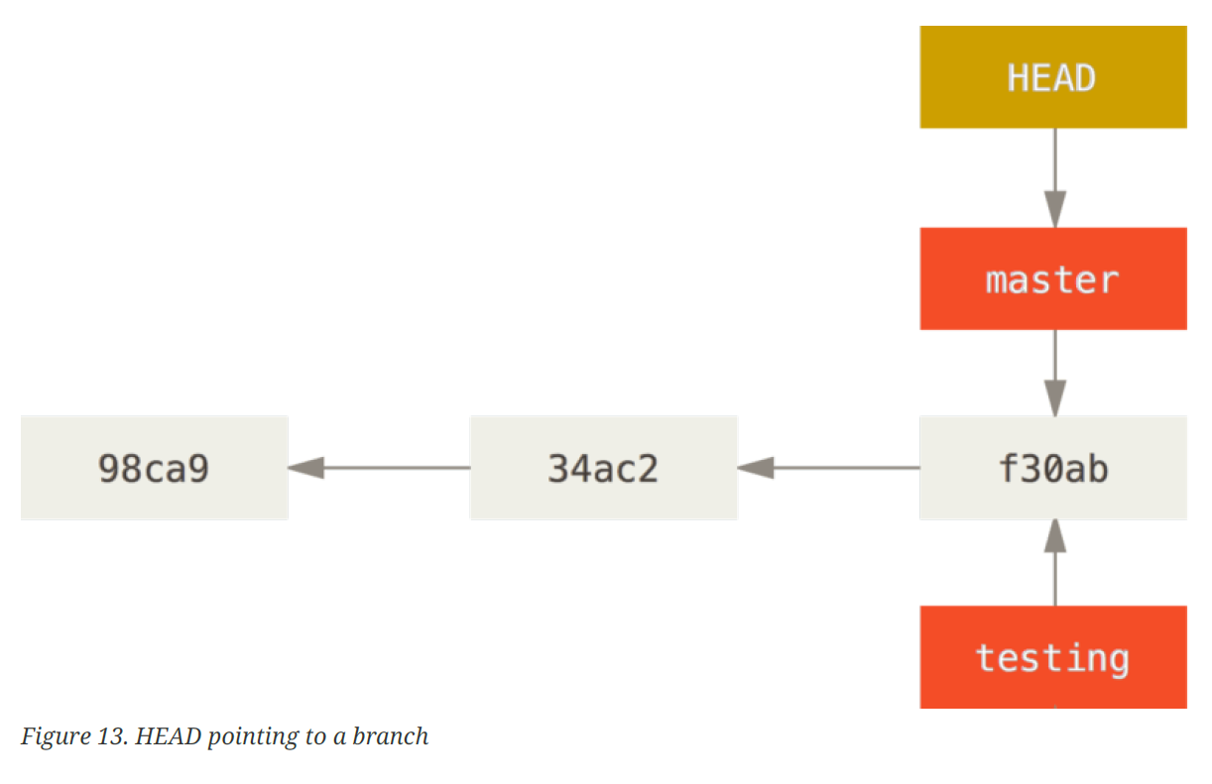
Branching…
git branch (-d -v) <name>
git checkout (-b) <branch name>
git stash
git merge <branch name>
git rebase <new base>
Notes:
Talk about good branching practices.
Branch often for testing and additions.
Git won’t let you switch branches without a clean working directory.
One option is to use git stash
Another option is to use commit amending
In the case of a merge conflict, you can use git status.
Show how to handle merge conflicts in a text based code file.
Show how Lishi and I handled merge coflicts with the presentation.

Slide 18
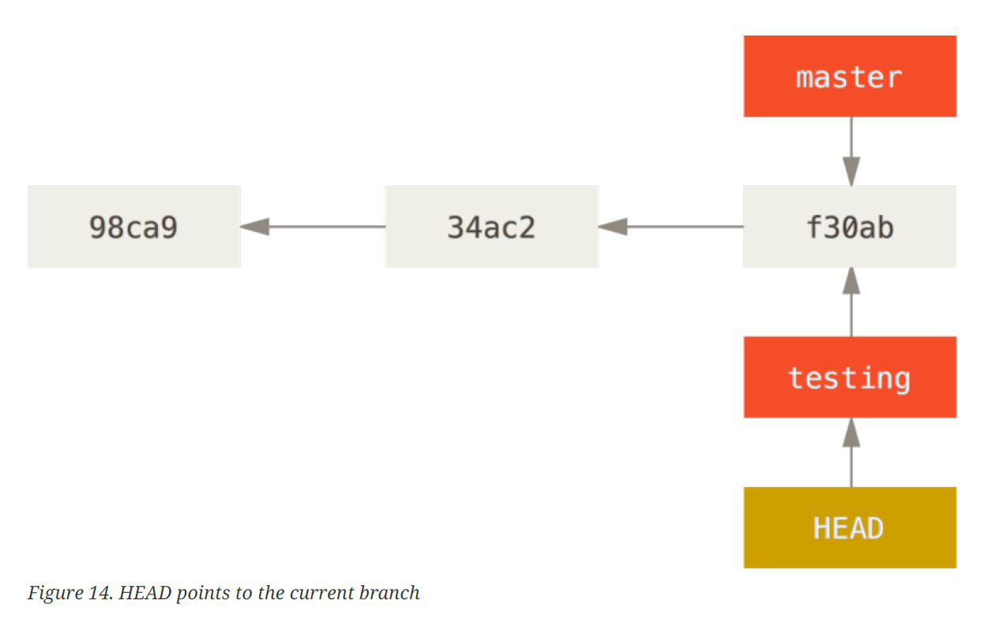
Branching…
git branch (-d -v) <name>
git checkout (-b) <branch name>
git stash
git merge <branch name>
git rebase <new base>
Notes:
Talk about good branching practices.
Branch often for testing and additions.
Git won’t let you switch branches without a clean working directory.
One option is to use git stash
Another option is to use commit amending
In the case of a merge conflict, you can use git status.
Show how to handle merge conflicts in a text based code file.
Show how Lishi and I handled merge coflicts with the presentation.

Slide 19
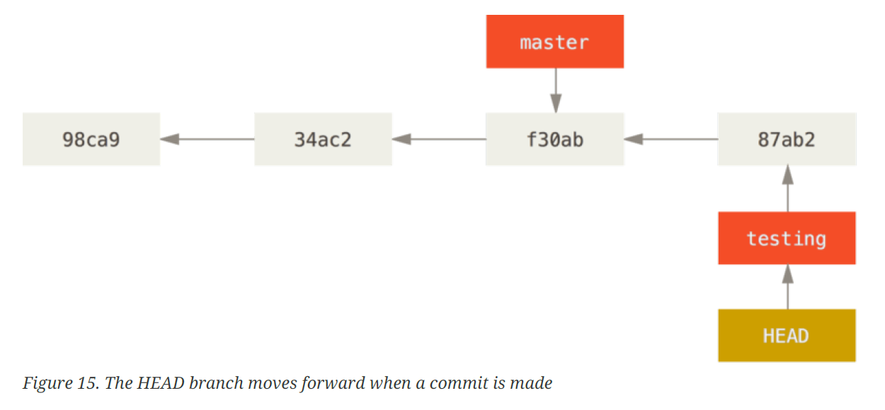
Branching…
git branch (-d -v) <name>
git checkout (-b) <branch name>
git stash
git merge <branch name>
git rebase <new base>
Notes:
Talk about good branching practices.
Branch often for testing and additions.
Git won’t let you switch branches without a clean working directory.
One option is to use git stash
Another option is to use commit amending
In the case of a merge conflict, you can use git status.
Show how to handle merge conflicts in a text based code file.
Show how Lishi and I handled merge coflicts with the presentation.

Slide 20
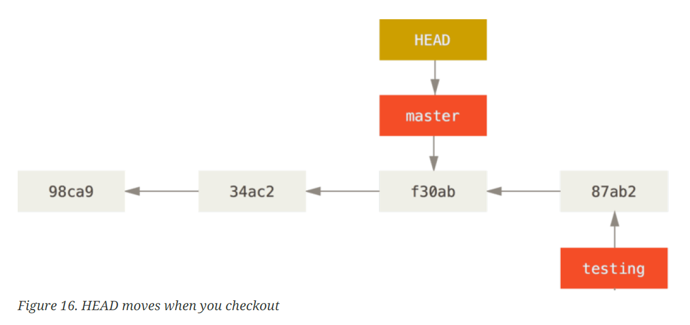
Branching…
git branch (-d -v) <name>
git checkout (-b) <branch name>
git stash
git merge <branch name>
git rebase <new base>
Notes:
Talk about good branching practices.
Branch often for testing and additions.
Git won’t let you switch branches without a clean working directory.
One option is to use git stash
Another option is to use commit amending
In the case of a merge conflict, you can use git status.
Show how to handle merge conflicts in a text based code file.
Show how Lishi and I handled merge coflicts with the presentation.

Slide 21
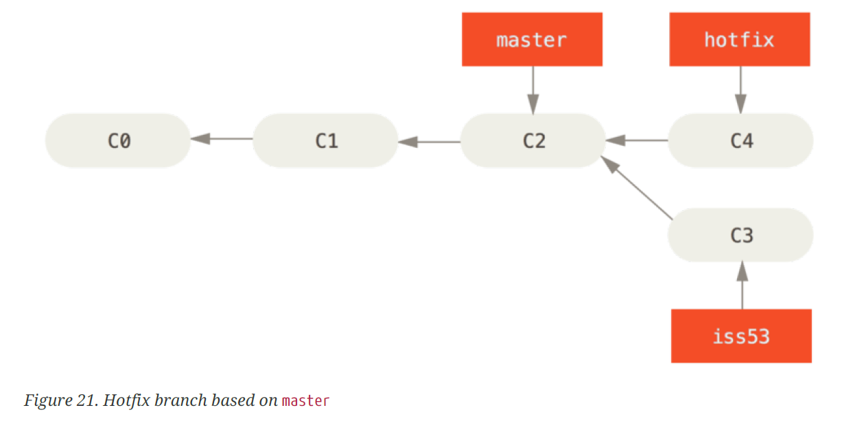
Branching…
git branch (-d -v) <name>
git checkout (-b) <branch name>
git stash
git merge <branch name>
git rebase <new base>
Notes:
Talk about good branching practices.
Branch often for testing and additions.
Git won’t let you switch branches without a clean working directory.
One option is to use git stash
Another option is to use commit amending
In the case of a merge conflict, you can use git status.
Show how to handle merge conflicts in a text based code file.
Show how Lishi and I handled merge coflicts with the presentation.

Slide 22
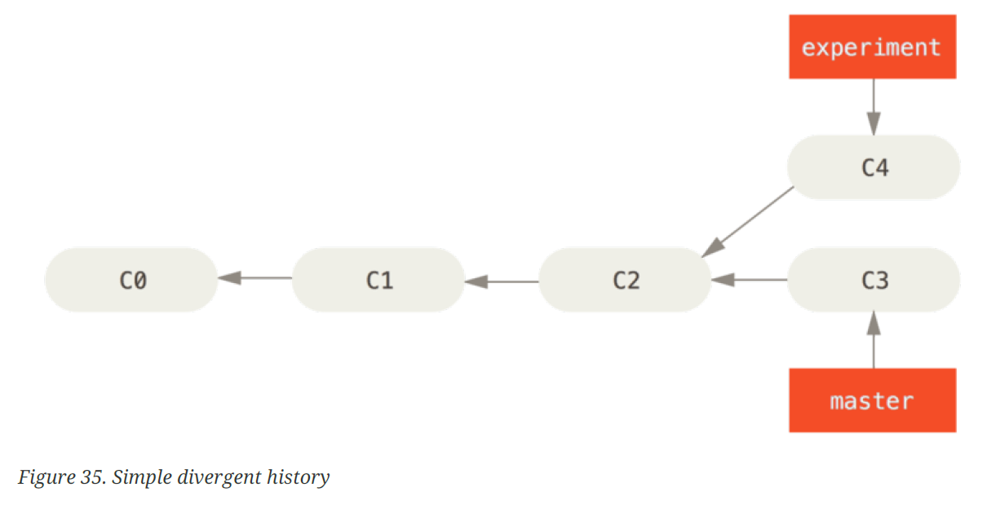
Branching…
git branch (-d -v) <name>
git checkout (-b) <branch name>
git stash
git merge <branch name>
git rebase <new base>
Notes:
Talk about good branching practices.
Branch often for testing and additions.
Git won’t let you switch branches without a clean working directory.
One option is to use git stash
Another option is to use commit amending
In the case of a merge conflict, you can use git status.
Show how to handle merge conflicts in a text based code file.
Show how Lishi and I handled merge coflicts with the presentation.

Slide 23
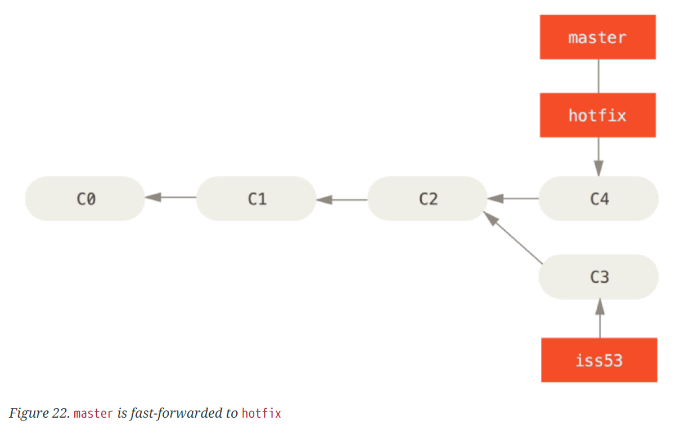
Branching…
git branch (-d -v) <name>
git checkout (-b) <branch name>
git stash
git merge <branch name>
git rebase <new base>
Notes:
Talk about good branching practices.
Branch often for testing and additions.
Git won’t let you switch branches without a clean working directory.
One option is to use git stash
Another option is to use commit amending
In the case of a merge conflict, you can use git status.
Show how to handle merge conflicts in a text based code file.
Show how Lishi and I handled merge coflicts with the presentation.

Slide 24
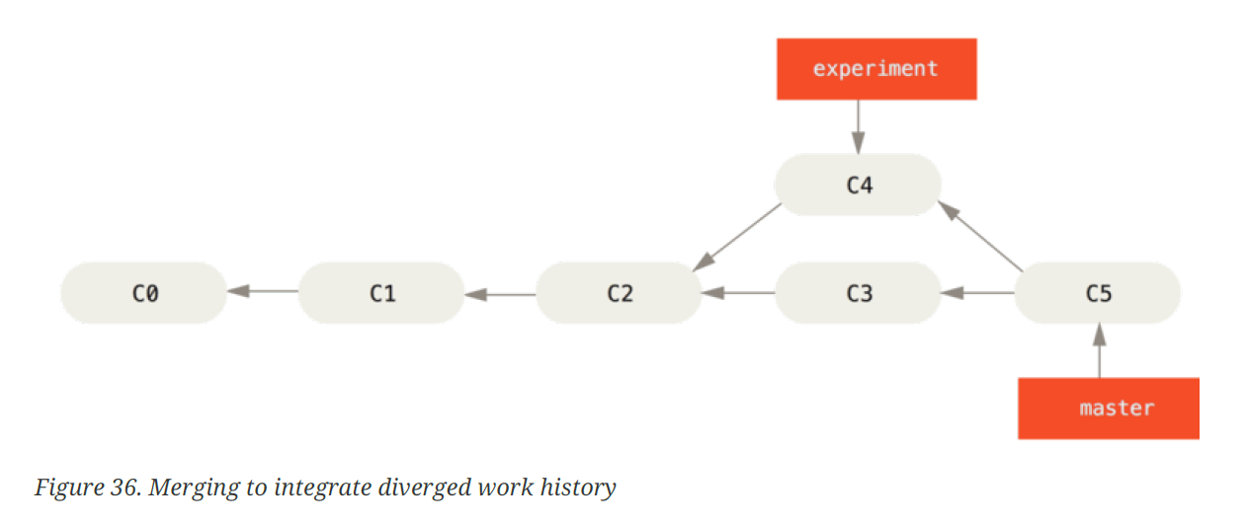
Branching…
git branch (-d -v) <name>
git checkout (-b) <branch name>
git stash
git merge <branch name>
git rebase <new base>
Notes:
Talk about good branching practices.
Branch often for testing and additions.
Git won’t let you switch branches without a clean working directory.
One option is to use git stash
Another option is to use commit amending
In the case of a merge conflict, you can use git status.
Show how to handle merge conflicts in a text based code file.
Show how Lishi and I handled merge coflicts with the presentation.

Slide 25
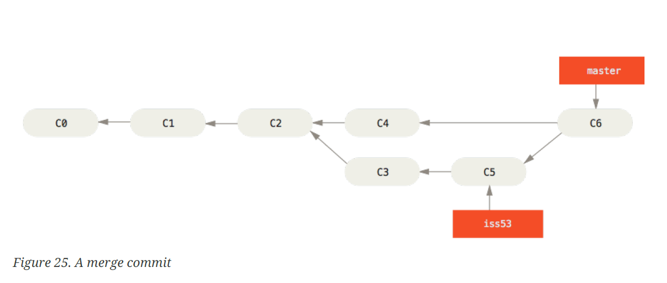
Branching…
git branch (-d -v) <name>
git checkout (-b) <branch name>
git stash
git merge <branch name>
git rebase <new base>
Notes:
Talk about good branching practices.
Branch often for testing and additions.
Git won’t let you switch branches without a clean working directory.
One option is to use git stash
Another option is to use commit amending
In the case of a merge conflict, you can use git status.
Show how to handle merge conflicts in a text based code file.
Show how Lishi and I handled merge coflicts with the presentation.

Slide 26
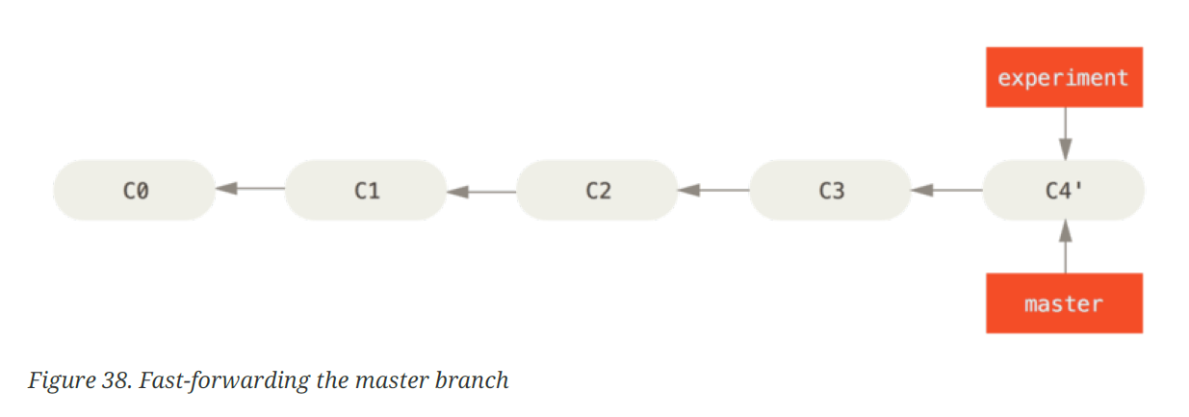
Branching…
git branch (-d -v) <name>
git checkout (-b) <branch name>
git stash
git merge <branch name>
git rebase <new base>
Notes:
Talk about good branching practices.
Branch often for testing and additions.
Git won’t let you switch branches without a clean working directory.
One option is to use git stash
Another option is to use commit amending
In the case of a merge conflict, you can use git status.
Show how to handle merge conflicts in a text based code file.
Show how Lishi and I handled merge coflicts with the presentation.

Slide 27
Set up github account

Slide 28
Create/add a project to github

Slide 29
Workflow with contributors
git push/pull
git branch
git remote

