Slide 1
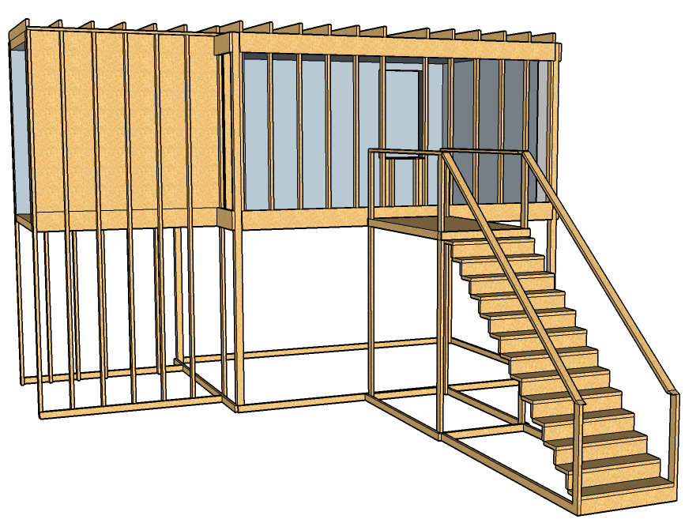
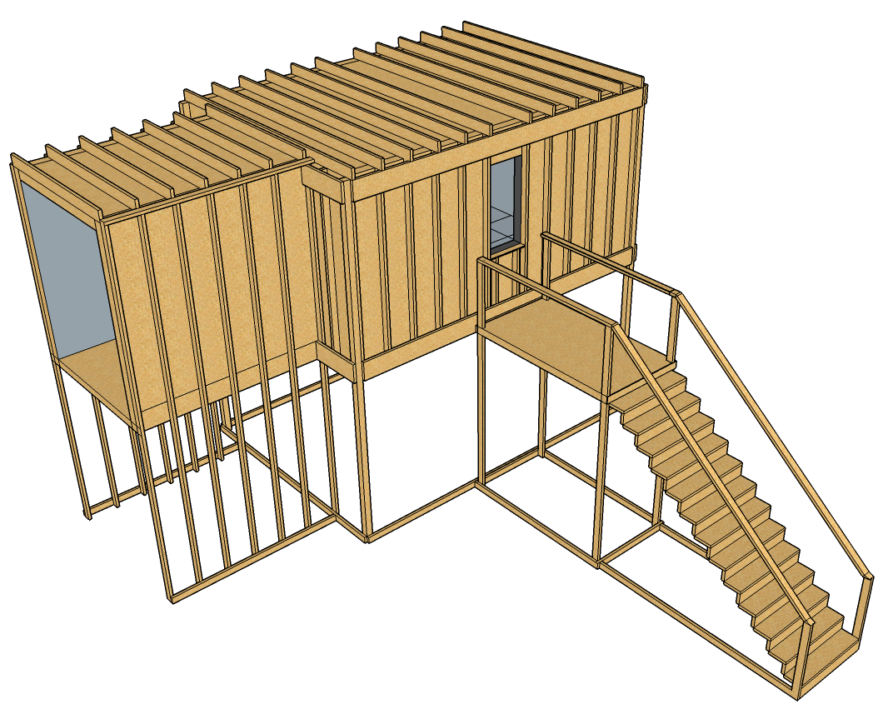
Exterior Attack
First Floor
4
3
2
1
1: Max Angle
2: Mid Ceiling
3: Min Angle: Ceiling
4: Min Angle: Wall

Slide 2
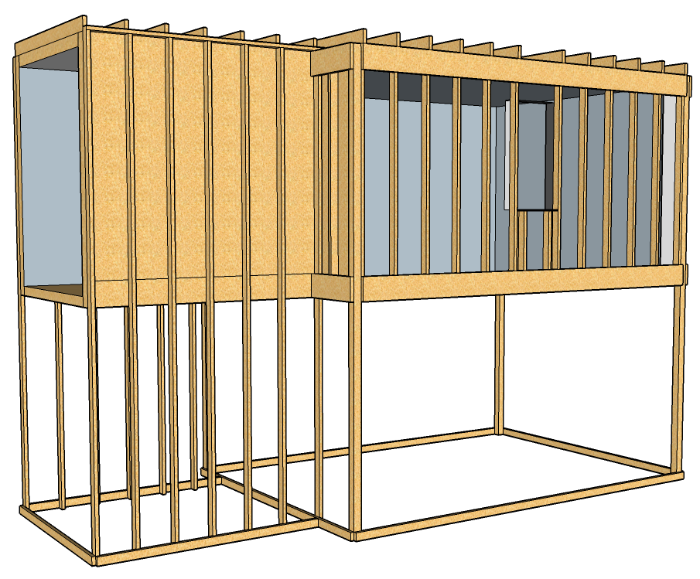
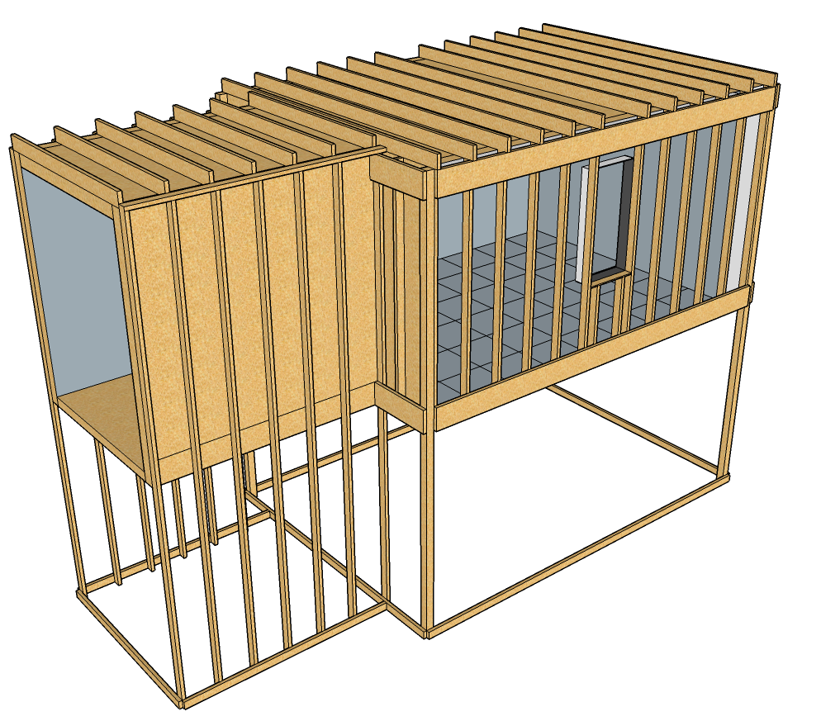
Exterior Attack
Second Floor
4
5
3
2
1
1: Max Angle
2: Mid Ceiling
3: Min Angle: Ceiling
4: Min Angle: Wall
5: Max Angle: Sill

Slide 3
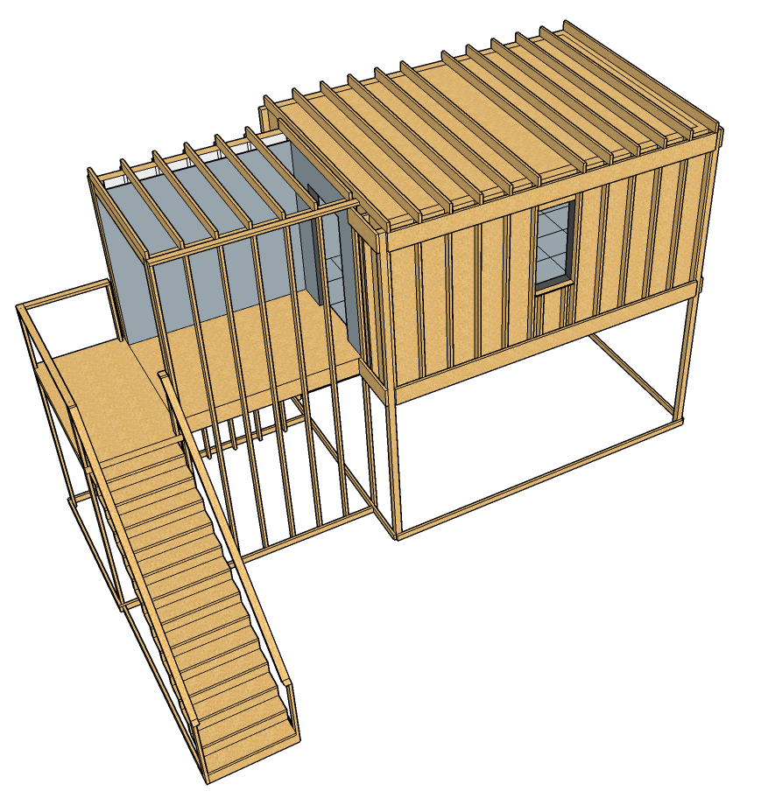
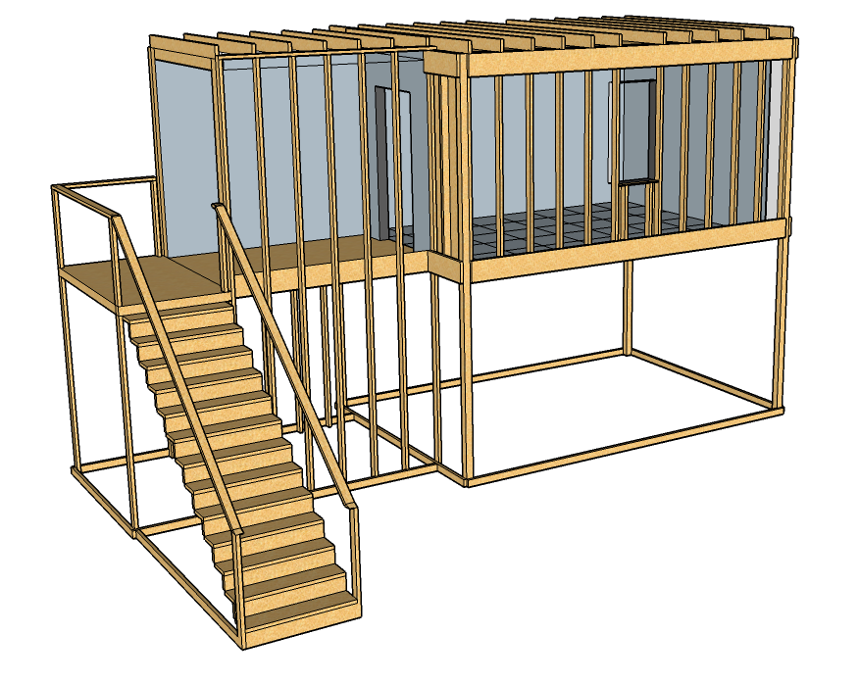
Interior Attack
3
2
1
4
1: Max Angle
2: Mid Ceiling
3: Min Angle: Ceiling
4: At Wall

