Slide 1
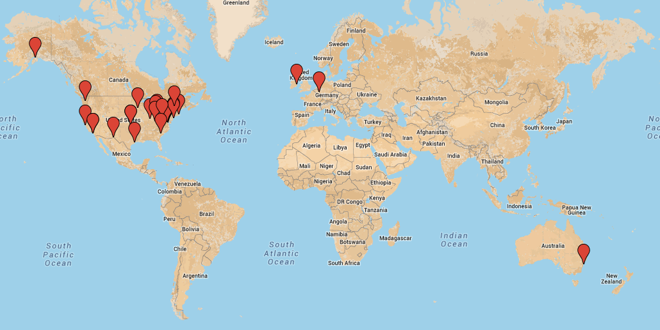

DHS2013 – Fire Attack Study: Technical Panel Member Locations

