Slide 1
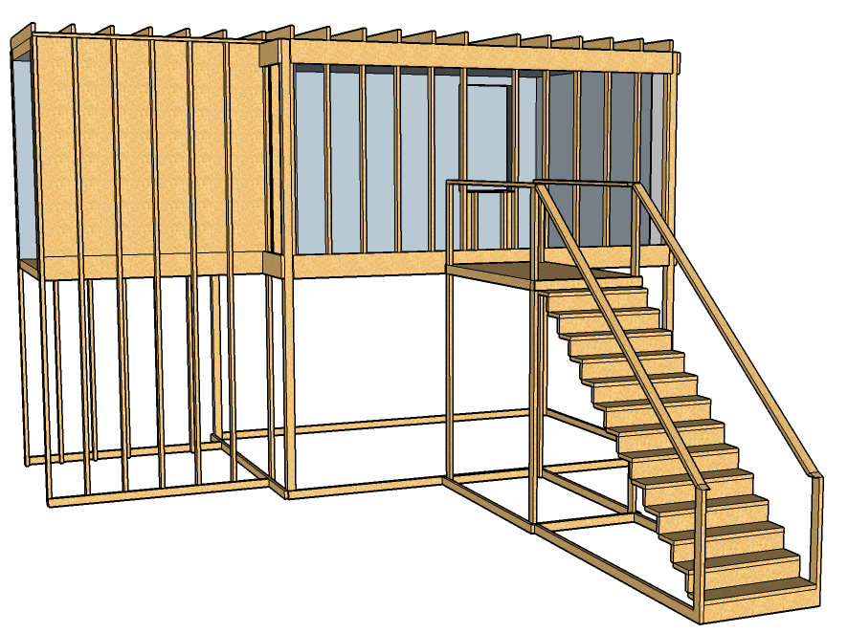
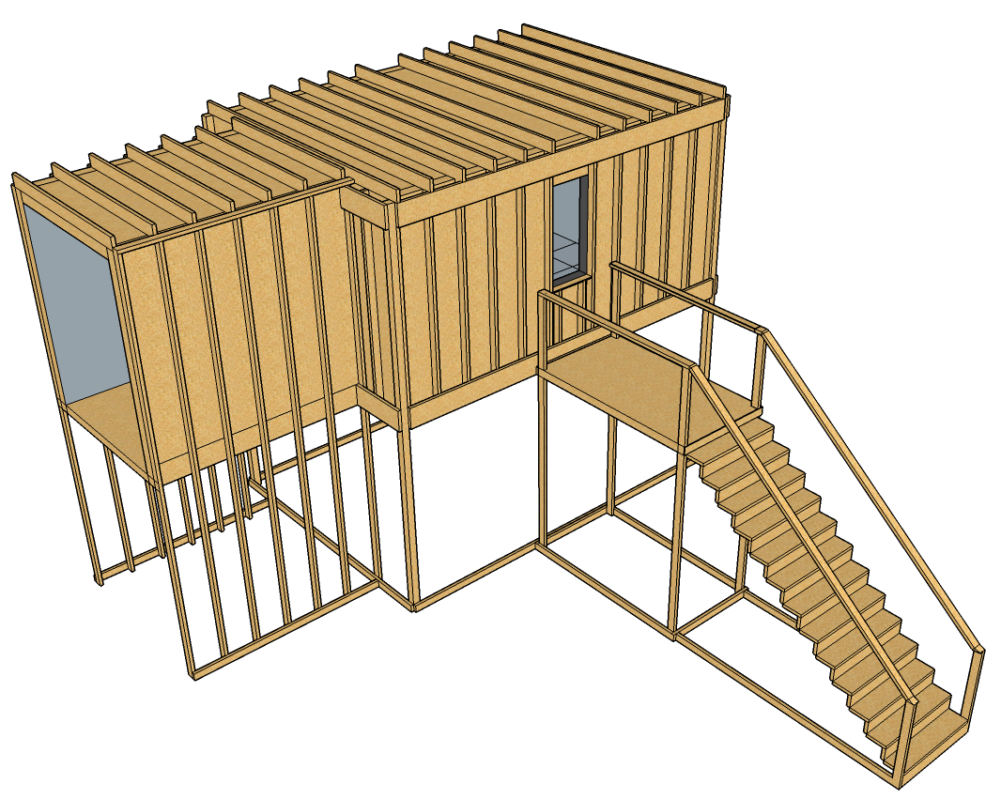
Exterior Attack
First Floor
4
5
3
2
1
1: Max Angle Ceiling
2: Mid Ceiling
3: Min Angle Ceiling
4: Max Angle Wall
5: At Wall

Slide 2
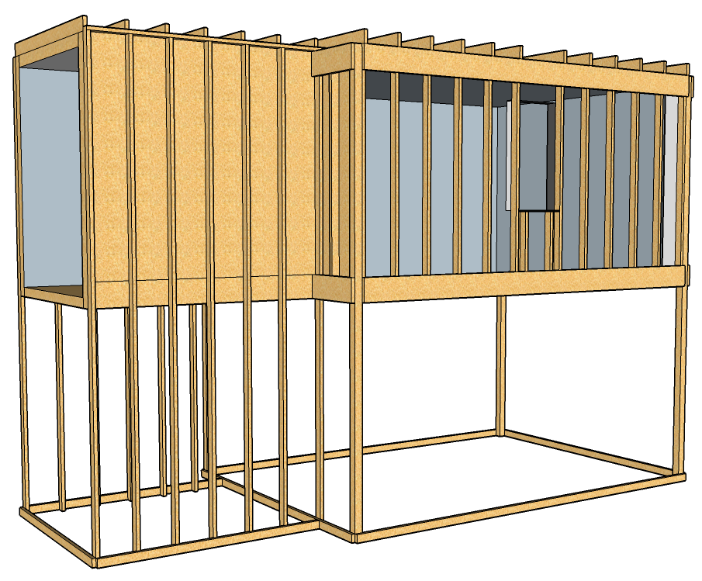
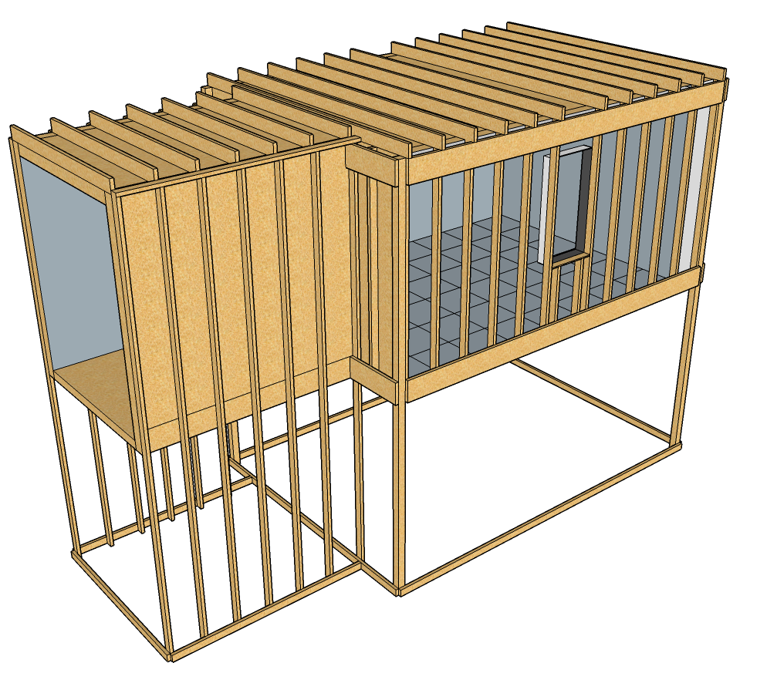
Exterior Attack
Second Floor
4
5
3
2
1
1: Max Angle Ceiling
2: Mid Ceiling
3: Min Angle Ceiling
4: Max Angle Wall
5: Soffit

Slide 3
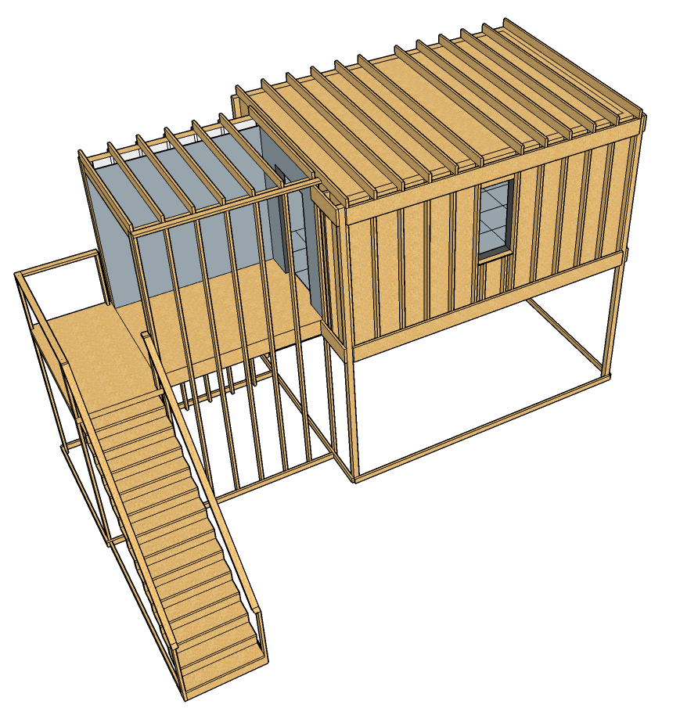
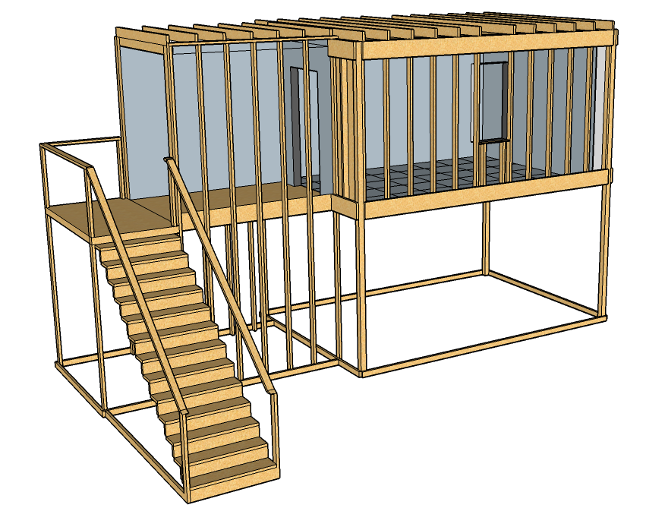
Interior Attack
2
1
3
1: Max Angle Ceiling
2: Mid Ceiling
3: At Wall

