Slide 1
CPMS Non-Identity Records
Evaluating a Lower Identity-Match Threshold
What we did, what we found, and what remains
Jira IDEN-43344 · Spike · PCIS Identity ART

Slide 2
The Problem We Set Out to Solve
CPMS party records are created off other filings and encounters, so today they cannot form a standalone identity.
1.1 million such records sit in 'non-identity' status. Many appear to be real people already in our system.
A scoring model compares each record to existing people; today it needs a very high score (0.98) to call it a match.
85% of these records fall just short — 'near matches' — so we are likely missing real matches (false negatives).
The question: should we lower the threshold so these records form identities — and what risk does that create?

Slide 3
Why the Records Get Stuck
The model needs strong ID numbers to be confident. On real CPMS data, those fields are mostly empty.
Field | Populated
Name (first / middle / last) | ~100%
Date of birth | ~100%
SSN | 20%
A-number | 23%
Fingerprint ID (FIN) | 6%
i94 | 0%
The consequence Two records for the same person agree on name and date of birth. With no A-number or SSN to confirm it, the score lands just under 0.98 — and a real match is missed.
Real — measured on production data; matches the prior Feature Analysis.

Slide 4
What We Did
Built a repeatable analysis in Databricks over three production snapshots — the party records, every scored match, and today's identities. Read-only; nothing written back.
Unpacked deeply nested source records and paired every model comparison so each row is one record-to-record match with its score.
Flagged what actually agrees on each pair (name, DOB, A-number, SSN) — so a strong match can be told from a weak one.
Added identity-level checks to catch wrongful merges, and a data-quality pass for placeholder values.
Designed to sweep every threshold from 0.98 to 0.90 and output tables, charts, and an Excel workbook.

Slide 5
What We Test & Measure
Thresholds: 0.98 (today) down to 0.90 (floor). Operating point under review: 0.94.
Recall (the gain) — of the true matches that exist, how many we recover.
Precision (the risk) — of the matches we accept, how many are actually correct.
Over-merge — whether lowering the bar wrongly fuses separate people into one identity.
Name+DOB-only break-even — where matches resting on name and DOB alone stop producing errors.

Slide 6
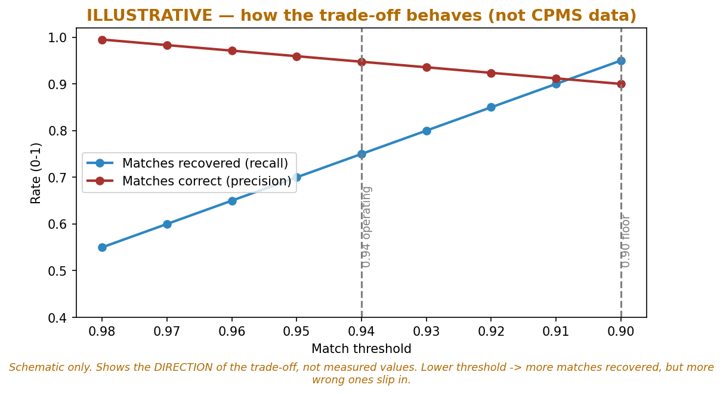
How the Trade-off Behaves
Two lines pull in opposite directions. Blue (recall) = how many real matches we catch — rises as we lower the bar. Red (precision) = how many accepted matches are correct — falls as we lower the bar. You can't maximize both; the threshold picks the balance.
Illustrative schematic — direction of the trade-off, not measured CPMS values.

Slide 7
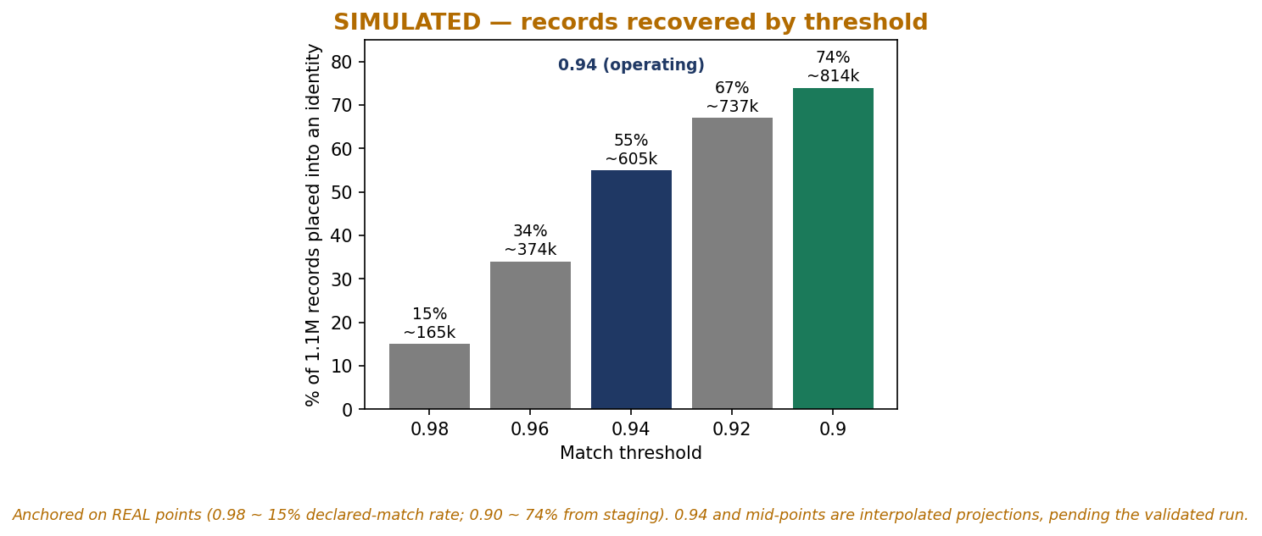
Projected Recovery by Threshold
Each bar = how many of the 1.1M stuck records would be reunited with a person at that threshold. Lower threshold → more recovered (0.98: ~165k → 0.90: ~814k). This shows only the upside; the risk of wrong merges is on the next slides.
Simulated projection anchored on real points (0.98 and 0.90). Middle values pending the validated run.

Slide 8
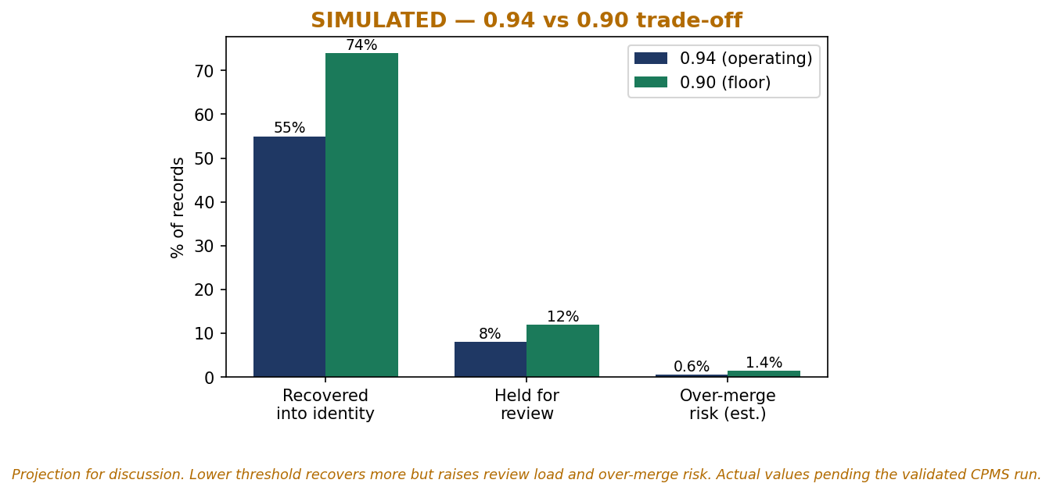
0.94 vs 0.90 — Simulated Trade-off
The two candidate settings side by side. 0.90 recovers more records (74% vs 55%) but costs more: more matches sent to human review, and a higher share of wrong merges. 0.94 recovers less but is safer and cheaper to operate.
Simulated projection for discussion. Actual values pending the validated CPMS run.

Slide 9
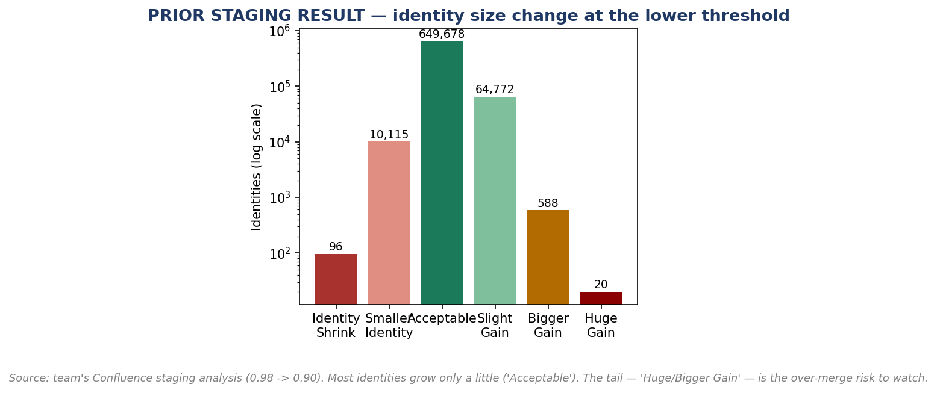
Prior Staging Result — Identity Size Change (Real)
When the team actually lowered to 0.90 in staging, this is how identity sizes changed. Most (650k, 'Acceptable') grew only a little — healthy. The small bars on the right ('Bigger/Huge Gain') are the ones to audit: identities that ballooned, a sign of possible wrong merges. Log scale — those cases are rare.
Real data — team's staging analysis of lowering 0.98 to 0.90.

Slide 10
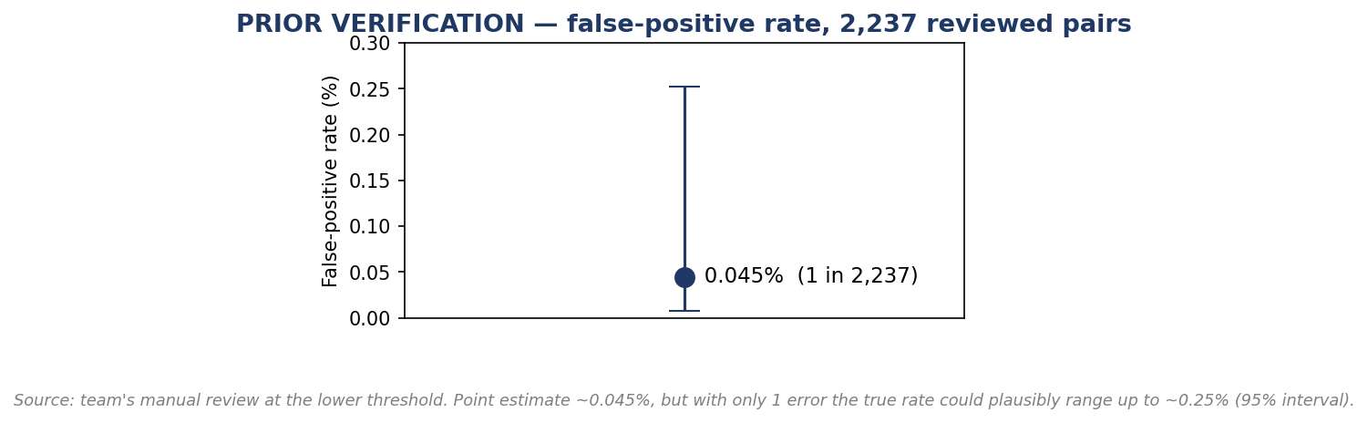
Prior Verification — False-Positive Rate (Real)
The dot is the measured error rate from manual review: 1 wrong merge in 2,237 pairs (~0.045%). The whiskers are the uncertainty — with only one error found, the true rate could be up to ~0.25%. Read it as 'low, but don't treat 0.045% as exact.'
~0.045% observed (1 wrong merge in 2,237 reviewed). With a single error, plan for up to ~0.25%.
Across ~848k records placed into identities, that implies roughly 380–2,100 wrong merges to monitor.

Slide 11
A Smarter Rule, Not Just a Lower Number
Score ≥ 0.94 AND a strong ID (A-number / SSN / FIN) agrees → accept (corroborated).
Score ≥ 0.98 → accept (today's rule still stands on its own).
Score ≥ 0.94 but only name + DOB agree → hold for review (thin evidence).
A-number agrees but DOB clearly differs → hold for review (the father/son pattern).
This recovers nearly all the missed matches while refusing to auto-merge the cases that caused known errors.

Slide 12
Where We Are & What's Next
STATUS
The analysis pipeline is built and runs end to end. Root-cause (sparse identifiers) and the data-quality issue are validated on real data. The full-scale run is constrained by long runtime and cluster instability on the production-size nested data — performance tuning is underway.
NEXT STEPS
1. Complete one validated full run for the CPMS-specific precision, recall, and false-positive numbers.
2. Load the 2,237 reviewed pairs to compute the real false-positive rate and the name+DOB break-even.
3. Reconcile against the prior staging analysis as a correctness check.
4. Bring a recommendation — 0.94 with the corroboration safeguard — to OIT / IIMD.
Charts marked SIMULATED are projections; final numbers require the validated run. Fill rates, DOB quality, and prior staging figures are real.

