Slide 1
Where 911 Nurse Navigation Calls Go
Full-population analysis of 150,003 calls, October 2024 to August 2026
Josh Smitherman | GMR | August 2026

Slide 2
The story in one slide
Nurse navigation handled 150,003 emergency calls from October 2024 to August 2026, a 23-month span.
One in five callers had an ambulance sent when triage did not indicate one. These are ambulance overrides (30,693 calls, 20.5%).
One in five calls were diverted from the emergency department to self-care, urgent care, or virtual care (31,542 calls, 21%).
Half of all calls fall into a single catch-all category that mixes multiple outcomes (79,671 calls, 53%).
99.3% of nurse notes contain enough text to read at scale, so the note-based analysis is well supported.
Takeaway. 150,003 calls analyzed. Override rate 20.5%, diversion rate 21%, uncategorized 53%.

Slide 3
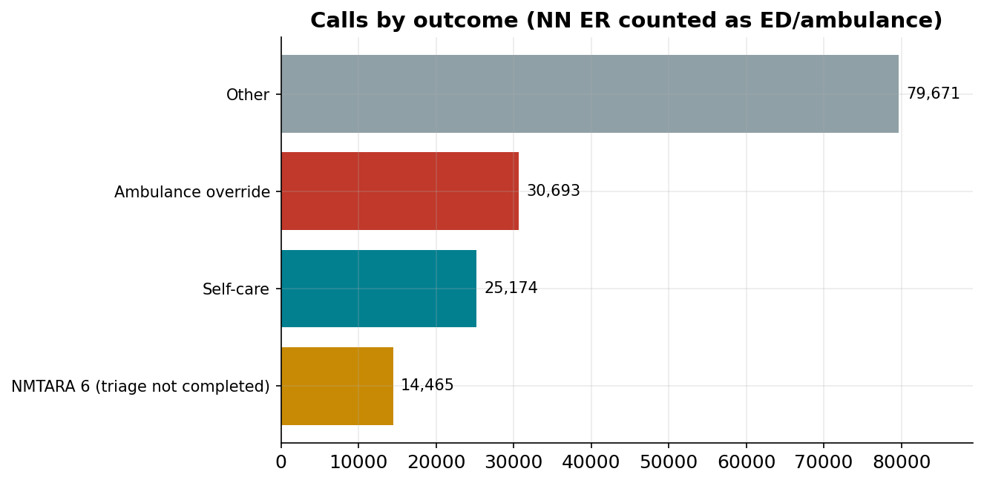
How the calls are handled
Every call sorted into one outcome, no double-counting
Each of the 150,003 calls is assigned to exactly one outcome. Ambulance / ED is the largest at 90,905 calls (60.6%). Ambulance override is 30,693 (20.5%): an ambulance was dispatched when triage returned a lower-acuity result. Self-care is 25,174 (16.8%): managed at home with no transport. Triage not completed is 14,465 (9.6%): the call ended before triage finished.
NN ER (18,428 calls) is counted here as an ED/ambulance dispatch. The override figure does not change whether or not NN ER is included, because NN ER calls do not carry a triage level of 1 to 5.
How this was derived: Source: Transaction Response Names (disposition) and Transaction Breakout (triage level). Each call mapped to one outcome by an explicit code map: BLS, ALS, NN ER, VC ER, VC EMS -> ambulance/ED; SELF-CARE -> self-care; NMTARA 6 label -> triage not completed; triage level 1-5 with an ambulance disposition -> override; all else -> Other. Population: all 150,003 calls. Override % of ambulance = 30,693 / 90,905.

Slide 4
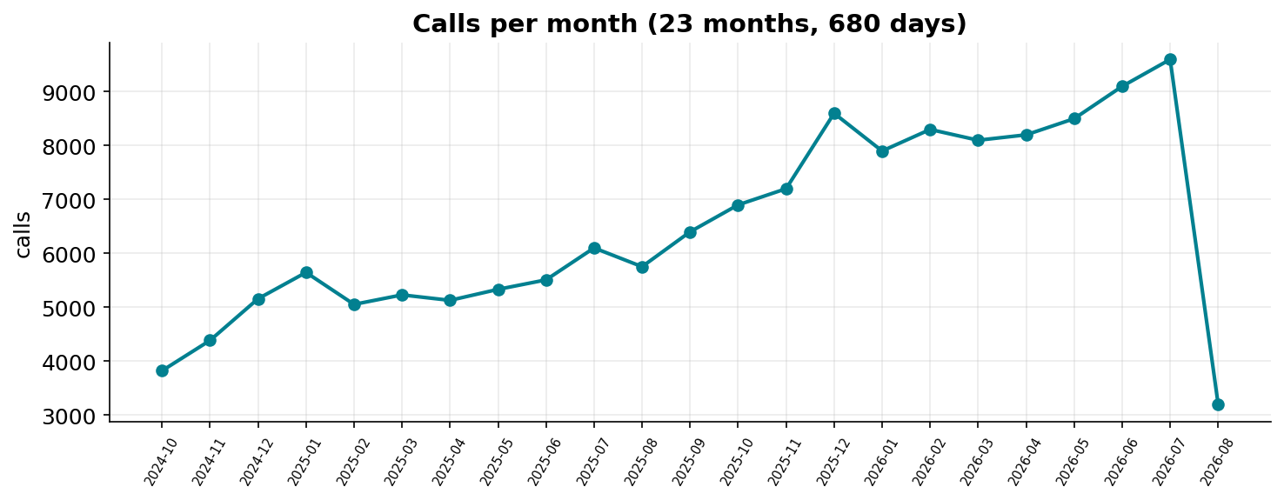
Call volume by month
October 2024 to August 2026, 23 months, 680 days
Monthly volume rises from 3,821 calls in October 2024 to a peak of 9,600 in July 2026.
The final month (August 2026) shows 3,200 and is a partial month, not a drop in demand.
There are no missing months across the 23-month span.
The extract already exceeds one year, so a separate one-year data pull is not required.
How this was derived: Source: Transaction Create Date-Time (Eastern). Each call’s timestamp grouped into calendar months; the count per month is plotted. Span computed as the difference between the earliest and latest timestamps (680 days). Population: all 150,003 calls with a parseable date. The final month is partial because the extract ends mid-month.

Slide 5
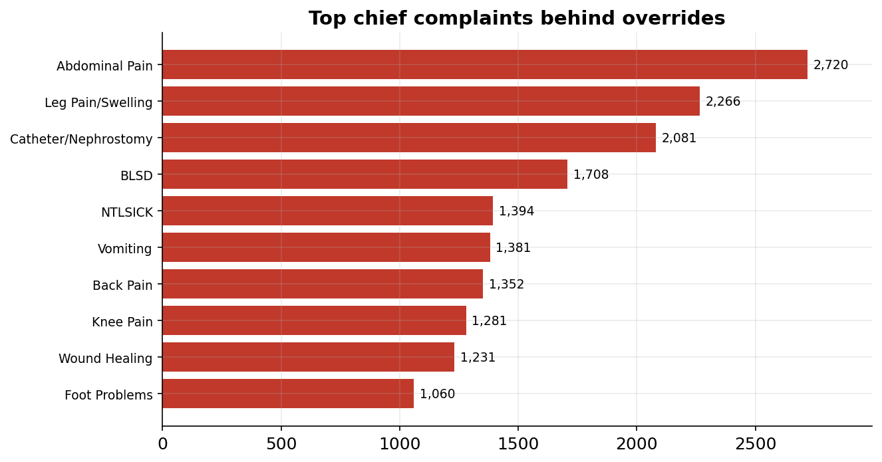
What drives the overrides
Top chief complaints among the 30,693 override calls
The ten most common complaints account for 15,474 override calls, roughly half of all overrides. Abdominal pain is the single largest at 2,720 (8.9% of overrides), followed by leg pain/swelling at 2,266 (7.4%) and catheter/nephrostomy tube problems at 2,081 (6.8%).
BLSD (1,708) and NTLSICK (1,394) are non-specific codes covering 3,102 calls combined. Their contents are not defined and require review.
How this was derived: Source: Cause (chief complaint) on the override population. Population: the 30,693 calls classified as overrides (triage level 1-5 with an ambulance disposition). Calls grouped by chief complaint and counted; share = each complaint’s count / 30,693. Top ten shown; their sum is 15,474.

Slide 6
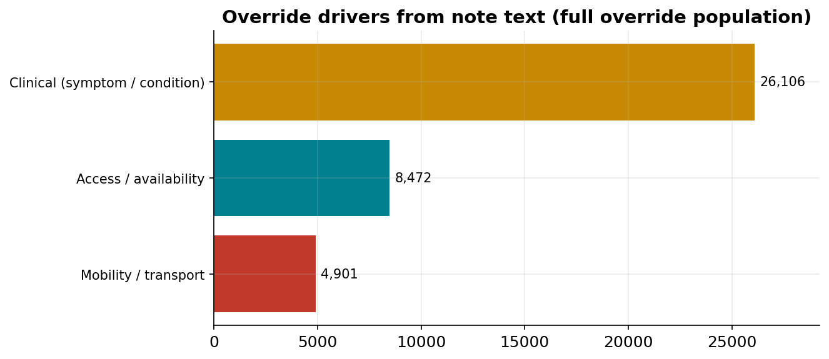
What drives the override decision
Override notes grouped by driver, full override population
Every override note is scanned for three driver groups. Clinical drivers (symptom severity or condition) appear in 26,106 notes, 85.1% of overrides. Access or availability barriers (no appointment, after hours, closed, no provider, cost) appear in 8,472 notes, 27.6%. Mobility or transport barriers appear in 4,901 notes, 16%.
A note can match more than one group, so the shares total more than 100%. The mobility and access groups are the drivers not tied to clinical severity. The keyword lists require nurse SME review before the split is treated as final.
How this was derived: Source: Nurses Notes on the 30,693 override calls. Each note lower-cased and scanned for three keyword groups - clinical (chest pain, bleeding, sudden onset, etc.), mobility (wheelchair, bedbound, cannot ambulate, stairs, no transport), access (no appointment, after hours, closed, no provider, cost). A note can match more than one group, so shares sum above 100%. Full population, not a sample. Share = group note count / 30,693.

Slide 7
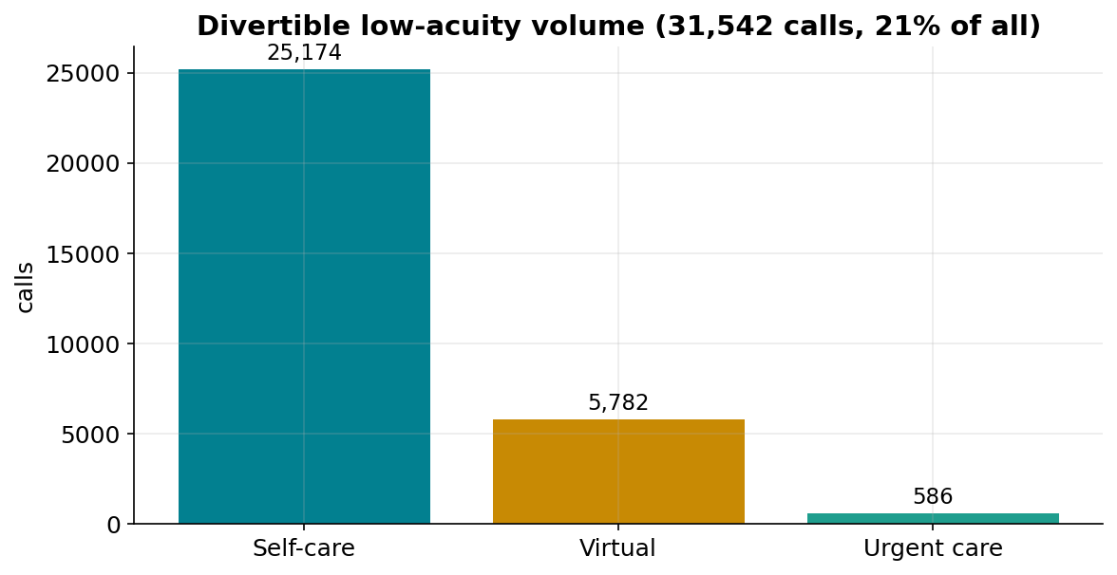
Diversion volume
Calls routed away from the emergency department
31,542 calls (21% of all volume) were diverted from the emergency department. Self-care accounts for 25,174, virtual care for 5,782, and urgent care for 586. Each represents an emergency-department visit that did not occur.
This count uses the explicit disposition map, so the three types do not overlap. A dollar value requires an avoided-cost figure per diverted visit, which finance and payer strategy have not yet set.
How this was derived: Source: disposition via the explicit code map. Self-care = SELF-CARE disposition; virtual = VIRTUAL CARE; urgent = MOBILE URGENT CARE and VC MUC. The three are mutually exclusive under the map, so no double counting. Population: all 150,003 calls. Divertible rate = 31,542 / 150,003.

Slide 8
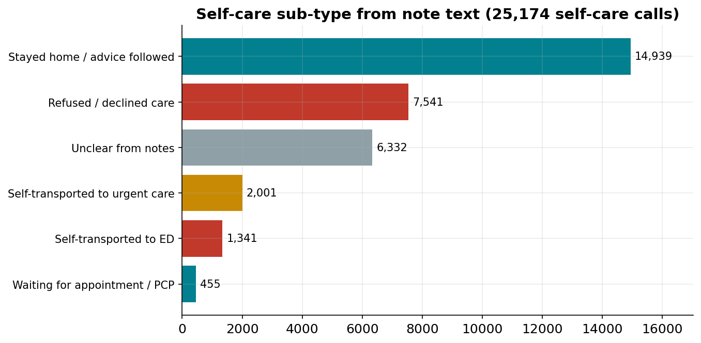
What self-care actually means
The 25,174 self-care calls split by what the patient did next
Self-care today records only that no ambulance, transport, or referral was arranged - not what the patient did next. Reading the notes, 14,939 (59.3%) stayed home on nurse advice. 7,541 (30%) refused or declined further care. 2,001 (7.9%) self-transported to urgent care, and 1,341 (5.3%) self-transported to the ED. A small group, 455 (1.8%), were waiting for an existing appointment.
6,332 (25.2%) could not be determined from the notes. Because a call can match more than one phrase, the sub-types overlap and do not sum to 100%.
How this was derived: Source: Nurses Notes on the 25,174 self-care calls (SELF-CARE disposition via the code map). Each note scanned for phrases indicating stayed-home, self-transport to ED, self-transport to urgent care, waiting for an appointment, or refusal. Full population, not a sample. A call matching no phrase is shown as “Unclear from notes.” Directional pending a note-sample audit.

Slide 9
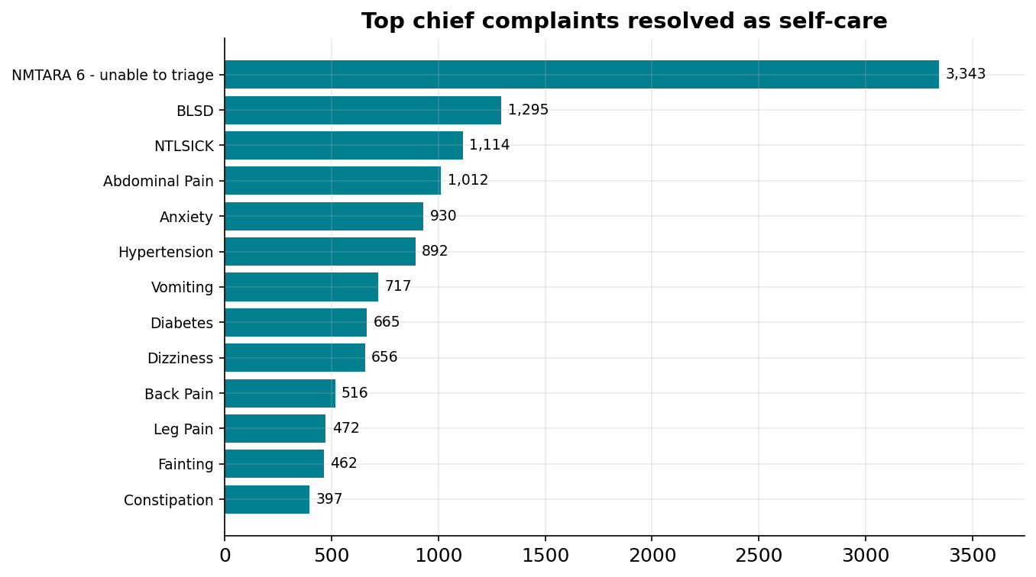
What conditions are resolved as self-care
Top chief complaints among the 25,174 self-care calls
The largest single group is calls where triage was not completed (3,343), which end in self-care by default rather than by clinical decision. Among clinical complaints, abdominal pain (1,012), anxiety (930), hypertension (892), and vomiting (717) lead. Diabetes and dizziness follow.
These are largely chronic or lower-acuity conditions. This is the condition mix that a new operating system would need to re-categorize, since “self-care” today does not distinguish them.
How this was derived: Source: the Cause field on the 25,174 self-care calls. Grouped by chief complaint and counted; share = each complaint’s count / 25,174. Full population, code-based, no note reading. Blank causes shown as “Not stated.”

Slide 10
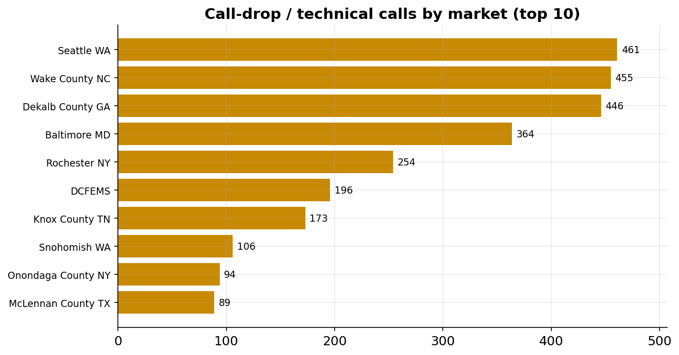
Call drop and technical issues
Within the 14,465 calls where triage did not complete
Of the 14,465 calls where triage did not complete, 3,384 (23.4%) ended from a dropped call or a technical issue rather than a clinical reason. The volume concentrates in a small set of markets: Seattle WA (461), Wake County NC (455), Dekalb County GA (446), and Baltimore MD (364) lead.
This is measured across every call from the note text, not a sample. It replaces the earlier sample-based 17% estimate; the two figures are different measurements and should be reconciled.
How this was derived: Source: Nurses Notes on the 14,465 triage-not-completed calls (NMTARA 6 label). Each note scanned for disconnect and technical terms (dropped, disconnected, hung up, technical, lost call, no answer, could not reach). Full population, not a sample. Share = 3,384 / 14,465. Market split groups those flagged calls by Market Name.

Slide 11
Half the calls are uncategorized
79,671 calls, 53% of volume, in a single catch-all group
Label inside the group | Calls
BLS for NMTARA 0 | 38,343
NN ER | 18,428
REF CCR | 7,855
VIRTUAL CARE | 5,782
ALS | 5,657
BLS without NMTARA | 1,747
All remaining | 1,859
79,671 calls sit in one category. It mixes emergency transports, ER referrals, and virtual care under a single label. The largest single label inside it is BLS for NMTARA 0 at 38,343 calls, followed by NN ER at 18,428.
While these calls sit together, diversion potential, cost, and clinical pattern cannot be measured for the group. Separating it into component outcomes is required before it can be read.
How this was derived: Source: the code map’s residual group - every disposition that is not self-care, not an override, and not NMTARA 6 falls to Other. Population: all 150,003 calls; 79,671 land here. Label counts come from Transaction Response Names within this group.

Slide 12
What needs a decision
Question | Why it matters | Owner
Should the largest call group count as an ambulance or a referral? | Changes the ambulance and diversion rates | Clinical + product
Do escalated virtual-care calls belong on the emergency side? | Refines the diversion volume | Nurse nav clinical
What is the avoided cost of one diverted ED visit? | Turns 31,542 diverted calls into a dollar figure | Finance + payer
Which conditions define a front-end high-acuity screen? | Determines override routing at first call | Clinical + product
None of these require new data collection. Each requires agreement on a definition or a cost figure. The mobility and access driver lists (slide 5) also require nurse SME sign-off before the override split is quoted as final.
Fact: four open decisions, all resolvable through definition agreement, not new data.

Slide 13
Next steps
Build a front-end screen for the conditions that drive most overrides, using the top complaints and the clinical/mobility/access driver split.
Separate the catch-all group into its component outcomes so the full dataset becomes readable.
Set an avoided-cost figure per diverted ED visit and apply it to the 31,542 diverted calls.
Report overrides against ambulance volume (36%) as well as against all calls (20.5%).
Address call-drop and technical failures in the four highest-volume markets: Seattle, Wake County, Dekalb County, Baltimore.
Have a nurse SME review the override driver keyword lists before the split is finalized.

