Slide 1
Images, Functions, and Reflections

Slide 2
Can we generate a random image?

Slide 3


Slide 4
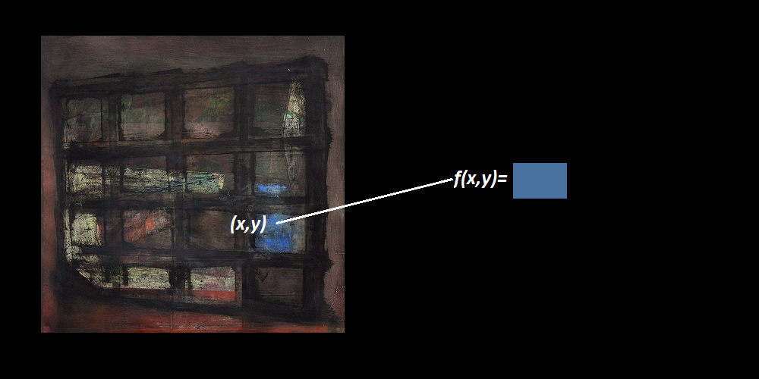
Images and Functions
An image is a function from a canvas to some colors.

Slide 5
Random image = Random function

Slide 6
Using standard mathematical functions can provide structure which gives the illusion of intent.

Slide 7
How do we build a random function using standard mathematical functions?

Slide 8
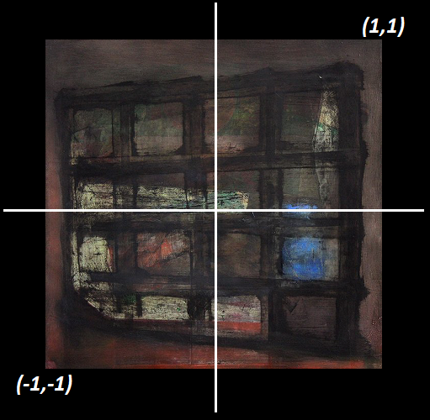


Special Functions
Impose a coordinate system on the canvas.
Place $(1,1)$ at the top right and $\left(−1,−1\right)$ at bottom left.
C$all a binary function that maps \left[−1,1\right]×[−1,1]$ to $[−1,1]$ a special function.
When we compose special functions, we get new special functions.

Slide 9


Random Functions
Make a list of some special functions.
Randomly compose these special functions.
This gives a randomish function to $[−1,1]$.

Slide 10


Simple Functions
$sin⁡(x⋅π)$
$cos⁡(x⋅π)$
$sin⁡(2x⋅π)$
$cos⁡(2x⋅π)$
$\sin\left(π⋅\left(x^{2}+y^{2}\right)\right)$
$Avg(x,y)$
$x$
$y$
$x⋅y$
$x^{2}$
$x^{3}$
$min⁡(x,y)$
$max⁡(x,y)$

Slide 11
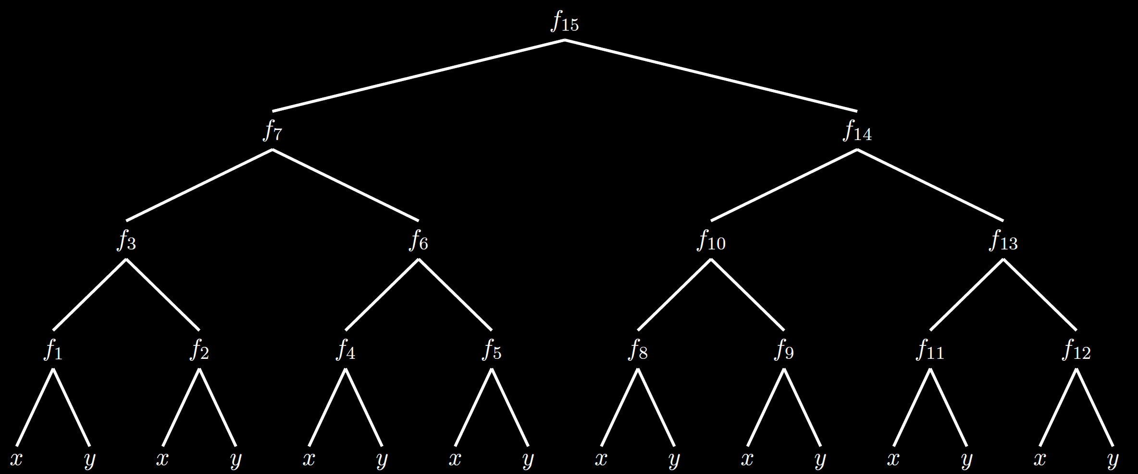
Random Composition

Slide 12

Random Composition
procedure randomFunction($height$){
if ($height=0$)
return $x$ half the time and $y$ half the time
else{
$g(x,y)=$randomFunction($height−1$)
$h(x,y)=$randomFunction($height−1$)
$f(x,y)=$specialFunctions.random()
return$(f(g(x, y), h(x, y))$
}
}

Slide 13
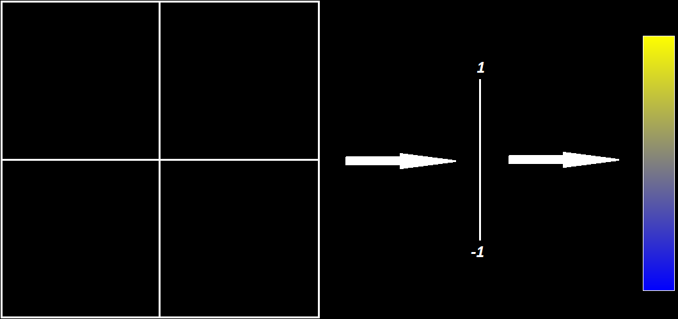
Random Functions
?

Slide 14

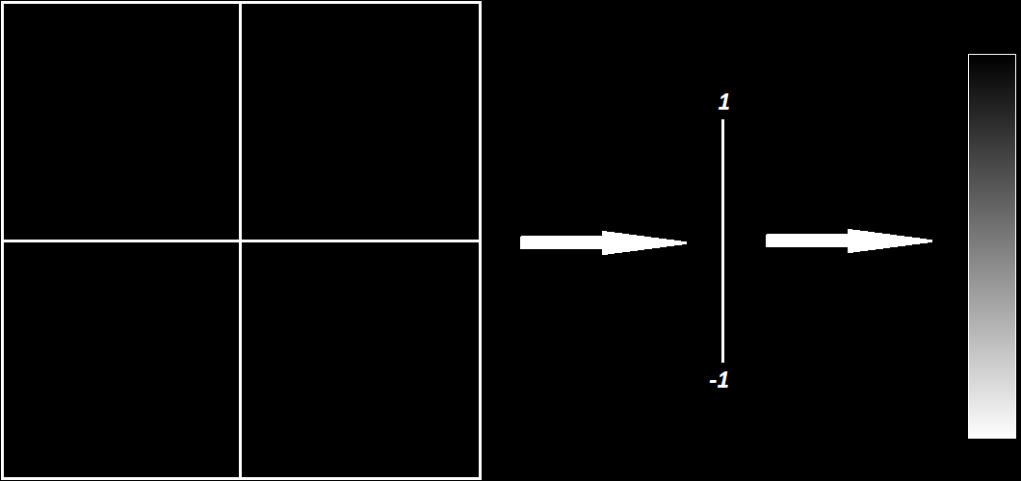
Numbers to Colors
Grayscale

Slide 15
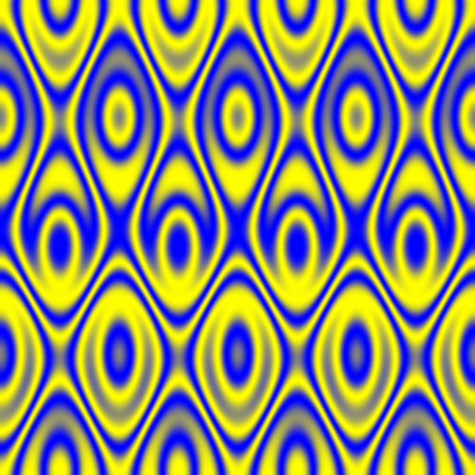
Numbers to Colors
Gradient

Slide 16
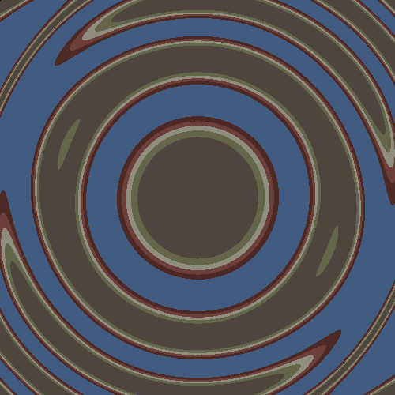
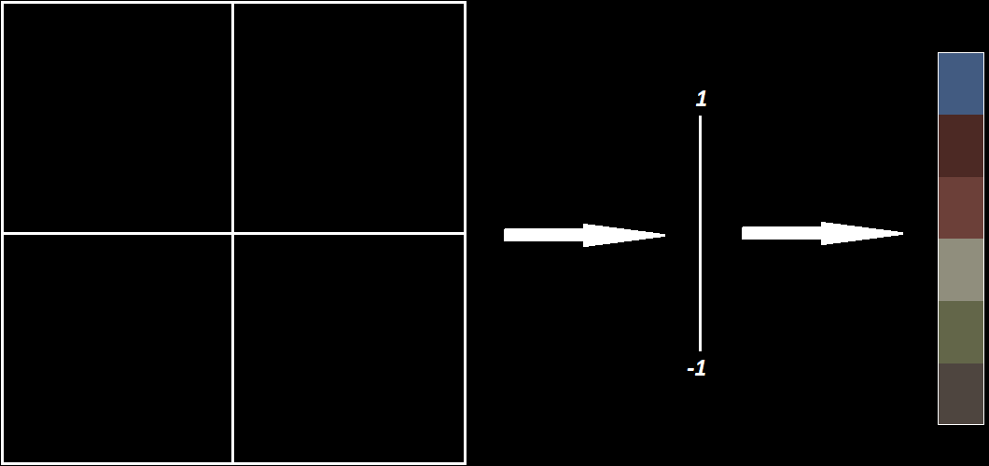
Numbers to Colors
Color array

Slide 17
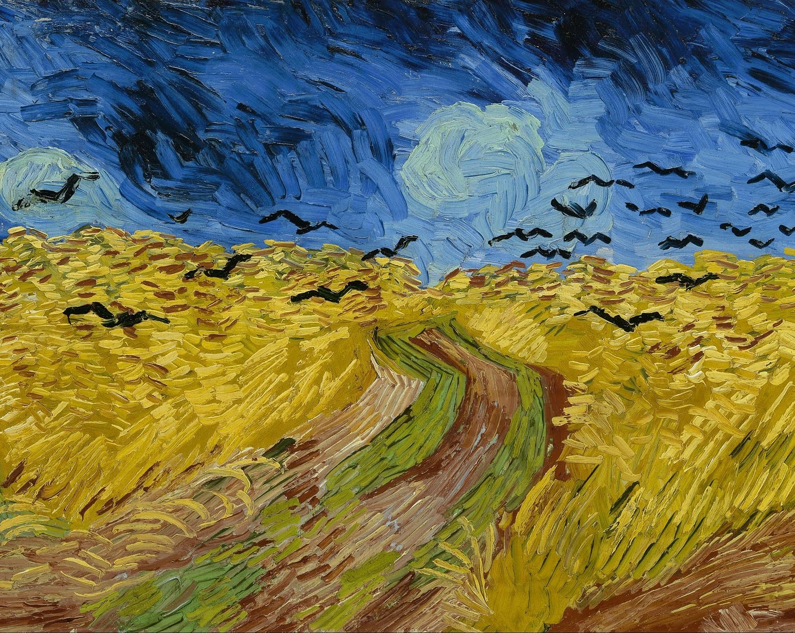
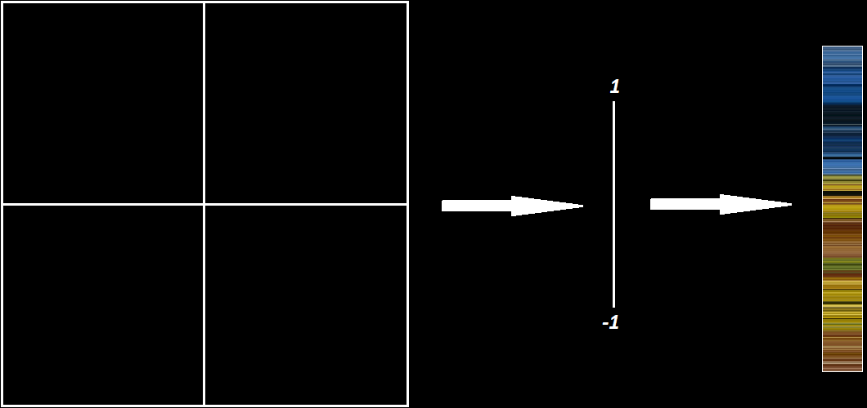
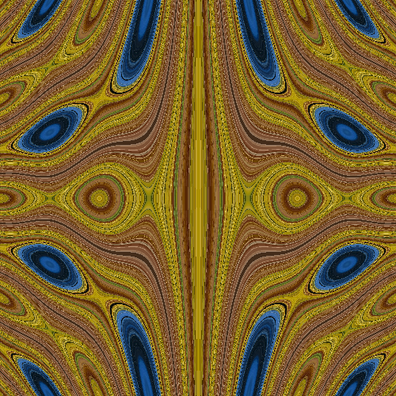
Numbers to Colors
Interval in another image

Slide 18

Numbers to Colors
Use two functions to map the canvas to another image.
Generate two special functions $f(x,y)$ and $g\left(x,y\right).$
Let $F\left(x,y\right)=\left(f\left(x,y\right), g\left(x,y\right)\right)$.
The point $(x,y)$ is colored the same as the point $F(x,y)$ in a seed image.
The picture generated is the inverse image of the seed image under the function $F(x,y)$.

Slide 19
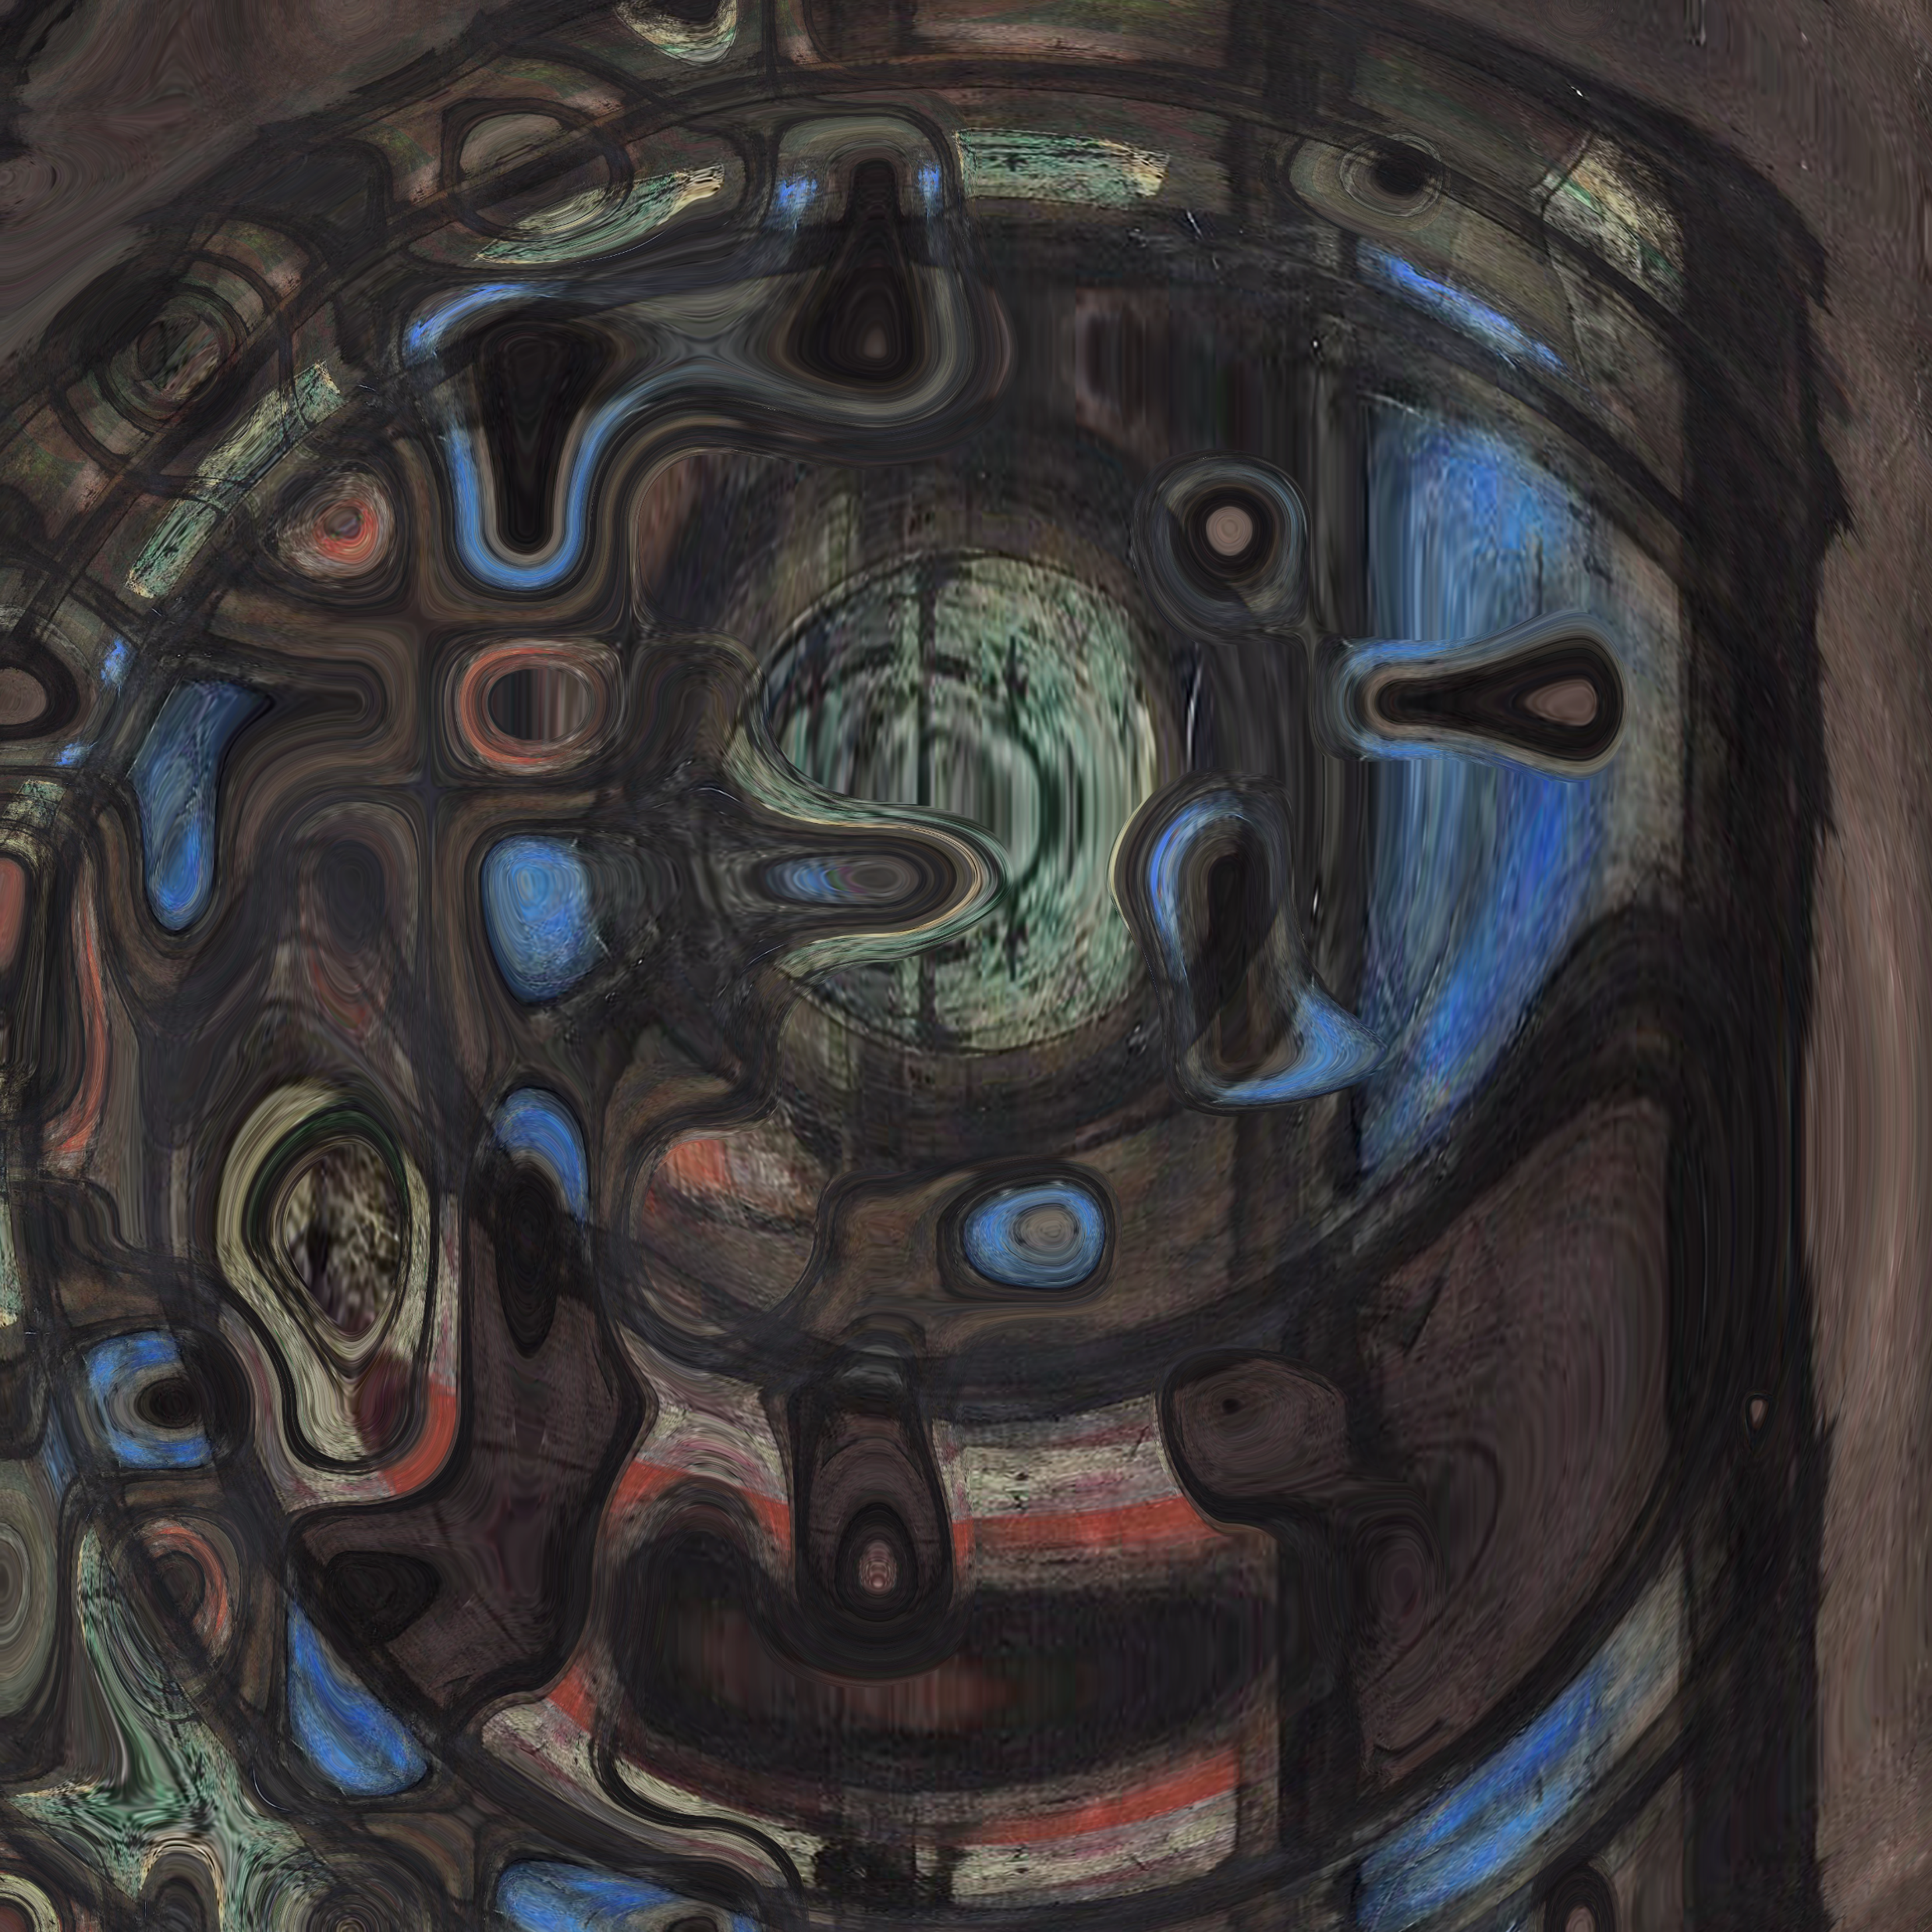
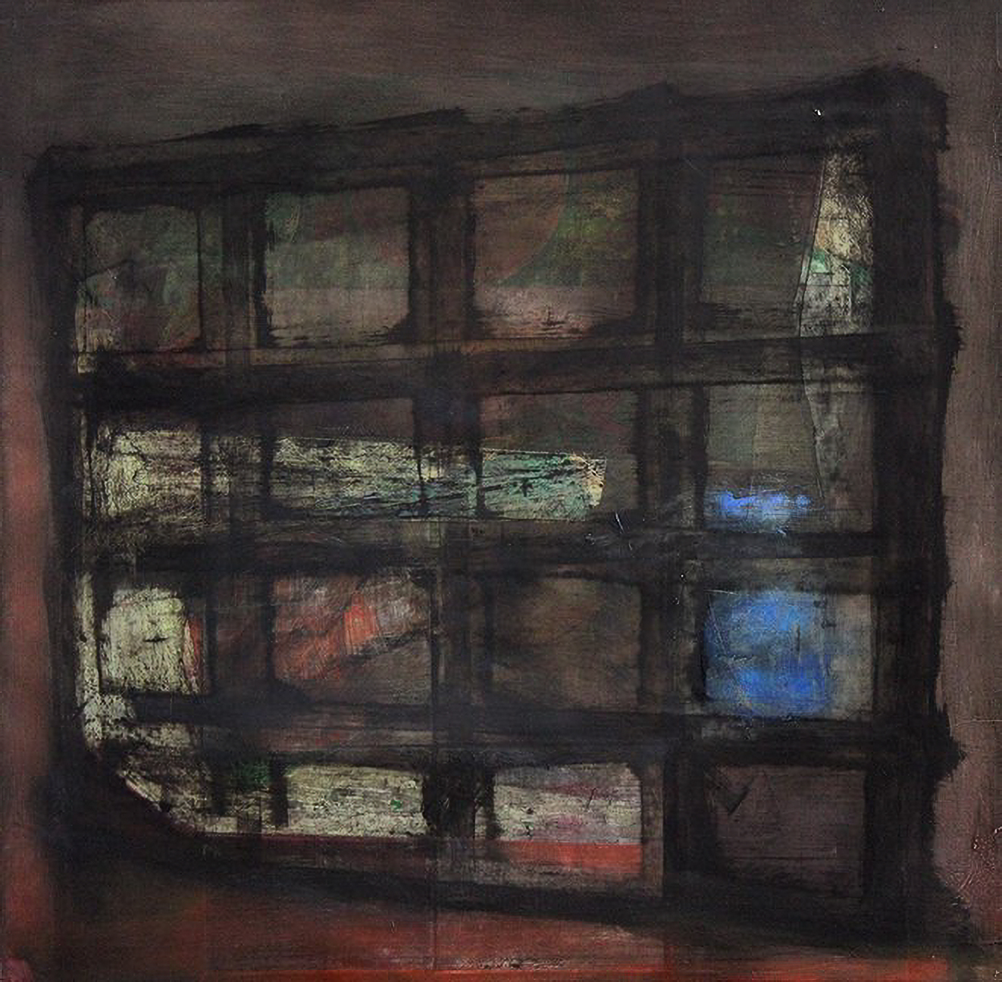
Two Functions

Slide 20
Interactive activity
jwsnow.github.io/reflection

Slide 21
More examples

