Slide 1


Helmax Technology Co., Limited
Independent Distributor for Electronic Components

Slide 2
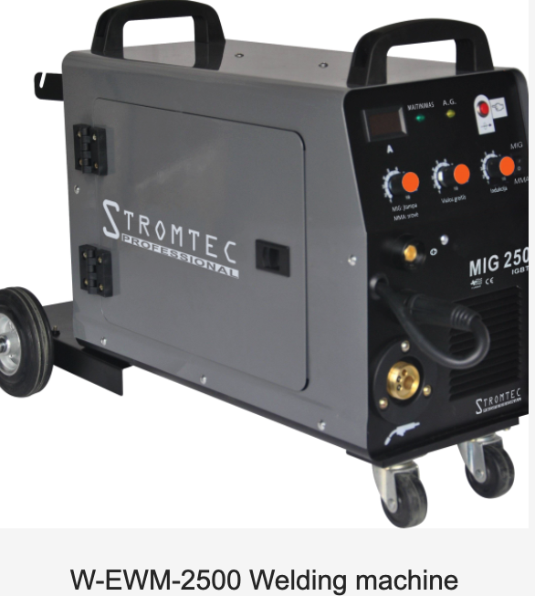
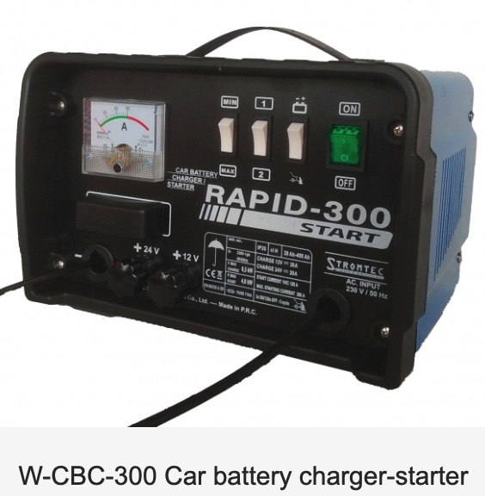
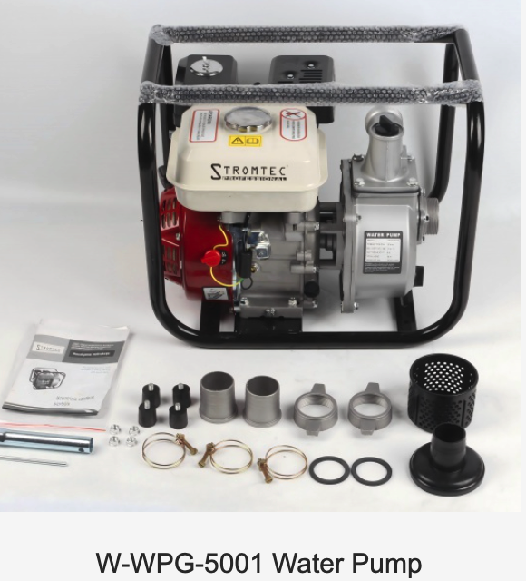
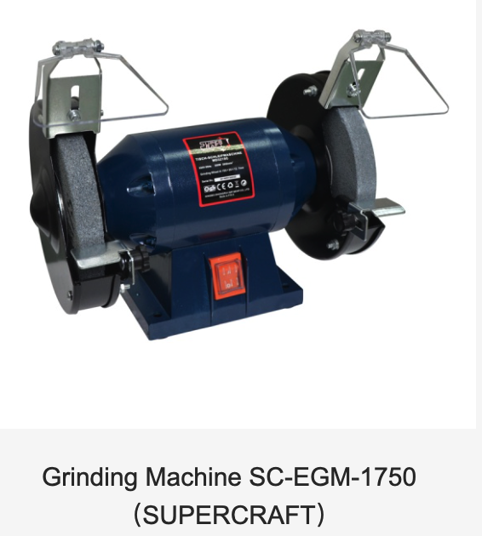
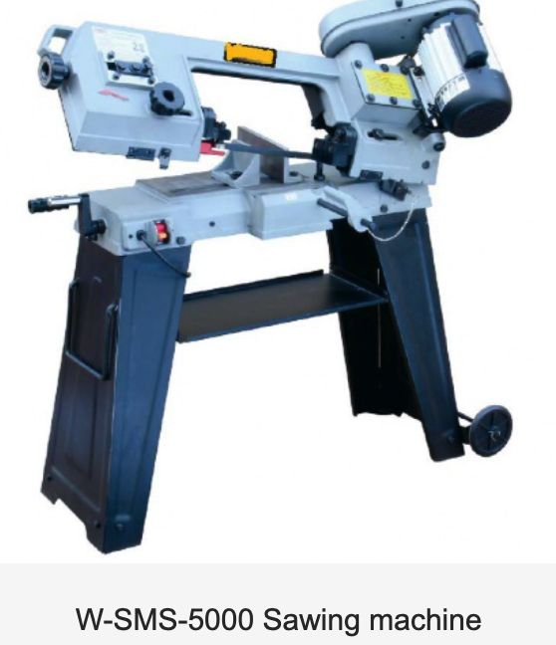
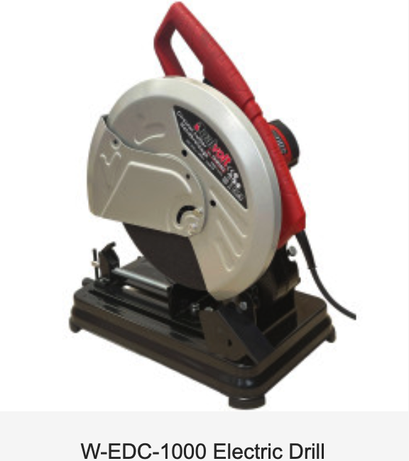
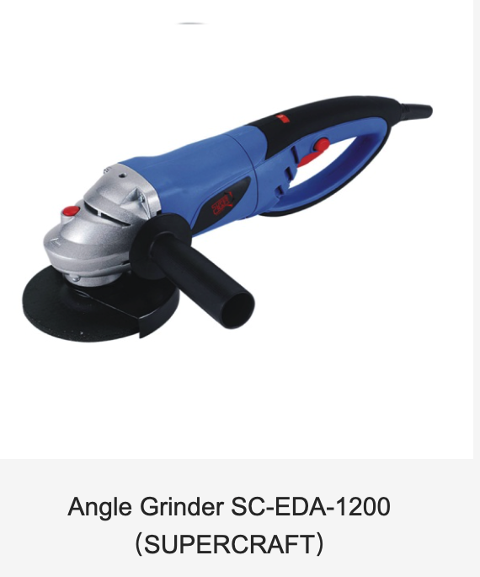
Helmax _ Investment Structure
Zeension Wayland
Zeension Technology (HK) Co., Limited
Wayland International Co., Limited
Key Customers:
HUAQIN
JABIL
PILA
PRIVORO
PREMAX
Key Brands:
STROMTEC
SUPERCRAFT
VATAS
VV
DUALVOLT

Slide 3
Company Introduction
Helmax Technology is a premier independent distributor of electronic components, committed to delivering superior service to the world's top OEMs. We position ourselves as your go-to partner for responsive spot-buy execution and strategic PPV supply chain optimization.
Services We Involve
• PPV / Cost-Down
• Spot Buy
• Stock Clearing

Slide 4
Value
• Low cost, high quality, fully scalable
• Optimal risk mitigation
• Maximum transactional velocity
Mission
• Operate as a highly valued independent distributor of electronics sourcing and supply chain services
Vision
• Globally distributed, flexible, scalable and compliant operations and fulfillment network
• Results-oriented and metrics-driven

Slide 5
Expertise
Successful business for 9 years
Global operation service
Experienced sourcing
Open Market
Intelligence
Extensive supply network
Prompt feedback & On-time delivery
Unwavering commitment to quality

Slide 6
Four Advantages That Drive Your Cost Down
Why choose us — pricing strength built on insight, partnership, sourcing & scale
01
Global Market Price Insight
Real-time tracking of global component market trends ensures every purchase is made at the most competitive price point.
02
Direct Sourcing from Manufacturers
Buying directly from component manufacturers eliminates middlemen, strengthening negotiation power and price advantage.
03
Order Consolidation & Scale Pricing
Consolidating orders across programs delivers economies of scale and volume-based pricing for maximum cost efficiency.
04
Strong OEM Partner Ties
Close, long-standing relationships with OEM partners unlock preferential contact pricing and priority supply access.

Slide 7
One-stop Kitting Service and Solution
The simplified process of full-line supply
01
02
03
04
Submit BOM & Target Price
Confirm Detailed Quotation
Analyze BOM & Drive Cost Down
Arrange JIT Delivery
You provide your complete BOM list together with your target price, so we understand your cost baseline from day one.
You receive a transparent, item-level quotation and decide whether to proceed — no obligation, full visibility.
We analyze your BOM, identify savings opportunities, and work with suppliers to drive your total cost down.
We arrange just-in-time delivery in accordance with your production requirements, keeping your lines supplied.

Slide 8














Various Product Line Areas
Automotive Electronics
Telecommunication & Networking
Industrial Control
Medical Appliance
Computer and Peripherals
Power Supply & Consumer Electronics
Key Partial Customer Base:

Slide 9
Suppliers Composition
Grade M Suppliers 60%
Strategic / certified partners, long-term contracts
Grade F1 Suppliers 30%
Qualified, volume-driven, secondary source
Grade F2 Suppliers 7%
Newly qualified / niche capabilities
Grade B1 Suppliers 3%
Contingency / spot-buy reserve
Grade distribution across the supply base — built for resilience and scale
90% of the supply base (Grades A & B) is qualified and strategically managed — ensuring stability, capacity and cost leverage.
Notes:
Grade M Suppliers
• OEM Factories
• Component Manufacturers
Grade F1 Suppliers
• 1st Class Franchised Distributor with more than 5 brands on hand
Grade F2 Suppliers
• 2nd Class Franchised Distributor with only 1 or 2 brands on hand
Grade B1 Suppliers
• Reliable brokers with stock on hand

Slide 10




















Long-term Key Collaborated E-component Brands
Business partnerships with top EMS manufacturers and strong relationships with over 6,00+ vendors.

Slide 11

Quality Control Flowchart
REJ
IQC
ACC
Visual Inspection
ACC
Surface Inspection
ACC
Marking Inspection
ACC
REJ
Customers
ACC
Approval
QCM
ACC
Inspection of
Solderability
ACC
Pins Inspection
RMA Process

Slide 12
RMA Process
To return merchandise, follow these 4 simple steps:
Contact sales within 30 days with failure reports, pictures & documentation
Complete & submit the RMA Request Form with Invoice and Packing List
Parts are inspected/tested by an authorized third-party Testing Center
Defective → return authorized; functional → returned at customer‘s expense
01
02
03
04
Initiate the RMA Request
Submit Form & Inspection
Decision & Return
Key Points
Within 30 days of receipt, contact your sales rep by phone or email. Report a verifiable quality issue with a failure report and photos.
Fill out the RMA Request Form (yellow highlighted). Send it with the invoice and packing slip to your sales rep; CC the Flexcon Customer Service / RMA Team.
An authorized third-party Testing Center inspects the part. If defective, return is authorized; if it works normally, the customer bears the return cost.
Submit within 30 days. Highlight the RMA Request Form; send via the Flexcon RMA Team to the Testing Center for verification.

Slide 13

Other Valued Services
VMI (Vendor Managed Inventory) Service
Provide financial support to faithful customers
24-hour, 7-day logistics service
Provide samples and cross parts
Third-party service & parts testing
Supply timely market news

Slide 14

THANK YOU!

