Slide 1
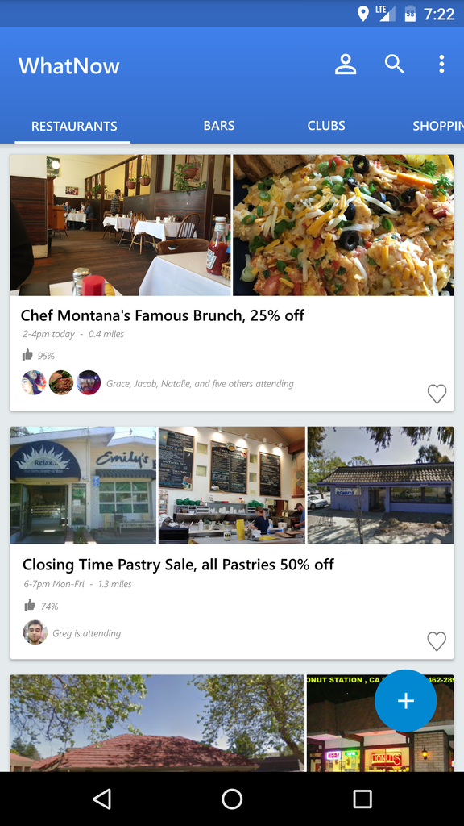
WhatNow
Find fun near you!

Slide 2
Team members
WhatNow
Francesco Fiacco (Product Owner)
Stefano Gasperini
Vanessa Hurtado
Jason Vance (SCRUM Master for Sprint 1)
Carlos Espinosa

Slide 3
Description
WhatNow
WhatNow: a platform for users to quickly find events happening around them
Our goals for WhatNow:
“Hosts” post listings for events
Make it easy for users to find local events they might be interested in
Results can be sorted and filtered based on categories, distance or time
More accessible and less obtrusive than Facebook events

Slide 4
Sprint 1 (4/11 - 5/1)
WhatNow
UI - As a user, I would like a slick UI where I can browse through events. 6
Log in - As a user, I would like to be able to to log-in to access user profiles. 3
Fake events - As a developer, I need to locally save fictitious events for testing purposes. 3

Slide 5
Sprint 2 (5/2 - 5/15)
WhatNow
Post an event (to server) - As a host, I would like to post an event. 9
View profiles - As a guest, I would like to navigate other guests’ and hosts’ profiles so that I can decide where to go. 5
Sort events - As a user, I would like to sort events by categories. 3

Slide 6
Sprint 3 (5/16 - 5/27)
WhatNow
Automatically fill events - As a guest, I would like to view events even if there is nobody hosting. 9
Bookmarks - As a guest, I would like to be able to bookmark events that I’m interested in. 2
Search - As a guest, I would like the ability to search events by keyword. 4

Slide 7
Tools
WhatNow
Android Studio (app development)
Firebase (backend services)
Google and Facebook APIs (to authenticate users and get information)
Slack (team communication)

