Slide 1
Bits, Bytes and Integers

Slide 2
Today: Bits, Bytes, and Integers
Representing information as bits
Bit-level manipulations
Integers
Representation: unsigned and signed
Conversion, casting
Expanding, truncating
Addition, negation, multiplication, shifting
Summary
Representations in memory, pointers, strings

Slide 3
Before digital there was analog…
Notes:
Analog computations can be very fast and efficient, but noise is a problem

Slide 4
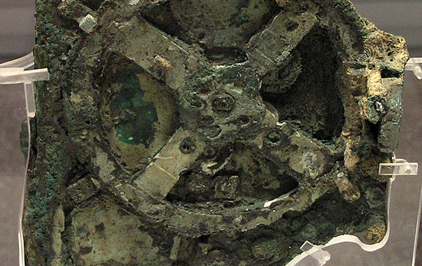
Antikythera Mechanism
Notes:
The action of turning a hand crank would cause all interlocked gears within the mechanism to rotate, resulting in the simultaneous calculation of the position of the Sun and Moon, the moon phase, eclipse, and calendar cycles, and perhaps the locations of planets. Designed and constructed by Greek scientists and has been variously dated to about 87 BC, or between 150 and 100 BC, or to 205 BC.

Slide 5
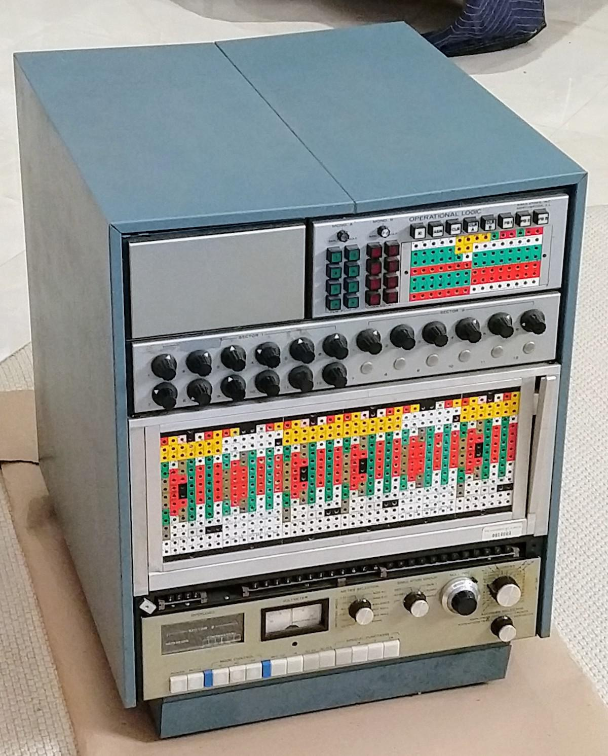
(1969) Simulators Inc. model 240
Notes:
This electronic analog computer solved differential equations, defined by wires plugged into the colorful plugboard in the middle. It used dozens of precision resistors and capacitors and was painfully expensive.

Slide 6
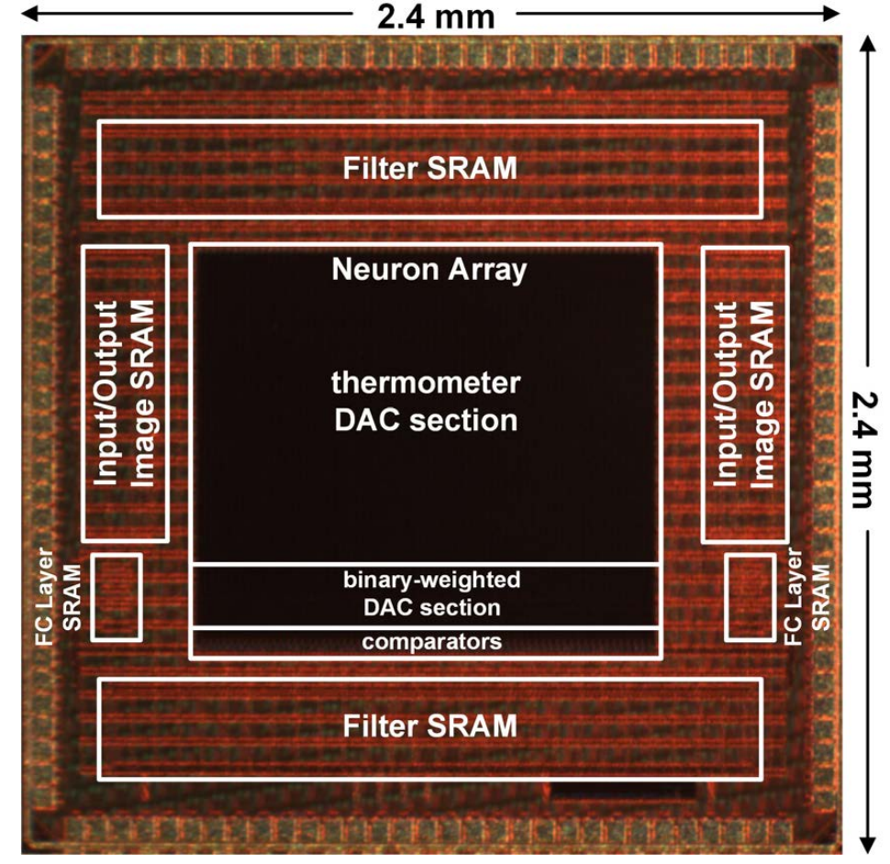
(2018) Digital+Analog AI processor
Bankman et al, “An always-on 3.8μJ/86% CIFAR-10 mixed-signal binary CNN processor with all memory on chip in 28nm CMOS”
Notes:
For an image classification task. Paper reported 4x energy improvement over a synthesized digital implementation.

Slide 7
Everything is bits
Each bit is 0 or 1
By encoding/interpreting sets of bits in various ways
Computers determine what to do (instructions)
… and represent and manipulate numbers, sets, strings, etc…
Why bits? Electronic Implementation
Easy to store with bistable elements
Reliably transmitted on noisy and inaccurate wires
0
1
0
1.1V
0.9V
0.2V
0.0V

Slide 8
For example, can count in binary
Base 2 Number Representation
Represent 15213₁₀ as 11101101101101₂
Represent 1.20₁₀ as 1.0011001100110011[0011]…₂
Represent 1.5213 X 10⁴ as 1.1101101101101₂ X 2¹³

Slide 9
Encoding Byte Values
Decimal
Hex
Binary
Byte = 8 bits
Binary 000000002 to 111111112
Decimal: 010 to 25510
Hexadecimal 0016 to FF16
Base 16 number representation
Use characters ‘0’ to ‘9’ and ‘A’ to ‘F’
Write FA1D37B16 in C as
0xFA1D37B
0xfa1d37b
0
0
0000
1
1
0001
2
2
0010
3
3
0011
4
4
0100
5
5
0101
6
6
0110
7
7
0111
8
8
1000
9
9
1001
A
10
1010
B
11
1011
C
12
1100
D
13
1101
E
14
1110
F
15
1111
15213: 0011 1011 0110 1101
3
B
6
D

Slide 10
Example Data Representations
C Data Type | Typical 32-bit | Typical 64-bit | x86-64
char | 1 | 1 | 1
short | 2 | 2 | 2
int | 4 | 4 | 4
long | 4 | 8 | 8
float | 4 | 4 | 4
double | 8 | 8 | 8
pointer | 4 | 8 | 8

Slide 11
Example Data Representations
C Data Type | Typical 32-bit | Typical 64-bit | x86-64
char | 1 | 1 | 1
short | 2 | 2 | 2
int | 4 | 4 | 4
long | 4 | 8 | 8
float | 4 | 4 | 4
double | 8 | 8 | 8
pointer | 4 | 8 | 8

Slide 12
Today: Bits, Bytes, and Integers
Representing information as bits
Bit-level manipulations
Integers
Representation: unsigned and signed
Conversion, casting
Expanding, truncating
Addition, negation, multiplication, shifting
Summary
Representations in memory, pointers, strings

Slide 13
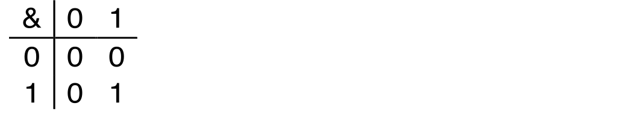
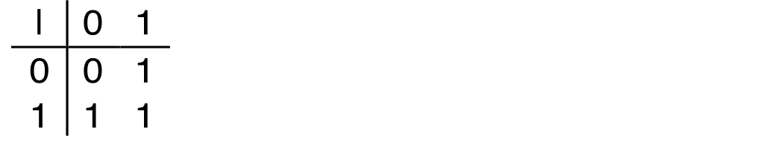
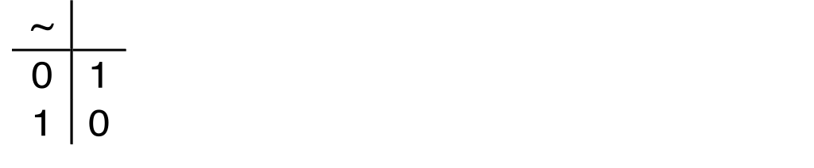
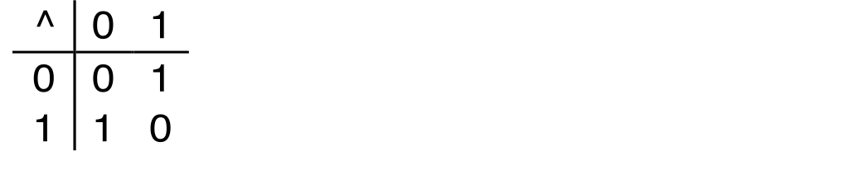
Boolean Algebra
Developed by George Boole in 19th Century
Algebraic representation of logic
Encode “True” as 1 and “False” as 0
And
A&B = 1 when both A=1 and B=1
Or
A|B = 1 when either A=1 or B=1
Not
~A = 1 when A=0
Exclusive-Or (Xor)
A^B = 1 when either A=1 or B=1, but not both

Slide 14
General Boolean Algebras
Operate on Bit Vectors
Operations applied bitwise
All of the Properties of Boolean Algebra Apply
01101001
& 01010101
01000001
01101001
| 01010101
01111101
01101001
^ 01010101
00111100
~ 01010101
10101010
01000001
01111101
00111100
10101010

Slide 15
Example: Representing & Manipulating Sets
Representation
Width w bit vector represents subsets of {0, …, w–1}
a_{j} = 1 if j ∈ A
01101001 { 0, 3, 5, 6 }
76543210
01010101 { 0, 2, 4, 6 }
76543210
Operations
& Intersection 01000001 { 0, 6 }
| Union 01111101 { 0, 2, 3, 4, 5, 6 }
^ Symmetric difference 00111100 { 2, 3, 4, 5 }
~ Complement 10101010 { 1, 3, 5, 7 }

Slide 16
Bit-Level Operations in C
Operations &, |, ~, ^ Available in C
Apply to any “integral” data type
long, int, short, char, unsigned
View arguments as bit vectors
Arguments applied bit-wise
Examples (Char data type)
~0x41 → 0xBE
~010000012 → 101111102
~0x00 → 0xFF
~000000002 → 111111112
0x69 & 0x55 → 0x41
011010012 & 010101012 → 010000012
0x69 | 0x55 → 0x7D
011010012 | 010101012 → 011111012
Decimal
Hex
Binary
0
0
0000
1
1
0001
2
2
0010
3
3
0011
4
4
0100
5
5
0101
6
6
0110
7
7
0111
8
8
1000
9
9
1001
A
10
1010
B
11
1011
C
12
1100
D
13
1101
E
14
1110
F
15
1111

Slide 17
Bit-Level Operations in C
Operations &, |, ~, ^ Available in C
Apply to any “integral” data type
long, int, short, char, unsigned
View arguments as bit vectors
Arguments applied bit-wise
Examples (Char data type)
~0x41 → 0xBE
~0100 00012 → 1011 11102
~0x00 → 0xFF
~0000 00002 → 1111 11112
0x69 & 0x55 → 0x41
0110 10012 & 0101 01012 → 0100 00012
0x69 | 0x55 → 0x7D
0110 10012 | 0101 01012 → 0111 11012
Operations &, |, ~, ^ Available in C
Apply to any “integral” data type
long, int, short, char, unsigned
View arguments as bit vectors
Arguments applied bit-wise
Examples (Char data type)
~0x41 →
~0x00 →
0x69 & 0x55 →
0x69 | 0x55 →
Decimal
Hex
Binary
0
0
0000
1
1
0001
2
2
0010
3
3
0011
4
4
0100
5
5
0101
6
6
0110
7
7
0111
8
8
1000
9
9
1001
A
10
1010
B
11
1011
C
12
1100
D
13
1101
E
14
1110
F
15
1111

Slide 18
Contrast: Logic Operations in C
Contrast to Bit-Level Operators
Logic Operations: &&, ||, !
View 0 as “False”
Anything nonzero as “True”
Always return 0 or 1
Early termination
Examples (char data type)
!0x41 → 0x00
!0x00 → 0x01
!!0x41→ 0x01
0x69 && 0x55 → 0x01
0x69 || 0x55 → 0x01
p && *p (avoids null pointer access)
Watch out for && vs. & (and || vs. |)…
Super common C programming pitfall!

Slide 19
Shift Operations
Left Shift: x << y
Shift bit-vector x left y positions
Throw away extra bits on left
Fill with 0’s on right
Right Shift: x >> y
Shift bit-vector x right y positions
Throw away extra bits on right
Logical shift
Fill with 0’s on left
Arithmetic shift
Replicate most significant bit on left
Undefined Behavior
Shift amount < 0 or ≥ word size
Argument x
01100010
<< 3
00010000
00010000
00010000
Log. >> 2
00011000
00011000
00011000
Arith. >> 2
00011000
00011000
00011000
Argument x
10100010
<< 3
00010000
00010000
00010000
Log. >> 2
00101000
00101000
00101000
Arith. >> 2
11101000
11101000
11101000

Slide 20
Today: Bits, Bytes, and Integers
Representing information as bits
Bit-level manipulations
Integers
Representation: unsigned and signed
Conversion, casting
Expanding, truncating
Addition, negation, multiplication, shifting
Summary
Representations in memory, pointers, strings
Summary

Slide 21
Encoding Integers
Unsigned
Two’s Complement
short int x = 15213;
short int y = -15213;
Sign Bit
C does not mandate using two’s complement
But, most machines do, and we will assume so
C short 2 bytes long
Sign Bit
For 2’s complement, most significant bit indicates sign
0 for nonnegative
1 for negative

Slide 22
Two-complement: Simple Example
-16 | 8 | 4 | 2 | 1
0 | 1 | 0 | 1 | 0
10 =
8+2 = 10
-16 | 8 | 4 | 2 | 1
1 | 0 | 1 | 1 | 0
-10 =
-16+4+2 = -10

Slide 23
Two-complement Encoding Example (Cont.)
x = 15213: 00111011 01101101
y = -15213: 11000100 10010011

Slide 24
Numeric Ranges
Unsigned Values
UMin = 0
000…0
UMax = 2^{w} – 1
111…1
Two’s Complement Values
TMin = –2^{w–1}
100…0
TMax = 2^{w–1} – 1
011…1
Minus 1
111…1
Values for W = 16

Slide 25
Values for Different Word Sizes
Observations
|TMin | = TMax + 1
Asymmetric range
UMax = 2 * TMax + 1
Question: abs(TMin)?
C Programming
#include <limits.h>
Declares constants, e.g.,
ULONG_MAX
LONG_MAX
LONG_MIN
Values platform specific

Slide 26
Unsigned & Signed Numeric Values
Equivalence
Same encodings for nonnegative values
Uniqueness
Every bit pattern represents unique integer value
Each representable integer has unique bit encoding
⇒ Can Invert Mappings
U2B(x) = B2U⁻¹(x)
Bit pattern for unsigned integer
T2B(x) = B2T⁻¹(x)
Bit pattern for two’s comp integer
X
B2U(X)
B2T(X)
0000
0
0
0001
1
1
0010
2
2
0011
3
3
0100
4
4
0101
5
5
0110
6
6
0111
7
7
1000
8
–8
1001
9
–7
1010
10
–6
1011
11
–5
1100
12
–4
1101
13
–3
1110
14
–2
1111
15
–1

Slide 27
Today: Bits, Bytes, and Integers
Representing information as bits
Bit-level manipulations
Integers
Representation: unsigned and signed
Conversion, casting
Expanding, truncating
Addition, negation, multiplication, shifting
Summary
Representations in memory, pointers, strings

Slide 28
Mapping Between Signed & Unsigned
Two’s Complement
Unsigned
T2U
x
T2B
B2U
ux
X
Maintain Same Bit Pattern
Unsigned
U2T
Two’s Complement
ux
U2B
B2T
x
X
Maintain Same Bit Pattern
Mappings between unsigned and two’s complement numbers: Keep bit representations and reinterpret

Slide 29
Mapping Signed ↔ Unsigned
Bits
0000
0001
0010
0011
0100
0101
0110
0111
1000
1001
1010
1011
1100
1101
1110
1111
Signed
0
1
2
3
4
5
6
7
-8
-7
-6
-5
-4
-3
-2
-1
Unsigned
0
1
2
3
4
5
6
7
8
9
10
11
12
13
14
15
T2U
U2T

Slide 30
Mapping Signed ↔ Unsigned
Bits
0000
0001
0010
0011
0100
0101
0110
0111
1000
1001
1010
1011
1100
1101
1110
1111
Signed
0
1
2
3
4
5
6
7
-8
-7
-6
-5
-4
-3
-2
-1
Unsigned
0
1
2
3
4
5
6
7
8
9
10
11
12
13
14
15
=
+/- 16

Slide 31
Relation between Signed & Unsigned
Two’s Complement
Unsigned
T2U
x
T2B
B2U
ux
X
Maintain Same Bit Pattern
w–1
0
ux
+
+
+
• • •
+
+
+
x
-
+
+
• • •
+
+
+
Large negative weight
becomes
Large positive weight

Slide 32
Conversion Visualized
2’s Comp. → Unsigned
Ordering Inversion
Negative → Big Positive
UMax
UMax – 1
TMax + 1
Unsigned
Range
TMax
TMax
2’s Complement Range
0
0
–1
–2
TMin

Slide 33
Signed vs. Unsigned in C
Constants
By default are considered to be signed
Unsigned if have “U” as suffix, or if too big to be signed
0U, 2147483648
Watch out! A leading minus sign is not part of the constant! -2147483648 == 2147483648 on 32-bit machines (why?)
Casting
Explicit casting between signed & unsigned same as U2T and T2U
int tx, ty;
unsigned ux, uy;
tx = (int) ux;
uy = (unsigned) ty;
Implicit casting also occurs via assignments and procedure calls
tx = ux; int fun(unsigned u);
uy = ty; uy = fun(tx);

Slide 34
Casting Surprises
Expression Evaluation
If there is a mix of unsigned and signed in single expression, signed values implicitly cast to unsigned
Including comparison operations <, >, ==, <=, >=
Examples for W = 32: TMIN = -2,147,483,648
TMAX = 2,147,483,647
Constant₁ Constant₂ Relation Evaluation
0 0U
-1 0
-1 0U
2147483647 -2147483647-1
2147483647U -2147483647-1
-1 -2
(unsigned)-1 -2
2147483647 2147483648U
2147483647 (int) 2147483648U
0 0U == unsigned
-1 0 < signed
-1 0U > unsigned
2147483647 -2147483648 > signed
2147483647U -2147483648 < unsigned
-1 -2 > signed
(unsigned) -1 -2 > unsigned
2147483647 2147483648U < unsigned
2147483647 (int) 2147483648U > signed

Slide 35
Unsigned vs. Signed: Easy to Make Mistakes
unsigned i;
for (i = cnt-2; i >= 0; i--)
a[i] += a[i+1];
Can be very subtle
#define DELTA sizeof(int)
int i;
for (i = CNT; i-DELTA >= 0; i-= DELTA)
. . .

Slide 36
Summary Casting Signed ↔ Unsigned: Basic Rules
Bit pattern is maintained
But reinterpreted
Can have unexpected effects: adding or subtracting 2^{w}
Expression containing signed and unsigned int
int is cast to unsigned!!

Slide 37
Today: Bits, Bytes, and Integers
Representing information as bits
Bit-level manipulations
Integers
Representation: unsigned and signed
Conversion, casting
Expanding, truncating
Addition, negation, multiplication, shifting
Summary
Representations in memory, pointers, strings

Slide 38
Sign Extension
Task:
Given w-bit signed integer x
Convert it to w+k-bit integer with same value
Rule:
Make k copies of sign bit:
X ′ = x_{w–1} ,…, x_{w–1} , x_{w–1} , x_{w–2} ,…, x₀
k copies of MSB
w
X
• • •
• • •
X ′
• • •
• • •
k
w

Slide 39
Sign Extension: Simple Example
Positive number
Negative number
-16 | 8 | 4 | 2 | 1
0 | 1 | 0 | 1 | 0
-16 | 8 | 4 | 2 | 1
1 | 0 | 1 | 1 | 0
10 =
-10 =
-32 | 16 | 8 | 4 | 2 | 1
0 | 0 | 1 | 0 | 1 | 0
-32 | 16 | 8 | 4 | 2 | 1
1 | 1 | 0 | 1 | 1 | 0
10 =
-10 =

Slide 40
Larger Sign Extension Example
short int x = 15213;
int ix = (int) x;
short int y = -15213;
int iy = (int) y;
Decimal
Hex
Binary
x
15213
3B 6D
00111011 01101101
ix
15213
00 00 3B 6D
00000000 00000000 00111011 01101101
y
-15213
C4 93
11000100 10010011
iy
-15213
FF FF C4 93
11111111 11111111 11000100 10010011
Converting from smaller to larger integer data type
C automatically performs sign extension

Slide 41
Truncation
Task:
Given k+w-bit signed or unsigned integer X
Convert it to w-bit integer X’ with same value for “small enough” X
Rule:
Drop top k bits:
X ′ = x_{w–1} , x_{w–2} ,…, x₀
k
w
X
• • •
• • •
• • •
X ′
• • •
w

Slide 42
Truncation: Simple Example
No sign change
Sign change
-16 | 8 | 4 | 2 | 1
0 | 0 | 0 | 1 | 0
-16 | 8 | 4 | 2 | 1
0 | 1 | 0 | 1 | 0
2 =
10 =
 | -8 | 4 | 2 | 1
 | 0 | 0 | 1 | 0
 | -8 | 4 | 2 | 1
 | 1 | 0 | 1 | 0
2 =
-6 =
2 mod 16 = 2
10 mod 16 = 10U mod 16 = 10U = -6
-16 | 8 | 4 | 2 | 1
1 | 1 | 0 | 1 | 0
-16 | 8 | 4 | 2 | 1
1 | 0 | 1 | 1 | 0
-6 =
-10 =
 | -8 | 4 | 2 | 1
 | 1 | 0 | 1 | 0
 | -8 | 4 | 2 | 1
 | 0 | 1 | 1 | 0
-6 =
6 =
-6 mod 16 = 26U mod 16 = 10U = -6
-10 mod 16 = 22U mod 16 = 6U = 6

Slide 43
Summary:Expanding, Truncating: Basic Rules
Expanding (e.g., short int to int)
Unsigned: zeros added
Signed: sign extension
Both yield expected result
Truncating (e.g., unsigned to unsigned short)
Unsigned/signed: bits are truncated
Result reinterpreted
Unsigned: mod operation
Signed: similar to mod
For small (in magnitude) numbers yields expected behavior

Slide 44
Today: Bits, Bytes, and Integers
Representing information as bits
Bit-level manipulations
Integers
Representation: unsigned and signed
Conversion, casting
Expanding, truncating
Addition, negation, multiplication, shifting
Representations in memory, pointers, strings
Summary

Slide 45
Unsigned Addition
u
Operands: w bits
• • •
+
v
• • •
True Sum: w+1 bits
u + v
• • •
Discard Carry: w bits
UAdd_{w}(u , v)
• • •
Decimal
Hex
Binary
Standard Addition Function
Ignores carry output
Implements Modular Arithmetic
s = UAdd_{w}(u , v) = u + v mod 2^{w}
0
0
0000
1
1
0001
2
2
0010
3
3
0011
4
4
0100
5
5
0101
6
6
0110
7
7
0111
unsigned char
1110 1001
+ 1101 0101
E9
+ D5
223
+ 213
8
8
1000
9
9
1001
A
10
1010
1 1011 1110
1BE
446
B
11
1011
C
12
1100
1011 1110
BE
190
D
13
1101
E
14
1110
F
15
1111

Slide 46
Visualizing (Mathematical) Integer Addition
Integer Addition
4-bit integers u, v
Compute true sum Add₄(u , v)
Values increase linearly with u and v
Forms planar surface
Add₄(u , v)
v
u

Slide 47
Visualizing Unsigned Addition
Wraps Around
If true sum ≥ 2^{w}
At most once
Overflow
UAdd₄(u , v)
True Sum
2^{w+1}
Overflow
2^{w}
v
0
Modular Sum
u

Slide 48
Two’s Complement Addition
Operands: w bits
u
• • •
+
v
• • •
True Sum: w+1 bits
u + v
• • •
Discard Carry: w bits
TAdd_{w}(u , v)
• • •
TAdd and UAdd have Identical Bit-Level Behavior
Signed vs. unsigned addition in C:
int s, t, u, v;
s = (int) ((unsigned) u + (unsigned) v);
t = u + v
Will give s == t
1110 1001
+ 1101 0101
E9
+ D5
-23
+ -43
1 1011 1110
1BE
-66
1011 1110
BE
-66

Slide 49
TAdd Overflow
Functionality
True sum requires w+1 bits
Drop off MSB
Treat remaining bits as 2’s comp. integer
True Sum
0 111…1
2^{w}–1
PosOver
TAdd Result
0 100…0
0 011…1
2^{w –1}–1
011…1
0 000…0
0
000…0
1 100…0
–2^{w –1}
100…0
1 011…1
1 000…0
–2^{w}
NegOver

Slide 50
Visualizing 2’s Complement Addition
NegOver
Values
4-bit two’s comp.
Range from -8 to +7
Wraps Around
If sum ≥ 2^{w–1}
Becomes negative
At most once
If sum < –2^{w–1}
Becomes positive
At most once
TAdd₄(u , v)
v
u
PosOver

Slide 51
Characterizing TAdd
Positive Overflow
Functionality
True sum requires w+1 bits
Drop off MSB
Treat remaining bits as 2’s comp. integer
TAdd(u , v)
> 0
v
< 0
< 0
> 0
u
Negative Overflow
2^{w}
(NegOver)
2^{w}
(PosOver)

Slide 52
Multiplication
Goal: Computing Product of w-bit numbers x, y
Either signed or unsigned
But, exact results can be bigger than w bits
Unsigned: up to 2w bits
Result range: 0 ≤ x * y ≤ (2^{w} – 1) ² = 2^{2w} – 2^{w+1} + 1
Two’s complement min (negative): Up to 2w-1 bits
Result range: x * y ≥ (–2^{w–1})*(2^{w–1}–1) = –2^{2w–2} + 2^{w–1}
Two’s complement max (positive): Up to 2w bits, but only for (TMin_{w})²
Result range: x * y ≤ (–2^{w–1}) ² = 2^{2w–2}
So, maintaining exact results…
would need to keep expanding word size with each product computed
is done in software, if needed
e.g., by “arbitrary precision” arithmetic packages

Slide 53
Unsigned Multiplication in C
u
• • •
Operands: w bits
*
v
• • •
True Product: 2*w bits
u · v
• • •
• • •
UMult_{w}(u , v)
Discard w bits: w bits
• • •
Standard Multiplication Function
Ignores high order w bits
Implements Modular Arithmetic
UMult_{w}(u , v) = u · v mod 2^{w}
1110 1001
* 1101 0101
E9
* D5
233
* 213
1100 0001 1101 1101
C1DD
49629
1101 1101
DD
221

Slide 54
Signed Multiplication in C
u
• • •
Operands: w bits
*
v
• • •
True Product: 2*w bits
u · v
• • •
• • •
TMult_{w}(u , v)
Discard w bits: w bits
• • •
Standard Multiplication Function
Ignores high order w bits
Some of which are different for signed vs. unsigned multiplication
Lower bits are the same
1110 1001
* 1101 0101
E9
* D5
-23
* -43
0000 0011 1101 1101
03DD
989
1101 1101
DD
-35

Slide 55
Power-of-2 Multiply with Shift
Operation
u << k gives u * 2^{k}
Both signed and unsigned
Examples
u << 3 == u * 8
(u << 5) – (u << 3) == u * 24
Most machines shift and add faster than multiply
Compiler generates this code automatically
k
u
• • •
Operands: w bits
*
2^{k}
0
•••
0
1
0
•••
0
0
True Product: w+k bits
u · 2^{k}
• • •
0
•••
0
0
Discard k bits: w bits
UMult_{w}(u , 2^{k})
•••
0
•••
0
0
TMult_{w}(u , 2^{k})

Slide 56
Unsigned Power-of-2 Divide with Shift
Quotient of Unsigned by Power of 2
u >> k gives ⎣ u / 2^{k} ⎦
Uses logical shift
k
u
•••
•••
Binary Point
Operands:
/
2^{k}
0
•••
0
1
0
•••
0
0
Division:
u / 2^{k}
0
.
0
•••
0
0
•••
•••
Result:
⎣ u / 2^{k} ⎦
0
0
•••
0
0
•••

Slide 57
Signed Power-of-2 Divide with Shift
Quotient of Signed by Power of 2
x >> k gives ⎣ x / 2^{k} ⎦
Uses arithmetic shift
Rounds wrong direction when x < 0
k
x
•••
•••
Binary Point
Operands:
/
2^{k}
0
•••
0
1
0
•••
0
0
Division:
x / 2^{k}
0
•••
•••
.
•••
Result:
RoundDown(x / 2^{k})
0
•••
•••

Slide 58
Correct Power-of-2 Divide
Quotient of Negative Number by Power of 2
Want ⎡ x / 2^{k} ⎤ (Round Toward 0)
Compute as ⎣ (x+2^{k}-1)/ 2^{k} ⎦
In C: (x + (1<<k)-1) >> k
Biases dividend toward 0
Case 1: No rounding
k
Dividend:
u
1
•••
0
•••
0
0
+2^{k} –1
0
•••
0
0
1
•••
1
1
Binary Point
1
•••
1
•••
1
1
Divisor:
/
2^{k}
0
•••
0
1
0
•••
0
0
⎡ u / 2^{k} ⎤
0
.
1
•••
1
1
1
•••
1
•••
1
1
Biasing has no effect

Slide 59
Correct Power-of-2 Divide (Cont.)
Case 2: Rounding
k
Dividend:
x
1
•••
•••
+2^{k} –1
0
•••
0
0
1
•••
1
1
1
•••
•••
Incremented by 1
Binary Point
Divisor:
/
2^{k}
0
•••
0
1
0
•••
0
0
⎡ x / 2^{k} ⎤
.
0
1
•••
1
1
1
•••
•••
Incremented by 1
Biasing adds 1 to final result

Slide 60
Negation: Complement & Increment
Negate through complement and increase ~x + 1 == -x
Example
Observation: ~x + x == 1111…111 == -1
x
1
0
0
1
1
1
0
1
+
~x
0
1
1
0
0
0
1
0
-1
1
1
1
1
1
1
1
1
x = 15213

Slide 61
Complement & Increment Examples
x = 0
x = TMin
Canonical counter example

Slide 62
Today: Bits, Bytes, and Integers
Representing information as bits
Bit-level manipulations
Integers
Representation: unsigned and signed
Conversion, casting
Expanding, truncating
Addition, negation, multiplication, shifting
Summary
Representations in memory, pointers, strings

Slide 63
Arithmetic: Basic Rules
Addition:
Unsigned/signed: Normal addition followed by truncate, same operation on bit level
Unsigned: addition mod 2^{w}
Mathematical addition + possible subtraction of 2^{w}
Signed: modified addition mod 2^{w} (result in proper range)
Mathematical addition + possible addition or subtraction of 2^{w}
Multiplication:
Unsigned/signed: Normal multiplication followed by truncate, same operation on bit level
Unsigned: multiplication mod 2^{w}
Signed: modified multiplication mod 2^{w} (result in proper range)

Slide 64
Why Should I Use Unsigned?
Don’t use without understanding implications
Easy to make mistakes
unsigned i;
for (i = cnt-2; i >= 0; i--)
a[i] += a[i+1];
Can be very subtle
#define DELTA sizeof(int)
int i;
for (i = CNT; i-DELTA >= 0; i-= DELTA)
. . .
Notes:
In the first case, if I ==0, I -1 will become a very big number.
In the second case, sizeof(int) is platform dependent…

Slide 65
Counting Down with Unsigned
Proper way to use unsigned as loop index
unsigned i;
for (i = cnt-2; i < cnt; i--)
a[i] += a[i+1];
See Robert Seacord, Secure Coding in C and C++
C Standard guarantees that unsigned addition will behave like modular arithmetic
0 – 1 → UMax
Even better
size_t i;
for (i = cnt-2; i < cnt; i--)
a[i] += a[i+1];
Data type size_t defined as unsigned value with length = word size
Code will work even if cnt = UMax
What if cnt is signed and < 0?
Notes:
If underflow, i will be bigger than cnt

Slide 66
Why Should I Use Unsigned? (cont.)
Do Use When Performing Modular Arithmetic
Multiprecision arithmetic
Do Use When Using Bits to Represent Sets
Logical right shift, no sign extension
Do Use In System Programming
Bit masks, device commands,…

Slide 67
Today: Bits, Bytes, and Integers
Representing information as bits
Bit-level manipulations
Integers
Representation: unsigned and signed
Conversion, casting
Expanding, truncating
Addition, negation, multiplication, shifting
Summary
Representations in memory, pointers, strings

Slide 68
Byte-Oriented Memory Organization
00•••0
FF•••F
• • •
Programs refer to data by address
Conceptually, envision it as a very large array of bytes
In reality, it’s not, but can think of it that way
An address is like an index into that array
and, a pointer variable stores an address
Note: system provides private address spaces to each “process”
Think of a process as a program being executed
So, a program can clobber its own data, but not that of others

Slide 69
Machine Words
Any given computer has a “Word Size”
Nominal size of integer-valued data
and of addresses
Until recently, most machines used 32 bits (4 bytes) as word size
Limits addresses to 4GB (2³² bytes)
Increasingly, machines have 64-bit word size
Potentially, could have 18 EB (exabytes) of addressable memory
That’s 18.4 X 10¹⁸
Machines still support multiple data formats
Fractions or multiples of word size
Always integral number of bytes

Slide 70
Word-Oriented Memory Organization
32-bit
Words
64-bit
Words
Bytes
Addr.
Addresses Specify Byte Locations
Address of first byte in word
Addresses of successive words differ by 4 (32-bit) or 8 (64-bit)
0000
Addr
=
??
0001
0000
0002
Addr
=
??
0003
0000
0004
Addr
=
??
0005
0004
0006
0007
0008
Addr
=
??
0009
0008
0010
Addr
=
??
0011
0008
0012
Addr
=
??
0013
0012
0014
0015

Slide 71
Example Data Representations
C Data Type | Typical 32-bit | Typical 64-bit | x86-64
char | 1 | 1 | 1
short | 2 | 2 | 2
int | 4 | 4 | 4
long | 4 | 8 | 8
float | 4 | 4 | 4
double | 8 | 8 | 8
pointer | 4 | 8 | 8

Slide 72
Byte Ordering
So, how are the bytes within a multi-byte word ordered in memory?
Conventions
Big Endian: Sun (Oracle SPARC), PPC Mac, Internet
Least significant byte has highest address
Little Endian: x86, ARM processors running Android, iOS, and Linux
Least significant byte has lowest address

Slide 73
Byte Ordering Example
Example
Variable x has 4-byte value of 0x01234567
Address given by &x is 0x100
Big Endian
0x100
0x101
0x102
0x103
01
01
23
23
45
45
67
67
Little Endian
0x100
0x101
0x102
0x103
67
67
45
45
23
23
01
01

Slide 74
Representing Integers
Decimal: 15213
Binary: 0011 1011 0110 1101
Hex: 3 B 6 D
int A = 15213;
long int C = 15213;
Increasing addresses
IA32, x86-64
Sun
IA32
x86-64
Sun
6D
00
3B
00
6D
6D
00
00
3B
3B
3B
00
00
6D
00
00
3B
00
00
6D
00
int B = -15213;
00
IA32, x86-64
Sun
00
00
93
FF
C4
FF
FF
C4
FF
93
Two’s complement representation

Slide 75
Examining Data Representations
Code to Print Byte Representation of Data
Casting pointer to unsigned char * allows treatment as a byte array
typedef unsigned char *pointer;
void show_bytes(pointer start, size_t len){
size_t i;
for (i = 0; i < len; i++)
printf(”%p\t0x%.2x\n",start+i, start[i]);
printf("\n");
}
Printf directives:
%p: Print pointer
%x: Print Hexadecimal

Slide 76
show_bytes Execution Example
int a = 15213;
printf("int a = 15213;\n");
show_bytes((pointer) &a, sizeof(int));
Result (Linux x86-64):
int a = 15213;
0x7fffb7f71dbc 6d
0x7fffb7f71dbd 3b
0x7fffb7f71dbe 00
0x7fffb7f71dbf 00

Slide 77
Representing Pointers
int B = -15213;
int *P = &B;
Sun
IA32
x86-64
EF
FF
FB
2C
AC
28
F5
FF
3C
1B
FE
82
FD
7F
00
00
Different compilers & machines assign different locations to objects
Even get different results each time run program

Slide 78
Representing Strings
char S[6] = "18213";
Strings in C
Represented by array of characters
Each character encoded in ASCII format
Standard 7-bit encoding of character set
Character “0” has code 0x30
Digit i has code 0x30+i
String should be null-terminated
Final character = 0
Compatibility
Byte ordering not an issue
IA32
Sun
31
38
32
31
33
00
31
38
32
31
33
00

Slide 79
Reading Byte-Reversed Listings
Disassembly
Text representation of binary machine code
Generated by program that reads the machine code
Example Fragment
Deciphering Numbers
Value: 0x12ab
Pad to 32 bits: 0x000012ab
Split into bytes: 00 00 12 ab
Reverse: ab 12 00 00
Address Instruction Code Assembly Rendition
8048365: 5b pop %ebx
8048366: 81 c3 ab 12 00 00 add $0x12ab,%ebx
804836c: 83 bb 28 00 00 00 00 cmpl $0x0,0x28(%ebx)

Slide 80


Integer C Puzzles
x < 0 ⇒ ((x*2) < 0)
ux >= 0
x & 7 == 7 ⇒ (x<<30) < 0
ux > -1
x > y ⇒ -x < -y
x * x >= 0
x > 0 && y > 0 ⇒ x + y > 0
x >= 0 ⇒ -x <= 0
x <= 0 ⇒ -x >= 0
(x|-x)>>31 == -1
ux >> 3 == ux/8
x >> 3 == x/8
x & (x-1) != 0
Initialization
int x = foo();
int y = bar();
unsigned ux = x;
unsigned uy = y;

Slide 81
Summary
Representing information as bits
Bit-level manipulations
Integers
Representation: unsigned and signed
Conversion, casting
Expanding, truncating
Addition, negation, multiplication, shifting
Representations in memory, pointers, strings
Summary

