Slide 1
Course Overview

Slide 2
Teaching Team
Instructor
Yi Li(李弋)
liy@fudan.edu.cn
Office: D2021, X Building No. 2, Jiangwan Campus
Teaching assistants
Jiasheng Wu(吴嘉晟),22110240044@m.fudan.edu.cn
Ming Zhang(张明), 18300200008@fudan.edu.cn
Shixing Peng(彭世昕), 21210240031@m.fudan.edu.cn
Shiji Ding(丁世纪), 22210240142@m.fudan.edu.cn

Slide 3
Grading
Homework
10%
Labs
5 labs
10% each
Examination
Open book
Mid, 20%
Final, 20%
No cheating/plagiarizing
Consequence…

Slide 4
(Systems) Knowledge is Power!
Systems Knowledge
How hardware (processors, memories, disk drives, network infrastructure) plus software (operating systems, compilers, libraries, network protocols) combine to support the execution of application programs
How you as a programmer can best use these resources
Useful outcomes
Become more effective programmers
Able to find and eliminate bugs efficiently
Able to understand and tune for program performance
Prepare for later “systems” classes in CS & SE
Compilers, Operating Systems, Networks, Computer Architecture, Embedded Systems, Storage Systems, Computer Security, etc.

Slide 5
It’s Important to Understand How Things Work
Why do I need to know this stuff?
Abstraction is good, but don’t forget reality
Most CS courses emphasize abstraction
Abstract data types
Asymptotic analysis
These abstractions have limits
Especially in the presence of bugs
Need to understand details of underlying implementations
Sometimes the abstract interfaces don’t provide the level of control or performance you need

Slide 6
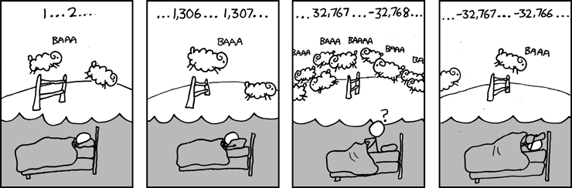
Great Reality #1: Ints are not Integers, Floats are not Reals
Example 1: Is x² ≥ 0?
Float’s: Yes!
Int’s:
40000 * 40000 --> 1600000000
50000 * 50000 --> ?
Example 2: Is (x + y) + z = x + (y + z)?
Unsigned & Signed Int’s: Yes!
Float’s:
(1e20 + -1e20) + 3.14 --> 3.14
1e20 + (-1e20 + 3.14) --> ??
Source: xkcd.com/571

Slide 7
Computer Arithmetic
Does not generate random values
Arithmetic operations have important mathematical properties
Cannot assume all “usual” mathematical properties
Due to finiteness of representations
Integer operations satisfy “ring” properties
Commutativity, associativity, distributivity
Floating point operations satisfy “ordering” properties
Monotonicity, values of signs
Observation
Need to understand which abstractions apply in which contexts
Important issues for compiler writers and serious application programmers

Slide 8
Great Reality #2: You’ve Got to Know Assembly
Chances are, you’ll never write programs in assembly
Compilers are much better & more patient than you are
But: Understanding assembly is key to machine-level execution model
Behavior of programs in presence of bugs
High-level language models break down
Tuning program performance
Understand optimizations done / not done by the compiler
Understanding sources of program inefficiency
Implementing system software
Compiler has machine code as target
Operating systems must manage process state
Creating / fighting malware
x86 assembly is the language of choice!

Slide 9
Great Reality #3: Memory Matters Random Access Memory Is an Unphysical Abstraction
Memory is not unbounded
It must be allocated and managed
Many applications are memory dominated
Memory referencing bugs especially pernicious
Effects are distant in both time and space
Memory performance is not uniform
Cache and virtual memory effects can greatly affect program performance
Adapting program to characteristics of memory system can lead to major speed improvements

Slide 10
Memory Referencing Bug Example
typedef struct {
int a[2];
double d;
} struct_t;
double fun(int i) {
volatile struct_t s;
s.d = 3.14;
s.a[i] = 1073741824; /* Possibly out of bounds */
return s.d;
}
fun(0) --> 3.14
fun(1) --> 3.14
fun(2) --> 3.1399998664856
fun(3) --> 2.00000061035156
fun(4) --> 3.14
fun(5) --> Segmentation fault
Result is system specific

Slide 11
Memory Referencing Bug Example
typedef struct {
int a[2];
double d;
} struct_t;
fun(0) --> 3.14
fun(1) --> 3.14
fun(2) --> 3.1399998664856
fun(3) --> 2.00000061035156
fun(4) --> 3.14
fun(6) --> Segmentation fault
Explanation:
Critical State | 6
? | 5
? | 4
d7 ... d4 | 3
d3 ... d0 | 2
a[1] | 1
a[0] | 0
Location accessed by fun(i)
struct_t

Slide 12
Memory Referencing Errors
C and C++ do not provide any memory protection
Out of bounds array references
Invalid pointer values
Abuses of malloc/free
Can lead to nasty bugs
Whether or not bug has any effect depends on system and compiler
Action at a distance
Corrupted object logically unrelated to one being accessed
Effect of bug may be first observed long after it is generated
How can I deal with this?
Program in Java, Ruby, Python, ML, …
Understand what possible interactions may occur
Use or develop tools to detect referencing errors (e.g. Valgrind)

Slide 13
Great Reality #4: There’s more to performance than asymptotic complexity
Constant factors matter too!
And even exact op count does not predict performance
Easily see 10:1 performance range depending on how code written
Must optimize at multiple levels: algorithm, data representations, procedures, and loops
Must understand system to optimize performance
How programs compiled and executed
How to measure program performance and identify bottlenecks
How to improve performance without destroying code modularity and generality

Slide 14
Memory System Performance Example
void copyij(int src[2048][2048],
int dst[2048][2048])
{
int i,j;
for (i = 0; i < 2048; i++)
for (j = 0; j < 2048; j++)
dst[i][j] = src[i][j];
}
void copyji(int src[2048][2048],
int dst[2048][2048])
{
int i,j;
for (j = 0; j < 2048; j++)
for (i = 0; i < 2048; i++)
dst[i][j] = src[i][j];
}
4.3ms
81.8ms
2.0 GHz Intel Core i7 Haswell
Hierarchical memory organization
Performance depends on access patterns
Including how step through multi-dimensional array

Slide 15
Why The Performance Differs
copyij
copyji

Slide 16
Great Reality #5: Computers do more than execute programs
They need to get data in and out
I/O system critical to program reliability and performance
They communicate with each other over networks
Many system-level issues arise in presence of network
Concurrent operations by autonomous processes
Coping with unreliable media
Cross platform compatibility
Complex performance issues

Slide 17
Course Perspective
Most Systems Courses are Builder-Centric
Computer Architecture
Design pipelined processor in Verilog
Operating Systems
Implement sample portions of operating system
Compilers
Write compiler for simple language
Networking
Implement and simulate network protocols

Slide 18
Course Perspective (Cont.)
Our Course is Programmer-Centric
Purpose is to show that by knowing more about the underlying system, one can be more effective as a programmer
Enable you to
Write programs that are more reliable and efficient
Incorporate features that require hooks into OS
E.g., concurrency, signal handlers
Cover material in this course that you won’t see elsewhere
Not just a course for dedicated hackers
We bring out the hidden hacker in everyone!

Slide 19
The Big Deal
This material is best learned by doing
Even though that can, at times, be difficult and frustrating
Starting with a copy of a program and then tweaking it is very different from writing from scratch
Planning, designing, organizing a program are important skills
We are the gateway to other system courses
Want to make sure everyone completing the course has mastered the material
Industry appreciates the value of this course
We want to make sure anyone claiming to have taken the course is prepared for the real world
Working in teams and collaboration is an important skill
But only if team members have solid foundations
This course is about foundations, not teamwork

Slide 20
Textbooks
Randal E. Bryant and David R. O’Hallaron,
Computer Systems: A Programmer’s Perspective, Third Edition (CS:APP3e), Pearson, 2016
http://csapp.cs.cmu.edu
This book really matters for the course!
How to solve labs
Practice problems typical of exam problems
Brian Kernighan and Dennis Ritchie,
The C Programming Language, Second Edition, Prentice Hall, 1988
Still the best book about C, from the originators

Slide 21
Overview of Computer Systems

Slide 22
Outline
Layers of computer systems
Suggested reading
1.2, 1.4.1, 1.7(before 1.7.1), 1.7.3, 1.8, 1.9.2 (the first paragraph), the first 4 asides in chapter 1

Slide 23
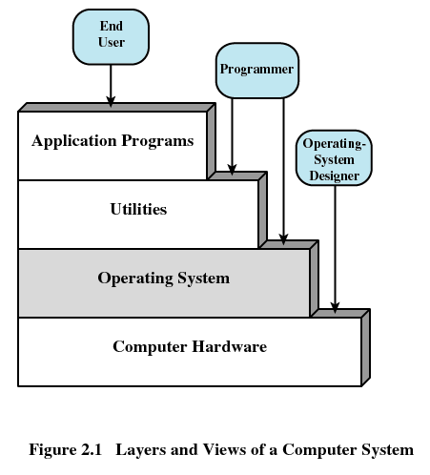
Layers of Computer Systems

Slide 24
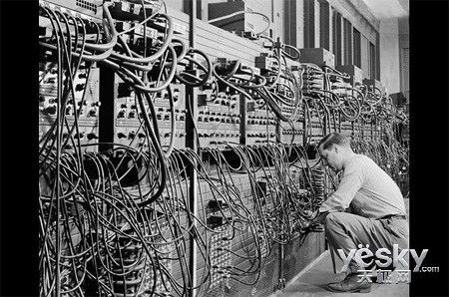
The first general purpose computer
ENIAC
Electronic Numerical Integrator And Computer
Delivered by UPenn. on Feb. 14, 1946
John Mauchly、John Eckert
ABC
Atanasoff–Berry Computer
1941
Notes:
ABC neither programmable nor turing-complete

Slide 25
Computer Hardware - Von Neumann Architecture
Instructions / Program
Main
Memory
Arithmetic
Unit
Control
Unit
PC
AC
IR
SR
Addresses
Input/Output
Unit
E.g. Storage
ENIAC
en:First Draft of a Report on the EDVAC

Slide 26
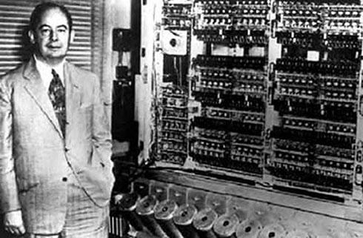
EDVAC(1944.8,1945.6,1949.8,1951-1961)
Notes:
Electronic Discrete Variable Automatic Computer

Slide 27
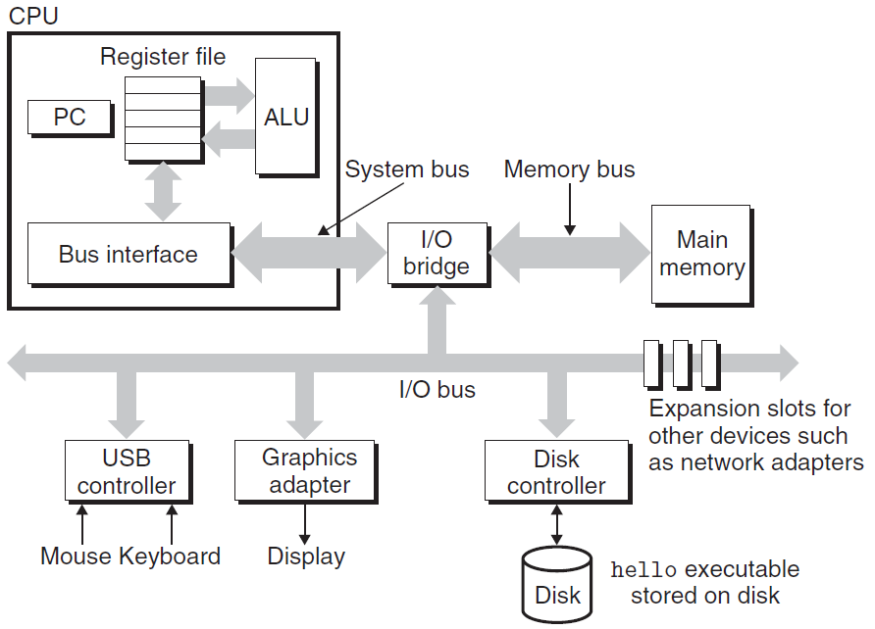
IA-32

Slide 28
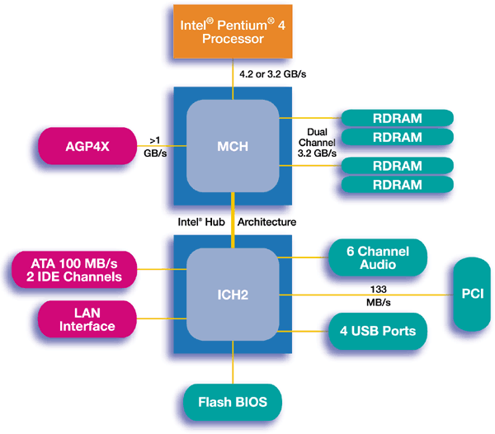
IA-32

Slide 29
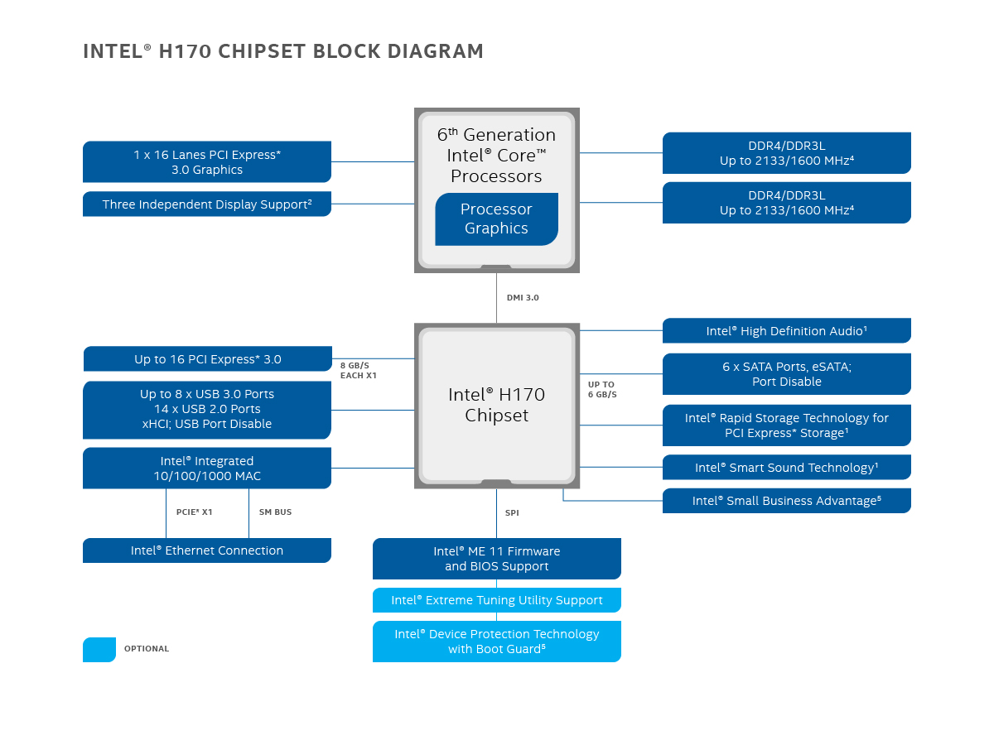
IA-32

Slide 30
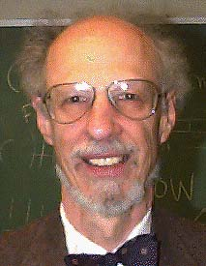
Operating Systems
1960’s
IBM OS/360, Honeywell Multics,
Fernado Jose Corbató
IEEE Computer Pioneer Award, 1982
ACM Turing Award, 1990

Slide 31
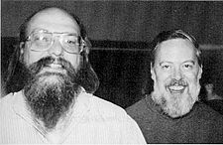
Operating Systems
Unix
Bell Lab, DEC PDP-7, 1969
Ken Thompson, Dennis Ritchie, Doug Mcllroy, Joe Ossana
1970 Brian Kernighan dubbed the system “Unix”
Rewritten in C in 1973, announced in 1974
BSD (UC, Berkeley), System V(Bell lab)
Solaris (Sun Microsystem)
Posix standard
Ken Thompson, Dennis Ritchie
ACM Turing Award, 1983

Slide 32
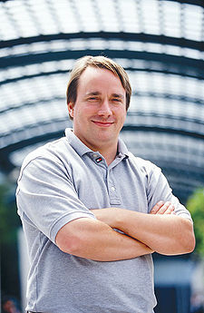

Linux
1991, Linus Torvalds
Unix-like operating systems
386(486)AT, bash(1.08), gcc(1.40)
Posix complaint version of Unix operating system
Available on a wide array of computers
From handheld devices to mainframe computers
wristwatch

Slide 33











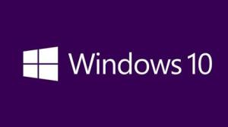
We have seen a bunch of Operating Systems

Slide 34












We have seen a bunch of Operating Systems

Slide 35
Utilities
Programming language
ANSI C
Compiler
GNU-gcc
Tools
GNU tool chain

Slide 36
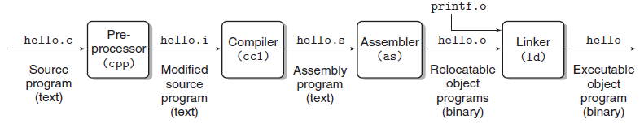
Compilation

Slide 37
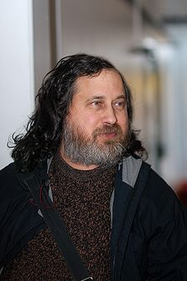

GNU
Free software
Richard Stallman, 1984
A complete Unix-like system with source code
An environment
All major components of a Unix operating system
Except for kernel

Slide 38
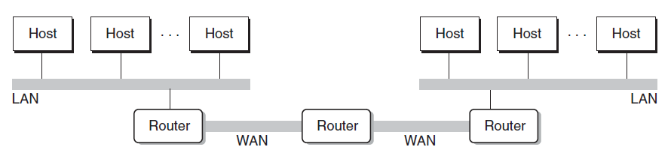
Networking
Computers are connected by networks

Slide 39


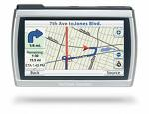
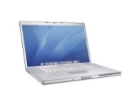

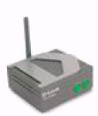

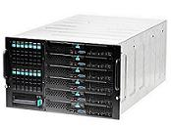

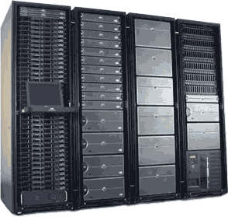
Cloud
Computer Systems support the cloud computing
Wireless
Ethernet

Slide 40
Platforms
Hardware platform
Intel IA-64
Operating system
Linux
Programming language
ANSI C
Utility
GNU
Networking
TCP/IP, Sockets

Slide 41
Important Themes
Concurrency and Parallelism
Concurrency: multiple, simultaneous activities
Parallelism: the use of concurrency to make a system run faster
Abstraction

Slide 42
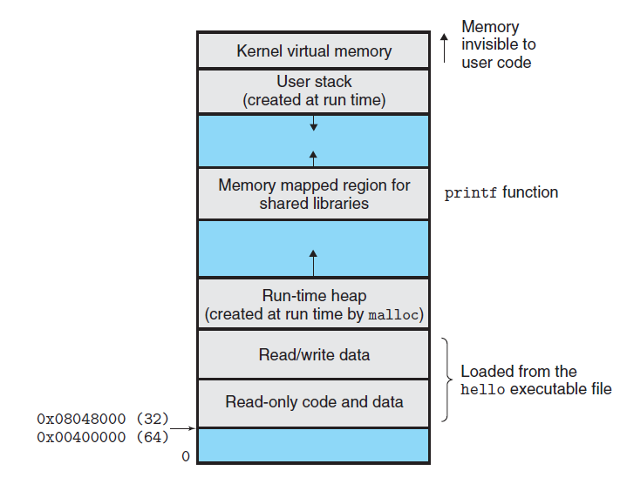

Slide 43
Roles of Computer Systems

Slide 44
Increasing the Footprint of CS
Data mining
Databases
Hardware
Robotics
Machine Learning
Distributed Systems
Systems
Natural Language
Networking
AI
Security
Comp. Bio.
HCI
Theory
Comp. Economics
Graphics
Geometric Comp.
Algorithms

Slide 45
Footprint of CS Students Saw Previously
Data mining
Databases
Hardware
Robotics
Machine Learning
Distributed Systems
Systems
Natural Language
Networking
AI
Security
Comp. Bio.
HCI
Theory
Comp. Economics
Graphics
Geometric Comp.
Algorithms

Slide 46
...in a More Diverse Set of Areas
Data mining
Databases
Hardware
Robotics
Machine Learning
Distributed Systems
Systems
Natural Language
Networking
AI
Security
Comp. Bio.
HCI
Theory
Comp. Economics
Graphics
Geometric Comp.
Algorithms

Slide 47
Total Potential Footprint is Larger
Data mining
Databases
Hardware
Robotics
Machine Learning
Distributed Systems
Systems
Natural Language
Networking
AI
Security
Comp. Bio.
HCI
Theory
Comp. Economics
Graphics
Geometric Comp.
Algorithms
Core material everyone sees is streamlined to accommodate

Slide 48
“Big Tent” Computer Science
Statistics
Electrical
Engineering
Data mining
Databases
Hardware
Robotics
Linguistics
Machine Learning
Distributed Systems
Systems
Natural Language
Networking
AI
Design
Biology
Security
Comp. Bio.
HCI
Theory
Comp. Economics
Psychology
Graphics
Geometric Comp.
Economics
Algorithms
Art

Slide 49
System Track Courses
Operating Systems
Architecture
Compilers
Distributed Systems
DBMS
Introduction to Computer Systems

