Slide 1
Good or Bad Tweets?
Twitter Sentiment Analysis
JONAH WITT AND GRACE NGUYEN

Slide 2
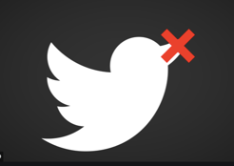
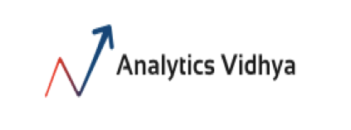
What’s the problem?
•Identify hate speech (racist/sexist)
•1 or 0 (has hate speech vs. not)
•Common problem on social media platforms
Perez, Sarah. “Twitter makes it easier to see enforcement taken on reported tweets. TechCrunch, WordPress VIP, October 17, 2018, https://techcrunch.com/2018/10/17/twitter-makes-it-easier-to-see-enforcement-taken-on-reported-tweets/.
”AnalyticsVidhyaLogo”.AnalyticsVidhya,2013,https://www.analyticsvidhya.com/blog/.
Notes:
-This data set is part of a competition hosted on Analytics Vidhya, a site where one can learn analytical techniques, read blog posts on all things data science-related, and participate in competitions.
-The goal of this competition is to predict whether a tweet has hate speech or not. Hate speech consists of anything with racial or sexist language.
-Each tweet in the training set is labeled with a 1 or a 0 along with each tweet. A 1 indicates that the tweet does have hateful speech. A 0 indicates a lack of hateful speech.
-Why is this important?
-Moderators of social media platforms face the challenge of identifying inappropriate and aggressive language that can possibly escalate into something dangerous to the public.

Slide 3
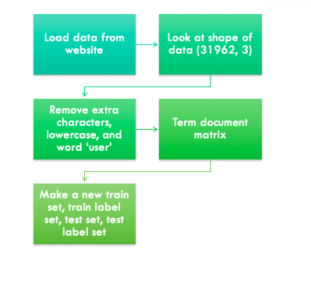
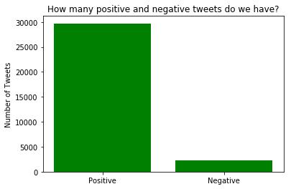
How did we prepare our data?
g
Notes:
-Analytics Vidhya has the files on their competition page to download.
-The train set had the tweets and the labels. The test set did not.
-Because of this, we did not use the test set, but, rather, created a test set and labels to train, fit, and predict.
-Thus, the shape of the data used had 31,962 rows and three columns (id, label, tweet)
-For data cleaning, we removed extra characters and words and made everything lowercase to account for the same word in different cases.
-Then, we created a term document matrix which describes how often a word occurs in a document.
-Following, we created a training set, a training set with labels, a test set, and a test set with labels with the cleaned data.
-With the TDM, the vectorizer also removes stop words!
This is prior to cleaning.
2242=negative tweets (with hateful messages, coded with ‘1’)
29720=positive tweets (no racists/sexist messages, coded with ‘0’)
total=31962 tweets

Slide 4
Negative Tweets
“the white establishment cant have blk folx running around loving themselves and promoting our greatness”
“its unbelievable that in the st century wed need something like this again neverump xenophia”
“how the altright uses amp insecurity to lure men into whitesupremacy”
“lets fight against love peace”

Slide 5
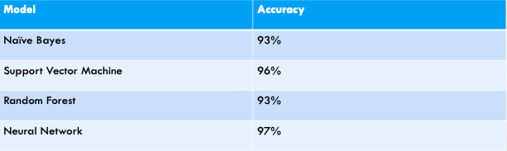
Modeling
g
Notes:
-We used 4 different models to predict hateful tweets: Naïve Bayes, SVM, Random Forest, and Neural Network with Keras.
-After training, fitting, predicting, and evaluating, these were our results.
-As you can see, SVM had the highest accuracy out of all of the models.

Slide 6
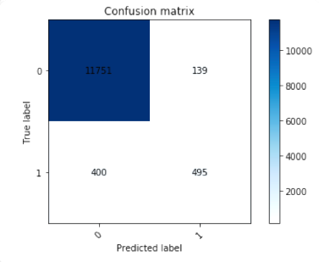
Evaluating our SVM model
g
Precision | 78%
Recall | 55%
Specificity | 98%
F-Score | 65%
Notes:
-We used a Confusion Matrix in order to evaluate our models.
-With our SVM model, which had the highest accuracy, the number of correctly identified tweets was 12,246 tweets (adding the TP and TN).
-Our error rate for our SVM model was around 4% (adding the FP and FN and dividing that by the total)
-Precision: TP/(TP+FP)=495/(495+139)=0.78
-Precision looks at the ratio of the actual number of tweets were labeled as racist to the total number of tweets labeled as racist
-Recall: the ratio of tweets labeled as racist to the total number of tweets that are racist
Recall: TP/(TP+FN)=495/(400+495)=0.55
F-Score: the harmonic average of the precision and recall
F-Score: 2*recall*precision/(recall+precision)=0.65
Specificity: of all of the non-racist tweets, what percentage of them did we predict correctly?
Specificity: 11751/(11751+139)=0.98
The problem lies in that we have too many positive tweets to negative tweets!
2242=negative tweets (with hateful messages, coded with ‘1’)
29720=positive tweets (no racists/sexist messages, coded with ‘0’)
total=31962 tweets

Slide 7
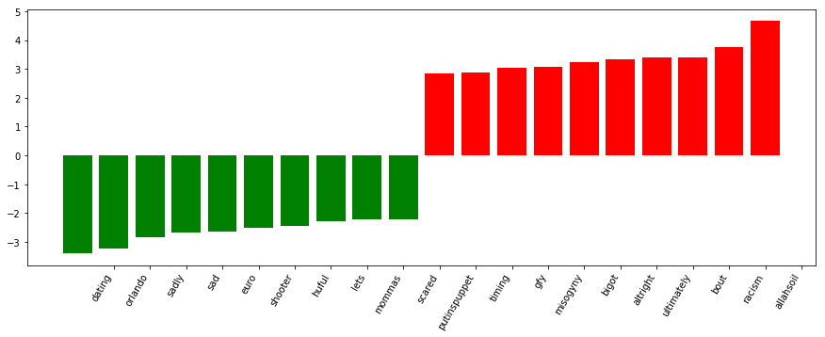
Most Influential Words

Slide 8
Mislabeled Tweets
g
“Im not interested in a linguistics that doesnt address race amp racism is about power raciolinguistics brings”
“how the altright uses amp insecurity to lure men into whitesupremacy”
Predicted: 0
Actual: 1
Notes:
Both labeled as racist (1) but predicted as 0 not racist

Slide 9
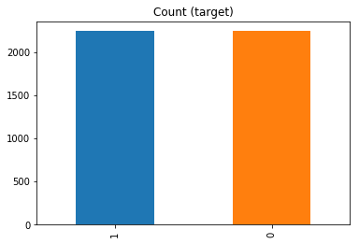
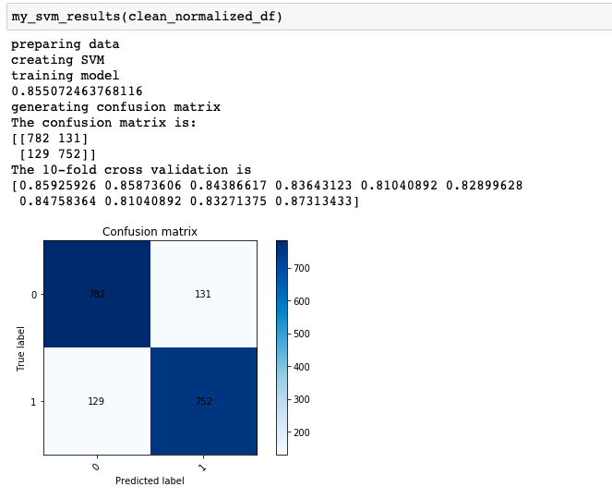
Undersampling Method
g
Precision | 85%
Recall | 85%
Specificity | 86%
F-Score | 85%
Notes:
1:2242 values
0: 2242 values
Undersampling for our data set
Accuracy is 86%
Precision:85%
Recall:85%
Specificity:86%
F-Score:85%
Undersampling vs. Oversampling
Oversampling- getting more samples for the smaller class
Oversampling problem: it creates duplicates of the samples in the minority class which can lead to overfitting.
Undersampling- reducing the number of samples in the bigger class
Problem with undersampling- loss of information (greatly reduces the number of values we would have to work with)

Slide 10
What did we learn?
“Hateful Speech” often appears to follow current trends.
For this particular problem, the model will need to be retrained often to keep with current trends.
Tweets with words like “white” and “racism” tend to get mislabeled with the model.
The Keras model had the highest accuracy but took the most time.
We would recommend the SVM model as it had 96% accuracy.
In the future, we should resample the data and ensure that the number of positive tweets is similar to the number of negative tweets.
Notes:
Undersampling vs. Oversampling
Oversampling- getting more samples for the smaller class
Oversampling problem: it creates duplicates of the samples in the minority class which can lead to overfitting.
Undersampling- reducing the number of samples in the bigger class
Problem with undersampling- loss of information (greatly reduces the number of values we would have to work with)

Slide 11
References
”ANALYTICS VIDHYA LOGO”. ANALYTICS VIDHYA, 2013, HTTPS://WWW.ANALYTICSVIDHYA.COM/BLOG/.
PEREZ, SARAH. “TWITTER MAKES IT EASIER TO SEE ENFORCEMENT TAKEN ON REPORTED TWEETS”. TECHCRUNCH, WORDPRESS VIP, OCTOBER 17, 2018, HTTPS://TECHCRUNCH.COM/2018/10/17/TWITTER-MAKES-IT-EASIER-TO-SEE-ENFORCEMENT-TAKEN-ON-REPORTED-TWEETS/.
“PRACTICE PROBLEM TWITTER SENTIMENT ANALYSIS”. ANALYTICS VIDHYA, 2019,HTTPS://DATAHACK.ANALYTICSVIDHYA.COM/CONTEST/PRACTICE-PROBLEM-TWITTER-SENTIMENT-ANALYSIS/.

Slide 12
Questions?

