Slide 1
DC Crime, AirBnB Rentals, and Housing Correlations 2010-2016
Guy, Chris, Chuck, Jonathan
Saturday, July 21, 2018
GW Data Analytics Bootcamp

Slide 2
Questions and Motivation: DC Robberies and Burglaries for the years 2010-2016
Questions:
What is the correlation between crime and AirB&B Rentals?
What is the correlation between burglaries and the number of single-family home sales?
Motivations
Is there truth to various stereotypes?
Are there more burglaries in lower-income neighborhoods?
Are there more Air BnB rentals in more affluent neighborhoods?
Etc …
How does the DC Police Department distinguish between Robbery and Burglary?
Robbery: The taking of anything of value from another person by force, violence or fear.
Burglary: The unlawful entry of a structure, vessel, watercraft, railroad car or yard where chattels are deposited with the intent to commit any criminal offense
Burglary-1: Burglary of a dwelling or other building that is occupied at the time of the event.
Burglary-1 Armed: Committing the act of burglary by use of, or threat of, any dangerous or deadly weapon.
Burglary-2: Burglary of a dwelling or other building that is not occupied at the time of the event.
http://crimemap.dc.gov/CrimeDefinitions.aspx

Slide 3
Data Sources
Neighborhood Info DC
Air bnb
DC Metropolitan Police Dept.

Slide 4
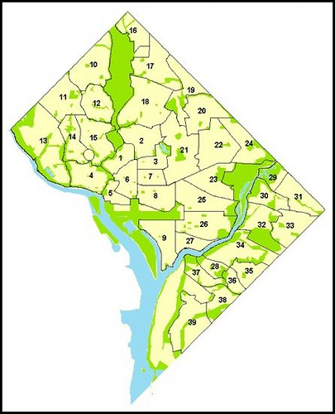
D.C. Neighborhood Clusters
Cluster 1: Kalorama Heights, Adams Morgan, Lanier Heights
Cluster 2: Columbia Heights, Mt. Pleasant, Pleasant Plains, Park View
Cluster 3: Howard University, Le Droit Park, Cardozo/Shaw
Cluster 4: Georgetown, Burleith/Hillandale
Cluster 5: West End, Foggy Bottom, GWU
Cluster 6: Dupont Circle, Connecticut Avenue/K Street
Cluster 7: Shaw, Logan Circle
Cluster 8: Downtown, Chinatown, Penn Quarters, Mount Vernon Square, North Capitol Street
Cluster 9: Southwest Employment Area, Southwest/Waterfront, Fort McNair, Buzzard Point
Cluster 10: Hawthorne, Barnaby Woods, Chevy Chase
Cluster 11: Friendship Heights, American University Park, Tenleytown
Cluster 12: North Cleveland Park, Forest Hills, Van Ness
Cluster 13: Spring Valley, Palisades, Wesley Heights, Foxhall Crescent, Foxhall Village, Georgetown Reservoir
Cluster 14: Cathedral Heights, McLean Gardens, Glover Park
Cluster 15: Cleveland Park, Woodley Park, Massachusetts Avenue Heights, Woodland-Normanstone Terrace
Cluster 16: Colonial Village, Shepherd Park, North Portal Estates
Cluster 17: Takoma, Brightwood, Manor Park
Cluster 18: Brightwood Park, Crestwood, Petworth
Cluster 19: Lamond Riggs, Queens Chapel, Fort Totten, Pleasant Hill
Cluster 20: North Michigan Park, Michigan Park, University Heights
Cluster 21: Edgewood, Bloomingdale, Truxton Circle, Eckington
Cluster 22: Brookland, Brentwood, Langdon
Cluster 23: Ivy City, Arboretum, Trinidad, Carver Langston
Cluster 24: Woodridge, Fort Lincoln, Gateway
Cluster 25: NoMa, Union Station, Stanton Park, Kingman Park
Cluster 26: Capitol Hill, Lincoln Park
Cluster 27: Near Southeast, Navy Yard
Cluster 28: Historic Anacostia
Cluster 29: Eastland Gardens, Kenilworth
Cluster 30: Mayfair, Hillbrook, Mahaning Heights
Cluster 31: Deanwood, Burrville, Grant Park, Lincoln Heights, Fairmont Heights
Cluster 32: River Terrace, Benning, Greenway, Fort Dupont
Cluster 33: Capitol View, Marshall Heights, Benning Heights
Cluster 34: Twining, Fairlawn, Randle Highlands, Penn Branch, Fort Davis Park, Dupont Park
Cluster 35: Fairfax Village, Naylor Gardens, Hillcrest, Summit Park
Cluster 36: Woodland/Fort Stanton, Garfield Heights, Knox Hill
Cluster 37: Sheridan, Barry Farm, Buena Vista
Cluster 38: Douglass, Shipley Terrace
Cluster 39: Congress Heights, Bellevue, Washington Highlands
https://neighborhoodinfodc.org/nclusters/nclusters.html

Slide 5
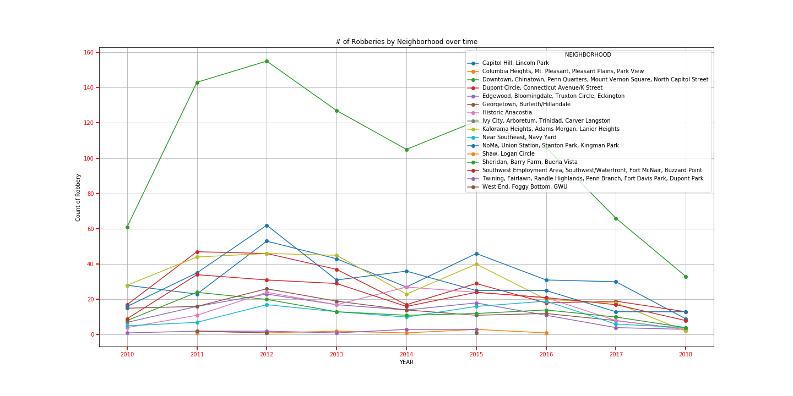
DC Robberies at a Glance

Slide 6
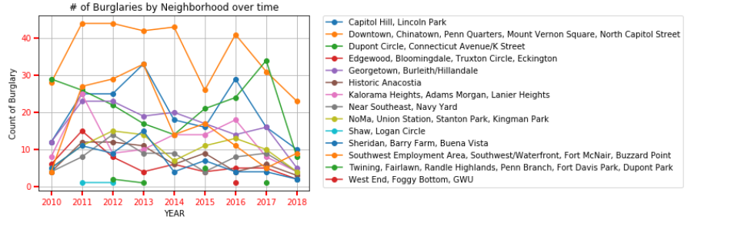
Burglary by Neighborhood over time

Slide 7
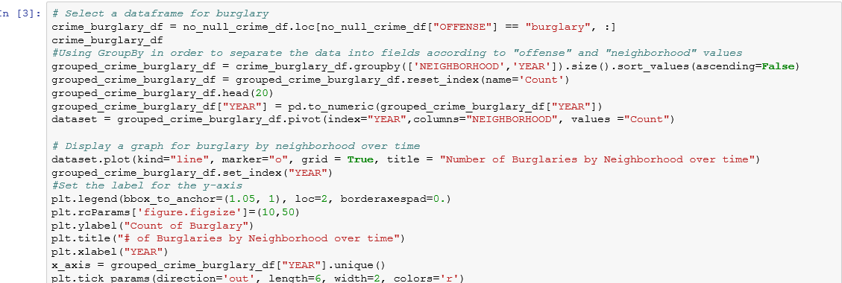
Step in the code

Slide 8
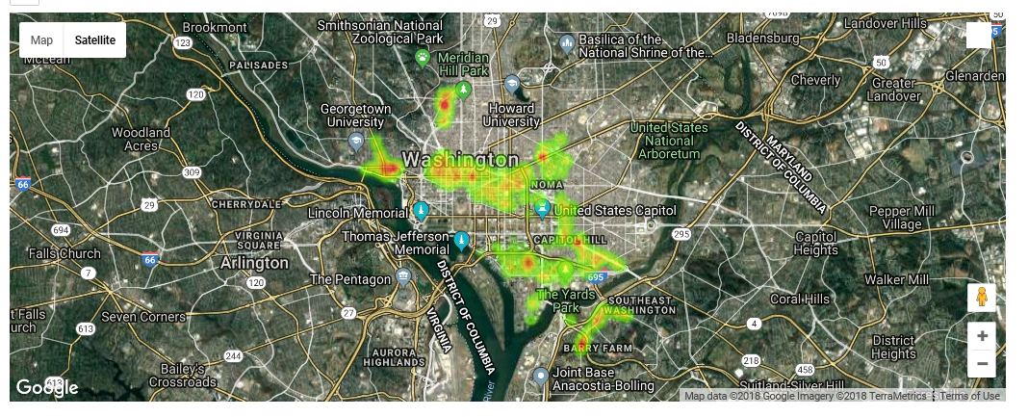
Washington d.C Burglary HEATMAP

Slide 9
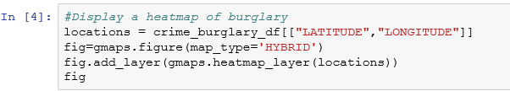
Step in the code

Slide 10
Air BnB Rentals

Slide 11
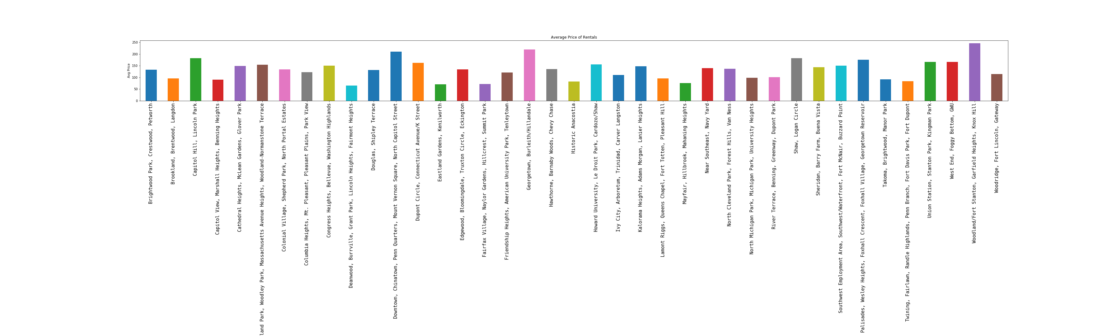

Slide 12
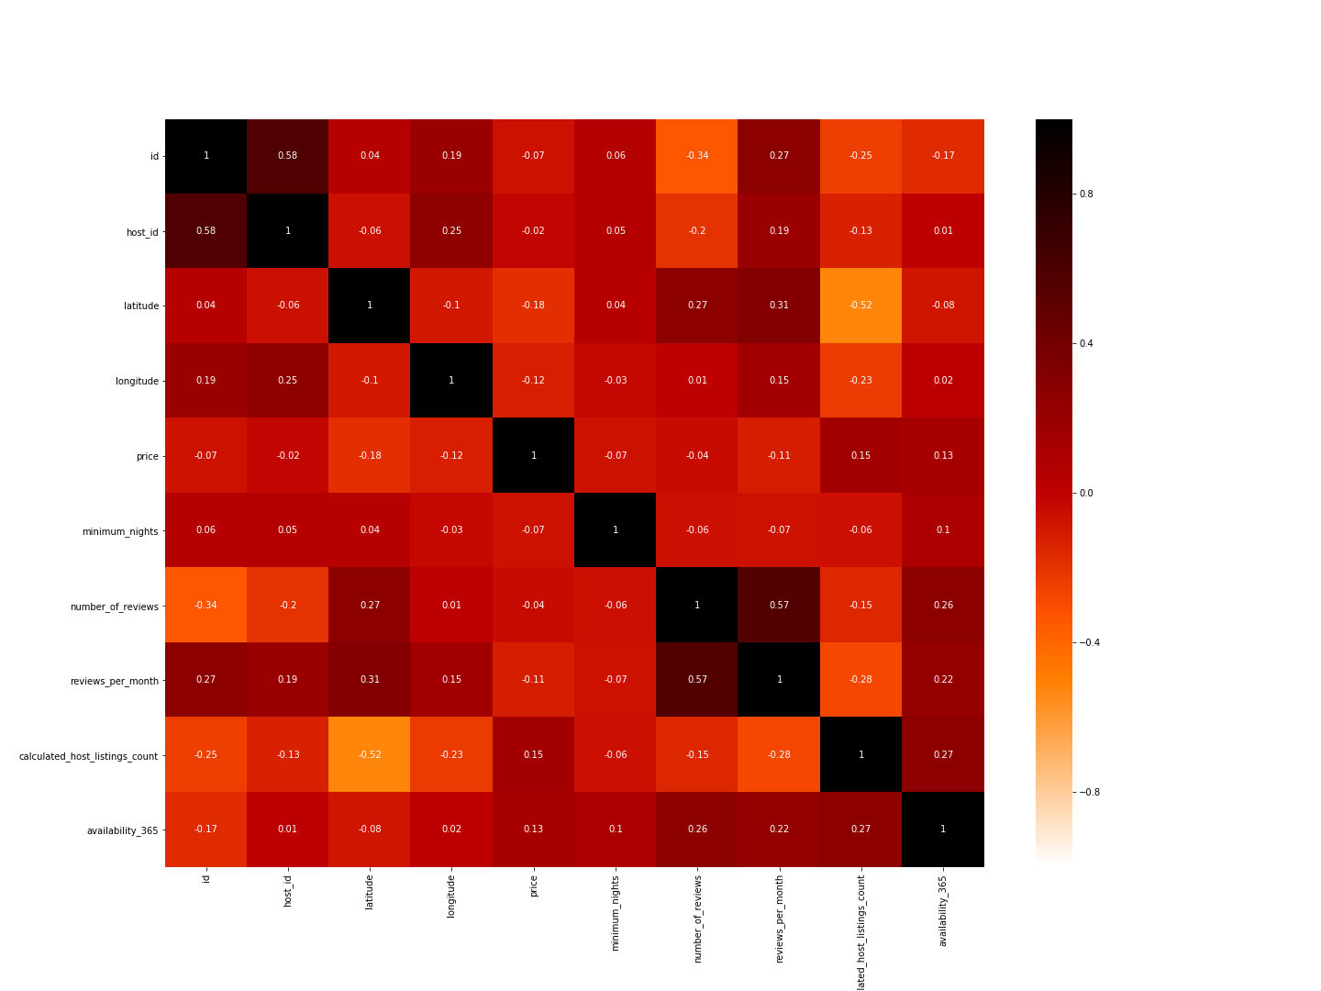
AiR BnB Correlations

Slide 13
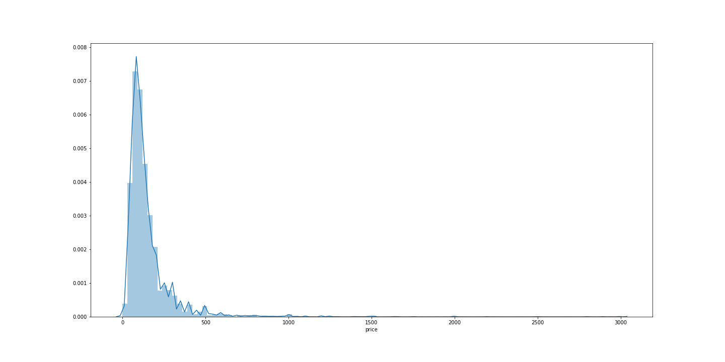
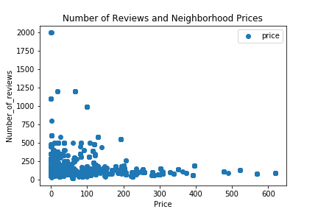
Air BnB Rental Price and Reviews Distribution

Slide 14
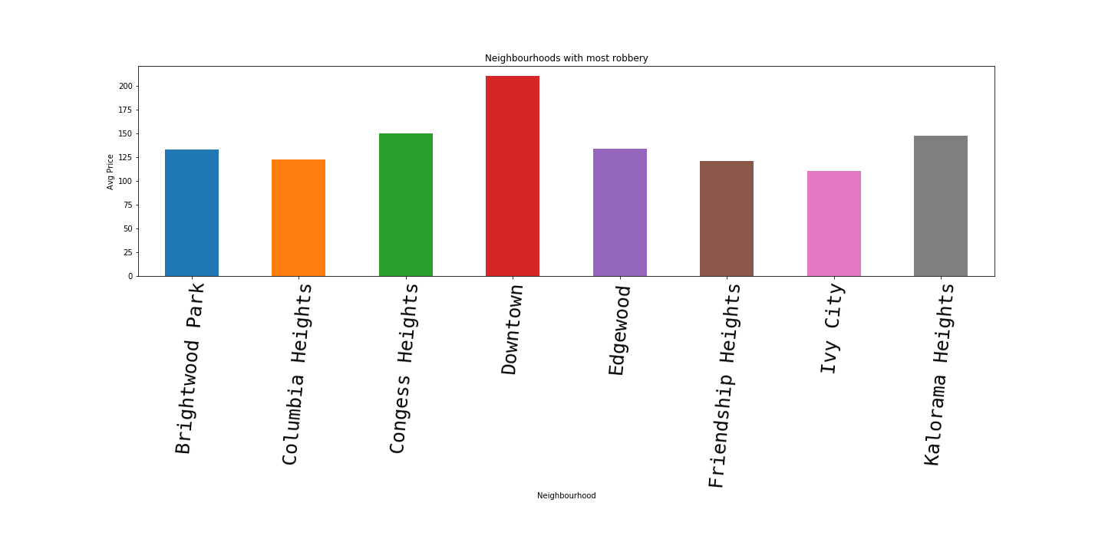
Air BnB Rental COST

Slide 15
Single-Family Housing

Slide 16
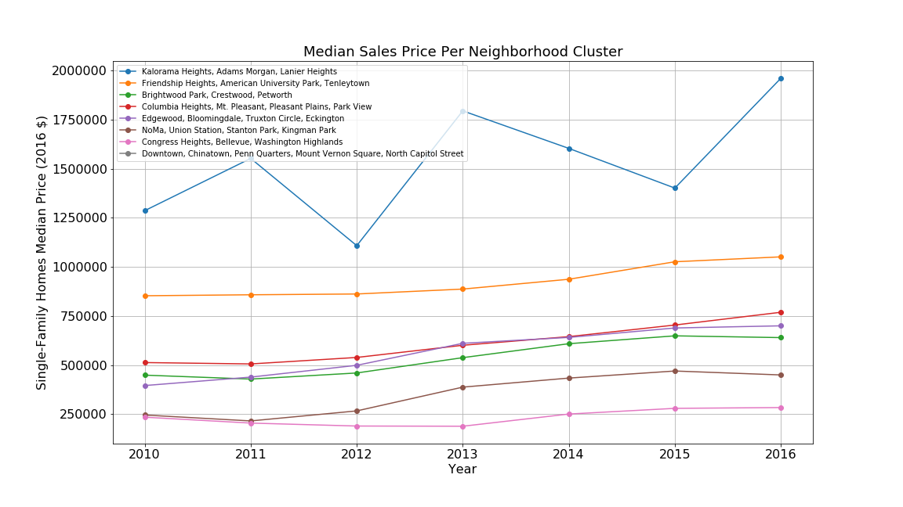
Median Prices of Single-Family Home Sales

Slide 17
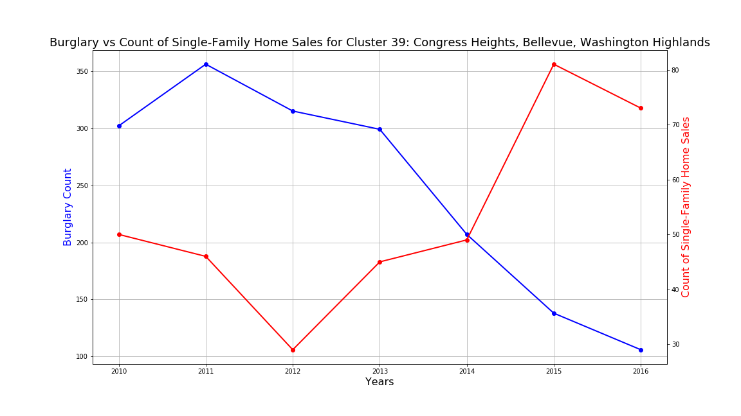
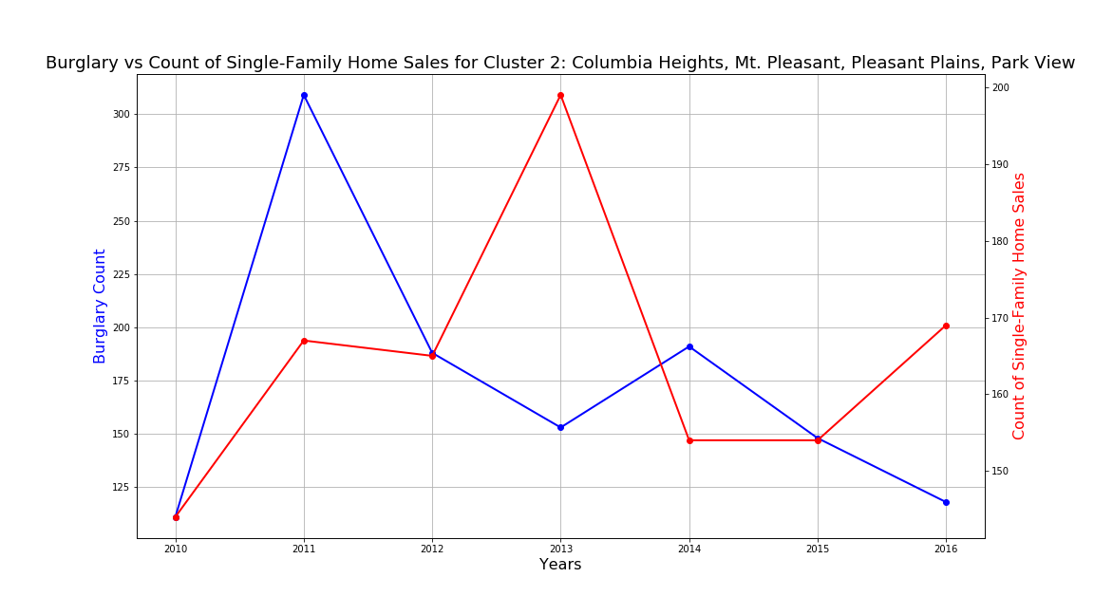
Burglaries vs Count of Single-Family Home Sales

Slide 18
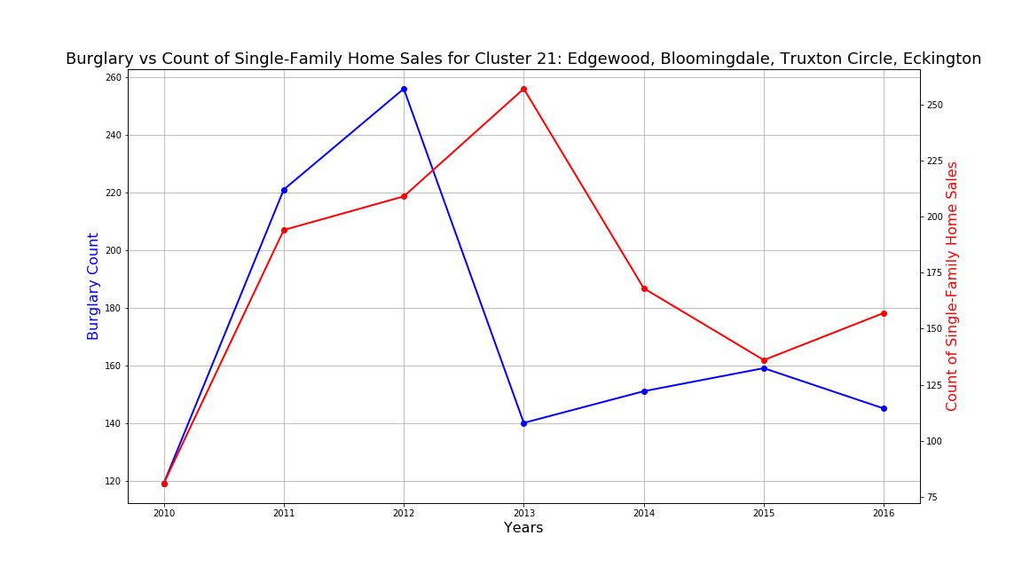
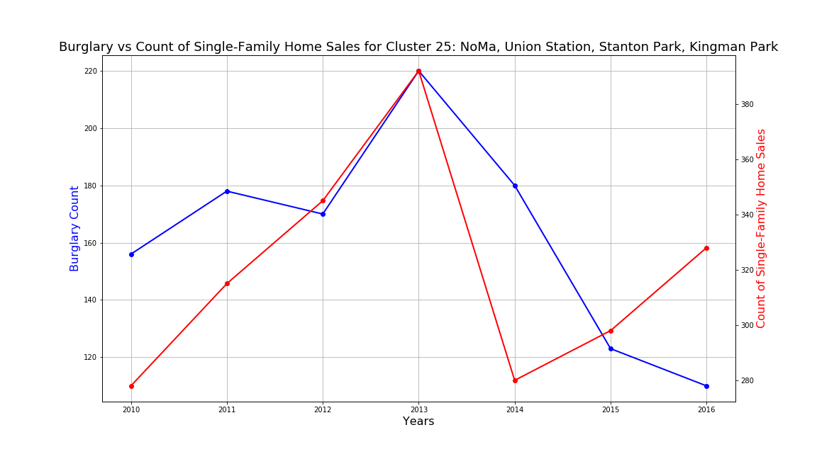
Burglaries vs Count of Single-Family Home Sales

Slide 19
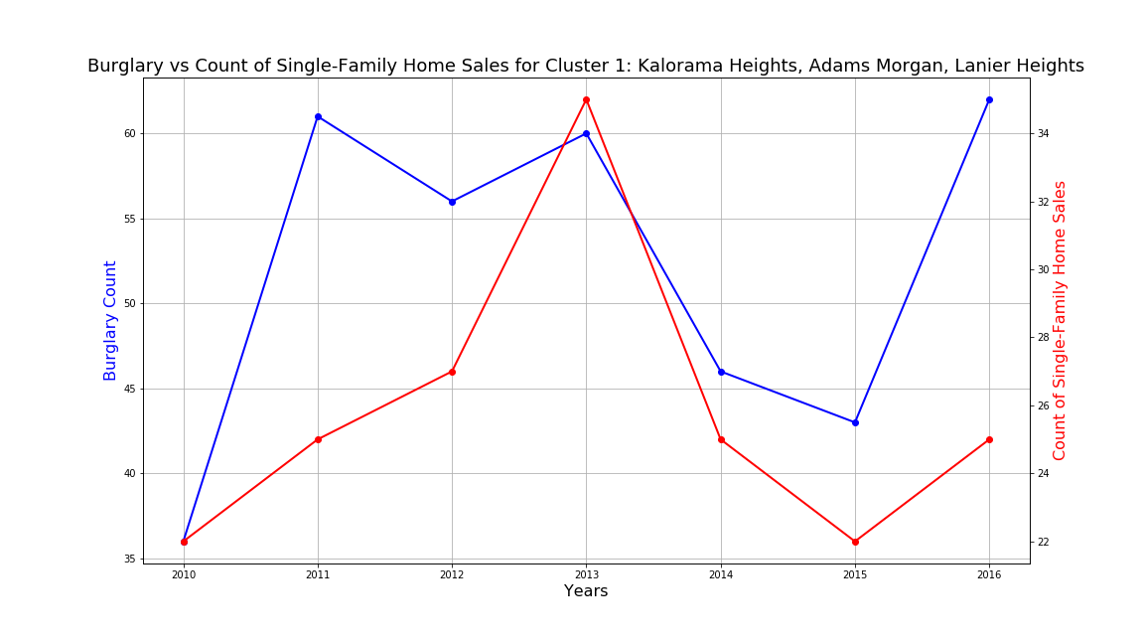
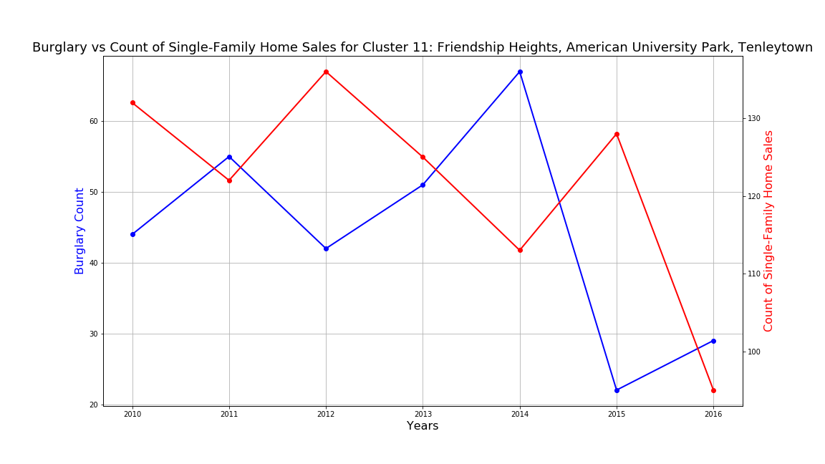
Burglaries vs Count of Single-Family Home Sales

Slide 20
Conclusions
Most Air BnB rentals in Washington DC rent between $100-$200.
Although the Downtown Neighborhood (Cluster 8) is one of the most affluent neighborhoods in the city it also has the highest rate of robberies.
Kalorama Heights (Cluster 1) has continually been the area of the city with the highest home value.
In general we found that when the number of burglaries dropped, the number of Homes sold increased. The strongest correlation of this was. in the Congress Heights Neighborhood (Cluster 39).

