Slide 1
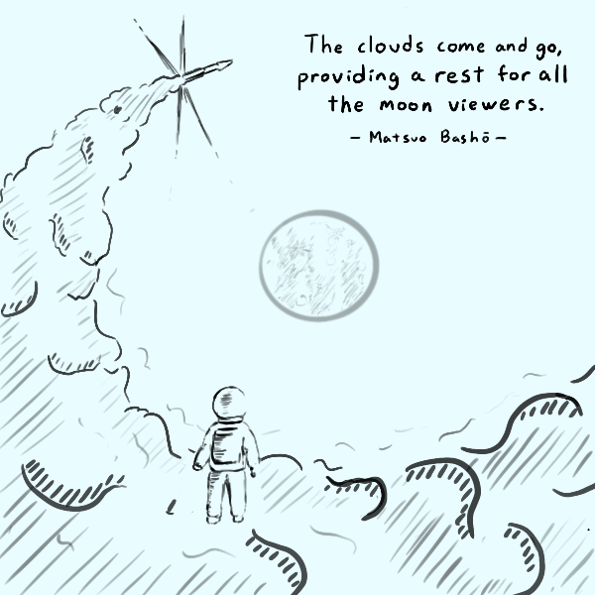
Announcements
Midterm Oct.3rd (Tuesday)
9:30-11:30 am
Late submission: 50% penalty
Download and submit at Canvas, like the assignments
Answering questions:
Bullets of key points are much clearer
Try to stick with the key points. You don’t need more than a couple of sentences if you really know the answers

Slide 2
Today’s plan: Midterm Review
Assignment #2 Review
Key Concepts Review
Notes:
Questions about miners?
The word “mining” is somewhat misleading. By evoking the extraction of precious metals, it focuses our attention on the reward for mining, the new bitcoins in each block. Although mining is incentivized by this reward, the primary purpose of mining is not the reward or the generation of new coins. If you view mining only as the process by which coins are created, you are mistaking the means (incentives) as a goal of the process. Mining is the main process of the decentralized clearinghouse, by which transactions are validated and cleared. Mining secures the bitcoin system and enables the emergence of network-wide consensus without a central authority.

Slide 3
Assignment #2 (Question 1)
The DES (Data Encryption Standard) was a symmetric encryption algorithm designed in 1976. It was the government standard until 2001. It has a block size of 64 bits, and key size of 56 bits. If Eve wants to brute-force attack DES, i.e., try all possible keys, how much time does Eve need? Assume that she can try 10¹⁰ keys per second with her personal computer.
Eve needs to try 2⁵⁶ = 2^{(10×5.6)}=10^{(3×5.6)}=10^{(16.8)} = 6.3×10¹⁶ keys. The needed time is 6.3×10¹⁶ / (10¹⁰)= 6.3×10⁶ seconds, roughly 73 days.
Reasonable approximations are allowed

Slide 4
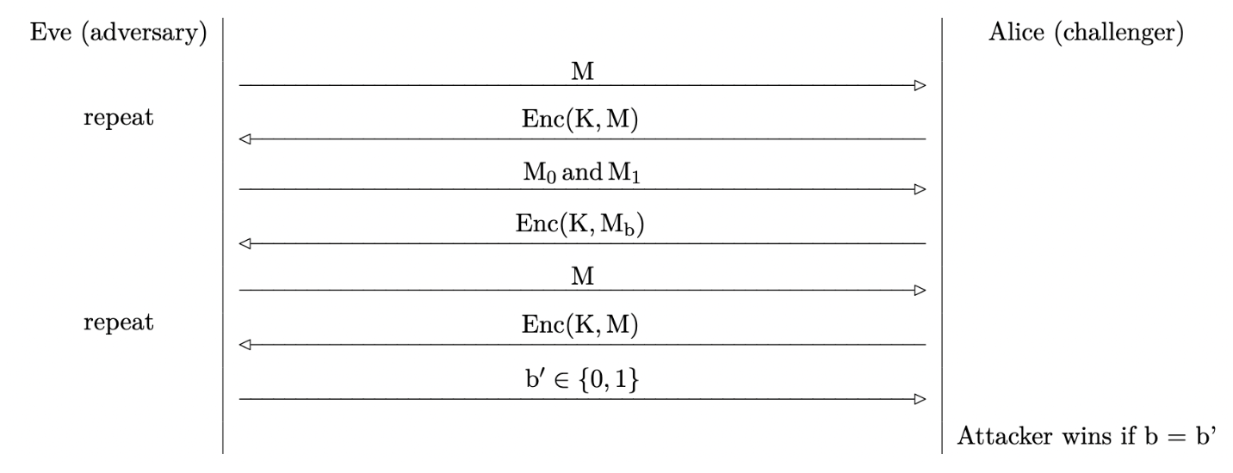
Assignment #2 (Question 2)
Q 2.1 and 2.2: Eve can trick Alice to encrypt M₀, if the return ciphertext C₀ is the same as C, then the b = 0, otherwise, b = 1.
Q 2.3: Eve can trick Alice to encrypt a message that is all 0, the return ciphertext C₀ is the key used by Alice. Then Eve can decrypt all other ciphertext with the key.

Slide 5
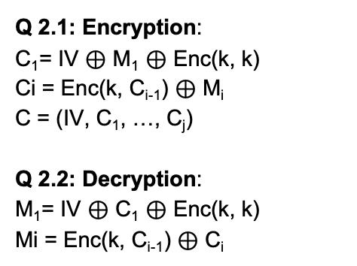
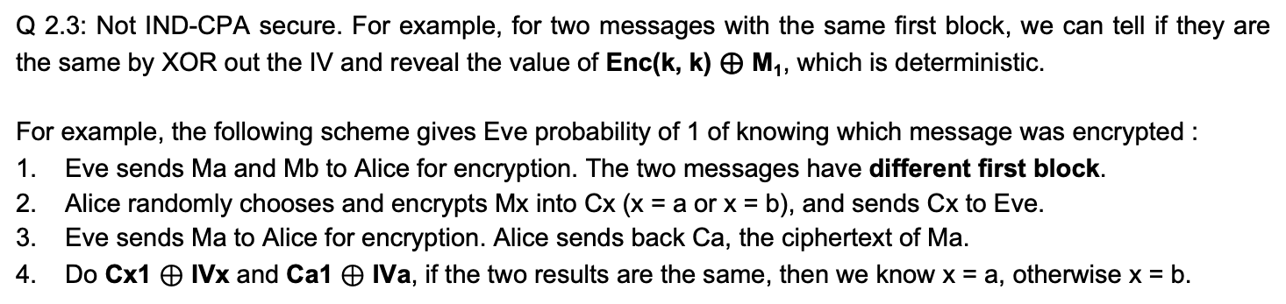
Assignment #2 (Question 3)
Q 2.1: Encryption:
C₁= IV $⊕$ M₁ $⊕$ Enc(k, k)
Ci = Enc(k, C_{i-1}) $⊕$ M_{i}
C = (IV, C₁, …, C_{j})
Q 2.2: Decryption:
M₁= IV $⊕$ C₁ $⊕$ Enc(k, k)
Mi = Enc(k, C_{i-1}) $⊕$ C_{i}
Q 2.3: Not IND-CPA secure. For example, for two messages with the same first block, we can tell if they are the same by XOR out the IV and reveal the value of Enc(k, k) ⊕ M₁, which is deterministic.
For example, the following scheme gives Eve probability of 1 of knowing which message was encrypted :
Eve sends Ma and Mb to Alice for encryption. The two messages have different first block.
Alice randomly chooses and encrypts Mx into Cx (x = a or x = b), and sends Cx to Eve.
Eve sends Ma to Alice for encryption. Alice sends back Ca, the ciphertext of Ma.
Do Cx1 $⊕$ IVx and Ca1 $⊕$ IVa, if the two results are the same, then we know x = a, otherwise x = b.

Slide 6
Assignment #2 (Question 4)
Ciphertext c = c₁ || c₂ where c₁ = Enc(K, m) and c₂ = Hash(c₁)
Q 4.1: Does it provide confidentiality?
It provides confidentiality
Q 4.2: Does it provide integrity?
No integrity, Mallory can send Bob (c’ || Hash(c’))
Q 4.3: A scheme that provides both confidentiality and integrity?
Ciphertext c = c₁ || c₂ where c₁ = Enc(K, m) and c₂ = MAC(K, c₁)
Encrypt then MAC

Slide 7
Assignment #2 (Question 5)
Eve is an eavesdropper between Alice and Bob.
Alice and Bob each seed a PRNG with different random inputs.
Alice uses her PRNG from the previous step to generate a, and Bob uses his PRNG from the previous step to generate b.
Alice and Bob perform a Diffie-Hellman key exchange using their generated secrets (a and b). Recall that, in Diffie-Hellman, neither a nor b are directly sent over the channel.
Alice and Bob, without reseeding, each use their PRNG to generate some pseudorandom output.
Eve learns both Alice’s and Bob’s pseudorandom outputs.
Can Eve learn about the secret if the PRNG is not rollback resistant?
Q 5.1: Yes. Eve may learn about a and b, thus the shared secret g^{ab} mod p.
Q 5.2: Yes. Eve may learn about b, thus the shared secret g^{ab} mod p by (gª mod p)^{b} mod p.
Find a m so that Mallory can share the same secret with both
Q 5.3: g^{am} mod p = g^{bm} mod p , there are many such m values

Slide 8
Security Principles
What are the security principles?
Identify security examples being used
Give real life examples of security principles

Slide 9
Cryptography Roadmap
 | Symmetric-key | Asymmetric-key
Confidentiality | One-time pads Block ciphers with chaining modes (e.g. AES-CBC) Stream ciphers | RSA encryption
Integrity, Authentication | MACs (e.g. HMAC) | Digital signatures (e.g. RSA signatures)
Hash functions
Pseudorandom number generators
Public key exchange (e.g. Diffie-Hellman)
Key management (certificates)
Password management

Slide 10
Symmetric-Key Encryption: Definition
A symmetric-key encryption scheme has three algorithms:
KeyGen() → K: Generate a key K
Enc(K, M) → C: Encrypt a plaintext M using the key K to produce ciphertext C
Dec(K, C) → M: Decrypt a ciphertext C using the key K
Alice
Key
Insecure Channel
Key
Bob
Plaintext
Encryption Algorithm
Ciphertext
Decryption Algorithm
Plaintext

Slide 11
One-Time Pad
How does it work?
How does encryption work? Formula?
How does decryption work? Formula?
Why is it called One-Time Pad?
Security
What is IND-CPA secure? What is the IND-CPA game?
Does One-Time Pad have IND-CPA?
What if we reuse the same key for different messages? Do we still have IND-CPA?
Notes:
Ask students if they can produce the decryption equation before showing it to them

Slide 12
Block Cipher
How does block ciphers work?
Why it is called block ciphers?
Why do we need operating modes?
Where do we use the key?
Analyzing Modes
Giving a new operating mode, analyzing the formulas used for encryption and description
Analyze the performance implication
Analyze if the mode is IND-CPA secure: why some modes are secure and others are not
Security
What are IV and nonce?
Where do we use them?
Why do we need them?
Does block cipher provide integrity?

Slide 13
Hash
What are the basic properties of hash functions?
What is one way function?
What is collision resistant?
What can length extension attacks do?
Security
Do hash provide integrity?
How can we use hash for integrity?

Slide 14
MAC
Why do we want MAC?
Why is it different from hash?
How does HMAC work?
What are the inputs?
Security
Do MACs provide integrity?
Do MACs provide confidentiality?
How do we get both confidentiality and integrity?
What is Encrypt-then-MAC?
What is MAC-then-encrypt?

Slide 15
PRNG
Where do we need random numbers?
PRNG
Why is it called Pseudorandom?
What is rollback resistance?
What can the attacker do if the PRNG is not rollback resistant?

Slide 16
Diffie-Hellman Key Exchange
Why do we want it?
How does it work?
What variables are public? What variables are private?
What is the information being sent between Alice and Bob? Formula?
What is the secret being shared? Formula?
Security
What’s the security issue with it?

Slide 17
Public-Key Encryption
Why do we want Asymmetric-key encryption?
What are the major benefits?
What is the major issue?
How does RSA encryption work?
What variables are the public key?
What variables are the private key?
How do we do encryption? Formula?
How do we do decryption? Formula?
Security
Can it defend against MITM attack?

Slide 18
Digital Signature
Why do we need signature?
What key is used for digital signature?
Why do we sign the hash instead of the plaintext?
How does RSA signature work?
How do we sign a message? Formula?
How do we verify a signature? Formula?
Security
How can we combine public-key encryption and digital signature?
Can we provide confidentiality and integrity together?

Slide 19
Certificate
Why do we need certificate?
What does a certificate contain?
What are Certificate Authorities?
Why do we need them?

