Slide 1
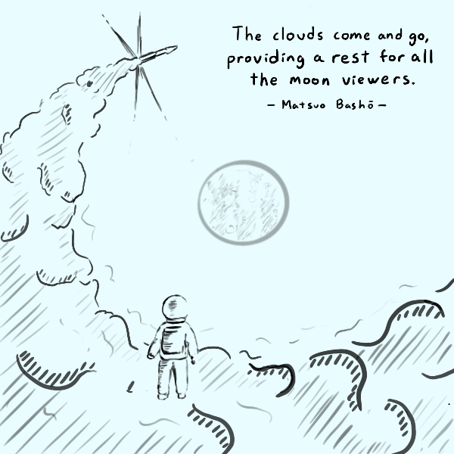
Announcements
Homework 2 due Sep.26th (Tuesday)
Midterm Oct.3rd (Tuesday)

Slide 2
Cryptography Roadmap
 | Symmetric-key | Asymmetric-key
Confidentiality | One-time pads Block ciphers (e.g. AES-CBC) Stream ciphers | RSA encryption
Integrity, Authentication | MACs (e.g. HMAC) | Digital signatures (e.g. RSA signatures)
Hash functions
Pseudorandom number generators
Public key exchange (e.g. Diffie-Hellman)
Key management (certificates)
Password management

Slide 3
Bitcoin

Slide 4
Today: Bitcoin
Bitcoin: Sending and receiving money without trusting a central authority
How does Bitcoin work?
How do we manage identity, transactions, and balances on a ledger?
How do we construct a decentralized, trusted ledger?
The trouble with Bitcoin
Bitcoin in practice
Notes:
Questions about miners?
The word “mining” is somewhat misleading. By evoking the extraction of precious metals, it focuses our attention on the reward for mining, the new bitcoins in each block. Although mining is incentivized by this reward, the primary purpose of mining is not the reward or the generation of new coins. If you view mining only as the process by which coins are created, you are mistaking the means (incentives) as a goal of the process. Mining is the main process of the decentralized clearinghouse, by which transactions are validated and cleared. Mining secures the bitcoin system and enables the emergence of network-wide consensus without a central authority.

Slide 5
Bitcoin: Identity and Transactions

Slide 6
Problem Statement: The Decentralized Bank
Alice, Bob, Carol, and Dave each have a sum of currency
Anyone can send money to anyone else
Dave pays Alice 10 coins
Dave’s balance decreases by 10
Alice’s balance increases by 10
No party can spend more currency than they currently have
Dave has 10 coins
Dave can send Alice 10 coins
Dave cannot send Alice 15 coins
No party trusts any other party, and there is no central authority
Usually, a centralized authority (e.g. a bank) tracks balances and enforces spending rules
Without a central authority, we must use cryptography to enforce correctness!

Slide 7




Identity Management
Alice
Bob
Idea: Use certificates to verify real-world identity?
But this needs central root CAs, which we don’t want
Instead, just define each identity as a public key
Circumvents the identity problem since we completely ignore real-world identities
Instead of transactions between “people,” we use transactions between public keys
PKA
PKB
Carol
Dave
PKC
PKD

Slide 8
Transactions
For now, assume the existence of a trusted, public ledger
Accessible to all parties: Everyone can view the ledger
Append-only: Everyone can add data to the ledger
Immutable: Nobody can change or delete existing data
This is a central authority for now, but we’ll deal with it later
How do we record transactions in a way that everyone can see them?
Idea: Put “PKD paid PKA 10 coins” on the ledger?
Problem: Mallory can forge a transaction (e.g. “PKA paid PKM 10,000 coins”)
Solution: Use digital signatures: Put {“PKD paid PKA 10 coins”}SKD⁻¹ on the ledger
Problem: How do we check how much currency Dave (PKD) has to spend?

Slide 9
Transactions
Each party’s balance exists only as (total received) - (total spent) on the ledger
Real-time balances values aren’t listed directly on the ledger!
How much time does this take?
Too long: We have to scan through the entire ledger to determine someone’s balance
The ledger grows indefinitely as more and more transactions occur
The Ledger v1
PKA, PKB, PKC, and PKD magically start with 10 coins.
{“PKA paid PKC 4 coins.”}SKA⁻¹
{“PKB paid PKD 6 coins.”}SKB⁻¹
{“PKB paid PKA 2 coins.”}SKB⁻¹
How many coins does PKA have right now?
8 coins! 10 - 4 + 2 = 8, for transactions 1, 2, and 4 on the ledger.

Slide 10
Transactions
Construction: Each transaction has inputs (sources, where the money came from) and outputs (destinations, who currency is going to)
Now, each party only needs to keep track of transactions where they received money (they were the output)
Example: {“Using currency from TX 2 and TX 4, give 3 coins to PKA and 4 coins to PKB”}SKD⁻¹
TX 2 and TX 4 are now “spent” (used as an input), so we don’t need to keep track of it anymore
Alice and Bob now have an additional unspent transaction
To validate a transaction T is unspent, check that no transaction after T uses T as an input
Pay whatever change you have back to yourself
Example: From TX 2 and TX 4, Dave has received 10 coins in total
{“Using TX 2 and TX 4, give 3 coins to PKA, 4 coins to PKB, and 3 coins to PKD”}SKD⁻¹

Slide 11
Transactions
TX2 (by PKB)
Inputs | TX1 (5 coins)
Outputs | PKD (5 coins)
TX4 (by PKD)
Inputs | TX2 (5 coins)
 | TX3 (5 coins)
Outputs | PKA (3 coin)
 | PKB (4 coins)
 | PKD (3 coins)
TX5 (by PKA)
Inputs | TX4 (3 coin)
Outputs | PKC (3 coin)
TX3 (by PKC)
Inputs | TX1 (5 coins)
Outputs | PKD (5 coins)
TX6 (by PKB)
Inputs | TX4 (4 coins)
Outputs | PKD (4 coins)
The Ledger v2
PKB and PKC magically start with 5 coins.
{“Using currency from TX 1, give 5 coins to PKD.”}SKB⁻¹
{“Using currency from TX 1, give 5 coins to PKD.”}SKC⁻¹
{“Using currency from TX 2 and TX 3, give 3 coin to PKA and 4 coins to PKB, and 3 coins to PKD”}SKD⁻¹
{“Using currency from TX 4, give 3 coin to PKC.”}SKA⁻¹
{“Using currency from TX 4, give 4 coins to PKD.”}SKB⁻¹

Slide 12
Transactions
TX2 (by PKB)
Inputs | TX1 (5 coins)
Outputs | PKD (5 coins)
TX4 (by PKD)
Inputs | TX2 (5 coins)
 | TX3 (5 coins)
Outputs | PKA (3 coin)
 | PKB (4 coins)
 | PKD (3 coins)
TX5 (by PKA)
Inputs | TX4 (3 coin)
Outputs | PKC (3 coin)
TX3 (by PKC)
Inputs | TX1 (5 coins)
Outputs | PKD (5 coins)
TX6 (by PKB)
Inputs | TX4 (4 coins)
Outputs | PKD (4 coins)
Each transaction must identify a valid source of currency by referencing a past transaction.
In each transaction, the total input currency is equal* to the total output currency.
In TX 4, 5 + 5 = 3 + 4 + 3
We must also verify that no other transaction has already claimed this input.
Leftover money is returned to the sender. PKD spent 7 coins and sent the remaining 3 back to himself.
Notes:
By independently verifying each transaction as it is received and before propagating it, every node builds a pool of valid (but unconfirmed) transactions known as the transaction pool, memory pool or mempool.

Slide 13
Bitcoin: The Public Ledger
Notes:
Bitcoin is powered by blockchain, which is the technology that powers many cryptocurrencies. A blockchain is a decentralized ledger of all the transactions across a network. Groups of approved transactions together form a block and are joined to create a chain. Think of it as a long public record that functions almost like a long running receipt. Bitcoin mining is the process of adding a block to the chain.

Slide 14
Recall: Hash Functions
Hash functions produce a fixed-length “fingerprint” over an arbitrary length of data
Preimage resistant: Given an output, difficult to find an input that hashes to the output
Collision resistant: Difficult to find two inputs that hash to the same output
In practice, hash functions “look” random
Changing the input causes the output to change unpredictably
Each bit in the output has a 50% chance of flipping

Slide 15
Hash Chains (Blockchain)
What we want: A data structure where we can append a node and then compute a hash over all nodes efficiently
Appending a node of size n should take O(n) time
Idea: To validate the previous block, include a hash of the previous block
The previous block validates the block before, etc.
To append:
Compute the hash of the current block
Construct a new block containing the previous hash and the data
Set the head of the chain to the new block
prev_hash: NULL
data: ...
B0
prev_hash: H(B0)
data: ...
B1
prev_hash: H(B1)
data: ...
B2
prev_hash: H(B2)
data: ...
B3
Notes:
a new group of accepted transactions, called a block, is created, added to the blockchain, and quickly published to all nodes, without requiring central oversight.
bitcoins only exist by virtue of the blockchain; they are represented by the unspent outputs of transactions.^{[7]: ch. 5}
To prevent double spending, each input must refer to a previous unspent output in the blockchain.^{[30]} The use of multiple inputs corresponds to the use of multiple coins in a cash transaction.
The word “mining” is somewhat misleading. By evoking the extraction of precious metals, it focuses our attention on the reward for mining, the new bitcoins in each block. Although mining is incentivized by this reward, the primary purpose of mining is not the reward or the generation of new coins. If you view mining only as the process by which coins are created, you are mistaking the means (incentives) as a goal of the process. Mining is the main process of the decentralized clearinghouse, by which transactions are validated and cleared. Mining secures the bitcoin system and enables the emergence of network-wide consensus without a central authority.

Slide 16
Hash Chains (Blockchain)
Result
The latest hash represents a hash over all previous nodes
Changing data changes the block’s hash, which changes the next block’s hash, etc.
This is really just an append-only linked list
Git uses this: Each commit contains a hash of the previous commit
prev_hash: NULL
data: ...
B0
prev_hash: H(B0)
data: ...
B1
prev_hash: H(B1)
data: ...
B2
prev_hash: H(B2)
data: ...
B3

Slide 17
Merkle Trees
What we want: A data structure where we can modify a node and then compute a hash over all nodes efficiently
Appending a node of size n to a structure with m nodes should take O(n + log m) time
Idea: Instead of hashing all nodes at once, combine hashes as a binary tree
Each node is a hash of the two child node’s hashes
To modify:
Modify and re-hash the block
Re-hash the parent nodes until you reach the root
Hash: H(B03)
Data: H(B01) || H(B23)
B03
Data: H(B0) || H(B1)
Data: H(B2) || H(B3)
B01
B23
Data: ...
Data: ...
Data: ...
Data: ...
B0
B1
B2
B3

Slide 18
Merkle Trees
Result
The top hash represents a hash over all nodes
Can easily modify any node and compute O(log m) hashes in order to compute a new top hash
Bitcoin uses a linear chain instead of a tree, but Merkle trees appear in many other applications
Hash: H(B03)
Data: H(B01) || H(B23)
B03
Data: H(B0) || H(B1)
Data: H(B2) || H(B3)
B01
B23
Data: ...
Data: ...
Data: ...
Data: ...
B0
B1
B2
B3

Slide 19
The Public Ledger
Our previous scheme needed a public, trusted ledger
Append-only, immutable
Accessible to all parties
We can’t trust any individual to maintain the ledger for us
Consensus: A way to reach agreement on something as a group, without placing trust in any individual
For simplicity, combine multiple transactions into one block, so we only need to reach consensus for one block at a time while maintaining several hundred transactions
Notes:
A proof of work mechanism requires miners to use computing resources for the privilege. Here’s how it works:
New transactions are grouped together. Users buy and sell cryptocurrency, and the data from these transactions are pooled into a block.
Miners compete to process the new block. Crypto miners compete to be the first to solve a complex math problem. By showing proof that they’ve undertaken the computational work—referred to as a hash—earns the miner the right to process the block of transactions.
One miner is chosen to add the new block. There is a degree of randomness in deciding which miner wins the right to process the block. The winner is awarded new cryptocurrency coins, and adds a new block to the blockchain.
To accomplish this, networks use something called a “consensus mechanism,” which is a system that allows all the computers in a crypto network to agree about which transactions are legitimate.
Proof-of-work blockchains are secured and verified by virtual miners around the world racing to be the first to solve a math puzzle. The winner gets to update the blockchain with the latest verified transactions and is rewarded by the network with a predetermined amount of crypto.
Note: The target hash adjusts once every 2016 block or approximately once every 2 weeks. All the miners immediately stop working on the said block and start mining the next block.

Slide 20
Forking Attacks
Do hash chains allow a group of individuals to reach a consensus?
No. If Mallory creates an alternate history where she didn’t spend 100,000 coins, this is still a valid hash chain!
Need a way to agree on the head of the blockchain
PKM spent 100,000 coins
PKM did not spend 100,000 coins
Notes:
A blockchain is a distributed ledger—essentially a database—that records transactions and information about them and then encrypts the data. The blockchain's network reaches a majority consensus about transactions through a validation process, and the blocks where the information is stored are sealed.
At this time, the decision on which block will be chosen depends on all the other miners in the network.
https://criptomo.com/two-simultaneous-blocks/
That is why in real world transactions it is considered correct to wait for the 6 confirmations to give the payment as insurance. That is, it waits for there to be 6 accepted blocks on top of the one that contains a transaction to consider that the block will no longer be orphaned.
Miners validate new transactions and record them on the global ledger. A new block, containing transactions that occurred since the last block, is “mined” every 10 minutes on average, thereby adding those transactions to the blockchain. Transactions that become part of a block and added to the blockchain are considered “confirmed,” which allows the new owners of bitcoin to spend the bitcoin they received in those transactions.

Slide 21

Proof of Work
In each block, include a random number (“nonce”)
For a block to be valid, the hash of the block must start with some number of 0’s
If you want 4 0’s, each nonce has a 1/2⁴ = 1/16 chance of creating a valid block
Each user keeps track of their own blockchain
Hash: 0b11100011
Hash: 0b01001000
nonce: 0x0000
prev_hash: ...
data: ...
nonce: 0x0001
prev_hash: ...
data: ...
✗
✗
Hash: 0b00011010
Hash: 0b00000101
nonce: 0x0002
prev_hash: ...
data: ...
nonce: 0x0017
prev_hash: ...
data: ...
✗
✓
Notes:
A key feature of proof-of-work schemes is their asymmetry: the work – the computation – must be moderately hard (yet feasible) on the prover or requester side but easy to check for the verifier or service provider. This idea is also known as a CPU cost function, client puzzle, computational puzzle, or CPU pricing function. Another common feature is built-in incentive-structures that reward allocating computational capacity to the network with value in the form of cryptocurrency.^{[5][6]3}
The “work” in proof of work is key: The system requires miners to compete with each other to be the first to solve arbitrary mathematical puzzles to prevent anybody from gaming the system. The winner of this race is selected to add the newest batch of data or transactions to the blockchain.
By incentivizing miners to verify the integrity of new crypto transactions before adding them to the distributed ledger that is blockchain, proof of work helps prevent double spending.

Slide 22
Proof of Work
Users “mine” a block by trying nonce values until a valid block is found
This requires trying many nonces to find one to produce the correct hash value for the block
The valid block is broadcasted to everyone else on the network
When a valid block is received, users add it to their blockchain and start mining the next block
Hash: 0b11100011
Hash: 0b01001000
nonce: 0x0000
prev_hash: ...
data: ...
nonce: 0x0001
prev_hash: ...
data: ...
✗
✗
Hash: 0b00011010
Hash: 0b00000101
nonce: 0x0002
prev_hash: ...
data: ...
nonce: 0x0017
prev_hash: ...
data: ...
✗
✓

Slide 23
Proof of Work
Consensus: The longest blockchain is the “true” blockchain
Everyone mines on the longest chain they know of
If we hear about a longer chain, we discard our current mining block and begin mining the longer chain
The more people agree to a chain, the more mining is done on that chain (more hashes per second)
The more mining is done on a chain, the faster the chain grows
Foiling the forking attack
For Mallory to fork the blockchain, she must mine her new chain faster than the current “true” chain
To mine a chain faster than the current “true” chain, she must mine faster than every other (honest) node combined
This is infeasible!

Slide 24
Proof of Work: Examples
What if two miners mine two blocks at the same time and append it to the blockchain, causing a fork?
The next miner that appends onto one of these chains invalidates the other chain. Longest chain wins.
If a miner included your transaction in the latest block created, are you guaranteed that your transaction is forever in the blockchain?
No. There could have been another miner appending a different block at the same time, and that chain might be winning.
To confirm a transaction, wait for a couple more blocks to be appended to the chain with your transaction to ensure that it will probably win in the long term
What happens if a miner who just mined a block refuses to include my transaction?
Hopefully, the next miner to mine a block is willing to include your transaction.

Slide 25
Incentivizing Mining
Miners are incentivized to mine blocks in exchange for currency
Each signed transaction includes a small fee given to the miner of a block
Example: “... and pay 0.0001 coins to the miner of this transaction”
Technically, the transaction fee paid is (sum of inputs) - (sum of outputs)
Each block may also give an agreed-upon number of free coins for the miner of the block
Example: Block B has 3 transactions and an additional transaction that reads, “PKA receives 25 free coins”
As more miners join the pool, the algorithm adjusts the number of 0’s needed to mine a block
Generally, the time per block is targeted at a certain amount of time, so more global hash power ⇒ more 0’s to make mining harder

Slide 26

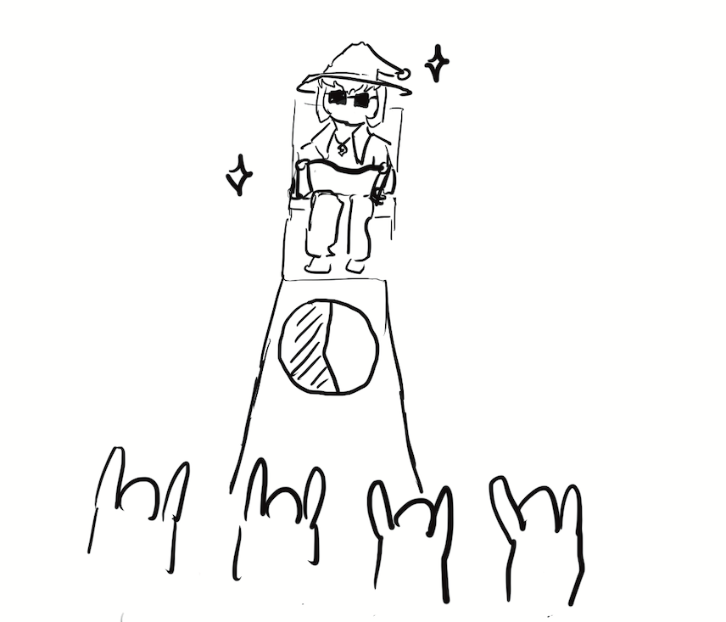
Attacks on Proof-of-Work
51% attack: An attacker who controls 51% of mining power can effectively rewrite history and perform a forking attack
Creates a centralized authority: An entity is given control over the currency network
Proof-of-work makes this difficult: The attacker must control 51% of the world’s computing power
Bitcoin’s security relies on the assumption that no attacker controls 51% of the world’s computing power

Slide 27
The Trouble with Bitcoin

Slide 28
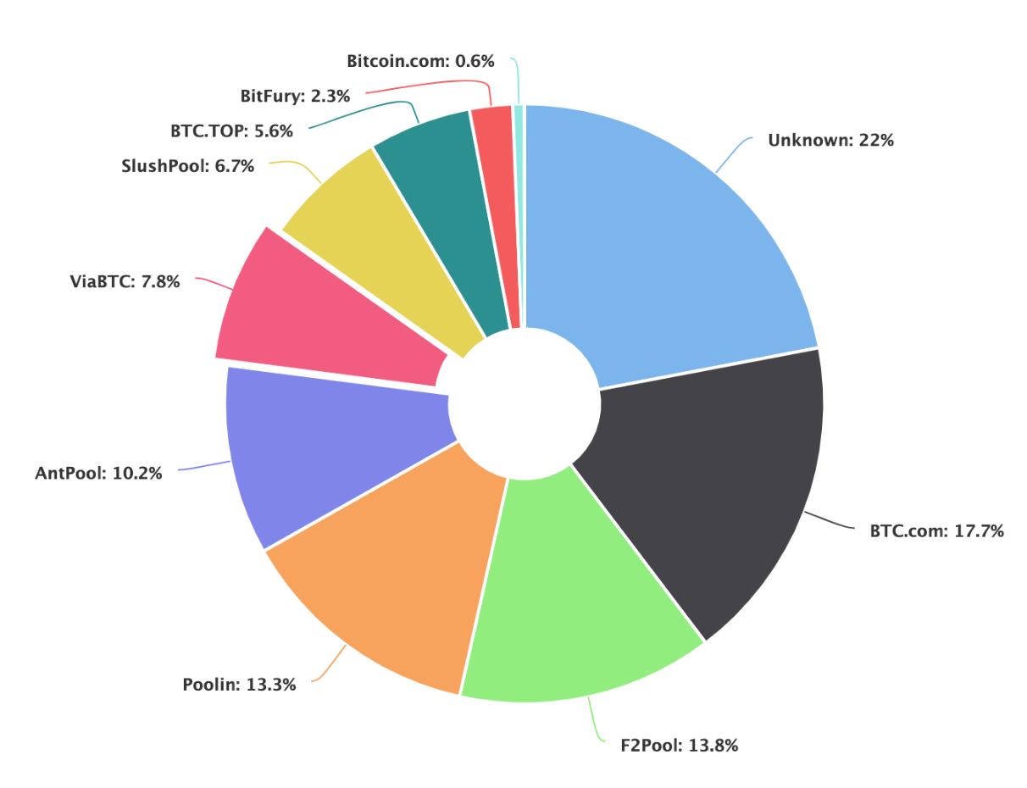
The Trouble with Bitcoin: Centralization of Power
Bitcoin is often not decentralized in practice
Recall: In Bitcoin’s design, there is no centralized authority controlling the system
In practice, a few small groups have a lot of control over the Bitcoin system
Mining pools: A team of users mining together
When one user receives a mining reward, everyone in the team shares the reward together
A user mining alone must get lucky to receive a reward
A mining pool gives users steady, smaller rewards
A few large mining pools control most of the computing power in Bitcoin
If large pools team up, the 51% attack is possible!
The four largest mining pools combined control 55% of all Bitcoin hash power
Notes:
https://news.bitcoin.com/a-short-history-of-the-worlds-largest-bitcoin-mining-pools/

Slide 29
The Trouble with Bitcoin: Centralization of Power
Codebases are developed and maintained by a few groups
These groups can rewrite the code to affect the entire system
Example: When Ethereum was hacked, the developers changed the code to retrieve their money
Some cryptocurrencies are not decentralized by design
Private blockchain: Only blocks signed by trusted private keys are valid
Only central authorities can sign blocks, but anyone can validate
Defeats the point of decentralized consensus!

Slide 30
The Trouble with Bitcoin: Pseudonymity
Bitcoin is pseudonymous
Pseudonymity: Multiple actions can be linked to a single identity which is not your real identity, a pseudonym
The pseudonym is the public key
Your transactions can be linked to your public key
Bitcoin transactions are not necessarily anonymous
Anonymity: Actions cannot be linked to your real identity
In theory, if you only ever use Bitcoin in an unpredictable manner, your pseudonym cannot be linked to your identity (anonymous)
In practice, your pseudonym can be linked to your real identity
If your shopping habits are predictable, it will be linked to you (the ledger is public)
If you exchange Bitcoin with real currency (dollars, euros, etc.), it will be linked to you

Slide 31
The Trouble with Bitcoin: Inefficiency
Runtime inefficiency
Proof-of-work requires a huge amount of useless computational work
Bitcoin: Hashing random values until a hash starts with many zeros
Storage inefficiency
Each Bitcoin user must store the entire transaction history to validate transactions
Alternative: Don’t store the entire transaction history
Problem: Now you have to ask a trusted source to send you the history
Defeats the point of decentralization!
Result: Low processing capacity
Original design limited each block to 1 MB in size to defend against spam
Bitcoin can only process 3–7 transactions per second

Slide 32
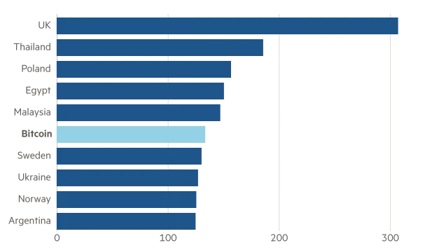
The Trouble with Bitcoin: Power Consumption
Bitcoin requires computers to waste energy on proof-of-work computations
Bitcoin mining incentivizes energy waste
People seek mining rewards
If mining becomes more efficient, Bitcoin adjusts the mining problem to be harder, so efficiency gains are not realized
Today, Bitcoin consumes more electricity than entire countries (measured in terawatt-hours)
Notes:
Proof-of-work is a central part of Bitcoin
There is no way to remove the high power consumption from the Bitcoin protocol
https://www.ft.com/content/1aecb2db-8f61-427c-a413-3b929291c8ac

Slide 33
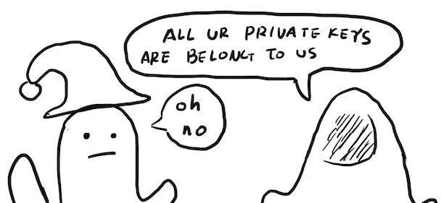
The Trouble with Bitcoin: Irreversibility
Modern banking transactions are designed to be reversible
Protects against fraud: If your money is stolen, the bank can recover the money for you
Bitcoin is not reversible
Once Bitcoin is sent, the transaction cannot be undone (unless the sender wants to return the money to you)
You only need your private key to access your Bitcoin
If someone steals your private key, they can access all your money
If your Bitcoin is stolen, there is no way to recover it
Result: It is dangerous to store Bitcoin on any computer connected to the Internet
Notes:
Article by Nick Weaver about stealing Bitcoin: http://www.buttcoinfoundation.org/how-to-make-money-with-bitcoin-in-10-easy-steps/

Slide 34
Bitcoin in Practice

Slide 35
Breaking Proof-of-Work
Proof-of-work viewed from an economic perspective
The system wastes $x per hour to defend against attacks
Each honest user contributes a small amount of the $x
Inefficiency: Money is constantly wasted, even if the service is not under attack
An attacker must spend more than $x per hour to control the system
Assumption: An attacker will not spend more than $x per hour
If an attacker can make more than $x per hour for an attack, they will spend $x per hour to execute the attack!
There are hashing services the attacker can pay to execute the attack

Slide 36
Proof-of-Work Alternatives
Main problem: Proof-of-work is inefficient and wastes electricity
Proof-of-work is necessary to prevent an attacker controlling the system (makes it expensive to control the system)
Alternative: Proof-of-stake
Proof-of-stake: Users with more coins have more mining power
People coins stake them in the system
If they act honestly, they gain more coins
If they act maliciously, their stake is slashed
Benefit: Uses much less electricity than proof-of-work, and the attacker must burn their own coins to attack the system!
Problem: Gives more power to wealthier users
Alternative: Articulated trust
Articulated trust: Designate several trusted parties, who vote on each transaction
As long as half of the trusted parties are trustworthy, then the protocol is secure
Relying on a little bit of trust solves both efficiency and energy problems!

Slide 37
Blockchain: Marketing and Buzzwords
“Blockchain” is often marketed as brand-new technology, but it is mostly existing technology
Hash chains are over 20 years old: Linked timestamping services used hash chains and were proposed in 1990
Merkle trees were patented in 1979
Private blockchains are not new technology: Many existing applications already use append-only database structures
“Blockchain” is a buzzword often applied to completely unrelated problems
“Use blockchain for electronic voting”
“Use blockchain to store medical records”
“Use blockchain to deliver vaccines”
Notes:
Nick's Iron Law of Blockchain: Blockchain solves exactly one problem: When someone says "you can solve X with Blockchain", they clearly don't know anything about X and should be ignored

Slide 38
Blockchain: Marketing and Buzzwords
Example of blockchain marketing: “Smart Contracts”
Smart contracts: Write an agreement in code, and execute the code to automatically follow the procedure
The code is stored on a blockchain so it cannot be modified
Problems with smart contracts
Unclear if they actually solve any real problem
Most “smart contracts” are actually standard finance bots: small programs to perform money transfers
If the code is vulnerable, you can violate the contract, with no way to reverse the effects
Contrast with legal contracts: Issues are handled by court systems

Slide 39
Blockchain: Marketing and Buzzwords
Example of blockchain marketing: Non-Fungible Tokens (NFTs)
NFT: A piece of data certifying that a digital file belongs to someone
Basically the statement {“This work of art now belongs to $individual”}PKprev_owner stored on the blockchain
Unrelated to copyrights or digital sharing of the file
The NFT market became extremely valuable in 2020–2021
NFTs of digital files have been selling for millions of dollars
Blockchain marketing: Adding a blockchain didn’t solve anything, but the “new technology” convinced buyers
Speculative bubble: NFTs are not worth anything on their own, but people buy NFTs to sell them later for more money, resulting in price increases

Slide 40
Bitcoin Enables Censorship Resistance
Bitcoin has no central authority to block transactions
Bitcoin can be used for electronic payments that standard platforms would block
Wikileaks: An organization that publishes leaked classified information
Used by whistleblowers to expose government corruption and corporate wrongdoing
Opposed and censored by many governments
Bitcoin is used to support Wikileaks
Many major platforms refused any donations to Wikileaks
Bitcoin has no central authority, so nobody can stop the Wikileaks donations
This is, generally, a good thing! But…

Slide 41
Bitcoin Enables Crime
Bitcoin is used for illegal transactions
Drug dealing
Money laundering
Illegal gambling
Hiring hitmen
Ransomware and extortion
Bitcoin has no central authority to block illegal transactions
Bitcoin is the most effective way to make illegal transactions

Slide 42
Economics of Bitcoin: Volatility
Volatile currency: The value changes quickly
The value of Bitcoin changes far more often than standard currency
Bitcoin is vulnerable to price shocks
Price shock: An extremely sudden change in value
When there are more transactions than the block capacity, prices increase
Users are competing for a limited number of transactions
Unknown attacks have also caused price shocks
Result: Bitcoin behaves more like stock than currency
Users keep Bitcoin to try and grow their investment when the value of Bitcoin increases

Slide 43
Economics of Bitcoin: Speculation
Because it is so volatile, Bitcoin behaves more like stock than currency
Speculation: Buying something so that you can sell it later for more money
You don’t buy Bitcoin because owning Bitcoin helps you make money
You buy Bitcoin because you hope to sell it later for more money
Relies on short-term price changes and not long-term value
Speculation results in a bubble
Bubble: Something sells for more than its true value
As more people buy Bitcoin to try and make a profit, the price of Bitcoin also increases
Bubbles always burst: Eventually the price returns to its original value, leading to huge economic losses

Slide 44
Economics of Bitcoin: Currency Exchange
Companies and people prefer to keep money in a more stable currency
To buy a product in Bitcoin, the buyer converts their standard currency to Bitcoin
The seller receives the Bitcoin and immediately converts it back to standard currency
Users should be able to exchange Bitcoin for other currency (e.g. dollars)
Buying and selling Bitcoin is difficult
Recall: Bitcoin transactions are irreversible
The buyer must trust that the seller will transfer the Bitcoin
The seller must trust that the buyer will pay when the Bitcoin is transferred
Ways to buy Bitcoin
Use another irreversible payment (e.g. cash)
Have a trusted relationship with the seller
Send a deposit first

Slide 45
Economics of Bitcoin: Volatility
Stable currencies require reliable conversion to other currency
Someone must support easy conversion between Bitcoin and other currency
This is usually a centralized entity (e.g. a bank or a government)
The centralized entity violates Bitcoin’s main purpose
Options for operating a conversion service
Follow government regulations (essentially becoming a regular currency)
Operate independently as a “wildcat bank” (similar to banks in the 1800s, before the US had a national currency)
Ignore federal regulations (e.g. Liberty Reserve, which was shut down by the government)
Some cryptocurrency designs claim to be “algorithmic stablecoins”
Designed to be stable in the market
Most of these are snake oil that don’t work

Slide 46







Other Cryptocurrencies
Most cryptocurrencies are based on the same principles
Public, append-only ledger structure
Designed with decentralization in mind
Some are software “forks” of the original Bitcoin blockchain
The fork ignores new Bitcoin blocks, and Bitcoin ignores fork blocks
New cryptocurrencies are marketed with a distinguishing feature
Litecoin: Adds a catchy slogan
Dogecoin: Adds an Internet meme
Ripple: Centralized cryptocurrency with an additional settlement structure
IOTA: Designed its own brand-new cryptography (using trinary math)
Monero: Improves pseudonymity
Zcash: Adds real anonymity
Etherium: Adds million-dollar rewards for catching bugs

Slide 47
Cryptocurrency Scams
Public interest in cryptocurrency as a “get rich quick” scheme leads to fraud
Many cryptocurrency frauds are old frauds with new technological branding
Ponzi schemes: Trick uninformed consumers to invest in a nonexistent product
Some “smart contracts” are actually modern Ponzi schemes
Wildcat banks: Independent, unregulated banks
If the bank shuts down, your money in the bank is gone
Physical wildcat banks stopped existing in the 1800s, but some cryptocurrencies essentially operate as wildcat banks
Unregulated securities: Stocks that are not regulated by the government
Often scams: The unregulated stock may be completely worthless
Initial coin offerings: Pay money now in exchange for some coins when the cryptocurrency launches later
If the cryptocurrency never launches, your money is gone

Slide 48
Bitcoin: Summary
Goal: Create a currency system that does not rely on any central authority
Identity: Each user is identified by their public key
Transactions
Users sign transactions with their private key and add them to the ledger
Each transaction must reference a previous transaction to identify a source of money
Public ledger
Hash chain: A linked list where each node contains the hash of the previous node
Append-only structure: Changing a node causes the hashes in all future nodes to change
Vulnerable to forking attacks: The attacker creates their own branch of the chain
Proof-of-work
The blockchain only accepts blocks whose hash starts with a sequence of n 0s
Finding valid blocks requires trying 2^{n} hashes. A reward is given to incentivize mining blocks
The longest hash chain is accepted as the true blockchain
An attacker must control 51% of the world’s computing power to create their own hash chain

Slide 49
The Trouble with Bitcoin: Summary
Centralization of power: In practice, Bitcoin is controlled by a few groups
Mining pools: Teams of users mining blocks together
Codebase developers: Can change the code to alter the system
Private blockchains: Only trusted parties can append to the blockchain
Pseudonymity
In theory, your transactions are only linked to your public key, not your true identity
With predictable transactions, your public key can be linked to your identity too
Inefficiency
Proof-of-work requires a huge amount of hashing
Each user must store the entire blockchain
Bitcoin can only process a few transactions per second
Power consumption: Hashing wastes electricity
Irreversibility: Transactions are not reversible
If your Bitcoin is stolen, there is no way to recover it
Reference
https://www.oreilly.com/library/view/mastering-bitcoin/9781491902639/ch08.html

