Slide 1
Cookies and CSRF

Slide 2
Last Time: URLs
URL: A string that uniquely identifies one piece of data on the web
Parts of a URL:
Protocol: Defines which Internet protocol to use to retrieve the data (e.g. HTTP or HTTPS)
Location: Defines which web server to contact
Path: Defines which file on the web server to fetch
Query (optional): Sends arguments in name-value pairs to the web server
Fragment (optional): Not sent to the web server, but used by the browser for processing
Special characters should be URL escaped

Slide 3
Last Time: Parts of a Webpage
HTML: A markup language to create structured documents
Create a link
Create a form
Embed an image
Embed another webpage (iframe or frame)
CSS: A style sheet language for defining the appearance of webpages
As powerful as JavaScript if used maliciously!
JavaScript: A programming language for running code in the web browser
JavaScript code runs in the web browser
Modify any part of the webpage (e.g. HTML or CSS)
Create pop-up messages
Make HTTP requests

Slide 4
Last Time: Same-Origin Policy
Rule enforced by the browser: Two websites with different origins cannot interact with each other
Two webpages have the same origin if and only if the protocol, domain, and port of the URL all match exactly (string matching)
Exceptions
JavaScript runs with the origin of the page that loads it
Websites can fetch and display images from other origins
Websites can agree to allow some limited sharing

Slide 5
Last Time: HTTP
HTTP: A protocol used to request and retrieve data from a web server
HTTPS: A secure version of HTTP
HTTP is a request-response protocol
HTTP request
Method (GET or POST)
URL path and query parameters
Protocol
Data (only for POST requests)
HTTP response
Protocol
Status code: A number indicating what happened with the request
Headers: Metadata about the response
Data

Slide 6
Today: Cookies and CSRF
Cookies
Parts of a cookie
Cookie Policy
Setting cookies
Sending cookies
Session Authentication
Cross-Site Request Forgery (CSRF)
CSRF Defenses

Slide 7
Cookies

Slide 8
Customizing HTTP Responses
HTTP is a request-response protocol
The web server processes each request independently of other requests
What if we want our responses to be customized?
Example: If I enable dark mode on a website, I want future responses from the website to be in dark mode
Example: If I log in to a website, I want future responses from the website to be related to my account

Slide 9
Cookies: Definition
Cookie: a piece of data used to maintain state across multiple requests
Creating cookies
The server can create a cookie by including a Set-Cookie header in its response
JavaScript in the browser can create a cookie
Users can manually create cookies in their browser
Storing cookies
Cookies are stored in the web browser (not the web server)
The browser’s cookie storage is sometimes called a cookie jar
Sending cookies
The browser automatically attaches relevant cookies in every request
The server uses received cookies to customize responses and connect related requests
Notes:
https://cci.charlotte.edu/academics/software-and-information-systems/phd-sis-track/
Chrome More settings => Developer tools => applications => Cookies

Slide 10
Parts of a Cookie: Name and Value
The actual data in the cookie is stored as a name-value pair
The name and value can be any string
Some special characters can’t be used (e.g. semicolons)
Name | Theme
Value | Dark
Domain | cci.charlotte.edu
Path | /sis-faculty
Secure | True
HttpOnly | False
Expires | 12 Aug 2023 20:00:00
(other fields omitted)

Slide 11
Parts of a Cookie: Domain and Path
The domain attribute and path attribute define which requests the browser should attach this cookie for
The domain attribute usually looks like the domain in a URL
The path attribute usually looks like a path in a URL
Name | Theme
Value | Dark
Domain | cci.charlotte.edu
Path | /sis-faculty
Secure | True
HttpOnly | False
Expires | 12 Aug 2023 20:00:00
(other fields omitted)

Slide 12
Parts of a Cookie: Secure and HttpOnly
The Secure attribute and HttpOnly attribute restrict the cookie for security purposes
Each attribute is either True or False
If the Secure attribute is True, then the browser only sends the cookie if the request is made over HTTPS (not HTTP)
If the HttpOnly attribute is True, then JavaScript in the browser is not allowed to access the cookie
Name | Theme
Value | Dark
Domain | cci.charlotte.edu
Path | /sis-faculty
Secure | True
HttpOnly | False
Expires | 12 Aug 2021 20:00:00
(other fields omitted)

Slide 13
Parts of a Cookie: Expires
The Expires attribute defines when the cookie is no longer valid
The expires attribute is usually a timestamp
If the timestamp is in the past, then the cookie has expired, and the browser deletes it from the cookie jar
Name | Theme
Value | Dark
Domain | cci.charlotte.edu
Path | /sis-faculty
Secure | True
HttpOnly | False
Expires | 12 Aug 2023 20:00:00
(other fields omitted)

Slide 14
Cookie Policy

Slide 15
Cookies: Issues
Recall:
The server can create a cookie by including a Set-Cookie header in its response
The browser automatically attaches relevant cookies in every request
Security issues:
A server should not be able to set cookies for unrelated websites
Example: evil.com should not be able to set a cookie that gets sent to google.com
Cookies shouldn’t be sent to the wrong websites
Example: A cookie used for authenticating a user to Google should not be sent to evil.com
We’ll see how cookies are used for logins later
Notes:
Set-Cookie when you click accept

Slide 16
Cookie Policy
Cookie policy: A set of rules enforced by the browser
When the browser receives a cookie from a server, should the cookie be accepted?
When the browser makes a request to a server, should the cookie be attached?
Cookie policy is not the same as same-origin policy

Slide 17
Domain Hierarchy
Recall: Domains
Located after the double slashes, but before the next single slash
Written as several phrases separated by dots
Domains can be sorted into a hierarchy
The hierarchy is separated by dots
. (root)
.edu
.org
.com
charlotte.edu
harvard.edu
python.org
piazza.com
google.com

Slide 18
Domain Hierarchy
. (root)
.edu is a top-level domain (TLD), because it is directly below the root of the tree.
.edu
charlotte.edu
cci.charlotte.edu is a subdomain of charlotte.edu.
cci.charlotte.edu

Slide 19
Cookie Policy: Setting Cookies
When the browser receives a cookie from a server, should the cookie be accepted?
Server with domain X can set a cookie with domain attribute Y if
The domain attribute is a domain suffix of the server’s domain
X ends in Y
X is below or equal to Y on the hierarchy
X is more specific or equal to Y
The domain attribute Y is not a top-level domain (TLD)
No restrictions for the Path attribute (the browser will accept any path)
Examples:
mail.google.com can set cookies for Domain=google.com
google.com can set cookies for Domain=google.com
google.com cannot set cookies for Domain=com, because com is a top-level domain
Notes:
Domain attribute is a suffix.

Slide 20
Cookie Policy: Sending Cookies
When the browser makes a request to a server, should the cookie be attached?
The browser sends the cookie if both of these are true:
The domain attribute is a domain suffix of the server’s domain
The path attribute is a prefix of the server’s path
Notes:
https://cci.charlotte.edu/academics/software-and-information-systems/phd-sis-track/

Slide 21
Cookie Policy: Sending Cookies
(server URL)
https://cci.charlotte.edu/academics/software-and-information-systems
charlotte.edu/academics
(cookie domain)
(cookie path)
Quick method to check cookie sending: Concatenate the cookie domain and path. Line it up below the requested URL at the first single slash.
If the domains and paths all match, then the cookie is sent.

Slide 22
Cookie Policy: Sending Cookies
(server URL)
https://cci.charlotte.edu/academics/software-and-information-systems
charlotte.edu/about-us/
(cookie domain)
(cookie path)
Quick method to check cookie sending: Concatenate the cookie domain and path. Line it up below the requested URL at the first single slash.
If the domain or path doesn’t match, then the cookie is not sent.

Slide 23
Attacks on Cookies

Slide 24
Cookie Ambiguity
If two cookies should both be sent to a page with the same name, they are sent in an undefined order!
Consider two cookies:
name=value1; Domain=bank.com; Path=/
name=value2; Domain=bank.com; Path=/page
The browser would send both cookies to bank.com/page in an undefined order!
The server doesn’t receive the Domain and Path attributes
The server might not be able to tell the cookies apart

Slide 25
Spectre Attack: Vulnerability
Original browser design: Chrome isolated each tab in its own Unix process
Security sandboxing: The operating system (OS) makes sure that one process cannot access other processes
Makes attacks harder: To compromise another tab, you have to exploit the browser code and escape the Unix sandbox
Usability: If one tab crashes, the rest of the browser won’t crash
Issues with this design
There are many scenarios where a program wants to protect data from other parts of the same program
Notable example: If one tab includes multiple origins (e.g. from an iframe embed), the browser must enforce same-origin policy: JavaScript from one origin cannot read cookies related to the other origin
Notes:
Spectre refers to one of the two original transient execution CPU vulnerabilities, which involve microarchitectural timing side-channel attacks. These affect modern microprocessors that perform branch prediction and other forms of speculation. Wikipedia
Affected hardware: All pre-2019 microprocessors that use branch prediction
CVE identifier(s): CVE-2017-5753 (Spectre-V1), CVE-2017-5715 (Spectre-V2)
Date discovered: January 2018; 5 years ago

Slide 26
Spectre Attack: Exploiting browser design
Spectre: An attack exploiting this browser design
The victim visits evil.com in a browser tab
evil.com opens an iframe with victim.com
Recall: JavaScript in evil.com should not be able to read any cookies from victim.com
evil.com and victim.com are now running in the same operating system process
No operating system sandboxing is active! The only memory protection is enforced by the JavaScript compiler
If we can break the JavaScript compiler, we can read memory from victim.com

Slide 27
Spectre Attack: Exploiting the processor
Quick review: Modern processors
Designed to be very fast: High instructions per cycle (IPC)
Uses aggressive behavior to achieve high IPC
Aggressive caching
Branch prediction: Guess the outcome of a branch and start executing that branch before the outcome is known
Speculative execution: Execute some code if the processor thinks it’ll be executed later
Note: Predictions are not always correct
Spectre: Exploits a hardware side-channel attack
Use a side channel (e.g. timing, cache state) to detect the results of failed speculative execution
Use a side channel to see what the input to the speculative execution was
Idea: Force speculative execution by forcing the processor to make wrong predictions
Idea: Read the side channel to see the results of the speculative execution

Slide 28
Spectre Attack: Exploiting the processor
Using the side-channel to break the JavaScript compiler’s memory isolation
Recall: evil.com has loaded an iframe with victim.com
evil.com executes a repeated loop with legitimate instructions
The branch predictor is trained to think this loop will keep going (it will keep guessing the while condition is true)
On the last run of the loop, the processor incorrectly guesses it will keep going and starts running the loop one more time (speculative execution)
In the speculative run of the loop, do computation on illegal memory (e.g. victim.com’s cookies)
Use the side-channel to leak some information about the illegal memory being read
Repeat this process to leak all the desired information
i = 0
while i <= 1000:
if i <= 1000:
[legal things]
else:
[illegal things]
i += 1
Speculative execution: The else case never runs, but the predictor will try to execute it after the last run of the loop

Slide 29
Spectre Attack: Defenses
Chrome and Firefox now run each origin, not tab, in its own process
Known as "Site Isolation"
Recall: The operating system (OS) makes sure that one process cannot access other processes
Security: Spectre attack is defeated
When evil.com loads an iframe with victim.com, the two frames are run in different processes
Speculative execution no longer works: the OS prevents the evil.com process from accessing memory of the victim.com process
The attack now requires breaking the OS isolation (much harder)
Cost: Processes are expensive
Lots of memory overhead
Switching between processes is expensive: optimizations (e.g. caches) must be wiped

Slide 30
Spectre Attack: Takeaways
Takeaway: Enforcing isolation between websites (same-origin policy, cookie policy) requires the browser to be securely designed. Getting this right can be very tricky!
Takeaway: The web was not designed in security in mind. Many defenses (e.g. same-origin policy) were added afterwards, leading to awkward design and expensive performance costs

Slide 31
Session Authentication

Slide 32
Session Authentication
Session: A sequence of requests and responses associated with the same authenticated user
Example: When you check all your unread emails, you make many requests to Gmail. The Gmail server needs a way to know all these requests are from you
When the session is over (you log out, or the session expires), future requests are not associated with you
Naïve solution: Type your username and password before each request
Problem: Very inconvenient for the user!
Better solution: Is there a way the browser can automatically send some information in a request for us?
Yes: Cookies!

Slide 33
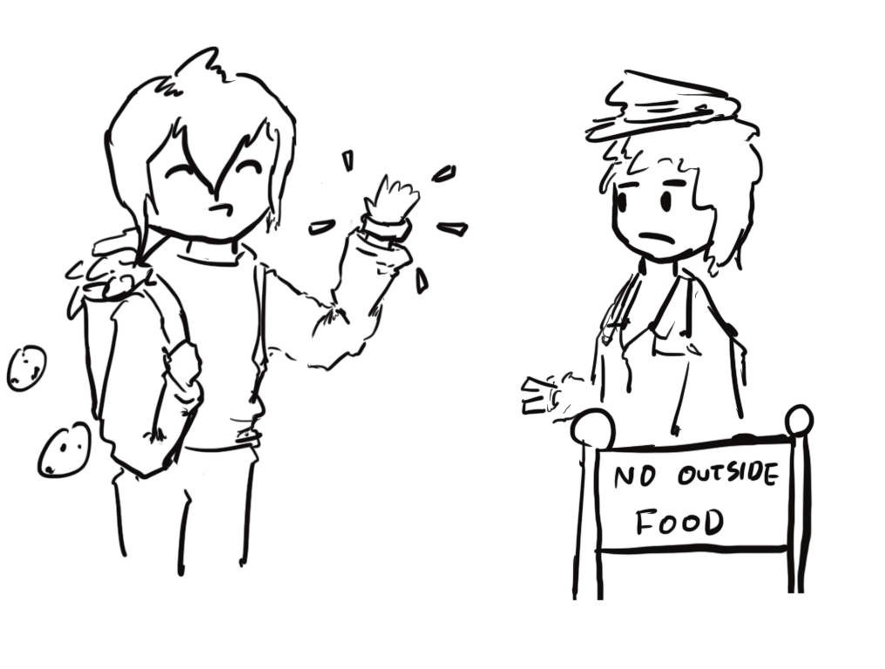
Session Authentication: Intuition
Imagine you’re attending a concert
The first time you enter the venue:
Present your ticket and ID
The doorperson checks your ticket and ID
If they’re valid, you receive a wristband
If you leave and want to re-enter later
Just show your wristband!
No need to present your ticket and ID again

Slide 34
Session Tokens
Session token: A secret value used to associate requests with an authenticated user
The first time you visit the website:
Present your username and password
If they’re valid, you receive a session token
The server associates you with the session token
When you make future requests to the website:
Attach the session token in your request
The server checks the session token to figure out that the request is from you
No need to re-enter your username and password!

Slide 35
Session Tokens with Cookies
Session tokens can be implemented with cookies
Cookies can be used to save any state across requests (e.g. dark mode)
Session tokens are just one way to use cookies
The first time you visit a website:
Make a request with your username and password
If they’re valid, the server sends you a cookie with the session token
The server associates you with the session token
When you make future requests to the website:
The browser attaches the session token cookie in your request
The server checks the session token to figure out that the request is from you
No need to re-enter your username and password!
When you log out (or when the session times out):
The browser and server delete the session token

Slide 36
Session Tokens: Security
If an attacker steals your session token, they can log in as you!
The attacker can make requests and attach your session token
The browser will think the attacker’s requests come from you
Servers need to generate session tokens randomly and securely
Browsers need to make sure malicious websites cannot steal session tokens
Enforce isolation with cookie policy and same-origin policy
Browsers should not send session tokens to the wrong websites
Enforced by cookie policy

Slide 37
Session Token Cookie Attributes
What attributes should the server set for the session token?
Domain and Path: Set so that the cookie is only sent on requests that require authentication
Secure: Can set to True to so the cookie is only sent over secure HTTPS connections
HttpOnly: Can set to True so JavaScript can’t access session tokens
Expires: Set so that the cookie expires when the session times out
Name | token
Value | {random value}
Domain | mail.google.com
Path | /
Secure | True
HttpOnly | True
Expires | {15 minutes later}
(other fields omitted)

Slide 38
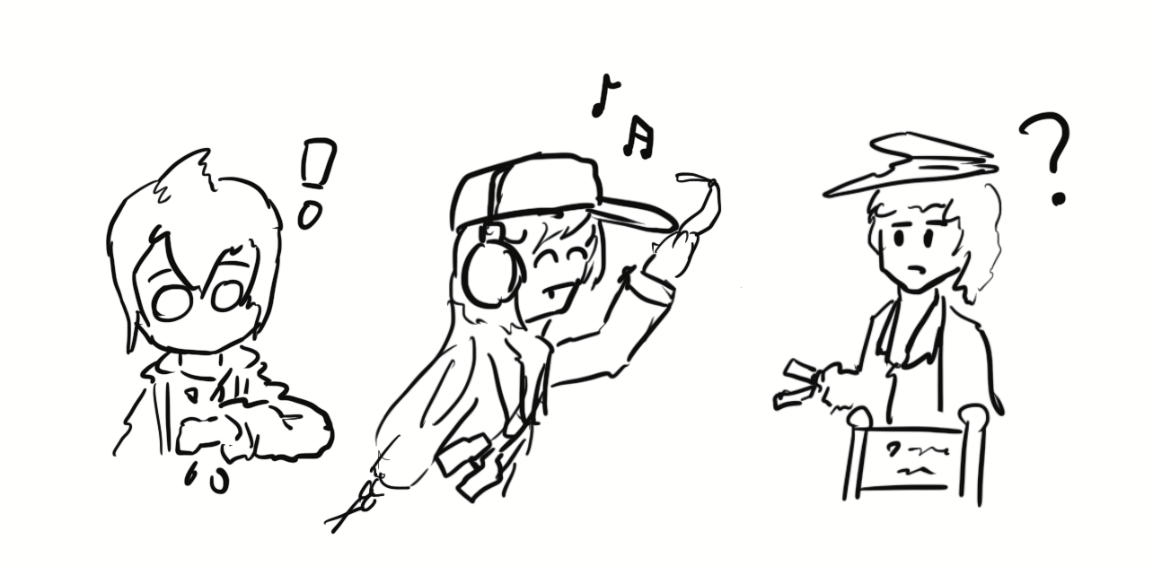
Cross-Site Request Forgery (CSRF)

Slide 39
Review: Cookies and Session Tokens
Session token cookies are used to associate a request with a user
The browser automatically attaches relevant cookies in every request

Slide 40
Cross-Site Request Forgery (CSRF)
Idea: What if the attacker tricks the victim into making an unintended request?
The victim’s browser will automatically attach relevant cookies
The server will think the request came from the victim!
Cross-site request forgery (CSRF or XSRF): An attack that exploits cookie-based authentication to perform an action as the victim
Notes:
A cross-site request forgery (CSRF) is an example of a confused deputy attack that uses the web browser to perform sensitive actions against a web application. A common form of this attack occurs when a web application uses a cookie to authenticate all requests transmitted by a browser.

Slide 41
Steps of a CSRF Attack
User
Server
Attacker

Slide 42
Steps of a CSRF Attack
User authenticates to the server
User receives a cookie with a valid session token
User
1. Login
Server
Attacker

Slide 43
Steps of a CSRF Attack
User authenticates to the server
User receives a cookie with a valid session token
Attacker tricks the victim into making a malicious request to the server
User
1. Login
Server
2. Make this request
Attacker

Slide 44
Steps of a CSRF Attack
User authenticates to the server
User receives a cookie with a valid session token
Attacker tricks the victim into making a malicious request to the server
The server accepts the malicious request from the victim
Recall: The cookie is automatically attached in the request
User
1. Login
Server
2. Make this request
3. Malicious request
Attacker

Slide 45
Steps of a CSRF Attack
User authenticates to the server
User receives a cookie with a valid session token
Attacker tricks the victim into making a malicious request to the server
The server accepts the malicious request from the victim
Recall: The cookie is automatically attached in the request

Slide 46
Executing a CSRF Attack
How might we trick the victim into making a GET request?
Strategy #1: Trick the victim into clicking a link
Later we’ll see how to trick a victim into clicking a link
The link can directly make a GET request: https://www.bank.com/transfer?amount=100&to=Mallory
The link can open an attacker’s website, which contains some JavaScript that makes the actual malicious request
Strategy #2: Put some HTML on a website the victim will visit
Example: The victim will visit a forum. Make a post with some HTML on the forum
HTML to automatically make a GET request to a URL: <img src="https://www.bank.com/transfer?amount=100&to=Mallory">
This HTML will probably return an error or a blank 1 pixel by 1 pixel image, but the GET request will still be sent...with the relevant cookies!
Notes:
Phishing attack

Slide 47
Executing a CSRF Attack
How might we trick the victim into making a POST request?
Example POST request: Submitting a form
Strategy #1: Trick the victim into clicking a link
Note: Clicking a link in your browser makes a GET request, not a POST request, so the link cannot directly make the malicious POST request
The link can open an attacker’s website, which contains some JavaScript that makes the actual malicious POST request
Strategy #2: Put some JavaScript on a website the victim will visit
Example: Pay for an advertisement on the website, and put JavaScript in the ad
Recall: JavaScript can make a POST request

Slide 48
Top 25 Most Dangerous Software Weaknesses (2020)
Rank | ID | Name | Score
[1] | CWE-79 | Improper Neutralization of Input During Web Page Generation (’Cross-site Scripting’) | 46.82
[2] | CWE-787 | Out-of-bounds Write | 46.17
[3] | CWE-20 | Improper Input Validation | 33.47
[4] | CWE-125 | Out-of-bounds Read | 26.50
[5] | CWE-119 | Improper Restriction of Operations within the Bounds of a Memory Buffer | 23.73
[6] | CWE-89 | Improper Neutralization of Special Elements used in an SQL Command (’SQL Injection’) | 20.69
[7] | CWE-200 | Exposure of Sensitive Information to an Unauthorized Actor | 19.16
[8] | CWE-416 | Use After Free | 18.87
[9] | CWE-352 | Cross-Site Request Forgery (CSRF) | 17.29
[10] | CWE-78 | Improper Neutralization of Special Elements used in an OS Command (’OS Command Injection’) | 16.44
[11] | CWE-190 | Integer Overflow or Wraparound | 15.81
[12] | CWE-22 | Improper Limitation of a Pathname to a Restricted Directory (’Path Traversal’) | 13.67
[13] | CWE-476 | NULL Pointer Dereference | 8.35
[14] | CWE-287 | Improper Authentication | 8.17
[15] | CWE-434 | Unrestricted Upload of File with Dangerous Type | 7.38
[16] | CWE-732 | Incorrect Permission Assignment for Critical Resource | 6.95
[17] | CWE-94 | Improper Control of Generation of Code (’Code Injection’) | 6.53
Notes:
https://cwe.mitre.org/top25/archive/2020/2020_cwe_top25.html

Slide 49
CSRF Example: Internet of Things (IoT)
IoT devices often use default passwords
Example login URL: http://10.1.1.1/login?user=admin&password=admin
The attacker tricks the victim into making a request to this link, which gives the victim a session token cookie
IoT devices often process commands with web requests
Example request URL: http://10.1.1.1/set-dns-server?server=8.8.8.8
These requests can perform actions that help the attacker mount other attacks
IoT devices don’t implement CSRF defenses
An attacker can publish an advertisement that makes these two requests
Any victim who opens a webpage with the advertisement will get their IoT device compromised!
Notes:
Nick calls it the "Internet of Shit"

Slide 50
CSRF Example: Malvertising
Short for malicious advertising
The attacker writes some JavaScript
The script opens a 1 pixel by 1 pixel frame (too small for human users to notice)
The frame opens a huge number of internal frames
Each frame launches possible CSRF attacks
The attacker pays for advertisements to put this JavaScript on legitimate websites
Takeaway: Many advertisers will publish malicious scripts for you as long as you pay for it

Slide 51
CSRF Example: YouTube
2008: Attackers exploit a CSRF vulnerability on YouTube
By forcing the victim to make a request, the attacker could:
Add any videos to the victim’s "Favorites"
Add any user to the victim’s "Friend" or "Family" list
Send arbitrary messages as the victim
Make the victim flag any videos as inappropriate
Make the victim share a video with their contacts
Make the victim subscribe to any channel
Add any videos to the user’s watchlist
Takeaway: With a CSRF attack, the attacker can force the victim to perform a wide variety of actions!

Slide 52

CSRF Example: Facebook
 | Link
Facebook Hit by Cross-Site Request Forgery Attack
Sean Michael Kerner | August 21, 2009
Nevertheless, that Facebook accounts were compromised in the wild is noteworthy because the attack used a legitimate HTML tag to violate users’ privacy. According to Zilberman’s disclosure, the attack simply involved the malicious HTML image tag residing on any site, including any blog or forum that permits the use of image tags even in the comments section. "The attack elegantly ends with a valid image so the page renders normally, and the attacked user does not notice that anything peculiar has happened," Zilberman said.
Takeaway: The HTML image tag can be used to execute a CSRF attack
Notes:
http://www.internetnews.com/security/article.php/3835596/Facebook+Hit+by+CrossSite+Request+Forgery+Attack.htm

Slide 53
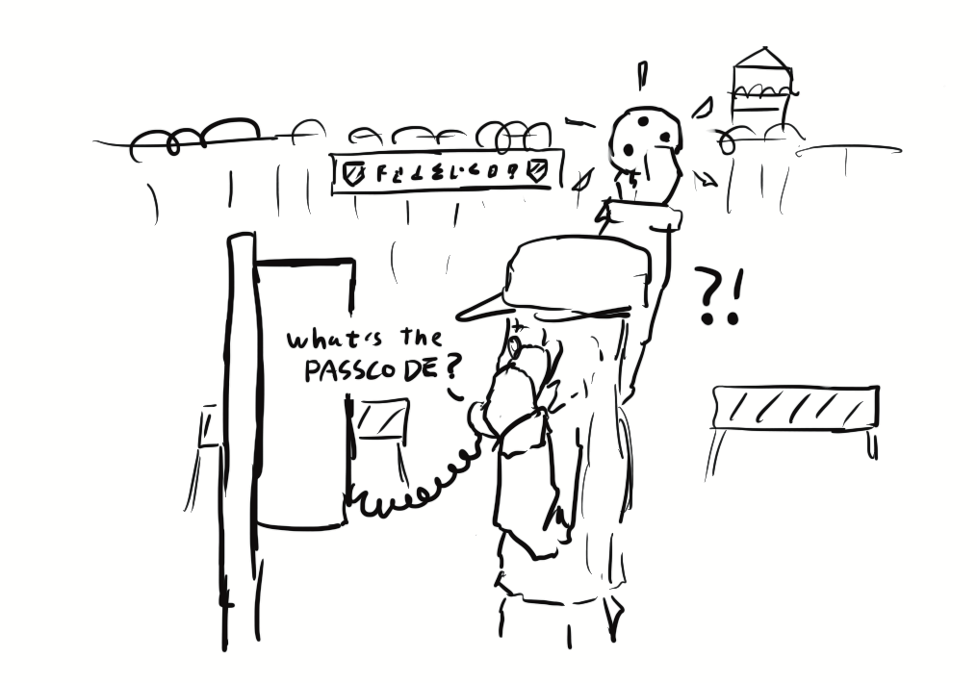
CSRF Defenses

Slide 54
CSRF Defenses
CSRF defenses are implemented by the server (not the browser)
Defense: CSRF tokens
Defense: Referer validation
Defense: SameSite cookie attribute

Slide 55
CSRF Tokens
Idea: Add a secret value in the request that the attacker doesn’t know
The server only accepts requests if it has a valid secret
Now, the attacker can’t create a malicious request without knowing the secret
CSRF token: A secret value provided by the server to the user. The user must attach the same value in the request for the server to accept the request.
CSRF tokens cannot be sent to the server in a cookie!
The token must be sent somewhere else (e.g. a header, GET parameter, or POST content)
CSRF tokens are usually valid for only one or two requests
Notes:
Ask: Why not in a cookie?

Slide 56
CSRF Tokens: Usage
Example: HTML forms
Forms are vulnerable to CSRF
If the victim visits the attacker’s page, the attacker’s JavaScript can make a POST request with a filled-out form
CSRF tokens are a defense against this attack
Every time the user requests a form from the legitimate website, the server attaches a CSRF token as a hidden form field (in the HTML, but not visible to the user)
When the user submits the form, the form contains the CSRF token
The attacker’s JavaScript won’t be able to create a valid form, because they don’t know the CSRF token!
The attacker can try to fetch their own CSRF token, but it will only be valid for the attacker, not the victim

Slide 57
CSRF Tokens: Usage
User
Server
1. Login
2. Get token
4. Make request
3. Make this request
Attacker
The request in step 4 will fail, because the attacker doesn’t know the token!

Slide 58
Referer Header
Idea: In a CSRF attack, the victim usually makes the malicious request from a different website
Referer header: A header in an HTTP request that indicates which webpage made the request
“Referer” is a 30-year typo in the HTTP standard (supposed to be “Referrer”)!
Example: If you type your username and password into the Facebook homepage, the Referer header for that request is https://www.facebook.com
Example: If an img HTML tag on a forum forces your browser to make a request, the Referer header for that request is the forum’s URL
Example: If JavaScript on an attacker’s website forces your browser to make a request, the Referer header for that request is the attacker’s URL

Slide 59
Referer Header
Checking the Referer header
Allow same-site requests: The Referer header matches an expected URL
Example: For a login request, expect it to come from https://bank.com/login
Disallow cross-site requests: The Referer header does not match an expected URL
If the server sees a cross-site request, reject it

Slide 60
Referer Header: Issues
The Referer header may leak private information
Example: If you made the request on a top-secret website, the Referer header might show you visited http://intranet.corp.apple.com/projects/iphone/competitors.html
Example: If you make a request to an advertiser, the Referer header gives the advertiser information about how you saw the ad
The Referer header might be removed before the request reaches the server
Example: Your company firewall removes the header before sending the request
Example: The browser removes the header because of your privacy settings
The Referer header is optional. What if the request leaves the header blank?
Allow requests without a header?
Less secure: CSRF attacks might be possible
Deny requests without a header?
Less usable: Legitimate requests might be denied
Need to consider fail-safe defaults: No clear answer

Slide 61
SameSite Cookie Attribute
Idea: Implement a flag on a cookie that makes it unexploitable by CSRF attacks
This flag must specify that cross-site requests will not contain the cookie
SameSite flag: A flag on a cookie that specifies it should be sent only when the domain of the cookie exactly matches the domain of the origin
SameSite=None: No effect
SameSite=Strict: The cookie will not be sent if the cookie domain does not match the origin domain
Example: If https://evil.com/ causes your browser to make a request to https://bank.com/transfer?to=mallory, cookies for bank.com will not be sent if SameSite=Strict, because the origin domain (evil.com) and cookie domain (bank.com) are different
Issue: Not yet implemented on all browsers

Slide 62
Cookies: Summary
Cookie: a piece of data used to maintain state across multiple requests
Set by the browser or server
Stored by the browser
Attributes: Name, value, domain, path, secure, HttpOnly, expires
Cookie policy
Server with domain X can set a cookie with domain attribute Y if the domain attribute is a domain suffix of the server’s domain, and the domain attribute Y is not a top-level domain (TLD)
The browser attaches a cookie on a request if the domain attribute is a domain suffix of the server’s domain, and the path attribute is a prefix of the server’s path

Slide 63
Session Authentication: Summary
Session authentication
Use cookies to associate requests with an authenticated user
First request: Enter username and password, receive session token (as a cookie)
Future requests: Browser automatically attaches the session token cookie
Session tokens
If an attacker steals your session token, they can log in as you
Should be randomly and securely generated by the server
The browser should not send tokens to the wrong place

Slide 64
CSRF: Summary
Cross-site request forgery (CSRF or XSRF): An attack that exploits cookie-based authentication to perform an action as the victim
User authenticates to the server
User receives a cookie with a valid session token
Attacker tricks the victim into making a malicious request to the server
The server accepts the malicious request from the victim
Recall: The cookie is automatically attached in the request
Attacker must trick the victim into creating a request
GET request: click on a link
POST request: use JavaScript

Slide 65
CSRF Defenses: Summary
CSRF token: A secret value provided by the server to the user. The user must attach the same value in the request for the server to accept the request.
The attacker does not know the token when tricking the user into making a request
Referer Header: Allow same-site requests, but disallow cross-site requests
Header may be blank or removed for privacy reasons
Same-site cookie attribute: The cookie is sent only when the domain of the cookie exactly matches the domain of the origin
Not implemented on all browsers

