Slide 1
Announcement
Project #1 due today
Assignment #3 release today
To be released at 11:59am
Due Nov.9 11:59pm
Project #2 to be released next Thursday
To be released at Nov.2 11:59am
Due Nov.16 11:59pm

Slide 2
Today’s Plan
Network Attackers
Man-in-the-middle attacker
On-path attacker
Off-path attacker
Important Concepts
ARP: Translate IP addresses to MAC addresses
DHCP: Get configurations when first connecting to a network
WPA: Communicate securely in a wireless local network
TCP: Reliably send packets
UDP: Not-reliably send packets
TLS: Secure TCP, securely send packets
DNS: Lookup IP address from domain names

Slide 3
Network Attackers

Slide 4
Types of Network Attackers
Threat model: There are 3 types of attackers we’ll consider
 | Can modify or delete packets | Can read packets
Man-in-the-middle/In-path attacker | ✓ | ✓
Man-on-the-side/On-path attacker |  | ✓
Off-path attacker

Slide 5
Spoofing
Spoofing: Lying about the identity of the sender
Example: Mallory sends a message and says the message is from Alice
The attacker can lie about the source address in the packet header
All types of attackers can spoof packets
However, some spoofing attacks may be harder if the attacker can’t read or modify packets

Slide 6
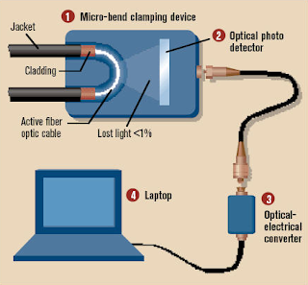

Real-World On-Path Attackers
How might a real-life attacker read packets?
Layer 1 attack: Use a special device to read bits being transmitted across space

Slide 7

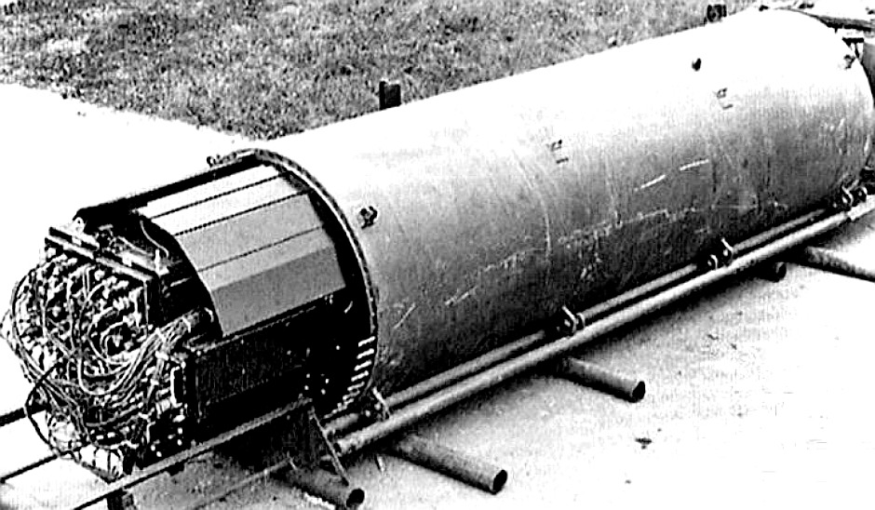
Real-World On-Path Attackers
Operation Ivy Bells
Matthew Carle | February 6, 2017
In an effort to alter the balance of the Cold War, divers from the USS Halibut scoured the ocean floor for a five-inch diameter cable that carried secret Soviet communications between military bases. The divers found the cable and installed a listening device. Upon their return to the United States, the NSA analyzed the recordings and found that a surprising amount of sensitive Soviet information travelled through the lines without encryption. The original tap was later discovered by the Soviets and is now on exhibit at the KGB museum in Moscow.
Notes:
https://www.military.com/history/operation-ivy-bells.html

Slide 8
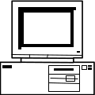
Real-World On-Path Attackers
Layer 2 attack: Read packets sent across the local area network (LAN)
Recall: A LAN is a network of connected machines
Any machine on the LAN can send packets to any other machine on the LAN
Some LANs use broadcast technologies
Every packet gets sent to every machine on the LAN
Each machine agrees to ignore packets where the destination is a different machine
A machine can break the agreement and read packets meant for other machines
This is called promiscuous mode
May require root access on the machine
A
B
C
D

Slide 9
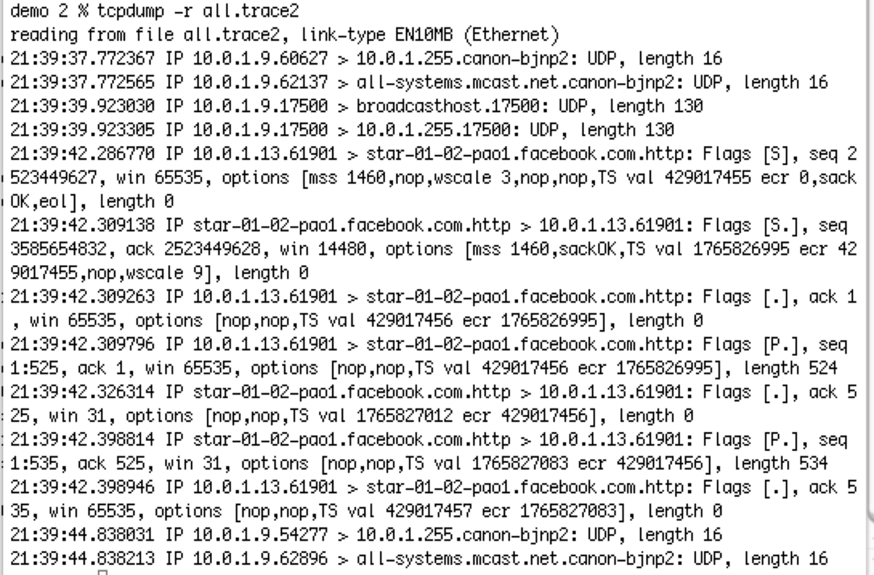
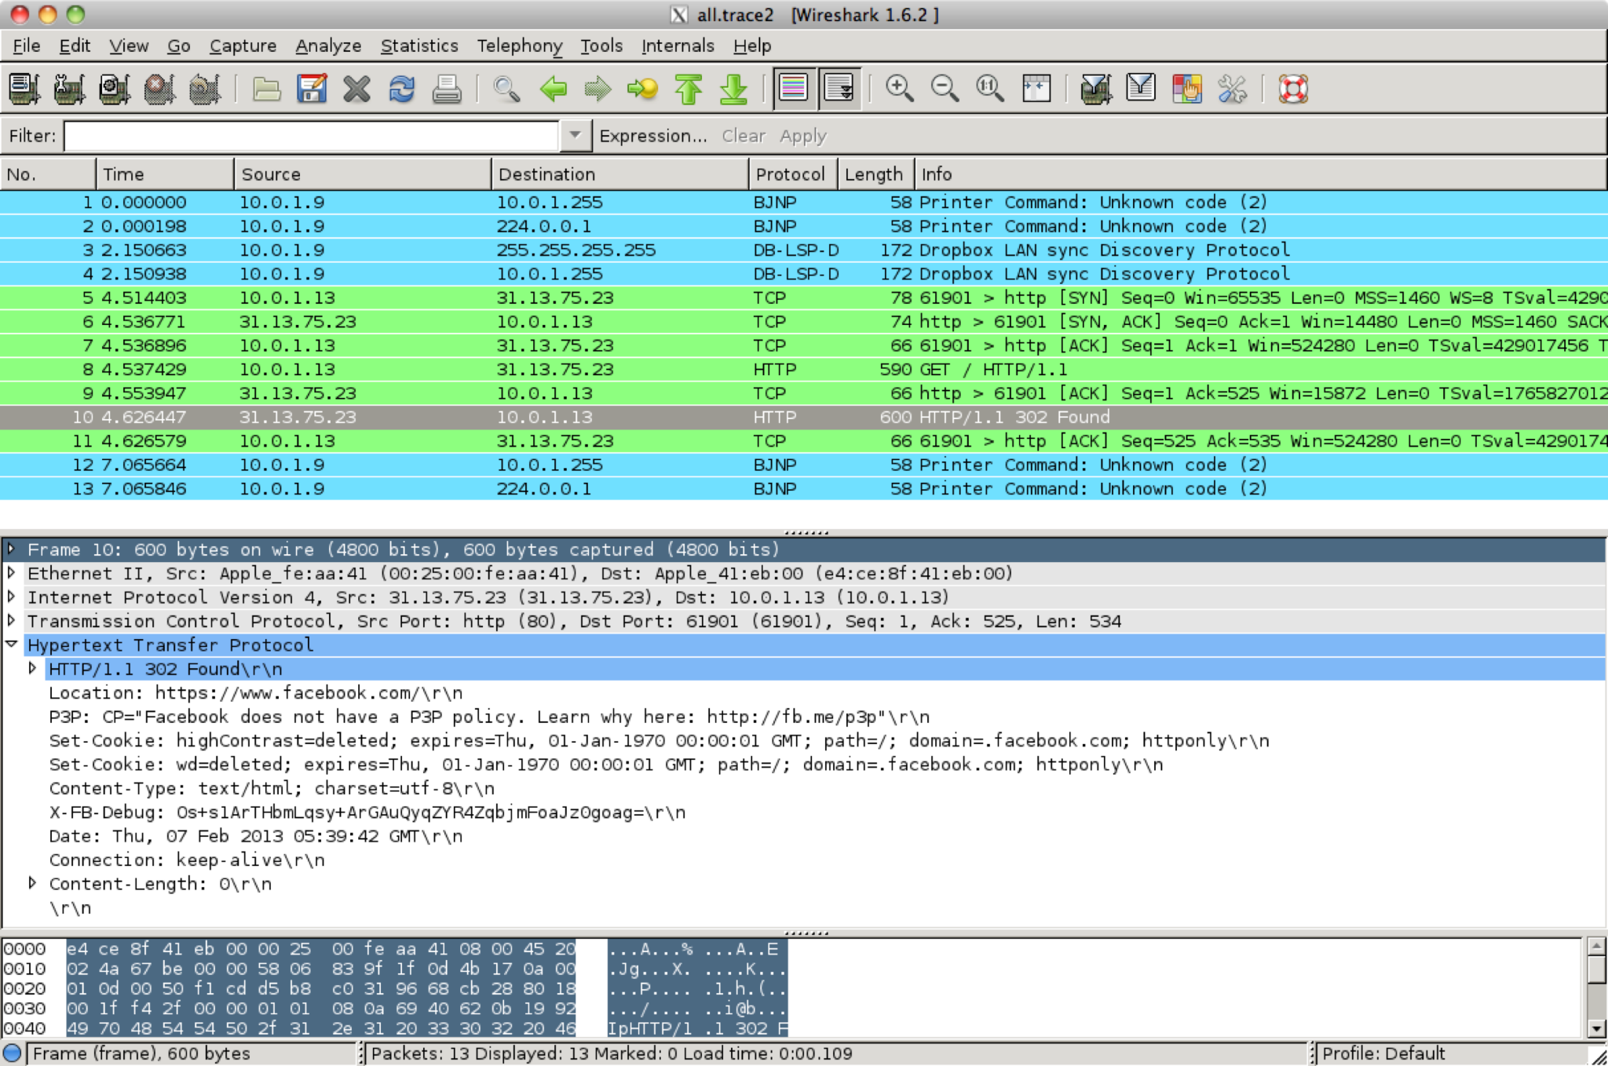
Real-World On-Path Attackers
tcpdump: A program for reading packets on the local network
Uses promiscuous mode to read other machines’ packets in broadcast technologies
Wireshark: A graphical user interface (GUI) for analyzing tcpdump packets

Slide 10
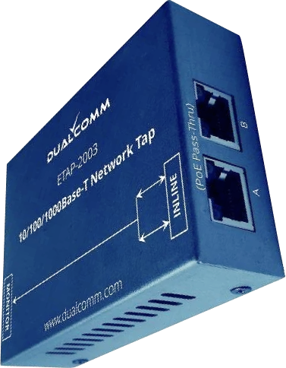
Real-World On-Path Attackers
Some layer 2 (Ethernet) devices can be configured to also send a copy of every packet to the attacker
Many switches support this through “port mirroring”
Or you can use dedicated Ethernet taps
Example: DualComm ETAP-2003
Cost: $200
Powered with USB (no extra power supply needed)
ETAP-2003R extra fun: Attacker can also send packets
Alice
To: Bob
“Hi”
Ethernet Device
To: Bob
“Hi”
To: Bob
“Hi”
Attacker
Bob

Slide 11
The Law and Sniffing Packets
You are allowed to sniff packets on your own network
After all, it is your computers you are using
Network administrators are allowed for network operation
Strongly encourage you to do so at home and see what you see!
It is both grossly immoral and highly illegal to sniff traffic otherwise
It is called “wiretapping”
So do not do this at Starbucks or other networks
Unless you add a filter to only include packets to/from your computer for debugging purposes

Slide 12
Address Resolution Protocol (ARP)

Slide 13
Review: Layer 2 and Layer 3
Local area network (LAN): A set of machines connected in a local network
The MAC identifies devices on layer 2
Internet protocol (IP): Many LANs connected together with routers
The IP identifies devices on layer 3
A
B
C
D
Router
E
F
G
H

Slide 14
Address Resolution Protocol (ARP)
ARP: Translates layer 3 IP addresses to layer 2 MAC addresses
Example: Alice wants to send a message to Bob on the local network, but Alice only knows Bob’s IP address (1.2.3.4). To use layer 2 protocols, she must learn Bob’s MAC address.
Steps of the protocol
Alice checks her cache to see if she already knows Bob’s MAC address.
If Bob’s MAC address is not in the cache, Alice broadcasts to everyone on the LAN: “What is the MAC address of 1.2.3.4?”
Bob responds by sending a message only to Alice: “My IP is 1.2.3.4 and my MAC address is ca:fe:f0:0d:be:ef.” Everyone else does nothing.
Alice caches Bob’s MAC address.

Slide 15
Address Resolution Protocol (ARP)
Alice knows Bob’s IP address (1.2.3.4) but wants to learn Bob’s MAC address.
Bob
Charlie
Alice’s cache
IP | MAC
Alice
Dave
Router
1. Alice checks her cache to see if she already knows the MAC address corresponding to 1.2.3.4.
Since her cache is empty, she must make a request to find out.

Slide 16
Address Resolution Protocol (ARP)
Alice knows Bob’s IP address (1.2.3.4) but wants to learn Bob’s MAC address.
Bob
Charlie
Alice’s cache
IP | MAC
Alice
Dave
Router
2. Alice asks everyone else on the local network: “What is the MAC address of 1.2.3.4?”

Slide 17
Address Resolution Protocol (ARP)
Alice knows Bob’s IP address (1.2.3.4) but wants to learn Bob’s MAC address.
Bob
Charlie
Alice’s cache
IP | MAC
Alice
Dave
Router
3. Bob responds: “My IP is 1.2.3.4 and my MAC address is ca:fe:f0:0d:be:ef.”
Everybody else ignores the request.

Slide 18
Address Resolution Protocol (ARP)
Alice knows Bob’s IP address (1.2.3.4) but wants to learn Bob’s MAC address.
Bob
Charlie
Alice’s cache
IP | MAC
1.2.3.4 | ca:fe:f0:0d:be:ef
Alice
Dave
Router
4. Alice adds Bob’s MAC address to her cache.

Slide 19
Address Resolution Protocol (ARP)
If Bob is outside of the LAN, Alice knows this
Bob’s IP is not on the same “subnet” as Alice
But Alice knows the IP address of the “Gateway router”
Recall: The router’s job is to make sure that the packet will be forwarded towards Bob (Layer 3)
So instead Alice generates an ARP request for the gateway router
Layer 2 MAC address of the frame is set to the router
Layer 3 IP address of the packet remains set as Bob's
The router will forward the packet to some other LAN to get it closer to Bob
Notes:
The Wireless Gateway acts as a modem (connection to the Internet) and a router (connecting multiple devices within the home)

Slide 20
Attacks on ARP
Alice knows Bob’s IP address (1.2.3.4) but wants to learn Bob’s MAC address.
Bob
Charlie
Alice’s cache
IP | MAC
Alice
Mallory
Router
1. Alice checks her cache to see if she already knows the MAC address corresponding to 1.2.3.4.
Since her cache is empty, she must make a request to find out.

Slide 21
Attacks on ARP
Alice knows Bob’s IP address (1.2.3.4) but wants to learn Bob’s MAC address.
Bob
Charlie
Alice’s cache
IP | MAC
Alice
Mallory
Router
2. Alice asks everyone else on the local network: “What is the MAC address of 1.2.3.4?”

Slide 22
Attacks on ARP
Alice knows Bob’s IP address (1.2.3.4) but wants to learn Bob’s MAC address.
Bob
Charlie
Alice’s cache
IP | MAC
Alice
Mallory
Router
3. Before Bob’s response can arrive, Mallory sends a malicious response: “My IP is 1.2.3.4 and my MAC address is 66:66:66:66:66:66.”

Slide 23
Attacks on ARP
Alice knows Bob’s IP address (1.2.3.4) but wants to learn Bob’s MAC address.
Bob
Charlie
Alice’s cache
IP | MAC
1.2.3.4 | 66:66:66:66:66:66
Alice
Mallory
Router
4. Alice adds Mallory’s malicious address to her cache.

Slide 24
Attack: ARP Spoofing
Alice has no way of verifying the ARP response
Spoofing: Any attacker on the network can claim to have the requested IP address
Alice is only expecting one machine to respond, so she will accept the first response
Race condition: As long as the attacker responds faster, the requester will accept the attacker’s response
ARP spoofing requires Mallory to be in the same LAN as Alice
ARP spoofing lets Mallory become a man-in-the-middle (MITM) attacker
Alice thinks that Bob’s MAC address is 66:66:66:66:66:66 (Mallory’s MAC address)
When Alice sends a message to Bob, she is actually sending the message to Mallory
Mallory can modify the message and then send the modified message to Bob

Slide 25
ARP Spoofing: Defenses
Network switches
When Alice wants to send a message to Bob, she sends the message to a switch on the LAN
The switch maintains a cache of MAC to port (physical connection) mappings
If Bob’s MAC address is in the cache, the switch sends the message directly to Bob
Otherwise, the switch broadcasts the message to all computers
Enterprise-class switches have additional optional features
Security: An additional IP/MAC cache that responds first, preventing the attacker from seeing repeated requests
Security: Only authorized MAC addresses can connect to specific ports—access control
Isolation: Virtual local area networks (VLANs), which splits a single LAN into isolated parts
Tools like arpwatch track ARP responses and make sure that there is no suspicious activity
Notes:
TODO Nick slide from FA21

Slide 26
Other Important Concepts

Slide 27
ARP (Address Resolution Protocol)
ARP: A protocol to translate local IP addresses to MAC addresses
Ask everyone on the network, “Who has the IP 1.2.3.4?”
Attack: The attacker can respond instead of the true device with 1.2.3.4, and packets will get routed to the attacker!
Defense: Switches
Defense: Rely on higher layers

Slide 28
DHCP (Dynamic Host Configuration Protocol)
DHCP: A protocol for a new client to receive a network configuration
Ask everyone on the network, “What is the network configuration to use?”
To connect to a network, a user needs:
An IP address so that other people can contact the user
The IP address of the DNS server
The IP address of the router (gateway) so that the user can contact machines outside of the LAN
DHCP gives the user a configuration when they first join the network
Attack: The attacker can respond with a malicious configuration
Defense: Rely on higher layers

Slide 29
WPA (Wi-Fi Protected Access)
WPA: A protocol to encrypt Wi-Fi connections at layer 1
A protocol for securing Wi-Fi network communications with cryptography
Messages between the client and the AP are encrypted with keys
Handshake uses MICs (cryptographic MACs) to verify that both parties have the same PSK and nonces
WPA-PSK: Use a password to derive a PSK, which is used in a handshake to arrive at a key
Attack: Attacker can pretend to be an AP
Attack: Brute-force the password after recording a handshake
Vulnerability: No forward secrecy
WPA-Enterprise: Use a third party to provide a one-time “replacement PSK,” used in the same handshake
Solves the attacks on WPA-PSK

Slide 30
Summary
Border Gateway Protocol (BGP): Routing packets
The Internet is made of smaller autonomous systems (AS)
Each AS broadcasts the shortest routes it knows of (dependent on the shortest routes of its neighbors and distance to neighbors)

Slide 31
Summary
Transmission Control Protocol (TCP): Reliably sending packets
3-way handshake: Client sends SYN, server sends SYN-ACK, client sends ACK
Provides reliability, ordering, and ports
Attack: TCP hijacking through data injection or RST injection
Blind attacks must guess the client’s or server’s sequence numbers
Attack: TCP spoofing by sending a spoofed SYN packet
Blind attacks must guess the server’s sequence number
User Datagram Protocol (UDP): Non-reliably sending packets
No reliability or ordering, only ports
Same injection and spoofing attacks as TCP, but easier

Slide 32
Transmission Control Protocol (TCP)
Provides a byte stream abstraction
Bytes go in one end of the stream at the source and come out at the other end at the destination
TCP automatically breaks streams into segments, which are sent as layer 3 packets
Provides ordering
Segments contain sequence numbers, so the destination can reassemble the stream in order
Provides reliability
The destination sends acknowledgements (ACKs) for each sequence number received
If the source doesn’t receive the ACK, the source sends the packet again
Provides ports
Multiple services can share the same IP address by using different ports

Slide 33
User Datagram Protocol (UDP)
Provides a datagram abstraction
A message, sent in a single layer 3 packet (though layer 3 could fragment the packet)
Max size limited by max size of packet
Applications break their data into datagrams, which are sent and received as a single unit
Contrast with TCP, where the application can use a bytestream abstraction
No reliability or ordering guarantees, but adds ports
It still has best effort delivery
Much faster than TCP, since there is no 3-way handshake
Usually used by low-latency, high-speed applications where errors are okay (e.g. video streaming, games)

Slide 34
TLS
TLS (Transport Layer Security): A protocol for creating a secure communication channel over the Internet
Replaces SSL (Secure Sockets Layer), which is an older version of the protocol
TLS is built on top of TCP
Relies upon: Byte stream abstraction between the client and the server
Provides: Byte stream abstraction between the client and the server
The abstraction appears the same to the end client, but TLS provides confidentiality and integrity!
7
Application
4.5
TLS
4
Transport
3
(Inter) Network
2
Link
1
Physical

Slide 35
Today: Secure Internet Communication with TLS
Goals of TLS
Confidentiality: Ensure that attackers cannot read your traffic
Integrity: Ensure that attackers cannot tamper with your traffic
Prevent replay attacks
The attacker records encrypted traffic and then replays it to the server
Example: Replaying a packet that sends “Pay $10 to Mallory”
Authenticity: Make sure you’re talking to the legitimate server
Defend against an attacker impersonating the server

Slide 36
TLS: Summary
Client
Server
TLS Handshake
Nonces make every handshake different (prevents replay attacks across connections)
Certificate proves server’s public key
RSA or DHE proves that the server owns the private key
RSA or DHE helps client and server agree on a shared secret key
MAC exchange ensures no one tampered with the handshake
Messages are sent with symmetric encryption and MACs
Record numbers prevent replay attacks within a connection
ClientHello
ServerHello
Certificate
{gª mod p}K⁻¹server
Or RSA exchange
g^{b} mod p
{M, MAC(IB, M)}CB
{M, MAC(IS, M)}CS

Slide 37
TLS: Summary
Security properties
DHE TLS: Forward secrecy
RSA TLS: No forward secrecy
End-to-end security: Secure even if all intermediate parties are malicious
Not anonymous: Attackers can determine who you’re talking to
No availability: Connections can be dropped or censored
Can be used by the application layer (e.g. HTTPS)
Trusting certificate authorities can be hard

Slide 38
DNS: Summary
DNS (Domain Name System): An Internet protocol for translating human-readable domain names to IP addresses
DNS name servers on the Internet provide answers to DNS queries
Name servers are arranged in a domain hierarchy tree
Lookups proceed down the domain tree: name servers will direct you down the tree until you receive an answer
The stub resolver tells the recursive resolver to perform the lookup
. (root)
.edu
.org
.com
berkeley.edu
mit.edu
cs161.org
piazza.com
google.com

Slide 39
DNS: Summary
DNS message structure
DNS uses UDP for efficiency
DNS packets include a random 16-bit ID field to match requests to responses
Data is encoded in records, which are name-value pairs with a type
A (answer) type records: Maps a domain name to an IPv4 address
NS (name server) type records: Designates another DNS server to handle a domain
Resolvers cache as many records as possible (until their time-to-live expires)

Slide 40
DNS Security: Summary
Cache poisoning attack: Send a malicious record to the resolver, which caches the record
Causes packets to be sent to the wrong place (e.g. to the attacker, who becomes a MITM)
Risk: Malicious name servers
Defense: Bailiwick checking: Resolver only accepts records in the name server’s zone
Risk: Network attackers
MITM attackers can poison the cache without detection
On-path attackers can race the legitimate response to poison the cache
Off-path attackers must guess the ID field (Defense: Make the ID field random)
Kaminsky attack: Query non-existent domains and put the poisoned record in the additional section (which will still be cached). Lets the off-path attacker try repeatedly until succeeding
Defense: Source port randomization (more bits for the off-path attacker to guess)

Slide 41
DNSSEC: Summary
DNSSEC: An extension of the DNS protocol that ensures integrity on the results
Provides object security (unlike DNS over TLS, which would provide channel security)
Uses signatures to cryptographically verify records
Uses a hierarchical public key infrastructure to delegate trust from the trust anchor (root)

