Slide 1
XSS and UI Attacks

Slide 2
Today: XSS
XSS
Websites use untrusted content as control data
Stored XSS
Reflected XSS
Defense: HTML sanitization
Defense: Content Security Policy (CSP)
UI attacks
Clickjacking
Phishing

Slide 3
Cross-Site Scripting (XSS)

Slide 4
Top 25 Most Dangerous Software Weaknesses (2020)
Rank | ID | Name | Score
[1] | CWE-79 | Improper Neutralization of Input During Web Page Generation (’Cross-site Scripting’) | 46.82
[2] | CWE-787 | Out-of-bounds Write | 46.17
[3] | CWE-20 | Improper Input Validation | 33.47
[4] | CWE-125 | Out-of-bounds Read | 26.50
[5] | CWE-119 | Improper Restriction of Operations within the Bounds of a Memory Buffer | 23.73
[6] | CWE-89 | Improper Neutralization of Special Elements used in an SQL Command (’SQL Injection’) | 20.69
[7] | CWE-200 | Exposure of Sensitive Information to an Unauthorized Actor | 19.16
[8] | CWE-416 | Use After Free | 18.87
[9] | CWE-352 | Cross-Site Request Forgery (CSRF) | 17.29
[10] | CWE-78 | Improper Neutralization of Special Elements used in an OS Command (’OS Command Injection’) | 16.44
[11] | CWE-190 | Integer Overflow or Wraparound | 15.81
[12] | CWE-22 | Improper Limitation of a Pathname to a Restricted Directory (’Path Traversal’) | 13.67
[13] | CWE-476 | NULL Pointer Dereference | 8.35
[14] | CWE-287 | Improper Authentication | 8.17
[15] | CWE-434 | Unrestricted Upload of File with Dangerous Type | 7.38
[16] | CWE-732 | Incorrect Permission Assignment for Critical Resource | 6.95
[17] | CWE-94 | Improper Control of Generation of Code (’Code Injection’) | 6.53
Notes:
https://cwe.mitre.org/top25/archive/2020/2020_cwe_top25.html

Slide 5
Review: Same-Origin Policy
Two webpages with different origins should not be able to access each other’s resources
Example: JavaScript on http://evil.com cannot access the information on http://bank.com

Slide 6
Review: JavaScript
JavaScript: A programming language for running code in the web browser
JavaScript is client-side
Code sent by the server as part of the response
Runs in the browser, not the web server!
Used to manipulate web pages (HTML and CSS)
Makes modern websites interactive
JavaScript can be directly embedded in HTML with <script> tags
Most modern webpages involve JavaScript
JavaScript is supported by all modern web browsers

Slide 7
Review: JavaScript
JavaScript can create a pop-up message
HTML (with embedded JavaScript)
<script>alert("Happy Birthday!")</script>
Webpage
Happy Birthday!
When the browser loads this HTML, it will run the embedded JavaScript and cause a pop-up to appear.
OK

Slide 8
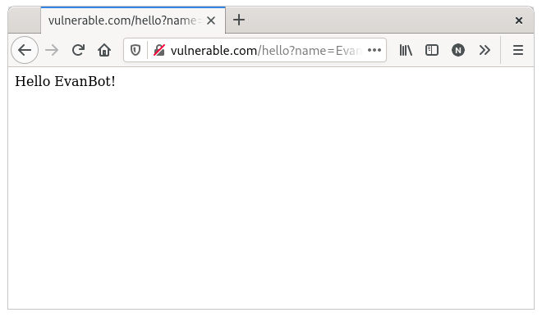
A Go HTTP Handler
Handler
func handleSayHello(w http.ResponseWriter, r *http.Request) {
name := r.URL.Query()["name"][0]
fmt.Fprintf(w, "<html><body>Hello %s!</body></html>", name)
}
URL
https://vulnerable.com/hello?name=EvanBot
Response
<html><body>Hello EvanBot!</body></html>

Slide 9
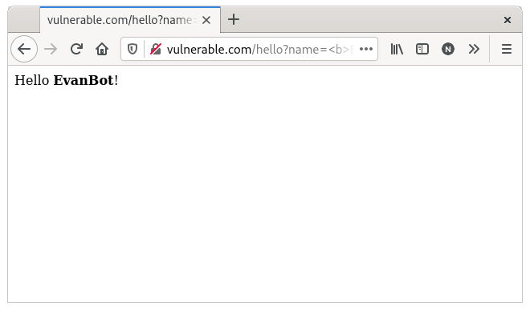
A Go HTTP Handler
Handler
func handleSayHello(w http.ResponseWriter, r *http.Request) {
name := r.URL.Query()["name"][0]
fmt.Fprintf(w, "<html><body>Hello %s!</body></html>", name)
}
URL
https://vulnerable.com/hello?name=<b>EvanBot</b>
Response
<html><body>Hello <b>EvanBot</b>!</body></html>
Notes:
%s the uninterpreted bytes of the string or slice
Package fmt implements formatted I/O with functions analogous to C's printf and scanf. The format 'verbs' are derived from C's but are simpler.

Slide 10
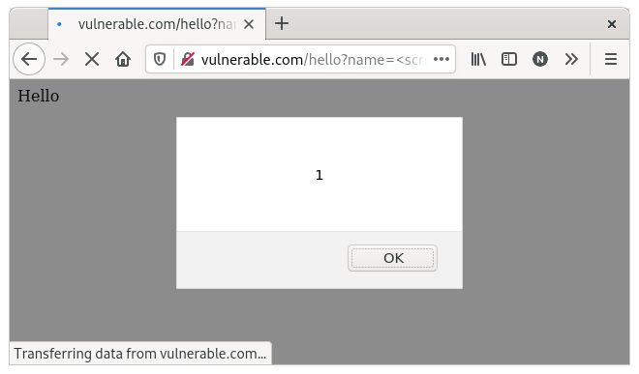
A Go HTTP Handler
Problem: This input represents control data (HTML), not just text!
Handler
func handleSayHello(w http.ResponseWriter, r *http.Request) {
name := r.URL.Query()["name"][0]
fmt.Fprintf(w, "<html><body>Hello %s!</body></html>", name)
}
URL
https://vulnerable.com/hello?name=<script>alert(1)</script>
Response
<html><body>Hello <script>alert(1)</script>!</body></html>

Slide 11
A Go HTTP Handler
Not just %s: It can happen with any string manipulation
Handler
func handleSayHello(w http.ResponseWriter, r *http.Request) {
name := r.URL.Query()["name"][0]
content := "<html><body>Hello "+name+"!</body></html>"
fmt.Fprint(w, content)
}
URL
https://vulnerable.com/hello?name=<script>alert(1)</script>
Response
<html><body>Hello <script>alert(1)</script>!</body></html>

Slide 12
Cross-Site Scripting (XSS)
Idea: The attacker adds malicious JavaScript to a legitimate website
The legitimate website will send the attacker’s JavaScript to browsers
The attacker’s JavaScript will run with the origin of the legitimate website
Now the attacker’s JavaScript can access information on the legitimate website!
Cross-site scripting (XSS): Injecting JavaScript into websites that are viewed by other users
Cross-site scripting subverts the same-origin policy
Two main types of XSS
Stored XSS
Reflected XSS

Slide 13
Stored XSS
Stored XSS (persistent XSS): The attacker’s JavaScript is stored on the legitimate server and sent to browsers
Classic example: Facebook pages
Anybody can load a Facebook page with content provided by users
An attacker puts some JavaScript on their Facebook page
Anybody who loads the attacker’s page will see JavaScript (with the origin of Facebook)
Stored XSS requires the victim to load the page with injected JavaScript

Slide 14
Stored XSS
bank.com
2. Request content
3. Receive malicious script
5b. Make malicious requests
Victim
1. Inject malicious script
5a. Steal valuable data (e.g. session token)
4. Victim browser executes malicious script
Attacker

Slide 15
Reflected XSS
Reflected XSS: The attacker causes the victim to input JavaScript into a request, and the content is reflected (copied) in the response from the server
Classic example: Search
If you make a request to http://google.com/search?q=evanbot, the response will say “10,000 results for evanbot”
If you make a request to http://google.com/search?q=<script>alert(1)</script>, the response will say “10,000 results for <script>alert(1)</script>”
Reflected XSS requires the victim to make a request with injected JavaScript

Slide 16
Reflected XSS
bank.com
2. Request URL under attacker’s control
3. Reflect malicious script
5b. Make malicious requests
Victim
1. Cause malicious request (e.g. click on link)
4. Victim browser executes malicious script
5a. Steal valuable data (e.g. session token)
Attacker

Slide 17
Reflected XSS: Making a Request
How do we force the victim to make a request to the legitimate website with injected JavaScript?
Trick the victim into visiting the attacker’s website, and include an embedded iframe that makes the request
Can make the iframe very small (1 pixel x 1 pixel), so the victim doesn’t notice it: <iframe height=1 width=1 src="http://google.com/search?q=<script>alert(1)</script>">
Trick the victim into clicking a link (e.g. posting on social media, sending a text, etc.)
Trick the victim into visiting the attacker’s website, which redirects to the reflected XSS link
… and many more!
Notes:
Iframe: an inline frame is used to embed another document within the current HTML document.

Slide 18
Reflected XSS is not CSRF
Reflected XSS and CSRF both require the victim to make a request to a link
XSS: An HTTP response contains maliciously inserted JavaScript, executed on the client side
CSRF: A malicious HTTP request is made (containing the user’s cookies), executing an effect on the server side
Notes:
Freewrite time.
The key difference:
1. CSRF attack requires an authenticated session, while XSS attacks don’t.
2. CSRF is restricted to the actions victims can perform; since it doesn't require any user interaction, XSS is believed to be more dangerous; CSRF attacks have a limited scope that is restricted to the actions user can perform, such as clicking a malicious link or visiting the hacker’s website. On the contrary, an XSS attack offers the execution of malicious scripts to perform any activity per the attacker’s choice, thus widening the scope of the attack.
Reflected XSS attacks can mostly be prevented by using a practical CSRF token. When a web server adequately validates submitted CSRF tokens and rejects requests without a valid token, the practice prevents attackers from exploiting reflected XSS application vulnerabilities.
https://www.geeksforgeeks.org/difference-between-xss-and-csrf/#

Slide 19
XSS Defenses
Defense: HTML sanitization
Idea: Certain characters are special, so create sequences that represent those characters as data, rather than as HTML
Start with an ampersand (&) and end with a semicolon (;)
Instead of <, use &lt;
Instead of ", use &quot;
And many more!
Note: You should always rely on trusted libraries to do this for you!
<html>
<body>
Hello &lt;script&gt;alert(1)&lt;/script&gt;!
</body>
</html>

Slide 20
XSS Defenses: Escaping
Handler
func handleSayHello(w http.ResponseWriter, r *http.Request) {
name := r.URL.Query()["name"][0]
fmt.Fprintf(w, "<html><body>Hello %s!</body></html>", html.EscapeString(name))
}
URL
https://vulnerable.com/hello?name=<script>alert(1)</script>
Response
<html><body>Hello &lt;script&gt;alert(1)&lt;/script&gt;!</body></html>

Slide 21
XSS Defenses: CSP
Defense: Content Security Policy (CSP)
Idea: Instruct the browser to only use resources loaded from specific places
Uses additional headers to specify the policy
Standard approach:
Disallow all inline scripts (JavaScript code directly in HTML), which prevents inline XSS
Example: Disallow <script>alert(1)</script>
Only allow scripts from specified domains, which prevents XSS from linking to external scripts
Example: Disallow <script src="https://test.com/hack.js">
Also works with other content (e.g. iframes, images, etc.)
Relies on the browser to enforce security

Slide 22
UI Attacks

Slide 23
User Interface (UI) Attacks
General theme: The attacker tricks the victim into thinking they are taking an intended action, when they are actually taking a malicious action
Takes advantage of user interfaces: The trusted path between the user and the computer
Browser disallows the website itself to interact across origins (same-origin policy), but trusts the user to do whatever they want
Remember: Consider human factors!
Two main types of UI attacks
Clickjacking: Trick the victim into clicking on something from the attacker
Phishing: Trick the victim into sending the attacker personal information

Slide 24
Clickjacking
Clickjacking: Trick the victim into clicking on something from the attacker
Main vulnerability: the browser trusts the user’s clicks
When the user clicks on something, the browser assumes the user intended to click there
Why steal clicks?
Download a malicious program
Like a Facebook page/YouTube video
Delete an online account
Why steal keystrokes?
Steal passwords
Steal credit card numbers
Steal personal info

Slide 25
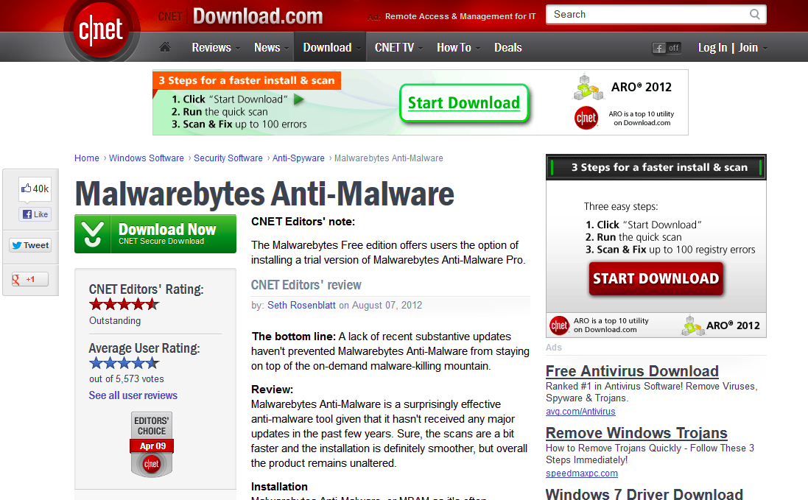
Clickjacking: Download buttons
Which is the real download button?
What if the user clicks the wrong one?

Slide 26
Clickjacking: Invisible iframes
Variant #1: Frame the legitimate site visibly, under invisible malicious content
Variant #2: Frame the legitimate site invisibly, over visible, enticing content
Variant #3: Frame the legitimate site visibly, under malicious content partially overlaying the site

Slide 27
Clickjacking: Temporal Attack
JavaScript can detect the position of the cursor and change the website right before the user clicks on something
The user clicks on the malicious input (embedded iframe, download button, etc.) before they notice that something changed
Instructions:
Please double-click on the button below to continue to your content
Click here

Slide 28
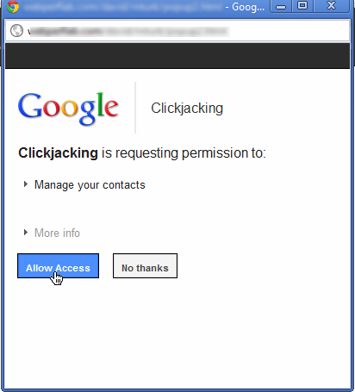

Clickjacking: Temporal Attack
Instructions:
Please double-click on the button below to continue to your content
Click here

Slide 29
Clickjacking: Cursorjacking
CSS has the ability to style the appearance of the cursor
JavaScript has the ability to track a cursor’s position
If we change the appearance a certain way, we can create a fake cursor to trick users into clicking on things!
Fake cursor, created with CSS and/or JavaScript
Real cursor, hidden or less visible with CSS

Slide 30
Clickjacking: Cursorjacking
What do you think you’re clicking on?
PLAY NOW!
Download .exe

Slide 31
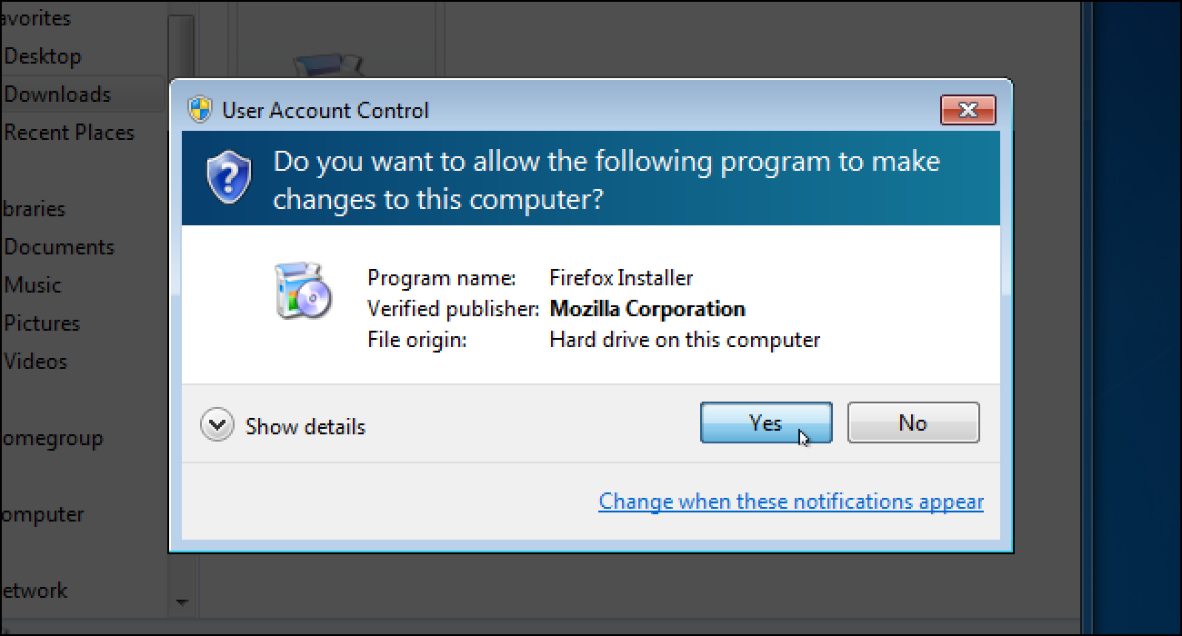
Clickjacking: Defenses
Enforce visual integrity: Ensure clear visual separation between important dialogs and content
Notice: Windows User Account Control darkens the entire screen and freezes the desktop

Slide 32
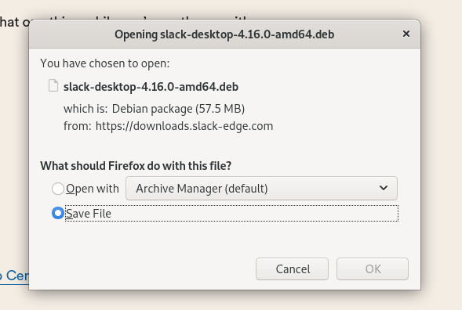
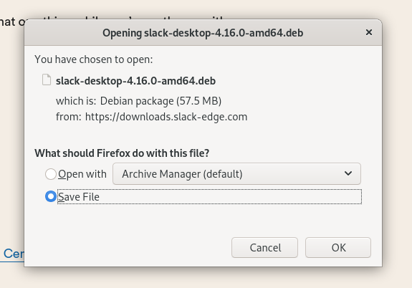
Clickjacking: Defenses
Enforce temporal integrity: Ensure that there is sufficient time for a user to register what they are clicking on
Notice: Firefox blocks the “OK” button until 1 second after the dialog has been focused

Slide 33
Clickjacking: Defenses
Require confirmation from users
The browser needs to confirm that the user’s click was intentional
Drawbacks: Asking for confirmation annoys users (consider human factors!)
Frame-busting: The legitimate website forbids other websites from embedding it in an iframe
Defeats the invisible iframe attacks
Can be enforced by Content Security Policy (CSP)
Can be enforced by X-Frame-Options (an HTTP header)

Slide 34
Phishing
Phishing: Trick the victim into sending the attacker personal information
Main vulnerability: The user can’t distinguish between a legitimate website and a website impersonating the legitimate website

Slide 35
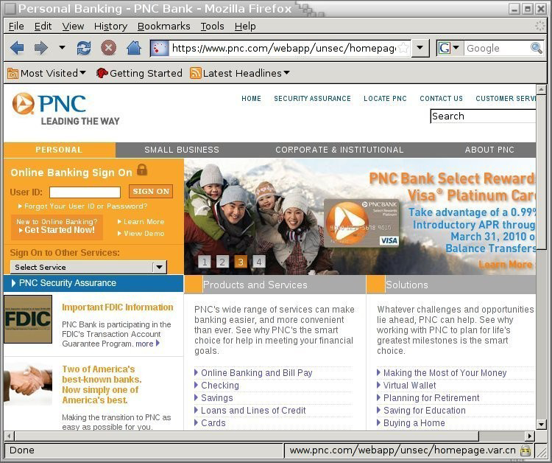
Phishing: Check the URL?
Is this real?
www.pnc.com/webapp/unsec/homepage.var.cn is actually an entire domain!
The attacker can still register an HTTPS certificate for the perfectly valid domain

Slide 36
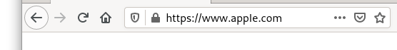
Phishing: Check the URL?
Is this real?
These letters come from the Cyrllic alphabet, not the Latin alphabet! They’re rendered the same but have completely different bytes!

Slide 37
Phishing: Homograph Attacks
Idea: Check if the URL is correct?
Homograph attack: Creating malicious URLs that look similar (or the same) to legitimate URLs
Homograph: Two words that look the same, but have different meanings

Slide 38
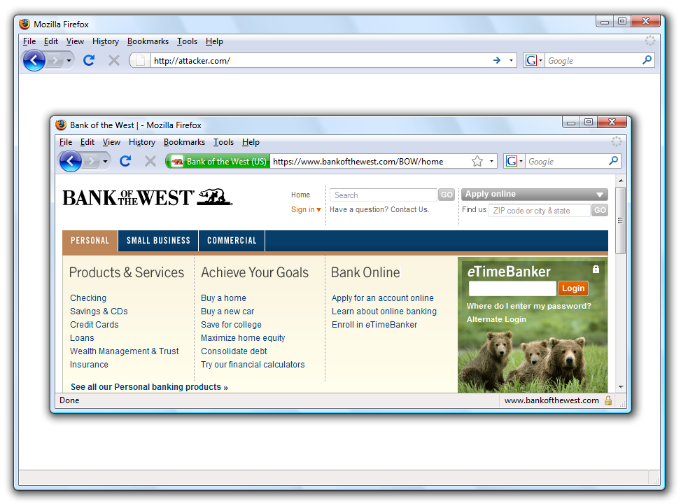
Phishing: Check Everything
Is this real?
Extended Validation: Certificate authority verified the identity of the site (not just the domain)

Slide 39
Phishing: Check Everything
Is this real?

Slide 40
Phishing: Browser-in-browser Attacks
Idea: Check for a green padlock icon in the browser’s address bar, or any other built-in browser security feature
Browser-in-browser attack: The attacker simulates the entire web browser with JavaScript

Slide 41
Phishing: Don’t Blame the Users
Most users aren’t security experts
Attacks are uncommon: users don’t always suspect malicious action
Detecting phishing is hard, even if you’re on the lookout for attacks
Legitimate messages often look like phishing attacks!

Slide 42
Two-Factor Authentication
Problem: Phishing attacks allow attackers to learn passwords
Idea: Require more than passwords to log in
Two-factor authentication (2FA): The user must prove their identity in two different ways before successfully authenticating
Three main ways for a user to prove their identity
Something the user knows: Password, security question (e.g. name of your first pet)
Something the user has: Their phone, their security key
Something the user is: Fingerprint, face ID
Even if the attacker steals the user’s password with phishing, they don’t have the second factor!

Slide 43
Two-Factor Authentication
Two-factor authentication also defends against other attacks where a user’s password is compromised
Example: An attacker steals the password file and performs a dictionary attack
Example: The user reuses passwords on two different websites. The attacker compromises one website and tries the same password on the second website
With 2FA, the password alone is no longer enough for the attacker to log in!

Slide 44
Subverting 2FA: Relay Attacks
Relay attacks (transient phishing): The attacker steals both factors in a phishing attack
Example
Two-factor authentication scheme
First factor: The user’s password (something the user knows)
Second factor: A code sent to the user’s phone (something the user owns)
Attack
The phishing website asks the user to input their password (first factor)
The attacker immediately tries to log in to the actual website as the user
The actual website sends a code to the user
The phishing website asks the user to enter the code (second factor)
The attacker enters the code to log in as the user

Slide 45
Subverting 2FA: Relay Attacks
Victim
“Welcome to Google. Please login”
Attacker
Google
“User: victim Password: password123”
“User: victim Password: password123”
“Your 2FA code is 382924”
Attacker
“Enter the security code.”
“382924”
“382924”

Slide 46
Subverting 2FA: Social Engineering
Some 2FA schemes text a one-time code to a phone number
Attackers can call your phone provider (e.g. Verizon) and tell them to activate the attacker’s SIM card, so they receive your texts!
2FA via SMS is not great but better than nothing
Some 2FA schemes can be bypassed with customer support
Attackers can call customer support and ask them to deactivate 2FA!
Companies should validate identity if you ask to do this (but not all do)

Slide 47
2FA Example: Authentication Tokens
Authentication token: A device that generates secure second-factor codes
Something the user owns
Examples: RSA SecurID and Google Authenticator
Usage
The token and the server share a common secret key k
When the user wants to log in, the token generates a code HMAC(k, time)
The time is often truncated to the nearest 30 seconds for usability
The code is often truncated to 6 digits for usability
The user submits the code to the website
The website uses its secret key to verify the HMAC
Drawback: Vulnerable to relay attacks
Drawback: Vulnerable to online brute-force attacks
Possible fix: Add a timeout

Slide 48
2FA Example: Security Keys
Security key: A second factor designed to defend against phishing
Usage
When the user signs up for a website, the security key generates a new public/private key pair and gives the public key to the website
When the user wants to log in, the server sends a nonce to the security key
The security key signs the nonce, website name (from the browser), and key ID, and gives the signature to the server
Security keys prevent phishing
In a phishing attack, the security key generates a signature with the attacker’s website name, not the legitimate website name

Slide 49
Summary: XSS
Websites use untrusted content as control data
<html><body>Hello EvanBot!</body></html>
<html><body>Hello <script>alert(1)</script>!</body></html>
Stored XSS
The attacker’s JavaScript is stored on the legitimate server and sent to browsers
Classic example: Make a post on a social media site (e.g. Facebook) with JavaScript
Reflected XSS
The attacker causes the victim to input JavaScript into a request, and the content it’s reflected (copied) in the response from the server
Classic example: Create a link for a search engine (e.g. Google) query with JavaScript
Requires the victim to click on the link with JavaScript

Slide 50
Summary: XSS Defenses
Defense: HTML sanitization
Replace control characters with data sequences
< becomes &lt;
" becomes &quot;
Use a trusted library to sanitize inputs for you
Defense: Content Security Policy (CSP)
Instruct the browser to only use resources loaded from specific places
Limits JavaScript: only scripts from trusted sources are run in the browser
Enforced by the browser

Slide 51
Summary: Clickjacking
Clickjacking: Trick the victim into clicking on something from the attacker
Main vulnerability: the browser trusts the user’s clicks
When the user clicks on something, the browser assumes the user intended to click there
Examples
Fake download buttons
Show the user one frame, when they’re actually clicking on another invisible frame
Temporal attack: Change the cursor just before the user clicks
Cursorjacking: Create a fake mouse cursor with JavaScript
Defenses
Enforce visual integrity: Focus the user’s vision on the relevant part of the screen
Enforce temporal integrity: Give the user time to understand what they’re clicking on
Ask the user for confirmation
Frame-busting: The legitimate website forbids other websites from embedding it in an iframe

Slide 52
Summary: Phishing
Phishing: Trick the victim into sending the attacker personal information
A malicious website impersonates a legitimate website to trick the user
Don’t blame the users
Detecting phishing is hard, especially if you aren’t a security expert
Check the URL? Still vulnerable to homograph attacks (malicious URLs that look legitimate)
Check the entire browser? Still vulnerable to browser-in-browser attacks
Defense: Two-Factor Authentication (2FA)
User must prove their identity two different ways (something you know, something you own, something you are)
Defends against attacks where an attacker has only stolen one factor (e.g. the password)
Vulnerable to relay attacks: The attacker phishes the victim into giving up both factors
Vulnerable to social engineering attacks: Trick humans to subvert 2FA
Example: Authentication tokens for generating secure two-factor codes
Example: Security keys to prevent phishing

