Slide 1
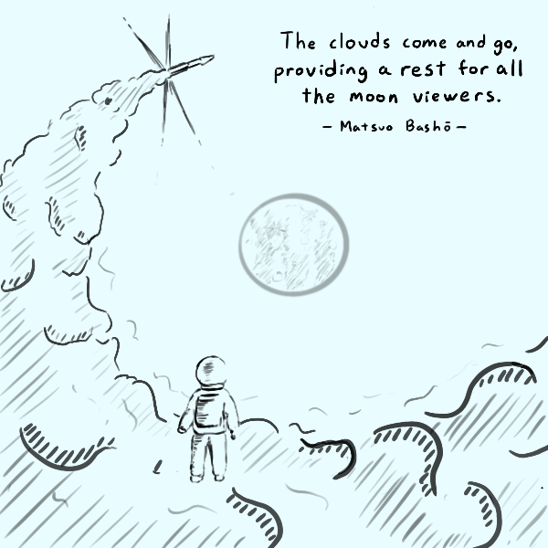
Announcements
Midterm Oct.3rd (Tuesday)
Thursday office hours
In person: Woodward Hall 330D
Zoom meeting link: https://charlotte-edu.zoom.us/my/jxiang1

Slide 2
Today’s plan: Midterm Review
Assignment #2 Review
Key Concepts Review
Notes:
Questions about miners?
The word “mining” is somewhat misleading. By evoking the extraction of precious metals, it focuses our attention on the reward for mining, the new bitcoins in each block. Although mining is incentivized by this reward, the primary purpose of mining is not the reward or the generation of new coins. If you view mining only as the process by which coins are created, you are mistaking the means (incentives) as a goal of the process. Mining is the main process of the decentralized clearinghouse, by which transactions are validated and cleared. Mining secures the bitcoin system and enables the emergence of network-wide consensus without a central authority.

Slide 3
Assignment #1 (Question 2)
Describe one example in computer security to show that cryptography cannot solve all problems in security.
Cryptography can’t protect you against human errors
Social engineering is one of the easy one, e.g., steal your passcode by making friends with you.
If you leave your computer unlocked when you go to the bathroom or to get a cup of coffee, somebody can use your computer and do things with your private keys.
Cryptography can’t protect against most denial-of-service attacks
Cryptography cannot provide availability in general.
Cryptography can’t protect against stolen encryption keys
The problem of information flow control: cryptography cannot prevent a party authorized to view information from improperly disclosing that information.

Slide 4
Assignment #2 (Question 1)
The DES (Data Encryption Standard) was a symmetric encryption algorithm designed in 1976. It was the government standard until 2001. It has a block size of 64 bits, and key size of 56 bits. If Eve wants to brute-force attack DES, i.e., try all possible keys, how much time does Eve need? Assume that she can try 10¹⁰ keys per second with her personal computer.
Eve needs to try 2⁵⁶ = 2^{(10×5.6)}=10^{(3×5.6)}=10^{(16.8)} = 6.3×10¹⁶ keys. The needed time is 6.3×10¹⁶ / (10¹⁰)= 6.3×10⁶ seconds, roughly 73 days.

Slide 5
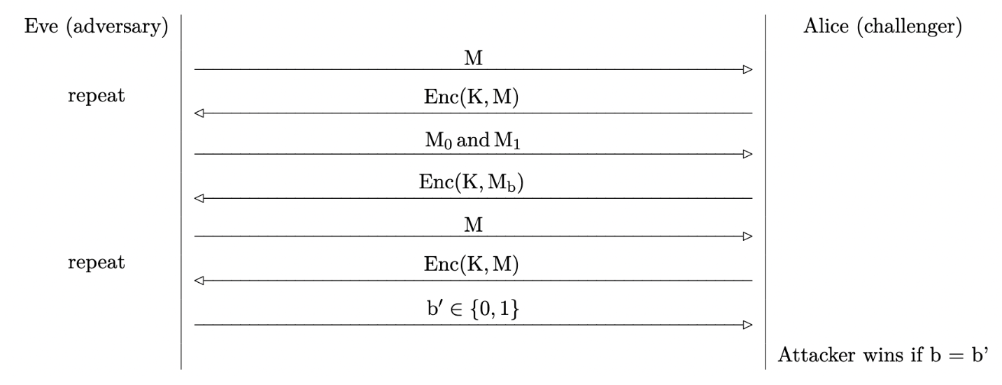
Assignment #2 (Question 2)
Q 2.1 and 2.2: Eve can trick Alice to encrypt M₀, if the return ciphertext C₀ is the same as C, then the b = 0, otherwise, b = 1.
Q 2.3: Eve can trick Alice to encrypt a message that is all 0, the return ciphertext C₀ is the key used by Alice. Then Eve can decrypt all other ciphertext with the key.

Slide 6
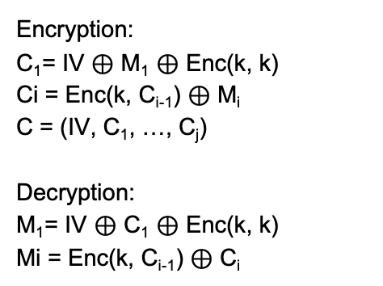
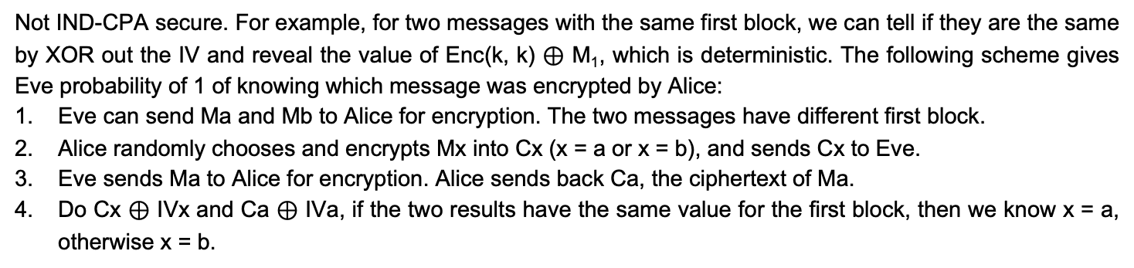
Assignment #2 (Question 3)
Encryption:
C₁= IV $⊕$ M₁ $⊕$ Enc(k, k)
Ci = Enc(k, C_{i-1}) $⊕$ M_{i}
C = (IV, C₁, …, C_{j})
Decryption:
M₁= IV $⊕$ C₁ $⊕$ Enc(k, k)
Mi = Enc(k, C_{i-1}) $⊕$ C_{i}
Not IND-CPA secure. For example, for two messages with the same first block, we can tell if they are the same by XOR out the IV and reveal the value of Enc(k, k) ⊕ M₁, which is deterministic. The following scheme gives Eve probability of 1 of knowing which message was encrypted by Alice:
Eve can send Ma and Mb to Alice for encryption. The two messages have different first block.
Alice randomly chooses and encrypts Mx into Cx (x = a or x = b), and sends Cx to Eve.
Eve sends Ma to Alice for encryption. Alice sends back Ca, the ciphertext of Ma.
Do Cx $⊕$ IVx and Ca $⊕$ IVa, if the two results have the same value for the first block, then we know x = a, otherwise x = b.

Slide 7
Assignment #2 (Question 4)
Ciphertext c = c₁ || c₂ where c₁ = Enc(K, m) and c₂ = Hash(c₁)
Q 4.1: It provides confidentiality
Q 4.2: No integrity, since SHA-256 may suffer from length extension attack.
Q 4.3: Ciphertext c = c₁ || c₂ where c₁ = Enc(K, m) and c₂ = MAC(K, c₁)

Slide 8
Assignment #2 (Question 5)
Eve is an eavesdropper between Alice and Bob.
Alice and Bob each seed a PRNG with different random inputs.
Alice uses her PRNG from the previous step to generate a, and Bob uses his PRNG from the previous step to generate b.
Alice and Bob perform a Diffie-Hellman key exchange using their generated secrets (a and b). Recall that, in Diffie-Hellman, neither a nor b are directly sent over the channel.
Alice and Bob, without reseeding, each use their PRNG to generate some pseudorandom output.
Eve learns both Alice’s and Bob’s pseudorandom outputs.
Q 5.1: Yes. Eve may learn about a and b, thus the shared secret g^{ab} mod p.
Q 5.2: Yes. Eve may learn about b, thus the shared secret g^{ab} mod p by (gª mod p)^{b} mod p.
Q 5.3: g^{am} mod p = g^{bm} mod p , there are many such m values

Slide 9
Public Key Encryption

Slide 10
Digital Signature

