Slide 1
HOW TO SHOP FOR FREE ONLINE – SECURITY ANALYSIS OF CASHIER-AS-A-SERVICE BASED WEB STORES
Rui Wang (Indiana Univ.)
Joint work with
Shuo Chen (MSR), XiaoFeng Wang (Indiana Univ.), Shaz Qadeer (MSR)

Slide 2
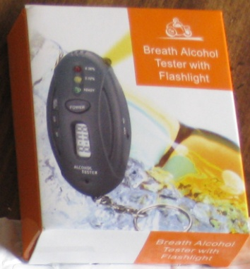

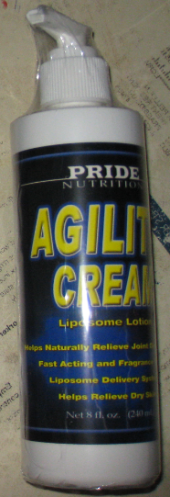

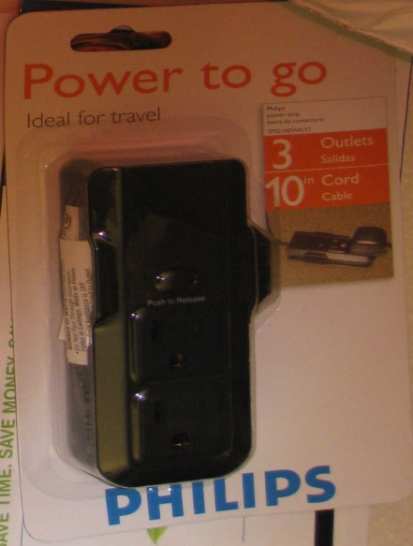

Free goodies
Random items bought from web stores
Alcohol Tester
Power Strip
DVD
Agility Cream
Digital Magazine
Did not pay, or with an arbitrary price
Due to logic bugs in checkout mechanisms

Slide 3


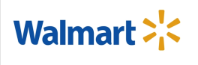







Web stores integrating 3rd party cashier services
3rd-party cashiers
e.g., PayPal, Amazon Payments, Google Checkout
We call them CaaS (Cashier-as-a-Service)
The CaaS exposes services through web APIs
Web stores call APIs to integrate services
A great number of stores use CaaS services.

Slide 4
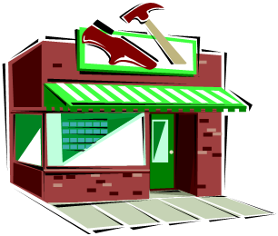


Need to make a joint decision
Web store
Shopper
communication about the order
Joint decision:
Is an order appropriately paid?
communication about the payment
CaaS

Slide 5
Why challenging, intuitively?
Sounds reasonable, but ask Dad to call me.
Mom,
can I do X?
Mom
I think it is fine.
Naughty kid
Sounds like a wacky idea. I am not sure. What do you think?
Dad,
Mom is ok about X’, can you call her?
Dad
OK.

Slide 6
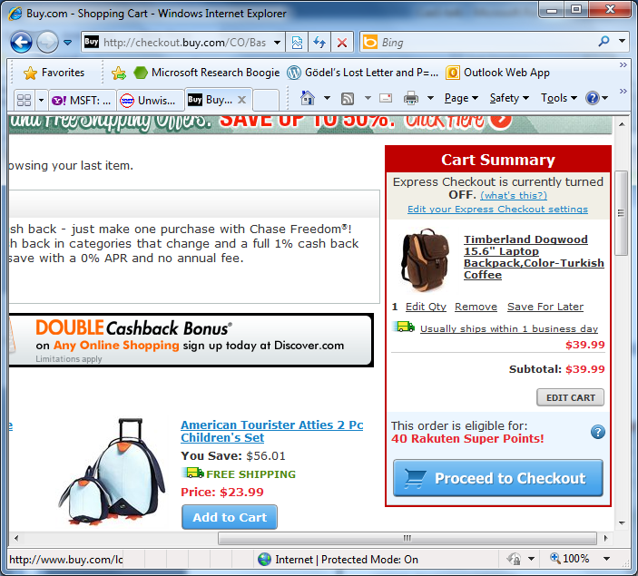
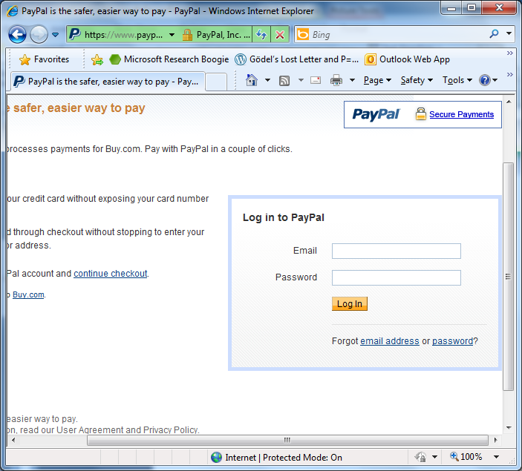

Example of a normal checkout workflow
Buy.com
RT1.a
T
RT1.b
Thank you for your order!
Your order #12345 will be shipped.
View the order
T
Please confirm:
shipping address:
xxxxxxxxxxxxxxxxxxx
billing address:
xxxxxxxxxxxxxxxxxx
total amount:
$39.54
RT4.a
RT4.b
Shopper
Why do you think that I have to run a browser?
RT3.a.a
RT3.a.b
RT2.a
There are many payment methods, such as PayPal Standard, Amazon Simple Pay, Google Checkout
Even for one payment method, each store integrates it in a different way
RT2.b
Pay Now
RT3.a
RT3.b
PayPal
(CaaS)
RT: HTTP round-trip : Web API

Slide 7
What we studied
Merchant software – with source code
Used to build web stores
NopCommerce – popular open-source
Interspire – ranked #1 by Top10Reviews.com
Amazon SDKs – used by stores to integrate Amazon Payments
High-profile web stores – no source code
JR.com
A store for consumer electronics since 1971
Buy.com
12 million shoppers

Slide 8
What do the seller and charger need to verify:
Seller owns the item
A payment will be transferred to seller from charger
The payment is for the right amount
The payment is for the right item

Slide 9
Why is it so complicated
Whose responsibility to verify the information
This transaction number is correct, but is it for my store?
The attacker can pretend to be a buyer as well as a seller
Many parallel transactions
The APIs are public and the attackers can analyze them as long as they want

Slide 10
Results
Logic flaws in 9 checkout scenarios
Explained in this talk
Merchant | CaaS | Flaw | Result
NopCommerce | PayPal Standard | Insufficient check of payment total | Pay arbitrary price
NopCommerce | Amazon Simple Pay | Insufficient protection against a shopper with a malicious merchant | Shop for free
Interspire | Amazon Simple Pay | Incorrect use of signature | Shop for free
Interspire | PayPal Express | Insufficient protection against a shopper with two shopping sessions | Pay arbitrary price
Interspire | PayPal Standard | Payment notification can be replayed under certain condition | Pay arbitrary price
Interspire | Google Checkout | Can add items to cart after payment total is fixed | Pay arbitrary price
JR.com | Checkout By Amazon | Insufficient protection against a shopper with a malicious merchant | Pay arbitrary price
Buy.com | PayPal Express | Paypal token allowed to be reused | Pay arbitrary price
Web stores using Amazon SDKs | Amazon Flexible Payments | Insufficient signature validation | Shop for free

Slide 11
Three Flaw Examples
Note:
Only high-level summaries, not full picture of the flaws
Details in the source code are critical, but skipped
Please read the paper for the whole stories

Slide 12

.
NopCommerce’s integration of Amazon Simple Pay
Chuck, pay in Amazon with this signed letter:
Amazon, I want to pay with this letter
Great, I will ship order#123!
Dear Amazon,
order#123 is $10, when it is paid, text me at 425-111-2222. [Jeff’s signature]
Jeff,
I want to buy this DVD.
Dear Amazon,
order#123 is $10, when it is paid, text me at 425-111-2222. [Jeff’s signature]
Jeff
Hi,
$10 has been paid for order#123.
[Amazon’s signature]
Shopper Chuck
Amazon
Note: phone number is analogous to the URL that Amazon uses to notify the merchant

Slide 13
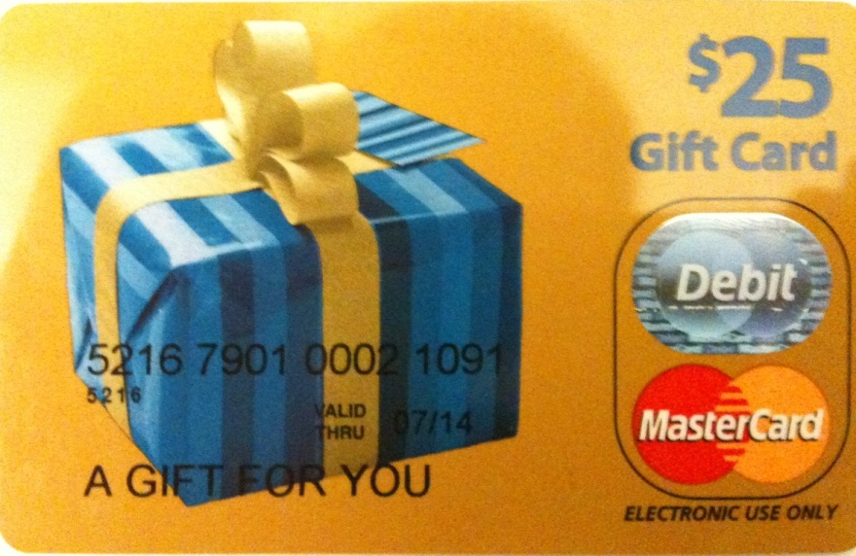


Flaw & exploit
Chuck, pay in Amazon with this signed letter:
Amazon, I want to pay with this letter
Dear Amazon,
order#123 is $10, when it is paid, text me at 425-111-2222.
[Jeff’s signature]
Anyone can register an Amazon seller account, so can Chuck.
We purchased a $25 MasterCard gift card by cash
We registered it under the name “Mark Smith” with fake address/phone number
Registered for seller accounts in PayPal, Amazon and Google using the card
Great, I will ship order#123!
Jeff,
I want to buy this DVD.
Dear Amazon,
order#123 is $10, when it is paid, text me at 425-111-2222. [Jeff’s signature] [Mark’s signature]
Jeff
Hi,
$10 has been paid for order#123.
[Amazon’s signature]
Shopper Chuck
(and seller Mark)
Chuck’s trick
Pay to Mark (i.e., Chuck himself), but check out from Jeff
Amazon is tricked to tell Jeff a payment between Chuck and Mark
Jeff is confused by Amazon
Amazon
(CaaS)

Slide 14
Interspire’s integration of PayPal Express

Slide 15
Interspire’s integration of PayPal Express (cont.)
Session1: pay for a cheap order (orderID1) in PayPal, but avoid the merchant from finalizing it by holding RT4.a
Session 2: place an expensive order (orderID2) , but skip the payment step in PayPal
store
store
RT3.b
RT3.b
RT4.a
(RT3.b) redir to
store.com/finalizeOrder?[orderID1]_{store}
(RT3.b) redir to
store.com/finalizeOrder?[orderID2]_{store}
[orderID2]_{store}
(RT4.a) call store.com/finalizeOrder?[orderID1]_{store}
Expensive order is checked out but the cheap one is paid

Slide 16
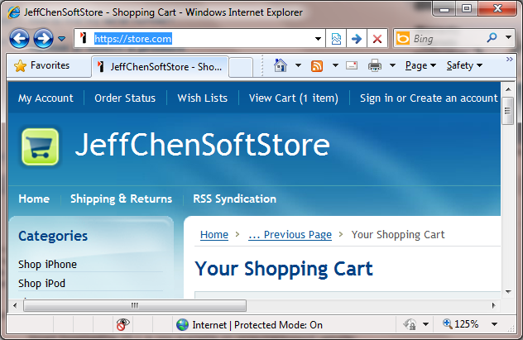
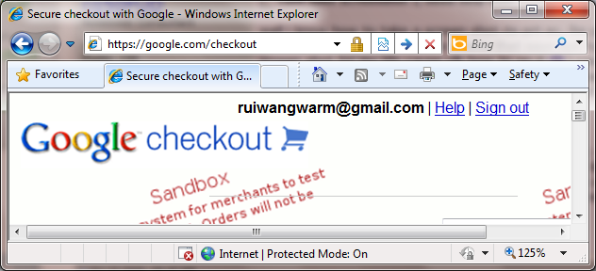
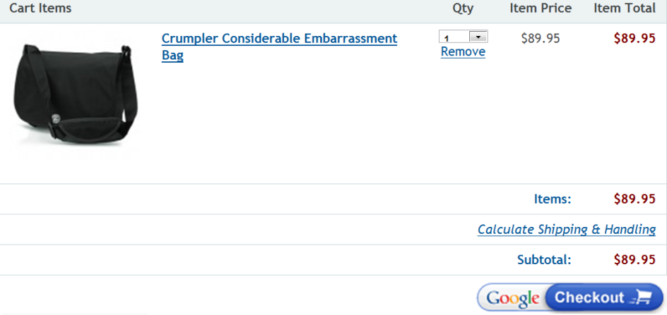
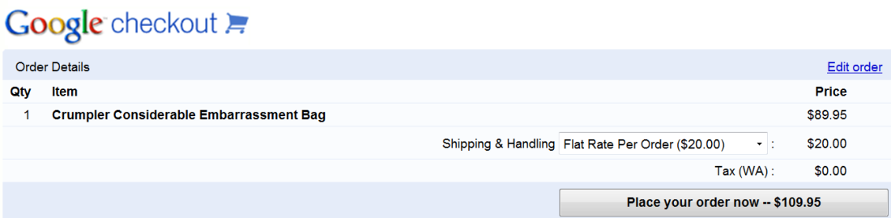
Interspire’s integration of Google Checkout
Pay Now
Payment total is calculated based on cart.
Order is calculated based on cart.
Oops! Cart is not locked.
time

Slide 17
Confirming the Presence of These Flaws in Real World

Slide 18
Our systematic validation
Against stores on our own web server
Against our store on Interspire’s popular hosting service
BigCommerce
Against real stores powered by NopCommerce and Interspire
GoodEmotionsDVD.com, PrideNutrition.com, LinuxJournalStore.com
Similar attacks against stores running closed-source software, e.g., Buy.com and JR.com
Without source code access, some exploit ideas are still applicable

Slide 19







Responsible experiments
Under close guidance of an Indiana University lawyer.
Support from Dean of School of Informatics
Principles
No intrusion
No monetary loss to the stores
Communicated full details to affected parties
Pleasant outcome
No negative opinions on our tests, responsible efforts appreciated by most of them
News articles are all positive

Slide 20
How hard to detect the attack?
Dear Buy.com customer service,
Last week I placed the two orders (Order Number: 54348156 Order number: 54348723) in buy.com. Both items were shipped recently, but I found that my paypal account has not been charged for the order 54348723 (the alcohol tester).
My credit card information is: [xxxxxxxxx] The total of the order 54348723 is $5.99. Please charge my credit card.
Thank you very much
Dear buy.com customer service,
I am a Ph.D. student doing research on e-commerce security. I bumped into an unexpected technical issue in buy.com's mechanism for accepting the paypal payments. I appreciate if you can forward this email to your engineering team.
The finding is regarding the order 54348723. I placed the order in an unconventional manner (by reusing a previous paypal token), which allowed me to check out the product without paying. I have received the product in the mail. Of course I need to pay for it. Here is my credit card information [xxxxxxxxxxxx]. Please charge my card. The total on the invoice is $5.99.
From: Buy.Com Support <customerhelp@noreply.buy.com> Date: Sun, Jun 13, 2010 at 3:32 PM Subject: Re: Other questions or comments (KMM3534132I15977L0KM) To: Test Wang ruiwangworm@gmail.com
Thank you for contacting us at Buy.com.
Buy.com will only bill your credit card only when a product has been shipped. We authorize payment on your credit card as soon as you place an order. Once an item has shipped, your credit card is billed for that item and for a portion of the shipping and/or tax charges (if applicable).
If there are items on "Back Order" status, your credit card is re-authorized for the remaining amount and all previous authorizations are removed. This is the reason you may have multiple billings for your order.
…
After our refund–eligible period, we mailed the products back by a certified mail. We disclosed technical details to them.
A generic reply that misunderstood the situation
Re: Other questions or comments
(KMM3545639I15977L0KM)
Buy.Com Support <customerhelp@noreply.buy.com> Wed, Jun 16, 2010 at 6:25 PM
To: Test Wang <ruiwangworm@gmail.com>
Hello Test,
Thank you for contacting us at Buy.com.
Based on our records you were billed on 6/10/2010 for $5.99. To confirm
your billing information please contact PayPal at
https://www.paypal.com/helpcenter or at 1-402-935-2050.

Slide 21
Companies are very serious about these bugs
They were very responsive
Most emails were replied
All 9 bugs have been quickly fixed
Amazon SDK vulnerability
15 days after our reporting, Amazon released a new set of SDKs for all supported languages and a security advisory, crediting Rui Wang
40 days after the advisory, Amazon disabled the support of vulnerable SDKs, forcing all stores to upgrade to the new version

Slide 22
Also in the paper
Complexity of CaaS-based checkout logic
Attacker Anonymity
Attacks can happen without disclosing the attacker’s identity

Slide 23
Conclusions
Multi-party web apps fundamentally more complicated than traditional web apps
Confusion in coordination
Concurrency and atomicity
Weak bindings among data fields
Adversary playing multiple roles
CaaS-based stores are under imminent threats
Shown by real purchases.
The issue is not specific to cashier service integration
It has a broader domain: web service integration
Social Network, e.g., Facebook, LinkedIn
3rd Authentication, e.g., Google, Yahoo, Twitter

Slide 24
Acknowledgements
Microsoft
Martín Abadi, Brian Beckman, Josh Benaloh, Cormac Herley, Akash Lal, Stuart Schechter, Dan Simon, Yi-Min Wang
Indiana University
Beth Cate (lawyer), Robert Schnabel (Dean of Informatics)

Slide 25
Thanks

Slide 26
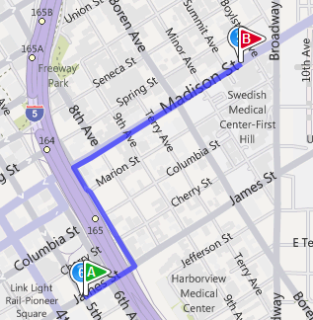

The real challenge that I see in system security in general
formal model
How to check?
(The verification community knows already)
predicates
How to extract the logic model?
System researcher’s contribution
What to check?
Actual merchant system
Actual CaaS
system
Security goals
(e.g., shopper should not be able to shop for free)
Notes:
When we talked to verification researchers about our work, some of them said that protocol verification tools would have discovered these bugs. What is your contribution then? [pause] Actually, the real problem here is not how to check a formal model such as a protocol against a set of security predicates. We have no doubt that the verification community knows how to do it. The problem is that there is no protocol, but actual web programs. The real fun part, 90% of our research time was on studying the real systems in order to extract the logic model, and the precise security goals at the programming level.
//Without such a clear understanding, you can only say that given a perfect protocol and accurate predicates. a protocol verification tool can rediscover these bugs,
So the challenge is not about how to check, but on how to extract and what to check, which is where system researchers make contributions.
I think a metaphor could be: the end-to-end problem here is to find a path in the real world. Verification is the technique to solve the reachability problem between two points on a well-defined map. But we need an insightful understanding of the real world in order to draw a useful map. I think we are the person to draw this map.

Slide 27
Summary of the 9 logic flaws
Merchant | CaaS | Flaw | Result | Specific to | Who fixed it
NopCommerce | PayPal Standard | Insufficient check of payment total | Pay arbitrary price | Merchant | Merchant
NopCommerce | Amazon Simple Pay | Insufficient protection against a shopper with a malicious merchant | Shop for free | Payment method | CaaS
Interspire | Amazon Simple Pay | Incorrect use of signature | Shop for free | Merchant | Merchant
Interspire | PayPal Express | Insufficient protection against a shopper with two shopping sessions | Pay arbitrary price | Merchant | Merchant
Interspire | PayPal Standard | Payment notification can be replayed under certain condition | Pay arbitrary price | Merchant | Merchant
Interspire | Google Checkout | Can add items to cart after payment total is fixed | Pay arbitrary price | Merchant | Merchant
JR.com | Checkout By Amazon | Insufficient protection against a shopper with a malicious merchant | Pay arbitrary price | Merchant | Merchant
Buy.com | PayPal Express | Paypal token allowed to be reused | Pay arbitrary price | Merchant | Merchant
Web stores using Amazon SDKs | Amazon Flexible Payments | Insufficient signature validation | Shop for free | CaaS | CaaS
Notes:
We have found logic bugs in 9 different checkout scenarios, which allows us to shop for free or pay self-determined prices.
We believe that this type of logic flaws are pervasive, because every merchant app and caas system that we have studied actually appears on this bug list.
Due to time limit, we can only talk about three attacks in this talk.

Slide 28
Some thoughts on solution
Security-conscious programming guides
Certified Integration
Verification/Testing tools

