Slide 1
Block Ciphers and Modes of Operation
IT IS 6200/8200 Fall 2023 - Lecture 3

Slide 2
Announcements
Assignment 1 release later today
Due Sep.12th 11:59 PM EST
Start early!
Office hours start this week
Notes:
Want to submit an announcements doodle? Email evanbot@berkeley.edu or post on Piazza!

Slide 3
Recap
What’s cryptography?
Communicating securely over insecure channels
You should never write your own crypto! Use existing libraries instead.
Definitions
Alice and Bob want to send messages over an insecure channel. Eve can read anything sent over the insecure channel. Mallory can read or modify anything sent over the insecure channel.
We want to ensure confidentiality (adversary can’t read message), integrity (adversary can’t modify message), and authenticity (prove message came from sender)
Crypto uses secret keys. Kerckhoff’s principle says to assume the attacker knows the entire system, except the secret keys.
There are several different threat models. We’ll focus on the chosen plaintext attack (CPA), where Eve tricks Alice into encrypting some messages.

Slide 4
Recap
IND-CPA security
Even if Eve can trick Alice into encrypting some messages of Eve’s choosing, given the encryption of either M0 or M1, Eve cannot distinguish which message was sent with probability greater than 1/2.
We can use the IND-CPA game to test for IND-CPA security
One-time pads
Symmetric encryption scheme: Alice and Bob share a secret key.
Encryption and decryption: Bitwise XOR with the key.
No information leakage if the key is never reused.
Information leaks if the key is reused.

Slide 5
Block Ciphers
Notes:
There two types of symmetric key cryptography: stream ciphers and block ciphers.
Today, We want to look at something called block ciphers. We will talk stream cypher in future lectures.

Slide 6
Cryptography Roadmap
 | Symmetric-key | Asymmetric-key
Confidentiality | One-time pads Block ciphers with chaining modes (e.g. AES-CBC) Stream ciphers | RSA encryption ElGamal encryption
Integrity, Authentication | MACs (e.g. HMAC) | Digital signatures (e.g. RSA signatures)
Hash functions
Pseudorandom number generators
Public key exchange (e.g. Diffie-Hellman)
Key management (certificates)
Password management

Slide 7
Intro to Block Ciphers
Types of symmetric key crypto
Use a fixed length key to encrypt a fixed length block of data
For example, a 64-bit block of data and a 128-bit key
Notes:
Block ciphers are a type of symmetric key crypto and what they do is they use a fixed length key to encrypt a fixed length block of data.
A block cipher encrypts specific blocks fixed length chunks of data into an ciphertext of the exact same length.
For example a 64-bit block of data and a 128-bit key could be the parameters for a block cipher, so I could have a block cipher where my key is 128 bits and I encrypt 64 bits of data at a time.

Slide 8
Intro to Block Ciphers
Similar to a substitution cipher
Much larger alphabet!
Example: if we have a 64-bit block cipher, then our substitution table has 2⁶⁴ entries (1.8 * 10¹⁹)
That’s a big substitution table!
Goal of a block cipher: Do this with an algorithm and a small key
Notes:
Block ciphers are a type of symmetric key crypto and what they do is they use a fixed length key to encrypt a fixed length block of data.
A block cipher encrypts specific blocks fixed length chunks of data into an ciphertext of the exact same length.
For example a 64-bit block of data and a 128-bit key could be the parameters for a block cipher, so I could have a block cipher where my key is 128 bits and I encrypt 64 bits of data at a time.
At its core a block cipher is in some ways very similar to a substitution cipher but with a much larger alphabet.
Remember in a substitution cipher we simply had every letter written out as one entry in a table and then we randomly permuted the entries, so that the encrypted version was just a randomized list of the alphabet so that meant that every letter in the plaintext had a one-to-one correspondence with a letter in the ciphertext.
The block cipher is basically the same thing except our alphabet size is a lot bigger.
Instead of it just being 26 letters it's every possible say 64 bit value so if we were to do a 64 bit block cipher that would mean that our substitution table would have 2 to the 64 entries which is 1.8 times 10 to 19 that's a huge number that would be a really big substitution table. In fact it would be a hundred and 25 million terabytes so it's huge.
I don't give this example to say that this is how a block cipher works.
It doesn't build an actual table but the idea is the same in concept. Every 64 bits of plaintext would have a corresponding cipher text for a given key.

Slide 9
Real-World Block Ciphers
Data Encryption Standard (DES)
64-bit block size
56-bit key size
Released in 1976
US government standard until 2001
Advanced Encryption Standard (AES)
128-bit block size
128, 192, or 256 bit key size
Current US government standard
Most widely used
Notes:
so some real-world block cyphers will go over two of them the first is the data encryption standard des des is a was a US government standard until 2001 it was released in 1976 and it uses a 64-bit block size in a 56 bit key size so the key was 56 bits but the blocks of data that you encrypt are 64 bits.
Now DES was replaced by AES the advanced encryption standard.
AES uses a 128-bit block size and it can take a variety of key sizes either 128 192 or 256 bits for the key size AES is the current US government standard and it's it's probably the most widely used symmetric key algorithm in in most applications today and it's considered very secure.
Lots of smart people have looked at it and they haven't found any significant weaknesses.

Slide 10
Simplified AES Example
Decryption
Encryption
Plaintext (128-bits)
Ciphertext (128-bits)
Key
(256-bits)
AES-E
Key
(256-bits)
AES-D
Ciphertext (128-bits)
Plaintext (128-bits)
Notes:
Let's do a simplified AES example.
So in this case my encryption I take some plaintext data of one block size so if we're doing a AES that block size is 128 bits.
I take a key which is 256 bits for AES here and I run it through the AES encryption algorithm so the key and the data go in together and that produces ciphertext data of 128 bits. so my plaintext block is converted to a ciphertext block of the same size.
When I decrypt I do the same thing in reverse.
I put my ciphertext and the key into the AES decryption algorithm and I get out the plaintext data now.
it's really important to note a couple of things here first is that the block size is really important you can't use a block cipher to encrypt something that's smaller or larger than the block size you can only encrypt an item that is exactly that size.
So if your item is bigger than the block size in this case 128 bits then you need to break it up into smaller pieces and encrypt each 128-bit piece separately
If your item is smaller than 128 bits then you need to add some junk we call it padding just add some extra bits to get it up to the right size because a block cipher only encrypts chunks of data that are the right size blocks.
%%%%%%%%%%
so let's look at some properties Properties of Block Ciphers of block ciphers now one important property is that the plaintext two ciphertext mappings must be one-to-one for a given key so that means that for a given key the same plaintext block always becomes the same ciphertext block and the same ciphertext block always becomes the same plaintext block so vice-versa it's also really important that the input and output have no correlation so what this means is if I have a 128-bit input block that will produce an output block if I change one bit of that input block then the output block should change significantly in a way that's not distinguishable from random and not distinguishable from random it's just a big fancy way to say that about 50% of the bit should change so if I change one bit on the input then about 50% of the output bits should change so get some features of block Features of Block Ciphers ciphers the first is the block size in general the bigger the block size the more secure it is to an extent but it's probably slower larger block sizes tend to be a little bit slower when you do the encryption in the decryption and key size is the same in general bigger is more secure but it's probably slower because it takes more computations to do the encryption okay so let's summarize this discussion Summing Up of block ciphers and stream ciphers stream ciphers are used to produce a pseudo-random stream of bits that you exclusive or with your plaintext so the stream cipher produces the stream of bits your ki stream and you exclusive or that with your plaintext to encrypt or you exclusive for it with your ciphertext to decrypt block ciphers are used to encrypt one data block or used to encrypt data one block at a time so you put in one block of plaintext you get out one block of ciphertext and in all of the symmetric key ciphers that we've talked about today the sender and receiver need to share the same key

Slide 11
Block Ciphers: Definition
plaintext
Block cipher: An encryption/decryption algorithm that encrypts a fixed-sized block of bits
EK(M) → C: Encryption
Inputs: k-bit key K and an n-bit plaintext M
Output: An n-bit ciphertext C
DK(C) → M: Decryption
Inputs: a k-bit key, and an n-bit ciphertext C
Output: An n-bit plaintext
The inverse of the encryption function
Properties
Correctness: EK is a permutation, DK is its inverse
Efficiency: Encryption/decryption should be fast
Security: E behaves like a random permutation
n bits
K
k bits
E
n bits
ciphertext
ciphertext
n bits
K
k bits
D
n bits
plaintext
Notes:
After seeing the example, let’s see some definitions of block ciphers

Slide 12
Block Ciphers: Correctness
EK(M) must be a permutation (bijective function) on n-bit strings
Each input must correspond to exactly one unique output
Intuition
Suppose EK(M) is not bijective
Then two inputs might correspond to the same output: E(K, x1) = E(K, x2) = y
Given ciphertext y, you can’t uniquely decrypt. D(K, y) = x1? D(K, y) = x2?
00
01
10
11
00
01
10
11
00
01
10
11
00
01
10
11
Not bijective: Two inputs encrypt to the same output
Bijective: Each input maps to exactly one unique output

Slide 13
Block Ciphers: Security
A secure block cipher behaves like a randomly chosen permutation from the set of all permutations on n-bit strings
A random permutation: Each n-bit input is mapped to one randomly-chosen n-bit output
Consider a distinguishing game
Eve gets two boxes: One is a randomly chosen permutation, and one is EK with a randomly chosen key K
Eve should not be able to tell which is which with probability > 1/2
00
01
10
11
00
01
10
11
00
01
10
11
00
01
10
11
One of these is EK with a randomly chosen K, and the other one is a randomly chosen permutation. Eve can’t distinguish them.

Slide 14
Block Ciphers: Brute-force attacks?
How hard is it to run a brute-force attack on a 128-bit key?
We have to try 2¹²⁸ possibilities. How big is 2¹²⁸?
Handy approximation: 2¹⁰ ≈ 10³
2¹²⁸ = 2^{10*12.8} ≈ (10³)^{12.8} ≈ (10³)¹³ = 10³⁹
Suppose we have massive hardware that can try 10⁹ (1 billion) keys in 1 nanosecond (a billionth of a second). That’s 10¹⁸ keys per second
We’ll need 10³⁹ / 10¹⁸ = 10²¹ seconds. How long is that?
One year ≈ 3×10⁷ seconds
10²¹ seconds / 3×10⁷ ≈ 3×10¹³ years ≈ 30 trillion years
Takeaway: Brute-forcing a 128-bit key takes astronomically long. Don’t even try.

Slide 15
Block Ciphers: Efficiency
Encryption and decryption should be computable in microseconds
Formally: KeyGen(), Enc(), and Dec(), should not take exponential time
Block cipher algorithms typically use operations like XOR, bit-shifting, and small table lookups
Very fast on modern processors
Modern CPUs provide dedicated hardware support for block ciphers
Notes:
TODO This should be E and D, not KeyGen, Enc, and Dec

Slide 16
DES (Data Encryption Standard)
Designed in late 1970s
Block size 64 bits (n = 64)
Key size 56 bits (k = 56)
NSA influenced two facets of its design
Altered some subtle internal workings in a mysterious way
Reduced key size from 64 bits to 56 bits
However, modern computer speeds make it completely unsafe due to small key size
~6.3 × 10¹⁶, say 10¹⁰ tries per second on my single desktop computer's Nvidia graphics card: Takes ~6.3 × 10⁶ seconds or ~70 days
Notes:
first is the data encryption standard des des is a was a US government standard until 2001 it was released in 1976 and it uses a 64-bit block size in a 56 bit key size so the key was 56 bits but the blocks of data that you encrypt are 64 bits now a DES was replaced by AES the advanced encryption standard
2^56 = 2^(10*5.6)=10^(3*5.6) = 10 ^ (16.8) = 6.3 * 10^16

Slide 17
AES (Advanced Encryption Standard)
1997–2000: NIST (National Institute of Standards and Technology) in the US held a competition to pick a new block cipher standard
Out of the 5 finalists:
Rijndael, Twofish, and Serpent had really good performance
RC6 had okay performance
MARS had ugly performance
On any given computing platform, Rijndael was never the fastest
But on every computing platform, Rijndael was always the second-fastest
Rijndael was selected as the new block cipher standard

Slide 18
AES (Advanced Encryption Standard)
Key size 128, 192, or 256 bits (k = 128, 192, or 256)
Actual cipher names are AES-128, AES-192, and AES-256
Block size 128 bits (n = 128)
Note: The block size is still always 128 bits, regardless of key size
You don’t need to know how AES works, but you do need to know its parameters
Notes:
DES was replaced by AES the advanced encryption standard.
An AES uses a 128-bit block size. it can take a variety of key sizes either 128 192 or 256 bits for the key size AES is the current US government standard and it's it's probably the most widely used symmetric key algorithm in in most applications today.
It's considered very secure lots of smart people have looked at it and they haven't found any significant weaknesses.
It's really important to note a couple of things here first is that the block size is really important you can't use a block cipher to encrypt something that's smaller or larger than the block size you can only encrypt an item that is exactly that size so if your item is smaller than in this case 128 bits you would need to break it up into pieces and encrypt each piece separately if your item is bigger than the block size in this case 128 bits then you need to break it up into smaller pieces and encrypt each 128-bit piece separately if your item is smaller than 128 bits then you need to add some junk we call it padding just add some extra bits to get it up to the right size because a block cipher only encrypts chunks of data that are the right size blocks

Slide 19
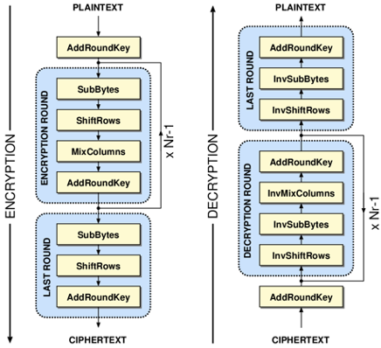
AES Algorithm
Different key sizes use different numbers of rounds
10 rounds for 128-bit keys
12 rounds for 192-bit keys
14 rounds for 256-bit keys
Each round uses its own “round key” derived from the cipher key
Each round:
SubBytes()
ShiftRows()
MixColumns() (if not last round)
AddRoundKey()
Notes:
AES slides, credit Kevin Orr

Slide 20
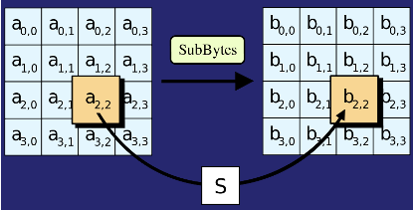
AES Algorithm: SubBytes()
Replace each byte in the block with another byte using an 8-bit substitution box

Slide 21
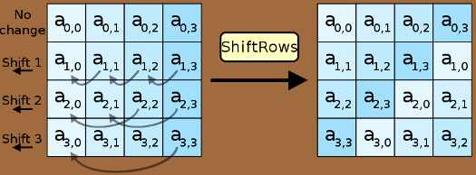
AES Algorithm: ShiftRows()
Cyclically shifts the bytes in each row by a certain offset
The number of places each byte is shifted differs for each row

Slide 22
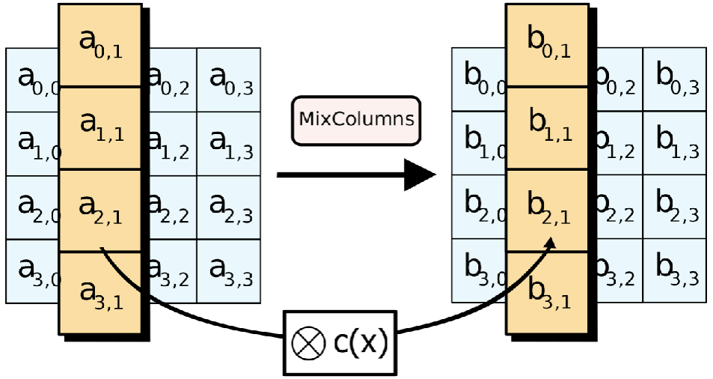
AES Algorithm: MixColumns()
Treats the 16-byte block as a 4 × 4 matrix and multiply it by by another matrix

Slide 23
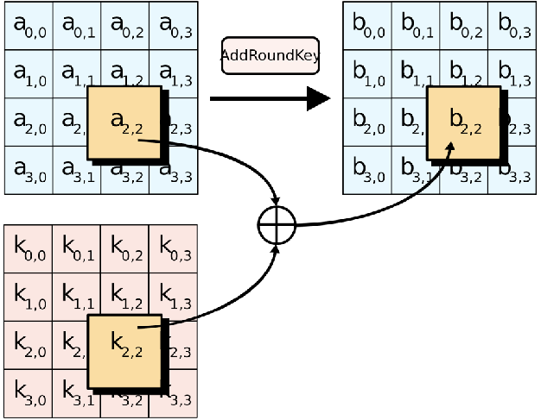
AES Algorithm: AddRoundKey()
XOR the 16-byte block with the 16-byte round key

Slide 24
AES (Advanced Encryption Standard)
There is no formal proof that AES is secure (indistinguishable from a random permutation)
However, in 20 years, nobody has been able to break it, so it is assumed to be secure
The NSA uses AES-256 for secrets they want to keep secure for the 40 years (even in the face of unknown breakthroughs in research)
Takeaway: AES is the modern standard block cipher algorithm
The standard key size (128 bits) is large enough to prevent brute-force attacks

Slide 25
Are Block Ciphers IND-CPA Secure?
Eve (adversary)
Alice (challenger)
Consider the following adversary:
Eve sends two different messages M0 and M1
Eve receives either EK(M0) or EK(M1)
Eve requests the encryption of M0 again
Strategy: If the encryption of M0 matches what she received, guess b = 0. Else, guess b = 1.
Eve can win the IND-CPA game with probability 1!
Block ciphers are not IND-CPA secure
M
(repeat)
Enc(K, M)
M0 and M1
pick b
Enc(K, Mb)
M
(repeat)
Enc(K, M)
Guess b = 0 or b = 1

Slide 26
Issues with Block Ciphers
Block ciphers are not IND-CPA secure, because they’re deterministic
A scheme is deterministic if the same input always produces the same output
No deterministic scheme can be IND-CPA secure because the adversary can always tell if the same message was encrypted twice
Block ciphers can only encrypt messages of a fixed size
For example, AES can only encrypt-decrypt 128-bit messages
What if we want to encrypt something longer than 128 bits?
To address these problems, we’ll add modes of operation that use block ciphers as a building block!
Notes:
Ask for any other issues students can think of after describing deterministic schemes
Large Messages? well what if i want to encrypt a larger message so what if i have more than one block for example so if i'm using aes with 128 bit block size that would be 16 bytes what if i want to encrypt something like a 30 megabyte video well there's more than one block in a 30 megabyte video in fact there's a whole lot more so what do i need to do in order to make that happen since my block cipher can only encrypt one block at a time Block Cipher Operating Modes in order to solve this problem i mean the fairly straightforward approach and hopefully you're thinking of this is we could just break up the big chunk of data into blocks that are the right size and just encrypt each of those blocks now the way that we encrypt the blocks after we've broken them up impacts security of the underlying ciphertext when we're done there are five traditional ways that we encrypt these this set of blocks of data and we call them operating modes because they're the ways that we use the block cipher in order to encrypt a large chunk of data we're going to cover three of the five traditional ways in this lecture and i just want to note that there are more than even the traditional five there are others as well

Slide 27
Summary: Block Ciphers
Encryption: input a k-bit key and n-bit plaintext, receive n-bit ciphertext
Decryption: input a k-bit key and n-bit ciphertext, receive n-bit plaintext
Correctness: when the key is fixed, EK(M) should be bijective
Security
Without the key, EK(m) is computationally indistinguishable from a random permutation
Brute-force attacks take astronomically long and are not possible
Efficiency: algorithms use XORs and bit-shifting (very fast)
Implementation: AES is the modern standard
Issues
Not IND-CPA secure because they’re deterministic
Can only encrypt n-bit messages

Slide 28
Block Cipher Modes of Operation

Slide 29
Block Ciphers Operating Mode
We need to break up the data into blocks and encrypt those
The way we encrypt the blocks impacts security
The ways of encrypting blocks are called operating modes
Notes:
We could just break up the big chunk of data into blocks that are the right size and just encrypt each of those blocks.
Now the way that we encrypt the blocks after we've broken them up impacts security of the underlying ciphertext.
There are different ways that we encrypt these this set of blocks of data and we call them operating modes. Because they're the ways that we use the block cipher in order to encrypt a large chunk of data. In this lecture, we're going to cover three operating modes.

Slide 30
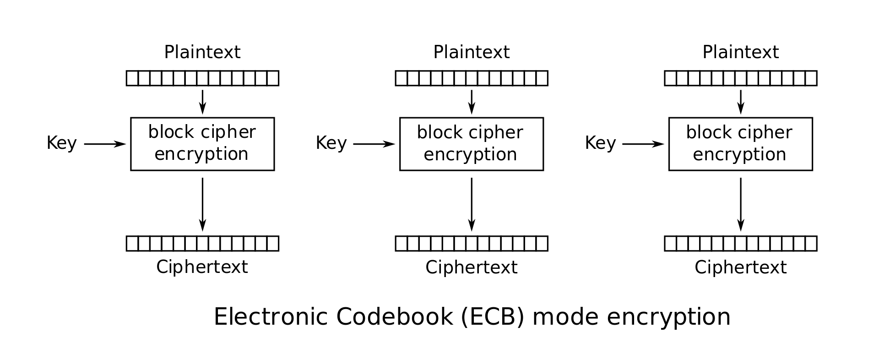
Scratchpad: Let’s design it together
Here’s an AES block. Remember that it can only encrypt 128-bit messages.
How can we use AES to encrypt a longer message (say, 256 bits?)

Slide 31
Scratchpad: Let’s design it together
Idea: Let’s use AES twice!
First 128 bits of message
Second 128 bits of message

Slide 32
Scratchpad: Let’s design it together
Note that we are using the same key twice. We want to avoid a situation like one-time pads where we need very long keys.

Slide 33
ECB Mode
We’ve just designed electronic code book (ECB) mode
Enc(K, M) = C1 || C2 || … || Cm
Assume m is the number of blocks of plaintext in M, each of size n
AES-ECB is not IND-CPA secure. Why?
Because ECB is deterministic
Notes:
Electronic Code Book (ECB) so the first method is called electronic codebook and this is kind of the obvious method the first thing that everybody comes up with when they think well how can i break it into blocks and encrypt it in electronic code book you break the data into blocks you encrypt each block independently and then you use the same key for every block so let's look at a diagram of this.
ECB: Encryption this diagram which i have shamelessly taken from wikipedia because it's good wikipedia has excellent entries on operating modes.
We simply take our plain text data and which is up here at the top and we break it into blocks that are the right size for use with my block cipher.
So if I was using AES for example then each of these blocks would be 128 bits so I break it into these 128 bit blocks and then I just encrypt each block with whatever key I am going to use for the encryption, I get blocks of ciphertext. and then I take each of these blocks of ciphertext and I put them all together and that becomes the ciphertext for my data.

Slide 34
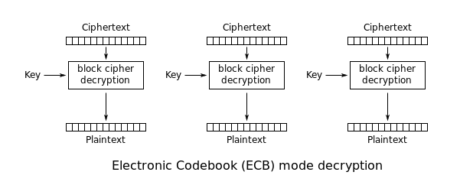
ECB Mode
Notes:
Now, for decryption of this is just doing the opposite which is what you would hopefully expect you take the you take the individual cipher text blocks you decrypt them using the key and you get back the original plain text which you then put back together in order to get the original file.
ECB is the straightforward simple approach but it has some problems.

Slide 35


ECB Mode: Problems
Deterministic: the same PT blocks produce the same CT blocks
Many computer files have duplicate blocks, and we don’t want an attacker to be able to tell this
Notes:
The main problem is that the same plain text blocks produce the same ciphertext blocks when you're using the same key so if you have two blocks in the file that have the exact same plain text.
They're also going to have the exact same cipher text now.
Originally we talked about a simple cipher the substitution cipher that had the same issue whenever you encrypt the same letter if the same letter is encrypted twice in the same message using a substitution cipher each time it becomes the same ciphertext letter and this allowed people to perform frequency analysis attacks against a substitution cipher well people can do the same thing against an ECB cipher it's just you know a different idea because we're dealing with bits and entire pieces of computer files instead of just individual letters.
Many computer files or other things you might want to encrypt on a computer already have duplicate blocks by default it's just normal that they would have duplicate blocks and we don't want an attacker to be able to tell this by looking at the cipher text you know so we wouldn't want an attacker to be able to analyze an encrypted file and be able to tell you which blocks are the same because that information could help the attacker figure out something about the original unencrypted version.
To illustrate this so here's an example of a picture of a penguin and if you encrypt that with ECB and then you just display the encrypted data as if it were an image you get this now if you look at that you should pause and say: that's kind of disturbing the encrypted image shouldn't look like the original one.
But this one kind of does now of course it's not as detailed but no it still kind of looks the same.
You know so you look here and you can kind of see that the white background here became this pattern here and it's consistent throughout wherever the white is;
the black part of the body became some consistent pattern or color here;
and the yellow on the feet became again a consistent pattern or color here.
Because of the fact that in an image file we have a lot of repeated blocks of data such as color, I mean you know every time we see the color white it's going to be represented the same way in the image file when that white is encrypted it becomes the same thing every time over here so we end up with just by looking at the encrypted data as if it were an image you can see what the original image really was. That's a problem with encryption.

Slide 36
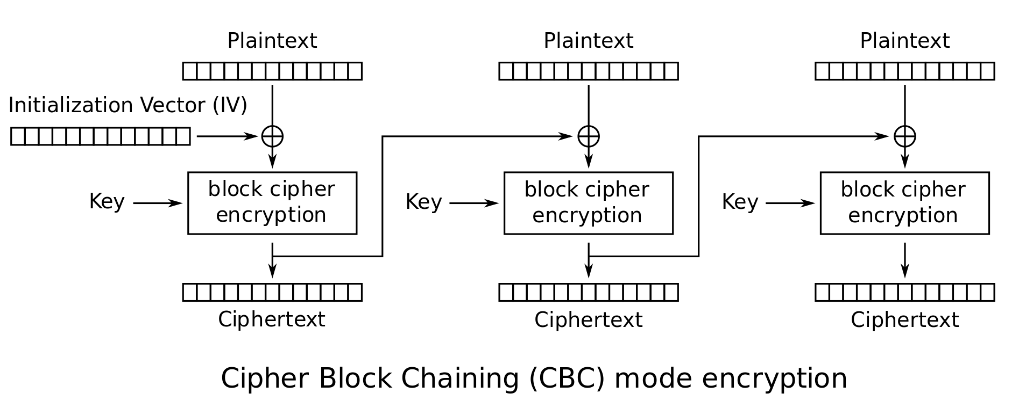
Scratchpad: Let’s design it together
Here’s ECB mode. It’s not IND-CPA secure because it’s deterministic.
Let’s fix that by adding some randomness.

Slide 37
Scratchpad: Let’s design it together
The Initialization Vector (IV) is different for every encryption. Now the first ciphertext block will be different for every encryption!
Okay, but the other blocks are still deterministic...
Notes:
If students propose adding

Slide 38
Scratchpad: Let’s design it together
Idea: The first ciphertext block was computed with some randomness. Let’s use it to add randomness to the second block.
Notes:
If students propose adding

Slide 39
Scratchpad: Let’s design it together
Now the second ciphertext block has some randomness in it. Let’s use it to add randomness to the third block.
Notes:
If students propose adding

Slide 40
CBC Mode
We’ve just designed cipher block chaining (CBC) mode
Ci = EK(Mi ⊕ Ci-1); C0 = IV
Enc(K, M):
Split M in m plaintext blocks P₁ … P_{m} each of size n
Choose a random IV
Compute and output (IV, C₁, …, C_{m}) as the overall ciphertext
How do we decrypt?
P₁
P₂
P_{m}
Notes:
Cipher Block Chaining (CBC) an improved approach something better than ecb is called cipher block chaining or cbc.
In CBC, each block is dependent on the previous one and this finished this fixes a lot of the problems with ecb CBC: Encryption so let's look at what i mean by each block is dependent on the previous one let's start with the middle here instead of the beginning
So if i have a piece of plain text in cbc what I do is that before I encrypt it I exclusive OR it with the ciphertext of the previous block so I take the ciphertext to the previous block I exclusive OR that with the plain text of the current block and then I encrypt that to produce my ciphertext and what this does is this means that my plain text is mixed in with the previous ciphertext so that even if two plain text blocks are identical when they get encrypted with CBC they're mixed in with something else before the encryption so they don't result in identical ciphertext.
So even if this plain text and this plain text are identical, even if they were the same they would result in different cipher texts because what was encrypted was mixed in with the previous ciphertext.
It wasn't just encrypting the plaintext data so this solves that problem
Now one thing I want to point out on here is that the very first block of data that you're encrypting needs what's called an initialization vector because it doesn't have a previous ciphertext block let's take a look at that CBC: Initialization Vector (IV) an initialization vector is put in place because the ciphertext of each block is dependent on the previous block and the first block has no previous block it's the first block of data there's nothing that came before it so you can't exclusive or it with the previous ciphertext there is no previous ciphertext so we pick a random value we call it the initialization vector and we use that as if it were the the previous ciphertext block so that's just what the initialization vector is it's just a randomly chosen value it's not even a secret it's just randomly chosen to in order to add that additional bit of mixing into the first block that you encrypt

Slide 41
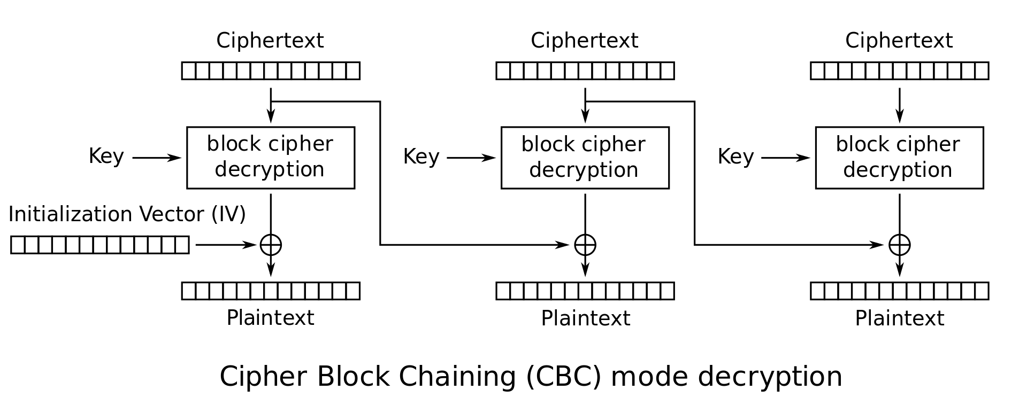
CBC Mode: Decryption
How do we decrypt CBC mode?
Parse ciphertext as (IV, C₁, …, C_{m})
Decrypt each ciphertext and then XOR with IV or previous ciphertext
M1 ⊕ IV
M2 ⊕ C1
M1
M2
C1
C2
C1
C2
M1
M2
M1 ⊕ IV ⊕ IV = M1
M2 ⊕ C1 ⊕ C1 = M2
Notes:
So what does decryption look like for CBC.
Well in in decryption it operates kind of like you would expect we're doing the reverse of what the encryption was so in decryption, we take the ciphertext that we have.
We decrypt it but that doesn't result in the original plaintext that results in a value that's the original plaintext exclusive OR with the previous ciphertext, because that's what was encrypted before.
So in order to recover the original plaintext we have to take that value and exclusive or it with the previous ciphertext which we happen to have, because we have all the ciphertext and that allows us to get the plain text.
So we're simply reversing the procedure that we used to encrypt with CBC which now means that we exclusive or with the previous ciphertext after the decryption.
And again for the first block we have that initial vector and in this case when you're doing decryption the initial vector is not a random value it's the value that was used during the encryption but since it's not a secret that value can be shared freely.
I can encrypt choose a random initial vector to start with and I can send you my ciphertext and the initial vector I used and it doesn't change the security of the problem as long as the key remains a secret between you and me so the initial vector is not a secret.

Slide 42
CBC Mode: Decryption
Ci | = | EK(Mi ⊕ Ci-1) | Definition of encryption
DK(Ci) | = | DK(EK(Mi ⊕ Ci-1)) | Decrypting both sides
DK(Ci) | = | Mi ⊕ Ci-1 | Decryption and encryption cancel
DK(Ci) ⊕ Ci-1 | = | Mi ⊕ Ci-1 ⊕ Ci-1 | XOR both sides with Ci-1
DK(Ci) ⊕ Ci-1 | = | Mi | XOR property

Slide 43
CBC Mode: Efficiency & Parallelism
Can encryption be parallelized?
No, we have to wait for block i to finish before encrypting block i+1
Can decryption be parallelized?
Yes, decryption only requires ciphertext as input

Slide 44
CBC Mode: Padding
What if you want to encrypt a message that isn’t a multiple of the block size?
AES-CBC is only defined if the plaintext length is a multiple of the block size
Solution: Pad the message until it’s a multiple of the block size
Padding: Adding dummy bytes at the end of the message until it’s the proper length

Slide 45
CBC Mode: Padding
What padding scheme should we use?
Padding with 0’s?
Doesn’t work: What if our message already ends with 0’s?
Padding with 1’s?
Same problem
We need a scheme that can be unpadded without ambiguity
One scheme that works: Append a 1, then pad with 0’s
If plaintext is multiple of n, you still need to pad with an entire block
Another scheme: Pad with the number of padding bytes
So if you need 1 byte, pad with 01; if you need 3 bytes, pad with 03 03 03
If you need 0 padding bytes, pad an entire dummy block
This is called PKCS #7
Notes:
Ask: Ideas for unambiguous padding schemes

Slide 46
CBC Mode: Security
AES-CBC is IND-CPA secure. With what assumption?
The IV must be randomly generated and never reused
What happens if you reuse the IV?
The scheme becomes deterministic: No more IND-CPA security

Slide 47
CBC Mode: IV Reuse
Consider two three-block messages: P1P2P3 and P1P2P4
The first two blocks are the same for both messages, but the last block is different
What if we encrypt them with the same IV?
When the IV is reused, CBC mode reveals when two messages start with the same plaintext blocks, up to the first different plaintext block

Slide 48
CBC Mode is IND-CPA (when used correctly)
Enc(K, M):
Split M in m plaintext blocks P1 … Pm each of size n
Choose random IV, compute and output (IV, C1, …, Cm) as the overall ciphertext
Why IND-CPA?
If there exists an attacker that wins in the IND-CPA game, then there exists an attacker that breaks the block cipher security. Proof is out of scope.
P₁
P₂
P_{m}

Slide 49

CBC Mode: Penguin
Original image
Encrypted with ECB
Encrypted with CBC
with random IVs

Slide 50
CBC Mode: Problems
If I want to change the plaintext of one block, I must re-encrypt every following block
It’s a chain, remember?
For some cases, this is bad
Encrypted file systems, for example
Notes:
CBC also has its own problems the biggest one is that if i want to change the plain text of one block i have to re-encrypt every following block because it's a chain right the following block is dependent on the ciphertext of the previous block which is dependent on the ciphertext of the block before that which is dependent on the ciphertext of the block before that so we end up with this big chain so if i'm going to change one plaintext block i end up needing to re-encrypt every block that follows it in the file well.
That's bad if I'm doing something like a large encrypted file system or even a large encrypted file where someone might want to change just a few bytes on the inside that makes the operation really slow because even if they only change one byte inside of the file or on the file system you have to re-encrypt everything that follows and that would be not wise for certain applications

Slide 51
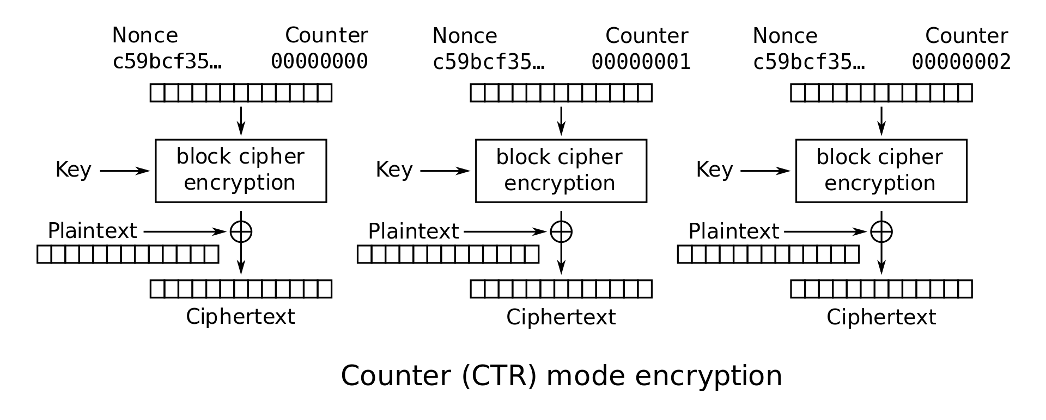
CTR Mode Scratchpad: Let’s design it together
One-time pads are secure if we never reuse the key.
Key
Notes:
Counter (CTR) so another type of operating mode and the third one we're going to talk about today is called counter mode now.
Counter mode is an operating mode that uses a block cipher to simulate a stream cipher now you may remember that a stream cipher just generates a pseudo random string of bits and then exclusive ores that with the cipher text sorry with the plain text in counter mode each block is encrypted independently but it involves incrementing nons and we'll look at that in just a second a nonce is just a number that's chosen randomly but but it's not a secret just like the initial vector it's not a secret in fact a nonce an initial vector are effectively identical in terms of what we're doing but we give them a different name just because of how they're used the initial vector is called an initial vector because it's the initial block used during cbc but a nonce is used because that's traditionally the word for a random value used in an encryption operation CTR: Encryption so anyway let's look at our diagram here so in this case we take our random value our knots and we append a counter to it and then we encrypt that random value using our key we just encrypt the value and that produces some sort of bitstream right it produces a set of bits and those bits are effectively random and we take those bits and we exclusive for them with the plain text in order to get the cipher text for the first block we do the same thing for the second block except now we've incremented our counter when we increment the counter that means that we should get on the output of the encryption a new a totally new set of bits ones that are substantially changed compared to the previous ones so even though my plain text is only changing by potentially one bit my cipher text on the output of the encryption changes significantly so i take those bits and i exclusive or them with the plain text and i get more ciphertext so it's important to note here that unlike the other operating modes we looked at in this case the block cipher is not being used to encrypt the plain text the block cipher is being used to generate a stream of bits that's exclusive ored with the plain text that's a very important distinction well in this case decryption then just involves producing the same set of bits and exclusive ring it with the cipher text just like we would do with a stream cipher you encrypt by exclusive oring with the bit stream and you decrypt by exclusive oring with that same bit stream so in this case our goal is to produce the same bit stream as before and that means that when we're using the block cipher we're still using it in encryption mode because we're just trying to produce the same bit stream we did when we had counter mode encryption so with decryption we're still going to use the encryption mode of the block cipher because again we're not encrypting or decrypting the plain text with the block cipher we're just using it to generate that stream of bits so operating modes are one of those topics that the first time you're exposed to them they're they're difficult to think about and reason about but if you spend more time reading and thinking about them then they kind of become second nature and they become more obvious for you and easier to understand so what i encourage you to do is to go spend more time with them by reading the wikipedia entry on block cipher modes of operation it's a really really really good entry apparently cryptographers love wikipedia and spend a lot of time on there making it strong so the wikipedia entry for these is very good so i would say go to wikipedia look for block cipher mode of operation and you can find an excellent page that describes the five general modes and a few more but gives their pluses and minuses and give you more information about them and i'll add just as a side note if you're ever building something and you need an operating mode chances are really high that cbc is what you want to use the other two modes are useful for specific types of scenarios ecb encounter but cbc's is in general useful for most scenarios that people operate under Summing Up so let's summarize when using block ciphers to encrypt data larger than one block you need to pick an operating mode and your choice of operating mode impacts security performance etc so you have to be able to understand how they work and to think about and reason about them so hopefully this lecture gives you a good introduction to that thanks

Slide 52
CTR Mode Scratchpad: Let’s design it together
If the attacker doesn’t know the key, the block cipher output looks random.
New idea: Can we use block ciphers to simulate a one-time pad?

Slide 53
CTR Mode Scratchpad: Let’s design it together
If the attacker doesn’t know the key, all of these outputs look random.

Slide 54
CTR Mode Scratchpad: Let’s design it together
Idea: Use this random-looking output as a one-time pad!
Remember one-time pads: XOR the pad with plaintext to get ciphertext

Slide 55
CTR Mode Scratchpad: Let’s design it together
What do we use as input to the block cipher?

Slide 56
CTR Mode Scratchpad: Let’s design it together
IND-CPA schemes need randomness, so let’s put a random nonce here!

Slide 57
CTR Mode Scratchpad: Let’s design it together
The counter increments per block to ensure each block cipher output is different.

Slide 58
CTR (Counter) Mode
Note: the random value is named the nonce here, but the idea is the same as the IV in CBC mode
Overall ciphertext is (Nonce, C₁, …, C_{m})
C₁
C_{m}

Slide 59
CTR Mode
Enc(K, M):
Split M in plaintext blocks P₁...P_{m} (each of block size n)
Choose random nonce
Compute and output (Nonce, C₁, …, C_{m})
How do you decrypt?
C₁
C_{m}

Slide 60
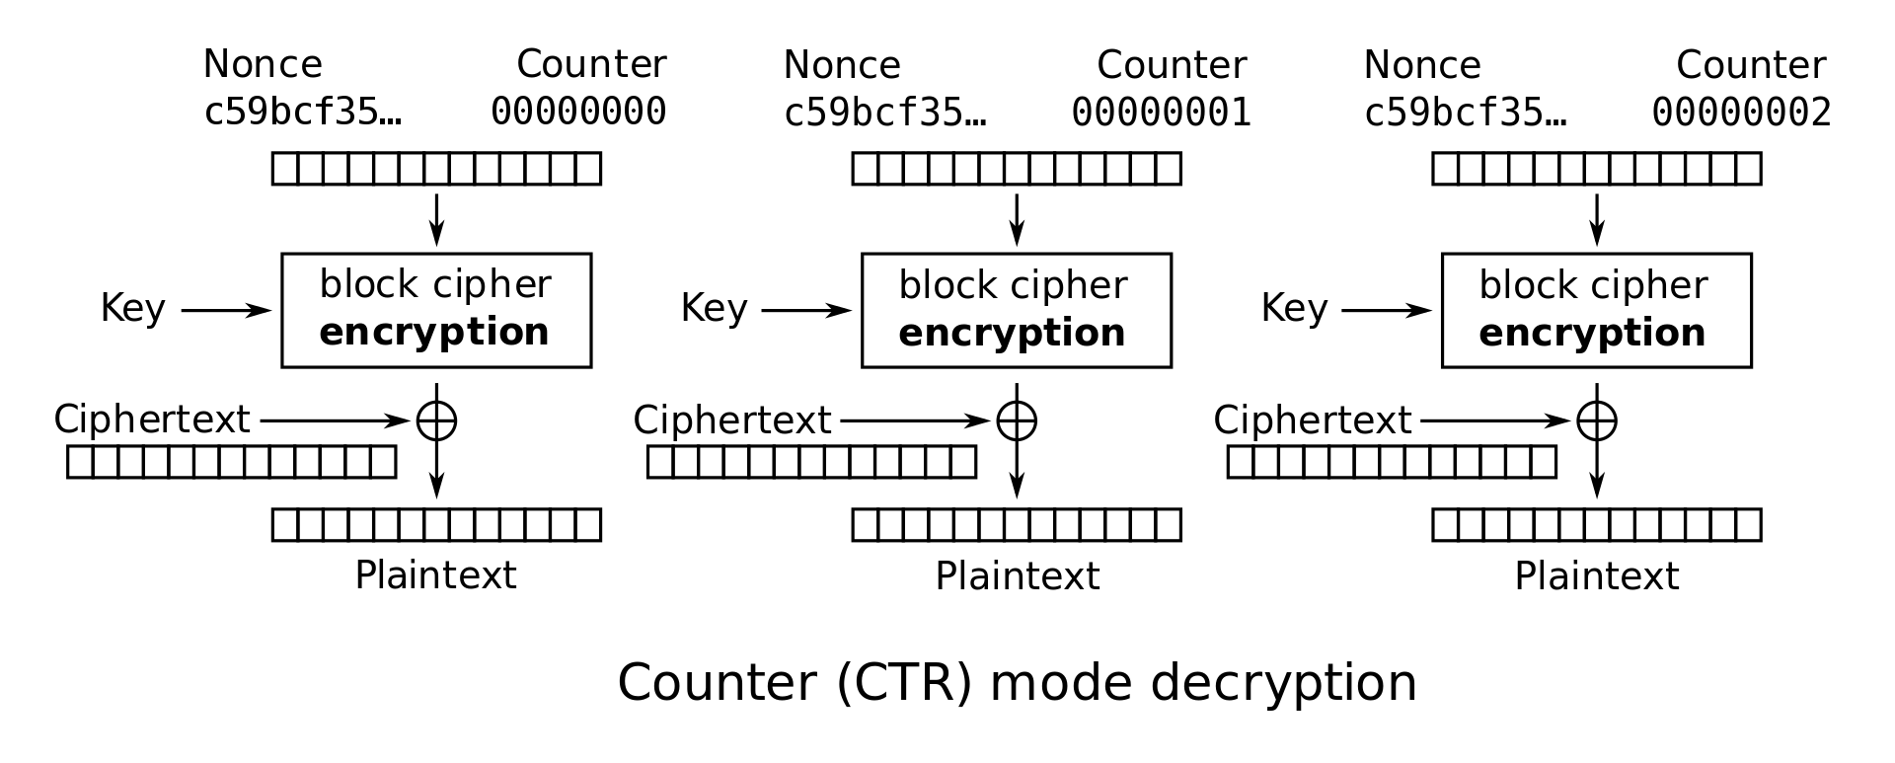
CTR Mode: Decryption
Recall one-time pad: XOR with ciphertext to get plaintext
Note: we are only using block cipher encryption, not decryption

Slide 61
CTR Mode: Decryption
Dec(K, C):
Parse C into (nonce, C₁, …, C_{m})
Compute P_{i} by XORing Ci with output of E_{k} on nonce and counter
Concatenate resulting plaintexts and output M = P₁ … P_{m}
C₁
C₂
C_{m}

Slide 62
CTR Mode: Efficiency
Can encryption be parallelized?
Yes
Can decryption be parallelized?
Yes

Slide 63
CTR Mode: Padding
Do we need to pad messages?
No! We can just cut off the parts of the XOR that are longer than the message.

Slide 64
CTR Mode: Security
AES-CTR is IND-CPA secure. With what assumption?
The nonce must be randomly generated and never reused
And in general less than 2^{n/2} blocks are encrypted
What happens if you reuse the nonce?
Equivalent to reusing a key in a one-time pad
Recall: Key reuse in a one-time pad is catastrophic: usually leaks enough information for an attacker to deduce the entire plaintext
Notes:
TODO Nick (elaborate on encrypting more than 2^{n/2} blocks)

Slide 65
CTR Mode: Penguin
Original image

Slide 66
CTR Mode: Penguin
Encrypted with CTR, with random nonces

Slide 67
IVs and Nonces
Initialization vector (IV): A random, but public, one-use value to introduce randomness into the algorithm
For CTR mode, we say that you use a nonce (number used once), since the value has to be unique, not necessarily random.
In this class, we use IV and nonce interchangeably
Never reuse IVs
In some algorithms, IV/nonce reuse leaks limited information (e.g. CBC)
In some algorithms, IV/nonce reuse leads to catastrophic failure (e.g. CTR)

Slide 68
IVs and Nonces
Thinking about the consequences of IV/nonce reuse is hard
What if the IV/nonce is not reused, but the attacker can predict future values?
Now you have to think about more attacks
We’ll analyze this more in discussion: it really depends on the encryption function
Solution: Randomly generate a new IV/nonce for every encryption
If the nonce is 128 bits or longer, the probability of generating the same IV/nonce twice is astronomically small (basically 0)
Now you don’t ever have to think about IV/nonce reuse attacks!

Slide 69
Comparing Modes of Operation
If you need high performance, which mode is better?
CTR mode, because you can parallelize both encryption and decryption
If you’re paranoid about security, which mode is better?
CBC mode is better
Theoretically, CBC and CTR mode are equally secure if used properly
However, if used improperly (IV/nonce reuse), CBC only leaks partial information, and CTR fails catastrophically
Consider human factors: Systems should be as secure as possible even when implemented incorrectly
IV failures on CTR mode have resulted in multiple real-world security incidents!

Slide 70
Other Modes of Operation
Other modes exist besides CBC and CTR
Trade-offs:
Do we need to pad messages?
How robust is the scheme if we use it incorrectly?
Can we parallelize encryption/decryption?

Slide 71
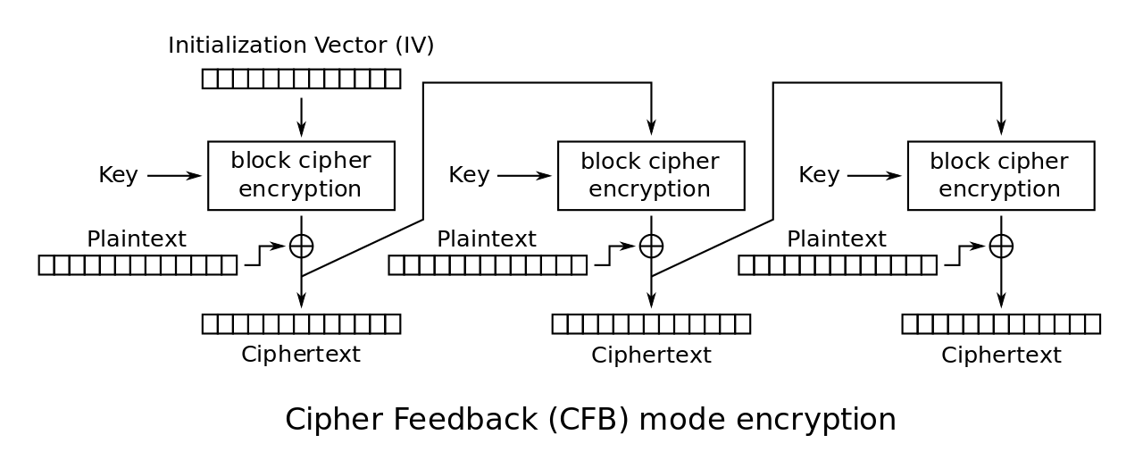
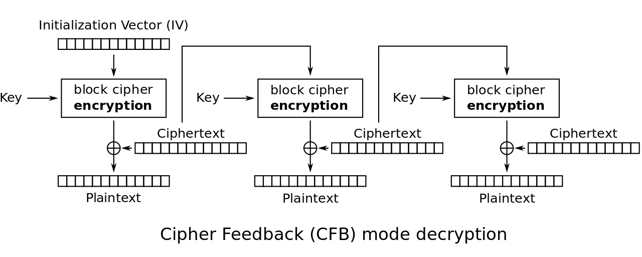
CFB Mode
Also IND-CPA
Try to analyze the trade-offs yourself:
Do we need to pad messages?
How robust is the scheme if we use it incorrectly?
Can we parallelize encryption/decryption?

Slide 72
CFB Mode
Try to analyze the trade-offs yourself:
Do we need to pad messages?
No
How robust is the scheme if we use it incorrectly?
Similar effects as CBC mode, but a bit worse if you reuse the IV
Can we parallelize encryption/decryption?
Only decryption is parallelizable

Slide 73
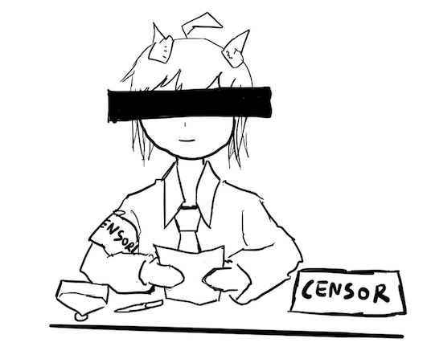
Lack of Integrity and Authenticity
Block ciphers are designed for confidentiality (IND-CPA)
If an attacker tampers with the ciphertext, we are not guaranteed to detect it
Remember Mallory: An active manipulator who wants to tamper with the message

Slide 74
Lack of Integrity and Authenticity
Consider CTR mode
What if Mallory tampers with the ciphertext using XOR?
P | a | y |  | M | a | l |  | $ | 1 | 0 | 0
0x50 | 0x61 | 0x79 | 0x20 | 0x4d | 0x61 | 0x6c | 0x20 | 0x24 | 0x31 | 0x30 | 0x30
M
⊕
EK(i)
0x8a | 0xe3 | 0x5e | 0xcf | 0x3b | 0x40 | 0x46 | 0x57 | 0xb8 | 0x69 | 0xd2 | 0x96
=
C
0xda | 0x82 | 0x27 | 0xef | 0x76 | 0x21 | 0x2a | 0x77 | 0x9c | 0x58 | 0xe2 | 0xa6

Slide 75
Lack of Integrity and Authenticity
Suppose Mallory knows the message M
How can Mallory change the M to say Pay Mal $900?
P | a | y |  | M | a | l |  | $ | 1 | 0 | 0
0x50 | 0x61 | 0x79 | 0x20 | 0x4d | 0x61 | 0x6c | 0x20 | 0x24 | 0x31 | 0x30 | 0x30
M
⊕
EK(i)
0x8a | 0xe3 | 0x5e | 0xcf | 0x3b | 0x40 | 0x46 | 0x57 | 0xb8 | 0x69 | 0xd2 | 0x96
=
C
0xda | 0x82 | 0x27 | 0xef | 0x76 | 0x21 | 0x2a | 0x77 | 0x9c | 0x58 | 0xe2 | 0xa6

Slide 76
Lack of Integrity and Authenticity
Ci | = | Mi ⊕ Padi | 0x58 | = | 0x31 ⊕ Padi | Definition of CTR
Padi | = | Mi ⊕ Ci | Padi | = | 0x58 ⊕ 0x31 | Solve for the ith byte of the pad
 |  |  |  | = | 0x69
C'i | = | M'i ⊕ Padi | C'i | = | 0x39 ⊕ 0x69 | Compute the changed ith byte
 |  |  |  | = | 0x50
C
0xda | 0x82 | 0x27 | 0xef | 0x76 | 0x21 | 0x2a | 0x77 | 0x9c | 0x58 | 0xe2 | 0xa6
C’
0xda | 0x82 | 0x27 | 0xef | 0x76 | 0x21 | 0x2a | 0x77 | 0x9c | 0x50 | 0xe2 | 0xa6

Slide 77
Lack of Integrity and Authenticity
What happens when we decrypt C'?
The message looks like “Pay Mal $900” now!
Note: Mallory didn’t have to know the key; no integrity or authenticity for CTR mode!
C'
0xda | 0x82 | 0x27 | 0xef | 0x76 | 0x21 | 0x2a | 0x77 | 0x9c | 0x50 | 0xe2 | 0xa6
⊕
EK(i)
0x8a | 0xe3 | 0x5e | 0xcf | 0x3b | 0x40 | 0x46 | 0x57 | 0xb8 | 0x69 | 0xd2 | 0x96
=
P'
0x50 | 0x61 | 0x79 | 0x20 | 0x4d | 0x61 | 0x6c | 0x20 | 0x24 | 0x39 | 0x30 | 0x30
P | a | y |  | M | a | l |  | $ | 9 | 0 | 0

Slide 78
Lack of Integrity and Authenticity
What about CBC?
Altering a bit of the ciphertext causes some blocks to become random gibberish
However, Bob cannot prove that Alice did not send random gibberish, so it still does not provide integrity or authenticity

Slide 79
Block Cipher Modes of Operation: Summary
ECB mode: Deterministic, so not IND-CPA secure
CBC mode
IND-CPA secure, assuming no IV reuse
Encryption is not parallelizable
Decryption is parallelizable
Must pad plaintext to a multiple of the block size
IV reuse leads to leaking the existence of identical blocks at the start of the message
CTR mode
IND-CPA secure, assuming no IV reuse
Encryption and decryption are parallelizable
Plaintext does not need to be padded
Nonce reuse leads to losing all security
Lack of integrity and authenticity

