Slide 1
ITIS 6200/8200

Slide 2
time-stamping services
Difficult to verify the creation date and accurate contents of a digital file
Required properties of time-stamping
  Data, instead of the storage medium, should be stamped
  Minor change in source file leads to major changes in stamp
  Low probability of conflict

Slide 3
Time-stamping using TTP
  Alice sends a file to T
  T keeps the file, date, and time in the record
  When it is needed, T can provide the evidence
  Problems:
    Need a TTP
    What about data error during transmission?
    Need huge storage space
    Why should Alice tell the secret to T?
    Collusion between Alice and T

Slide 4
Time-stamping using TTP
  Using hash result and digital signature we can fix most of the problems
  Alice asks T to sign the hash result of the file
  T sends the digital signature back to Alice, T does not need to record the file
  Alice verifies the signature and make sure that no error happens during transmission

Slide 5
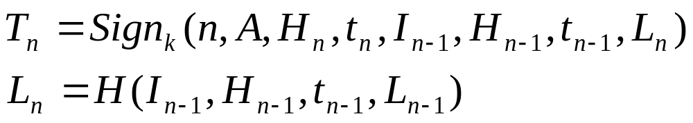
How to defend against collusion
  Linking protocol: every signature is restricted by the previous one and the following one
  T will sign:
  Alice will also receive the owner of the next hash result In+1
  Q: Why do we need the Ln entry? Will I, H and t be enough?

Slide 6
How does the linking protocol mitigate the collusion between T and Alice
  The timestamp is restricted by the previous one and the next one
  T cannot predict the order of the requesters
  Possible way to compromise this method:
    T generates fake event sequences and leaves some gaps for future use
    Counteraction: linking a longer sequence

Slide 7
The generation of a hash tree
  Need to timestamp a large number of files
  Using the hash values to construct a tree
  Publish only the root of the tree
  Provide corresponding entries in the tree to the end users so that they can verify

