Slide 1
Replication of: Legacies of Wartime Order: Punishment Attacks and Social Control in Northern Ireland by Kit Rickard & Kristin M. Bakke
Jacqueline Bouvier SN 23364975

Slide 2
ABSTRACT :
“We argue that instead of going away, informal institutions that emerge in wartime have a sticky legacy, both because armed actors can benefit from the social control these institutions grant them long after the conflict ends and because both armed actors and civilians are socialized into relying on them.”
“We explore how the informal “justice” systems created during the Troubles have long- lasting legacies at the fringes of postwar society, drawing on historical works, interviews with stakeholders, geocoded data on paramilitary-style attacks, and survey data."
“This study speaks to broader debates about governance, the rule of law, and state–society relations in postwar peace and state-building."

Slide 3
THE STUDY :
Assessing whether paramilitary groups’ social control during the Troubles is associated with the location of paramilitary-style attacks today while also accounting for other variables that can account for the occurrence of such attacks today, not least deprivation.
Civilians rely on informal justice institutions persist into the post conflict period due to mistrust of police.

Slide 4
DATA:
PSNI geolocated attack report
2016 survey
1998 – 2018
Split analysis of Protestant vs. Catholic

Slide 5

Top-Down Bottom-Up
Learned behaviour from Leader figures
Proper support for informal institutions – learned from peers
Fear and respect vs. coercion

Slide 6
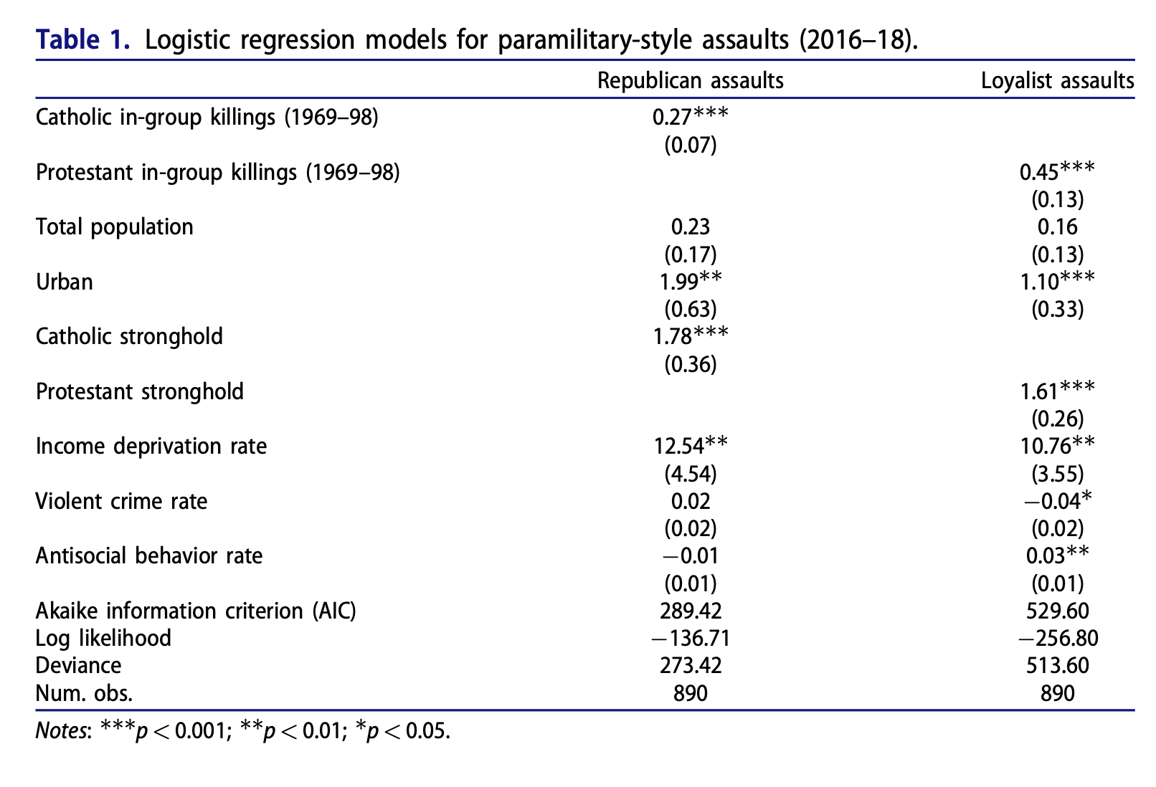
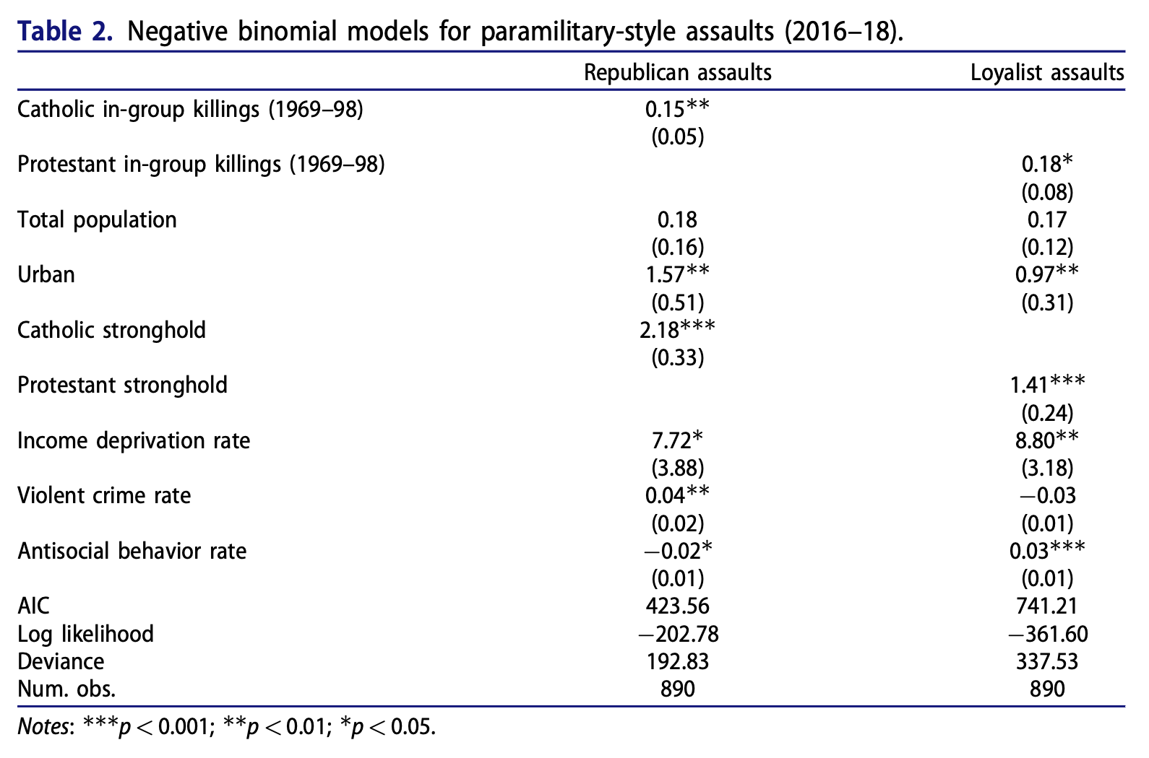
It can be concluded that areas of informal “justice” systems that existed during the Troubles are more likely to still exist after the conflict as well as experience PSAs

Slide 7
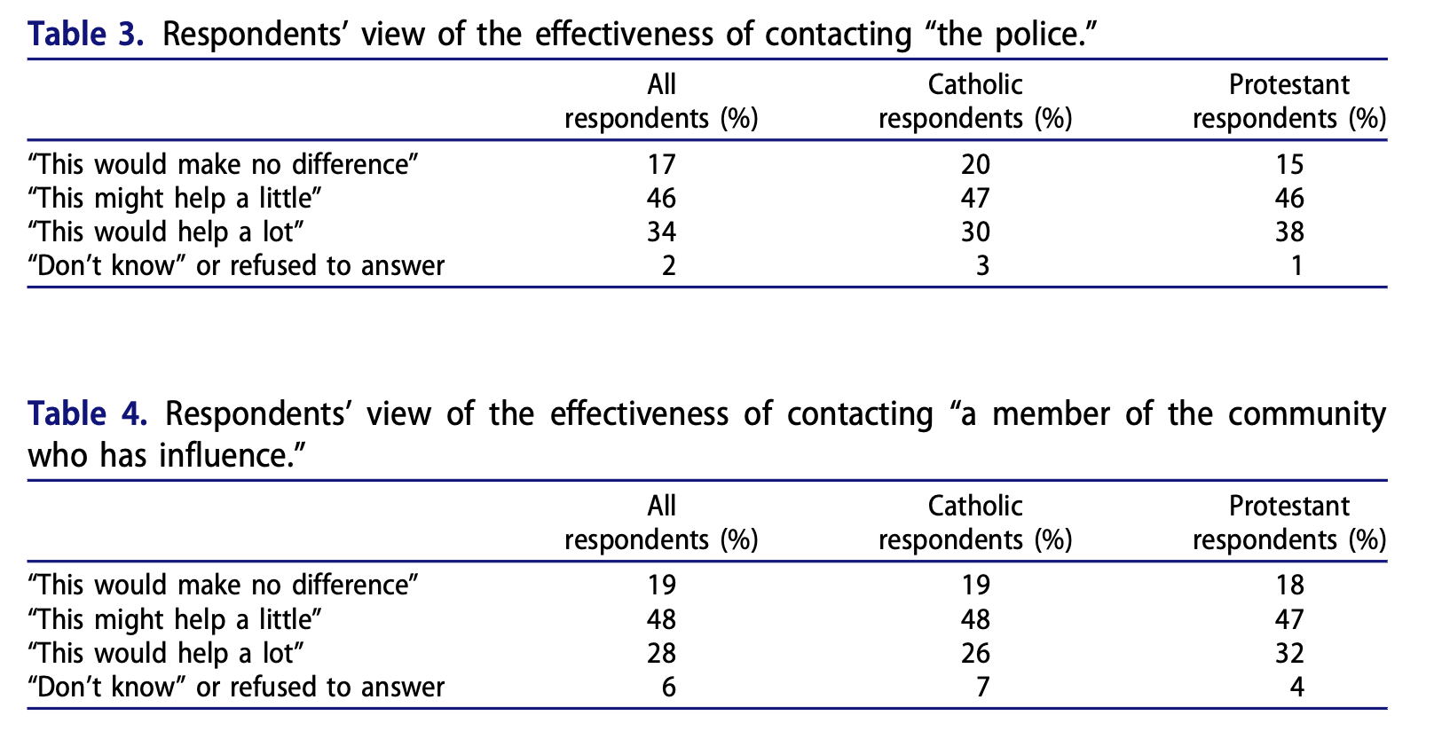
FIGURES:
2016 survey
Belfast & Derry
811 participants
Groups are split

Slide 8
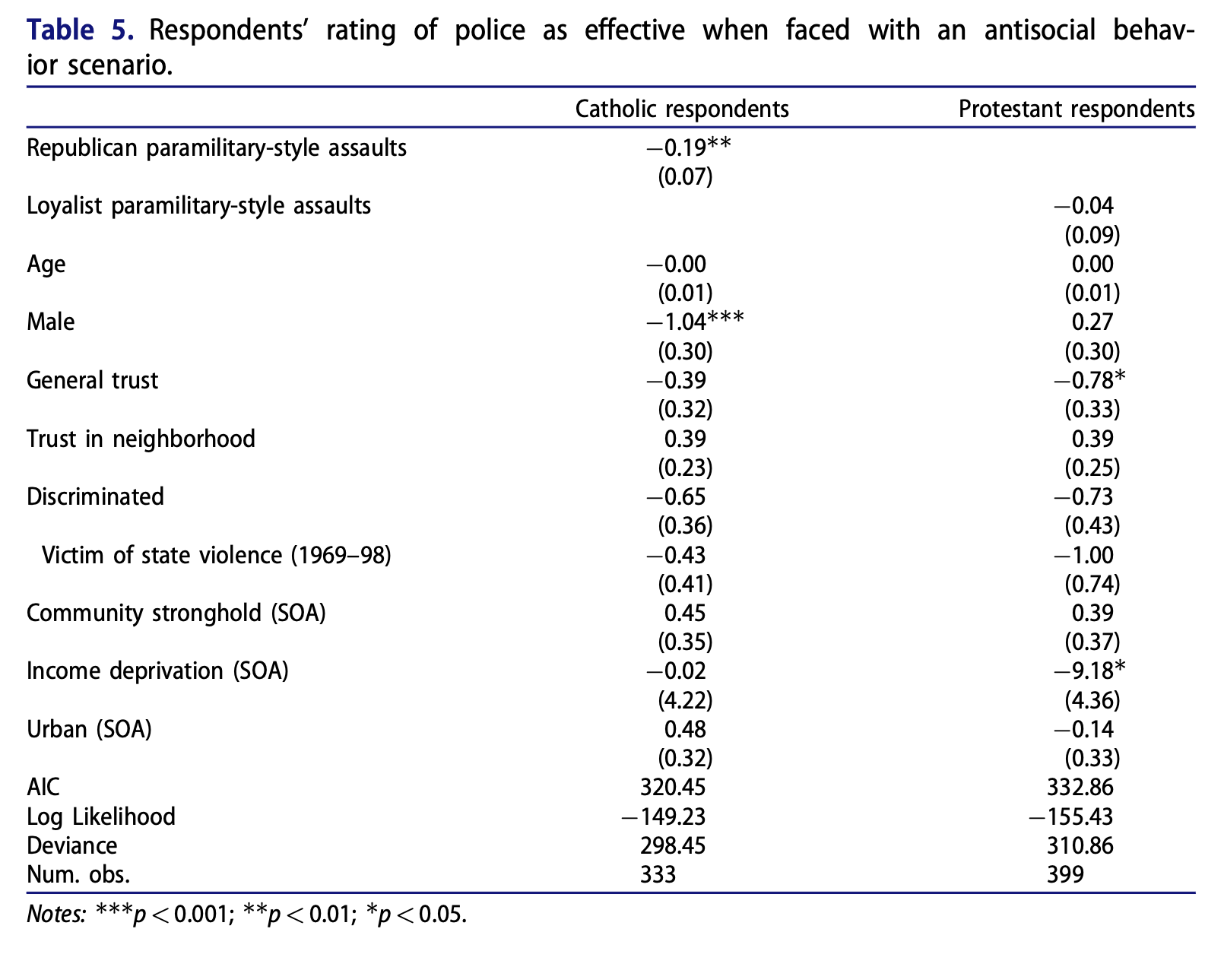
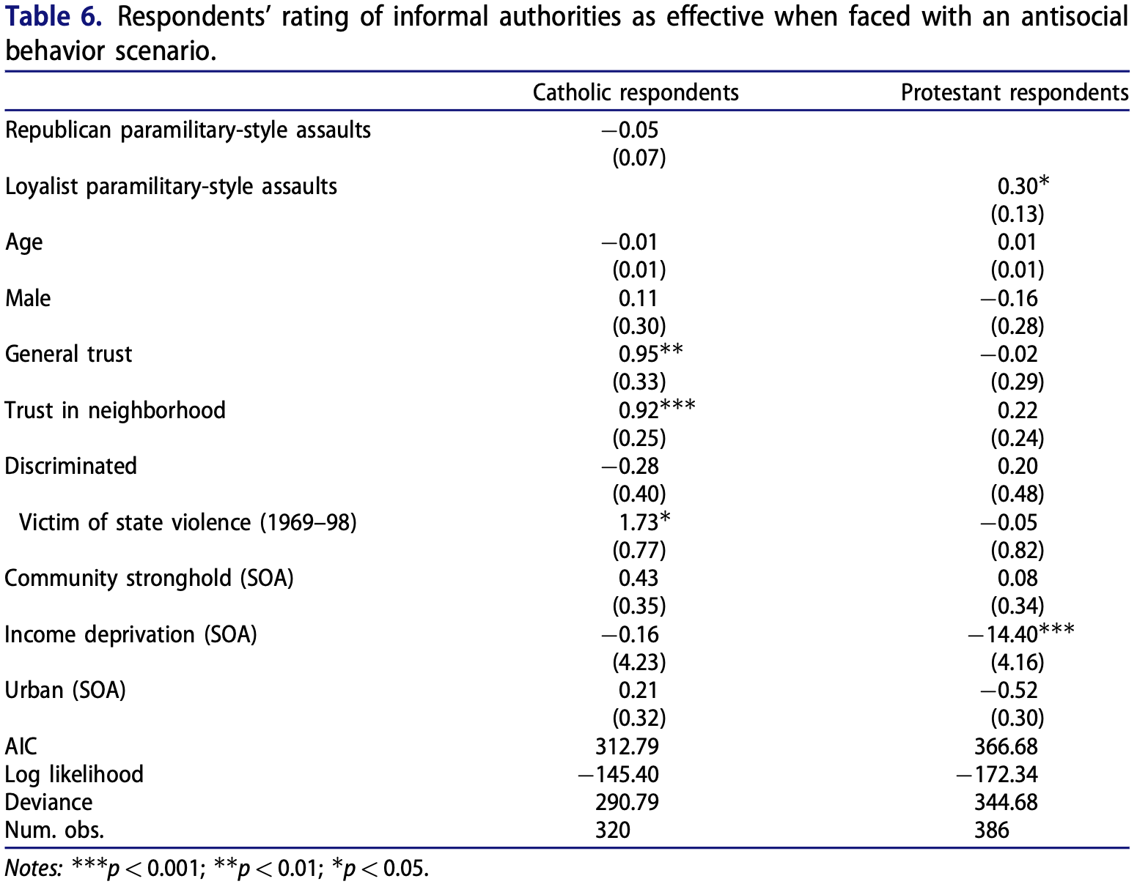
Informal vs. Police

Slide 9
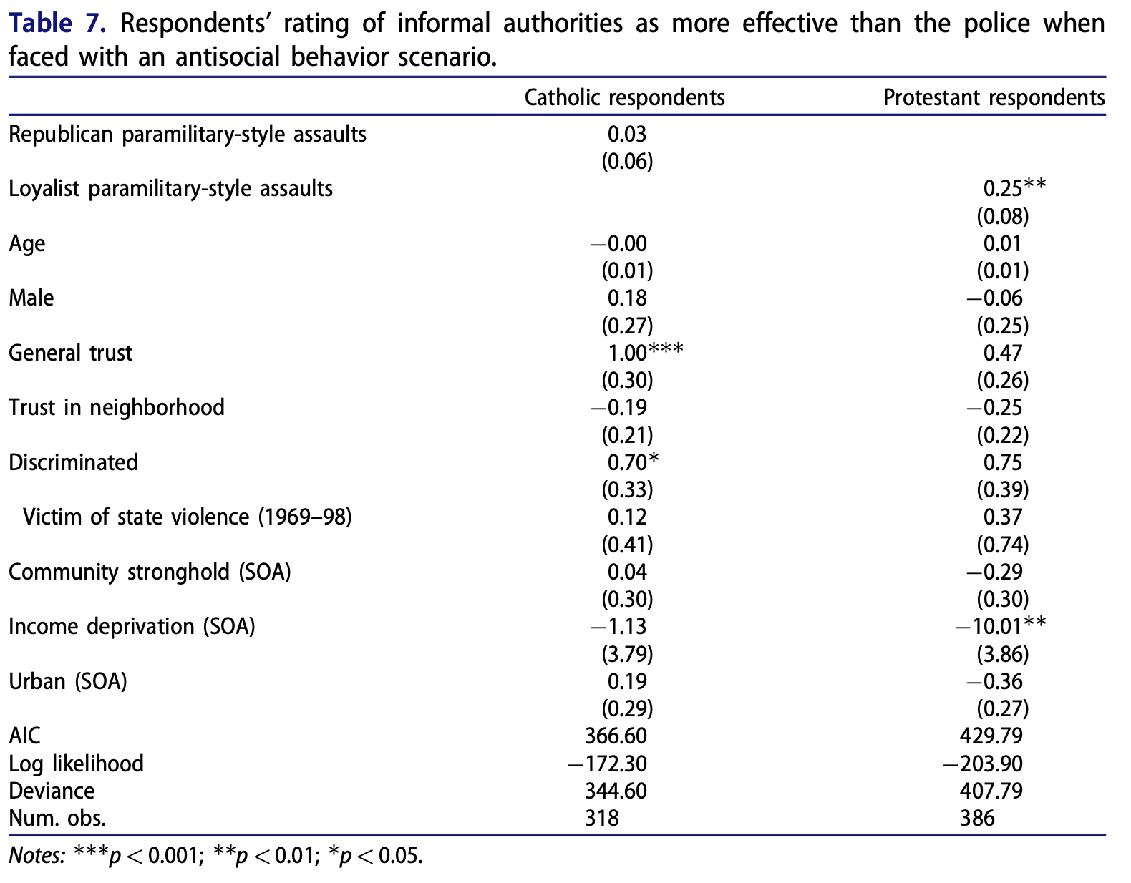

Slide 10
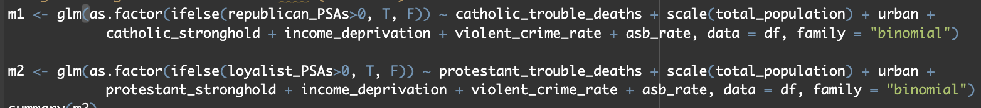
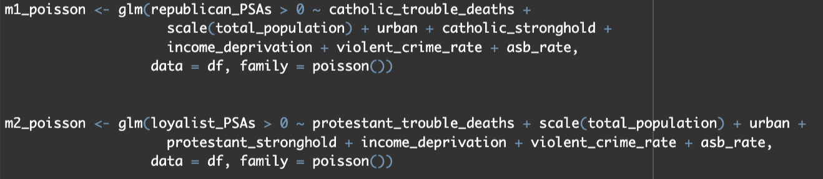
TWIST
Poisson Models for Paramilitary-style Assaults (2016-2018)
Logit vs Poisson

Slide 11
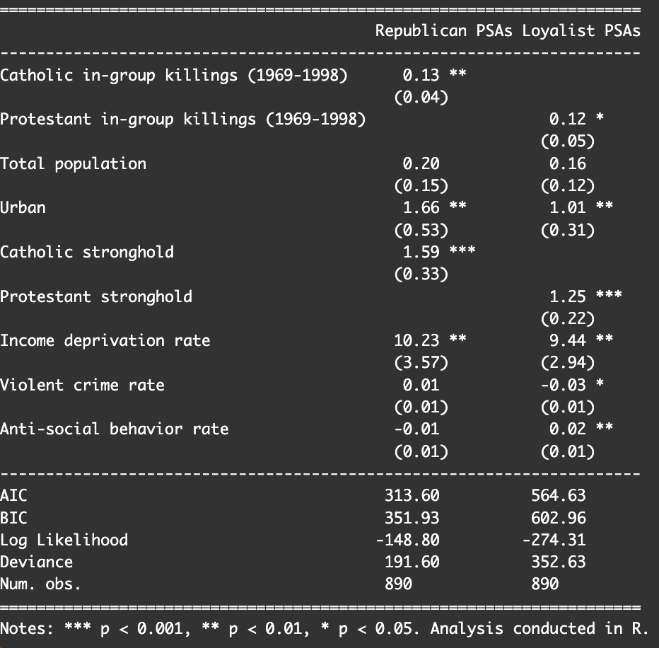
When changing the model we see less of a significance in the analysis
Areas that were studied to hold significance
Urban
Strongholds
Income Deprivation

Slide 12
References
Rickard, K., & Bakke, K. M. (2021). Legacies of wartime order: Punishment attacks and Social Control in Northern Ireland. Security Studies, 30(4), 603–636. https://doi.org/10.1080/09636412.2021.1976822
Rickard, K., & Bakke, K. M. (2022, January 26). Replication data for “legacies of wartime order: Punishment attacks and Social Control in Northern Ireland”. Harvard Dataverse. https://dataverse.harvard.edu/dataset.xhtml?persistentId=doi%3A10.7910%2FDVN%2FXXQX2G

Slide 13
Thank you, I’ll take any questions now

