Slide 1
Your home network,
watched calmly.
GWatch
BETA 0.6.0
You're invited to the beta.
Notes:
GWatch is a calm monitor for a home network and its services. We're opening a beta before the 1.0 public release, and this is the invitation.

Slide 2

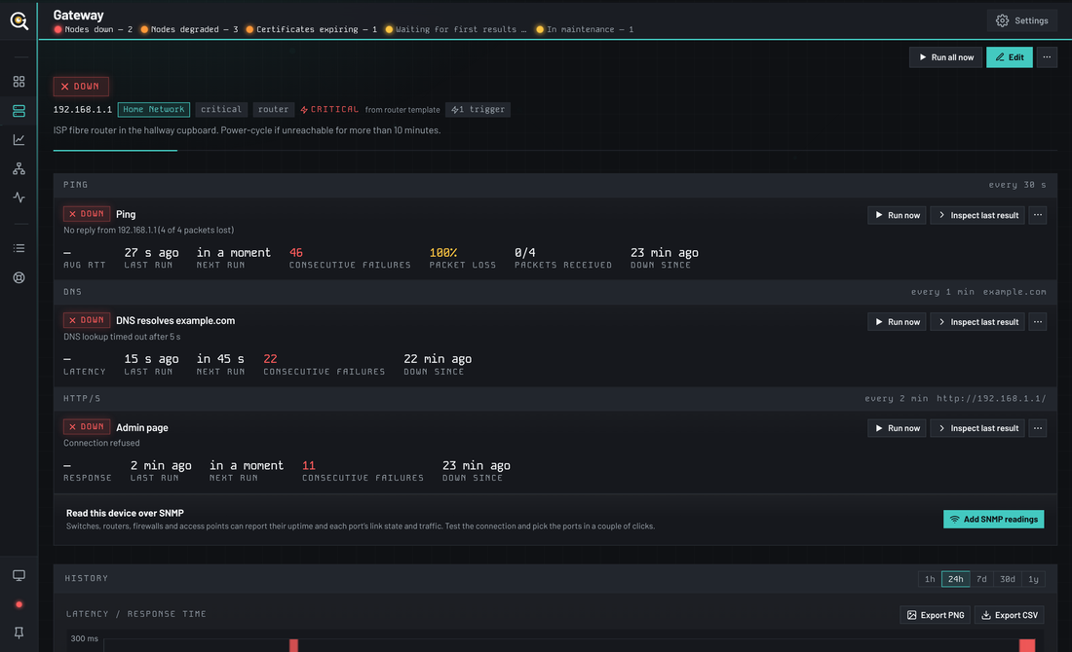
A calm monitor for
everything you run.
WHAT IT IS
GWatch checks your router, servers, websites and services on a schedule, keeps the history, and only speaks up when something actually needs you.
Ping
HTTP/S
Certificates
TCP port
DNS
Keyword
JSON
Custom script
Hardware health
SNMP
2
Notes:
What it is: one program, installed on a PC, a server, a NAS or a Pi. It checks things on a schedule, keeps history, and alerts with restraint.

Slide 3
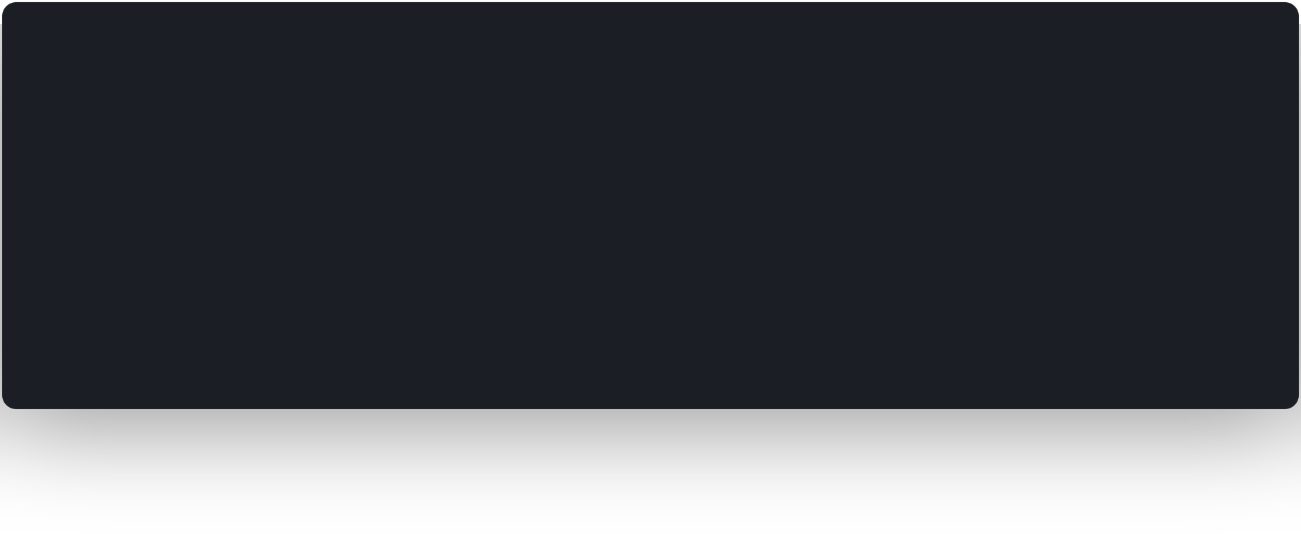
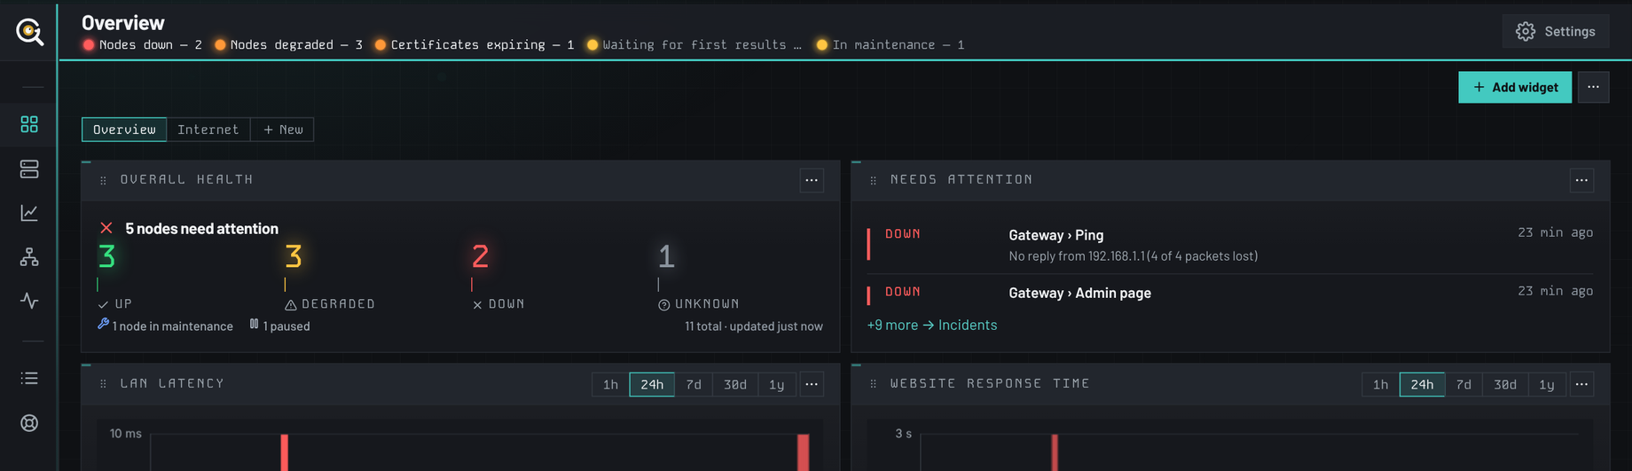
Everything, at a glance.
THE DASHBOARD
3
Notes:
The dashboard: overall health, what needs attention, latency and response charts, groups, certificates. Widgets drag where you drop them.

Slide 4
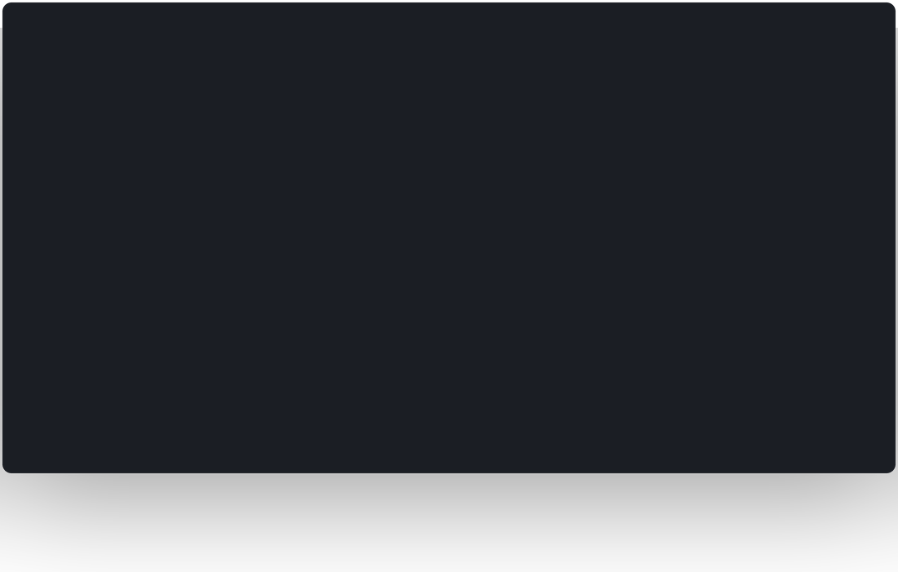
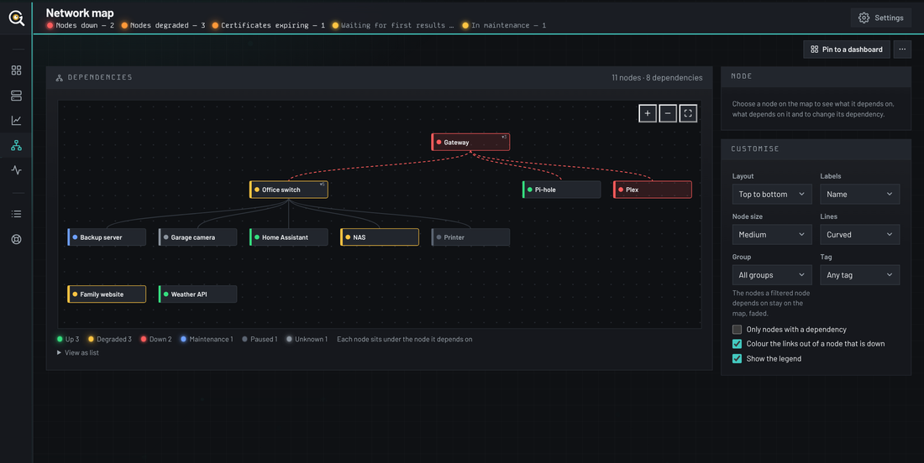
One outage. One alert.
THE NETWORK MAP
Dependencies
The firewall on top; everything it would silence beneath.
Three layouts
Styled to taste, edited in place.
Pin it
Put the map on any dashboard or wallboard.
4
Notes:
The network map draws each node under the one it depends on, and traces an outage's reach in red. Alerts for everything beneath a failed parent are suppressed, so you hear about the cause once.

Slide 5
Robust enough to trust.
Simple enough to enjoy.
WHY IT'S GOOD
Checks everything
Alerts that don't nag
Sees the whole picture
Ping, HTTP/S, certificates, ports, DNS, keywords, JSON, SNMP, hardware health and your own scripts.
After N failures, on recovery, with cooldowns, silences, maintenance windows and dependency-aware quiet.
A live network map traces what an outage really takes down, beneath the device that failed.
Remembers
Acts for you
Stays home
Long-term history, charts that stack today over last week, incidents and availability reports.
Email, Slack, Teams, ntfy, Pushover, webhooks, git and scripts when something changes.
No cloud account, nothing phoned home, never internet-facing on its own. Signed updates, encrypted backups.
5
Notes:
Six reasons people stay: the checks, the restraint, the map, the memory, the automation and the privacy.

Slide 6
Your hardware.
Your data.
RUNS WHERE YOU DO
5
3
8
0
places it runs
database choices
ways to notify
cloud accounts
Windows, Linux, macOS, Docker, Raspberry Pi
SQLite built in, or PostgreSQL / MySQL
Email, Webhooks, Slack, Teams, ntfy, Pushover, git and scripts
Nothing leaves your network
6
Notes:
Runs as a Windows service, a Linux/macOS program, a multi-arch Docker image or on a Raspberry Pi. SQLite by default; PostgreSQL or MySQL if you prefer.

Slide 7
It works. Now help
us make it great.
THE BETA
Find the bugs
Spot the rough edges
Ask for features
Anything that looks wrong, reads wrong or stops working.
The screen that confused you, the setting you couldn't find.
What would make GWatch the one you'd recommend?
Beta builds are signed, update themselves, and back up with one click, so trying it is low-risk.
7
Notes:
What the beta is: 0.6.0 works and looks after your data. The interface and API can still change before 1.0, and that's exactly where testers come in.

Slide 8
Three steps. Ten minutes.
HOW TO JOIN
01
02
03
Install 0.6.0
Watch your real network
Tell us everything
Windows installer, Docker image or Linux/macOS build, signed and free.
Your router, NAS, Pi-hole, websites and APIs: whatever you run.
Bugs, rough edges and the features you wish it had, on GitHub Issues.
Download github.com/jxburros/GWatch/releases
Feedback github.com/jxburros/GWatch/issues
8
Notes:
How to join: download from the latest GitHub release, run it on your network, and file issues for bugs, rough edges and feature ideas.

Slide 9
Join the GWatch Beta.
github.com/jxburros/GWatch
Notes:
Thank you. Every report makes 1.0 better.

