Slide 1

THE EMOTIONAL MIRROR
HEYOKA / MODERN ARCHETYPE / 01
In modern heyoka spirituality,
the mirror is the central image:
someone whose presence is
imagined to bring an unspoken
feeling into view.
What did I actually see—and what did I
add?
HEYOKA / A contemporary spiritual interpretation • Companion booklet: Mirrors & Paradox
Notes:
Heyoka: six modern lenses. Page 1. Public educational content; consult the reading-source notes.

Slide 2
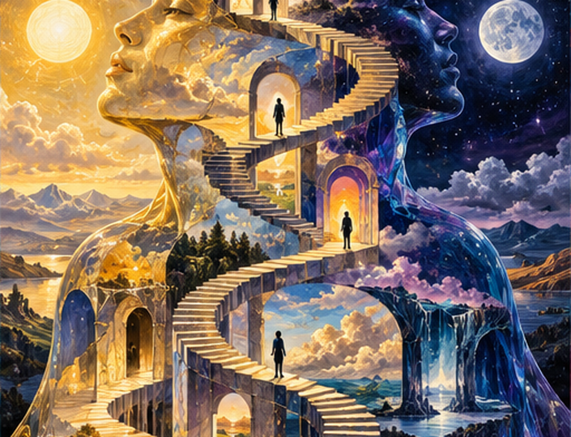
THE LIVING PARADOX
HEYOKA / MODERN ARCHETYPE / 02
The modern heyoka archetype
holds opposites together:
playful and perceptive, soft and
confrontational, ridiculous and
unexpectedly revealing.
Can two truths share the same frame?
HEYOKA / A contemporary spiritual interpretation • Companion booklet: Mirrors & Paradox
Notes:
Heyoka: six modern lenses. Page 2. Public educational content; consult the reading-source notes.

Slide 3
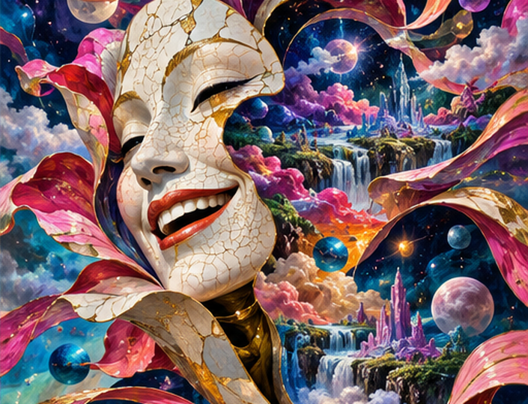
HUMOR THAT REVEALS
HEYOKA / MODERN ARCHETYPE / 03
In the modern heyoka image,
humor works like a sideways
entrance: the laugh arrives
first, and recognition follows a
moment later.
Did the laugh reveal a pattern—or hide a
criticism?
HEYOKA / A contemporary spiritual interpretation • Companion booklet: Mirrors & Paradox
Notes:
Heyoka: six modern lenses. Page 3. Public educational content; consult the reading-source notes.

Slide 4
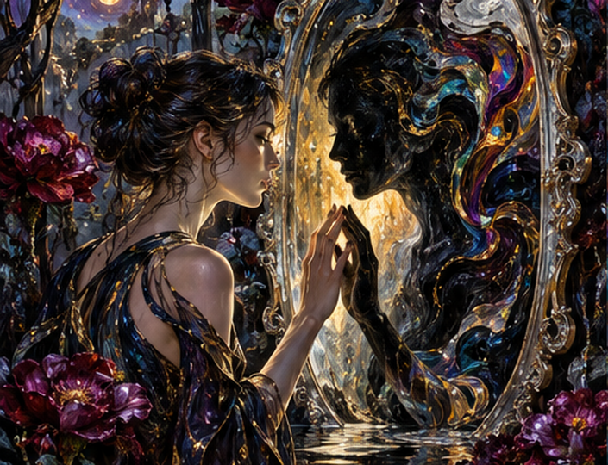
THE SHADOW MIRROR
HEYOKA / MODERN ARCHETYPE / 04
Modern spiritual language
connects heyoka with shadow
work: noticing qualities we
disown, project, or struggle to
recognize in ourselves.
Why did this particular moment stay with
me?
HEYOKA / A contemporary spiritual interpretation • Companion booklet: Mirrors & Paradox
Notes:
Heyoka: six modern lenses. Page 4. Public educational content; consult the reading-source notes.

Slide 5
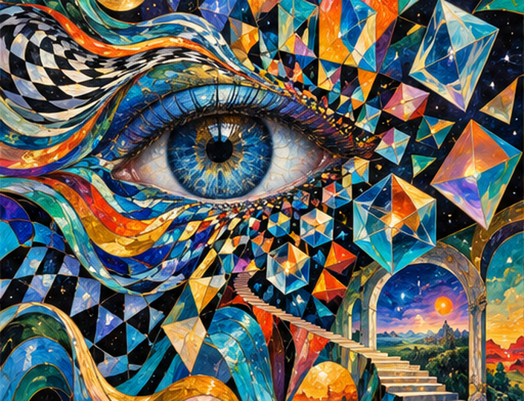
THE PATTERN BREAKER
HEYOKA / MODERN ARCHETYPE / 05
The modern heyoka archetype
is imagined as a pattern
breaker: an unexpected
presence that interrupts the
usual script of a conversation.
What became possible when the usual
response stopped?
HEYOKA / A contemporary spiritual interpretation • Companion booklet: Mirrors & Paradox
Notes:
Heyoka: six modern lenses. Page 5. Public educational content; consult the reading-source notes.

Slide 6

THE GROUNDED MIRROR
HEYOKA / MODERN ARCHETYPE / 06
A grounded modern heyoka
interpretation keeps emotional
mirroring connected to care:
the other person remains a
person, not material for a
lesson.
Can I stay curious without deciding who
someone is?
HEYOKA / A contemporary spiritual interpretation • Companion booklet: Mirrors & Paradox
Notes:
Heyoka: six modern lenses. Page 6. Public educational content; consult the reading-source notes.

