Slide 1



The image editor
your AI agent can
actually use.
Release 0.21.0 · MCP · CLI · Python · REST
Notes:
Vixl is an editable image-document engine built for AI agents. 30-second pitch.

Slide 2

Design tools are built
for hands, not agents.
THE PROBLEM
01
02
03
Click-only
Flattened
Unchecked
Sliders, canvases and menus an agent cannot see or drive.
Image generators return pixels; the layers and text are gone.
Nobody knows the headline overflowed until a human looks.
2
Notes:
Creative tools assume a person with a mouse. Agents need structure, feedback and editable output.

Slide 3
Design as atomic,
checkable operations.
THE SOLUTION
design.json
Editable .vixl masters: text, vector paths, masks, pages
[
{
"type": "layout-apply",
"name": "hero-statement",
"title": "Launch day",
"seed": 7
},
{"type": "look", "look": "glow"}
]
180 operations, up to 10,000 per atomic batch
Structured errors with suggestions
Undo, branches, checkpoints and diffs
3
Notes:
Every design is a document of editable layers. Every change is an operation.

Slide 4
One loop for every design.
HOW IT WORKS
01
02
03
04
05
Inspect
Apply
Check
Preview
Export
Read layers, bounds and fonts
Atomic batches, up to 10,000 ops
Contrast, overlap, bounds, print
Render and look
PNG, SVG, PDF, PPTX, MP4 ...
Checks find overflowing text, low contrast, overlaps, unsafe margins, missing glyphs and print ink problems, so the agent fixes them before anyone looks.
4
Notes:
The agent loop: inspect the document, apply a batch, run checks, preview, export.

Slide 5

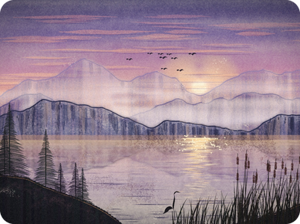
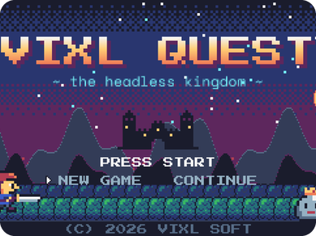
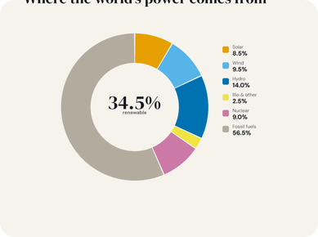


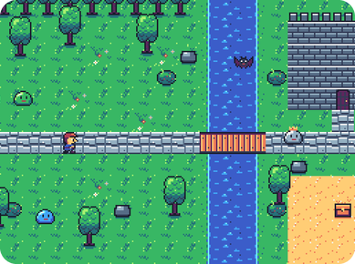
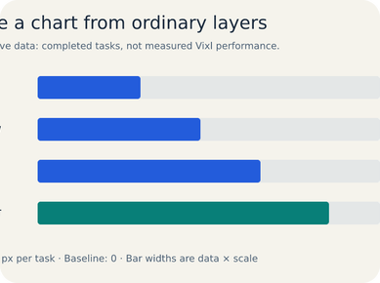
Posters to pixel games.
MADE WITH VIXL
Print poster
Generative painting
Pixel-art game
Data infographic
Character animation
Photo editing
Tile maps
Editable charts
5
Notes:
All of these were built with Vixl in this repository's explorations, without a GUI.

Slide 6
FAST WHERE IT MATTERS
Seconds, not minutes.
10+ min
9.8 s
10.7 s
17 s
1.6 s
0.3 s
Full design check, 11 x 17 poster
Paint 400 brush strokes
Add 1 stroke to a 3,000-stroke layer
Timings from the repository's exploration projects (explorations/README.md), before and after the performance fixes in Vixl 0.18.0.
6
Notes:
Real timings from the exploration projects, before and after the 0.18.0 performance fixes.

Slide 7
Four doors, one engine.
INTERFACES
MCP
CLI
Python
REST
vixl mcp --tools core
vixl -p a.vixl text add 'Hi'
Project(800, 600).apply([...])
POST /operations
Agents in Claude Code and other MCP clients
Scripts, CI pipelines and batch jobs
Notebooks, generators, data merges
Web apps and live human review
7
Notes:
Same operations everywhere: an agent over MCP, a shell script, a notebook or a web service.

Slide 8
One master. Every format.
OUTPUTS
PNG
JPEG
WEBP
TIFF
AVIF
SVG
PDF
PPTX
HTML
ICO
GIF
MP4
CMYK
WebM
APNG
WAV audio
8
Notes:
One master, every format. CMYK print, editable PowerPoint and mixed WAV audio included.

Slide 9

Give your agent
a design studio.
terminal
$ pip install -e '.[server,pdf]'
$ vixl mcp --workspace . --tools core --schema slim
github.com/jxburros/Vixl
Notes:
Install from source or the Windows installer, then connect an agent.

