Slide 1
Ideas become
editable.
VIXL / A DESIGN ENGINE FOR AI AGENTS
Programmable. Editable. Checked.
MCP · CLI · Python · REST
THIS DECK IS MADE WITH VIXL
1 / 12
Notes:
Vixl is a design engine for AI agents. Your agent builds graphics, documents and motion out of real layers, Vixl checks the work, and you get a file you can still change next week. Fun fact: this deck was made with Vixl.

Slide 2
Not a picture. A document.
THE CORE IDEA
01
02
03
Content
Structure
History
Text, paths, images, masks and effects. All still editable.
Groups, variables, pages, layouts and reusable parts.
Undo, checkpoints, branches and diffs. Go back in time.
2 / 12
Notes:
Ask for a poster and most tools hand you a picture of a poster. The .vixl master keeps the content, settings and branching history instead. Raster images stay pixels; text, supported shapes and paths stay editable. Send the master along with whatever formats people asked for.

Slide 3
Look before you export.
THE AGENT LOOP
Inspect
Apply
Check
Preview
Export
Read the canvas. Make atomic edits. Run the checks.
Look at the render. Then ship the files.
3 / 12
Notes:
Inspect, apply, check, preview and export. Each step tells the agent what went wrong while it is still cheap to fix. The diagram is Vixl's own diagram operation: editable nodes, routed paths and text. Checks back up visual review; they do not judge taste.

Slide 4



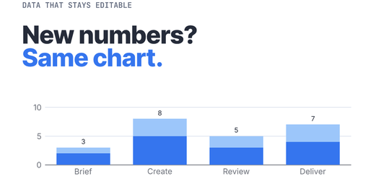


From print to pixels.
SAME ENGINE, VERY DIFFERENT JOBS
Print poster
Generative painting
Pixel-art game
Data-bound charts
Character animation
Photo editing
4 / 12
Notes:
Every one of these is a real output in this repository: a print layout, a generative painting, a pixel game, data graphics, character animation and a photo edit. They show range, not usage statistics.

Slide 5
New numbers? Same chart.
DATA TO STORY
Change the values with chart-data.
Scale, bars, labels and totals follow along.
In PowerPoint, hit Edit Data. It is all there.
ILLUSTRATIVE WORKFLOW DATA
5 / 12
Notes:
Illustrative workflow data, not a customer result or performance claim. Vixl binds the chart to categories and series, so new numbers do not mean a new chart. In the PowerPoint export it is a native chart with an embedded workbook: open Edit Data and poke around.

Slide 6
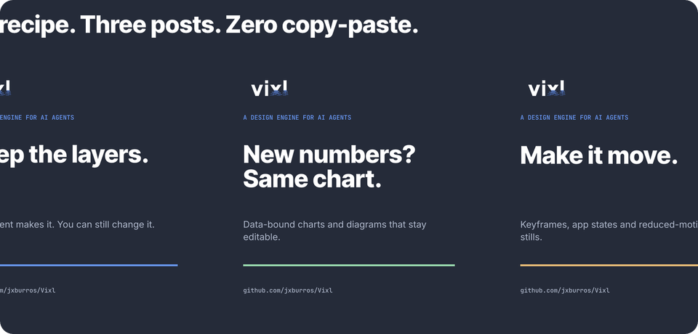
One recipe. Plenty of posts.
CREATIVE AUTOMATION
Typed inputs + variables
Text fitting + saved checks
CSV-driven batches
Reusable containers and templates
6 / 12
Notes:
The included social campaign is a typed recipe: headline, description and accent go in, posts come out. Production fills in three CSV rows, runs the saved design suite and exports only the variants that pass. Nobody copies and pastes anything. Start from the supplied CSV and production request.

Slide 7
Make it move.
Ship the states.
MOTION THAT SHIPS
01
02
03
Author
Export
Integrate
Keyframes, motion recipes, posable characters, cameras and audio.
GIF, animated WebP, APNG, MP4 and other timeline formats.
App states, theme variables, transitions and reduced-motion stills.
7 / 12
Notes:
Vixl has timeline tracks, cameras, audio and rigged joint pose keys. The app demo in this kit ships ready, creating and delivered states with light and dark themes, explicit transitions, editable masters and reduced-motion PNGs. The teaser is an editable timeline exported to MP4 and GIF.

Slide 8
Write the brief as tests.
CHECKED BEFORE IT SHIPS
01
02
03
Define
Inspect
Share
Turn margins, contrast and hierarchy into saved suites.
Run the checks, read the findings, then actually look.
Offline proof pages or a live REST review session.
8 / 12
Notes:
Design checks cover bounds, flow, contrast, fonts and more. Saved suites turn margins, hierarchy and spacing into rules that pass or fail. Proof pages collect previews and findings offline. A passing check proves its rules, not your taste, so someone still looks at the render.

Slide 9
Designs get code review too.
REVIEWABLE WORK
01
02
03
Git review
Shared work
Portable files
Readable JSON + assets through pack and unpack.
Branches, explicit merges, project groups and shared libraries.
Fonts and content travel inside the editable master.
9 / 12
Notes:
Unpack a .vixl master into stable JSON and hashed assets, review the diff in Git, then pack it back into a document. Branching history, project groups and reusable libraries cover the rest of teamwork. The included campaign has an unpacked source folder you can browse.

Slide 10
Same operations. Your tools.
FOUR WAYS IN
01
02
03
04
MCP
CLI
Python
REST
Hand the workspace to your agent.
Script it, batch it, run it in CI.
Generate designs from code and data.
Plug it into web services.
10 / 12
Notes:
MCP serves agents, the CLI serves scripts and CI, Python serves generators and notebooks, and REST serves integrations and live review. All share canonical operations. The server extra is needed for REST.

Slide 11
Whatever format they asked for.
A COMPLETE HANDOFF
01
02
03
Screen
Documents
Print + motion
PNG, JPEG, WebP, SVG and icons.
PDF, fillable PDF, PPTX and HTML decks.
CMYK PDF/TIFF, GIF, WebP, MP4 and more.
11 / 12
Notes:
Supported vectors stay vector in SVG/PDF where possible; some features use reported raster fallbacks. PPTX preserves supported editable shapes, text, tables and charts. PSD export is layered pixels, not native editable type. CMYK is an export setting; ask your printer to confirm the profile.

Slide 12
Give your agent real layers.
YOUR TURN
terminal
git clone https://github.com/jxburros/Vixl.git
cd Vixl
python -m pip install -e '.[server,pdf]'
vixl mcp --workspace . --tools core --schema slim
Windows installer: GitHub Releases
github.com/jxburros/Vixl
Source-available · PolyForm Small Business 1.0.0
AI features use configured external providers.
12 / 12
Notes:
Windows users can use the installer from GitHub Releases. Developers need Python 3.11 or newer; clone the repo, then install its extras. Run the MCP command in an existing workspace. Vixl is source-available under PolyForm Small Business 1.0.0; read LICENSE for eligibility. Core authoring works locally. AI generation and vision need configured external providers.

