Slide 1
AWS AI Job Search Agent
Profile-Isolated Job Discovery, Governance, ML Ranking & GenAI Review
AWS Portfolio Project - V2
Employer Adapters | Deterministic Governance | Lambda | SageMaker | Amazon Bedrock | S3 Website | Glue | MWAA | LangSmith
Jingru Chen • October 4, 2026

Slide 2
What the Platform Solves
2
One shared AWS platform while search, ranking, publication and history remain isolated by candidate profile.
BUSINESS PROBLEM
ARCHITECTURE RESPONSE
PROFILE ISOLATION
• Employer sites expose different search backends and schemas.
• Candidate profiles require different job families and screening rules.
• Daily runs must avoid rescoring recent postings while still scoring every NEW eligible job.
• Recruiter-facing output needs traceable AWS / AI evidence.
• Shared platform + employer adapter layer.
• Central profile configuration; no title logic duplicated inside employer code.
• Deterministic screening before ML / GenAI.
• Profile-aware lifecycle and score cache.
• Daily publication with 7-day history.
Frank C.
Data Science • AI • Quant • Analytics
W.Y. / Family-A
Bioanalysis • LC-MS/MS • Mass Spectrometry
Rule: profiles share infrastructure, not business search results.
Design principle: share infrastructure → isolate business intent → govern deterministically → score incrementally → publish auditable daily results.

Slide 3
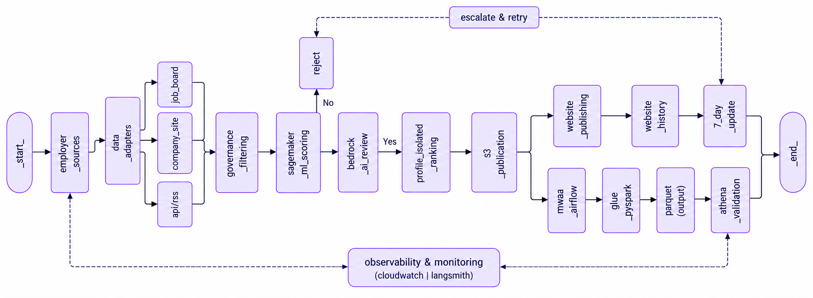
Production AI Job-Search Platform on AWS
3

Slide 4
Daily Scoring, Review & Publication Workflow
4
Incremental processing reduces unnecessary inference while preserving profile isolation and deterministic controls.
1 DISCOVER
2 GOVERN
3 RESOLVE
Employer adapters collect postings; profile configuration defines allowed job families.
Exclude internships, irrelevant roles and disallowed clearance requirements before AI scoring.
Identify NEW eligible postings; reuse recent cached scores when allowed by lifecycle policy.
4 SCORE
5 REVIEW
6 PUBLISH
Score every NEW eligible posting with SageMaker; retain model evidence for downstream selection.
Use Bedrock for grounded review while preserving deterministic governance boundaries.
Rank high-to-low and retain up to Top 5 NEW jobs per employer; publish profile/date artifacts.
Daily contract: score all NEW eligible jobs first → then select Top 5 per employer → publish without cross-profile leakage.

Slide 5
ML Ground Truth, XGBoost Scoring & Bedrock GenAI Review
ML Ground Truth, XGBoost Scoring & Bedrock GenAI Review
5
5
Two profile-specific SageMaker XGBoost models provide quantitative job-fit scoring; Amazon Nova 2 Lite on Bedrock provides grounded semantic review.
1 Human / graded
Ground Truth
2 Structured
Features
3 XGBoost
Training
4 SageMaker
Inference
5 Job-Fit
Score
6 Nova 2 Lite
GenAI Review
7 Governed
Ranking
FRANK C. — XGBOOST JOB-FIT MODEL
FAMILY-A / W.Y. — XGBOOST MODEL
AMAZON BEDROCK — NOVA 2 LITE
• Supervised XGBoost model trained in SageMaker.
• Ground truth: 24 labeled training rows; 8 human-approved positive rows.
• Structured fit features feed quantitative ranking.
• Real Batch Transform example: GDIT RQ227420 → score 0.8923.
• Interpretation guardrail: small-sample demonstration score, not a calibrated probability.
• Separate profile-specific SageMaker XGBoost model for bioanalysis roles.
• Independent model + inference + prediction artifacts preserve profile isolation.
• Purpose: rank LC-MS/MS / bioanalysis opportunities using Family-A-specific relevance.
• Exact aggregate accuracy / calibration metrics are not claimed by the recovered evidence.
• Amazon Nova 2 Lite is a transformer-based generative foundation model available through Amazon Bedrock.
• Project role: read JD + profile context and produce grounded semantic review.
• Outputs: verified matches, gaps / unknowns, concise assessment.
• Bedrock does not replace deterministic screening and does not overwrite the SageMaker score.
• Separation of duties: XGBoost ranks quantitatively; Nova explains semantically.
ML / GenAI design: human-review labels -> profile-specific XGBoost scoring -> grounded Nova 2 Lite review -> governed publication

Slide 6
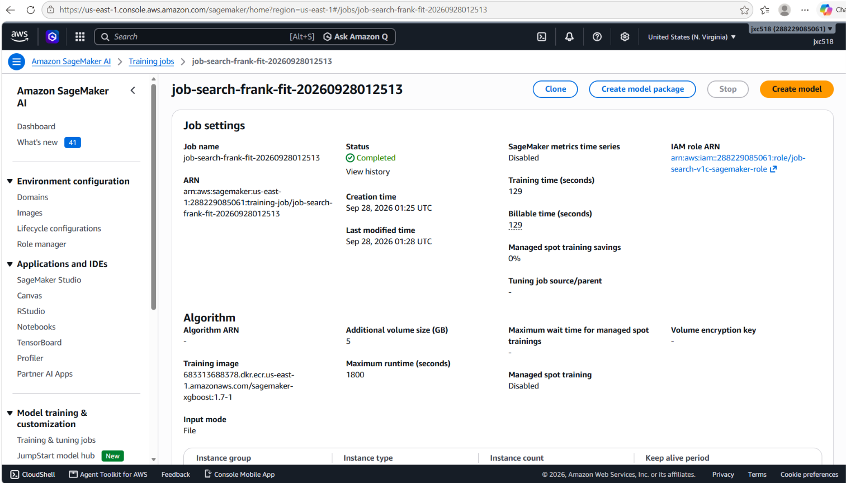
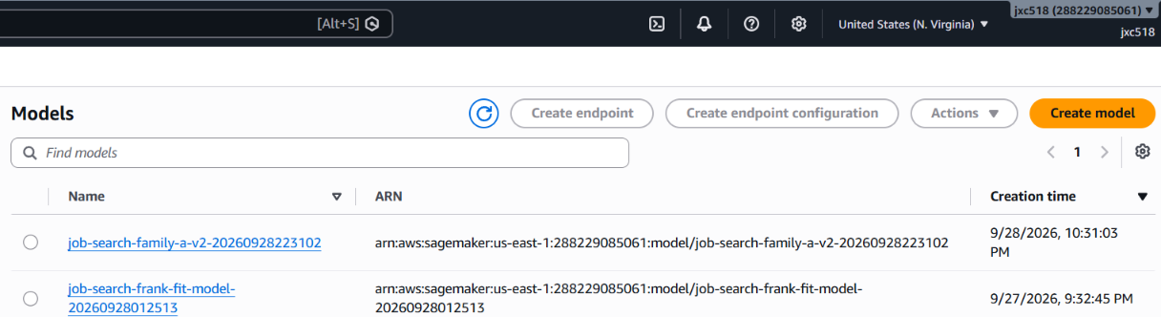
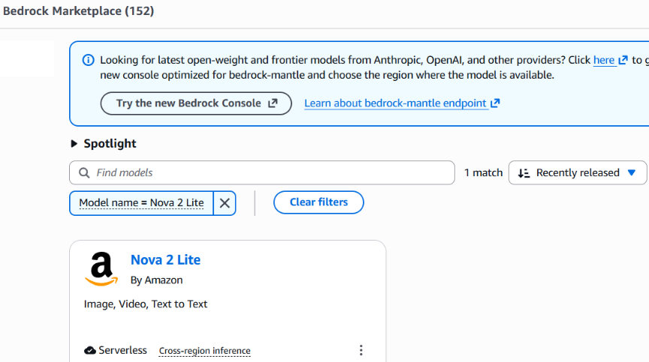
Production AWS Evidence — SageMaker XGBoost & Bedrock Nova 2 Lite
ML Ground Truth, XGBoost Scoring & Bedrock GenAI Review
556
6

Slide 7
AWS Website — Profile-Isolated Daily Results
7
HR-ready website presents candidate-specific daily history while keeping the underlying platform shared.
FRANK C. — DATA SCIENCE / AI
W.Y. / FAMILY-A — BIOANALYSIS
September 29 daily publication
• Root summary: 3,154 raw jobs searched
• 191 passed deterministic governance
• 191 AI-scored NEW jobs
• 20 published Top jobs
Employers represented in the frozen daily artifact include Capital One, GDIT, Navy Federal and Optum.
September 29 daily publication
• Real employer/job records only
• AstraZeneca — Oncology Bioanalytical Strategy Lead
• Pfizer — Senior Scientist Mass Spectrometrist
September 28 was intentionally not backfilled because the only recovered Family-A artifact was a synthetic contract-test fixture.
Governance choice: missing historical evidence is preferable to publishing synthetic or unverifiable job data.

Slide 8
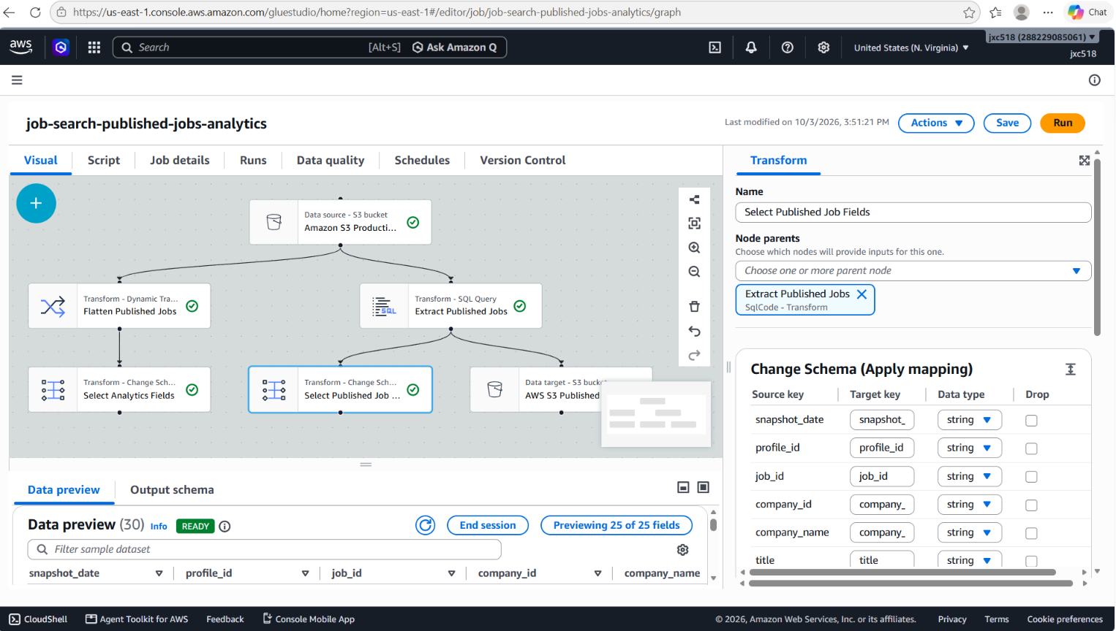
AWS Glue Analytics Pipeline — Visual ETL & Schema Transformation
8
S3 daily snapshots → schema transformation → partitioned Parquet → Glue Data Catalog → Athena validation

Slide 9
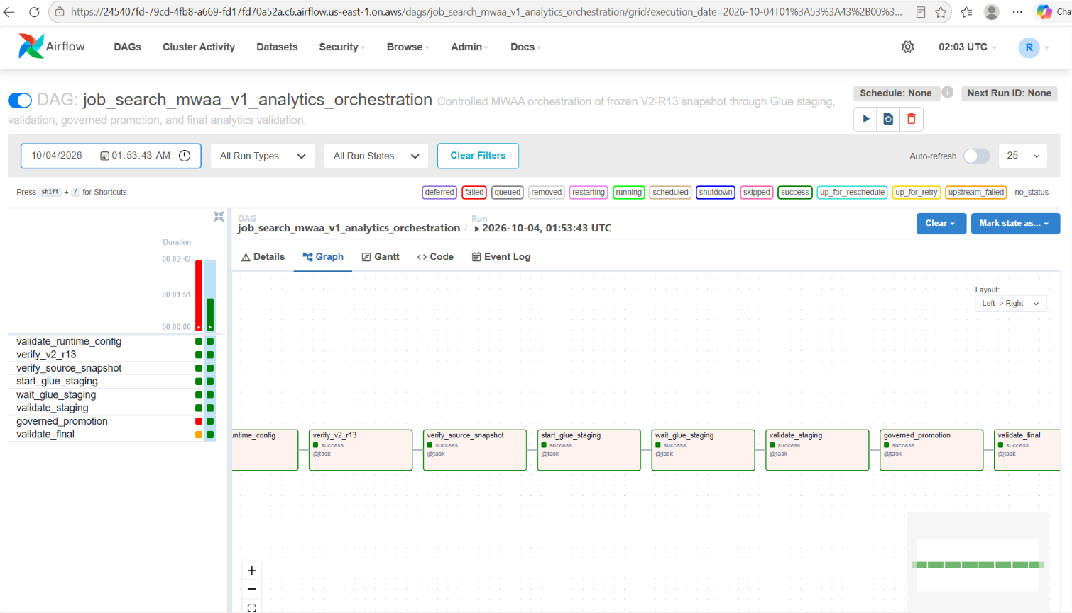
Governed Workflow Orchestration with Amazon MWAA
9
Dependency Management | Retry & Failure Handling | Run-Scoped Staging | Governed Promotion | Final Validation

Slide 10
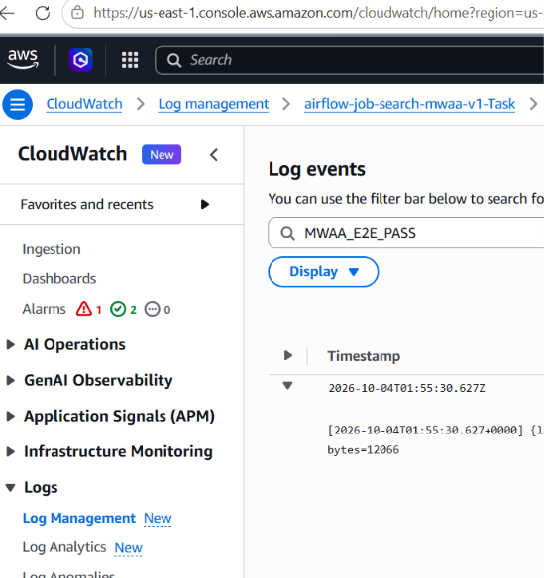
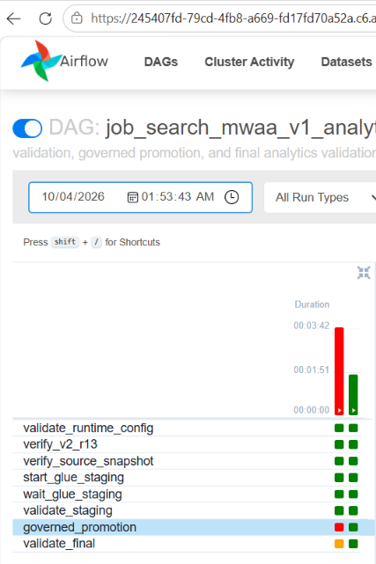
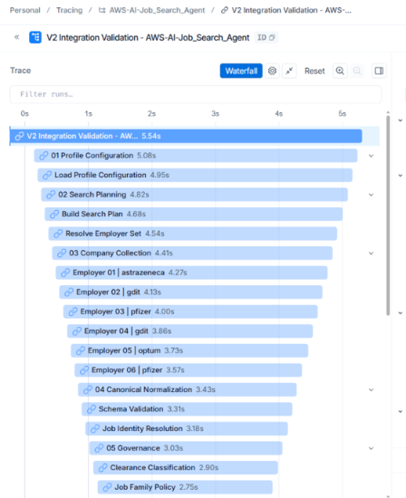
Production Observability & Governance
10
AWS Runtime — CloudWatch · MWAA_E2E_PASS
Workflow — Airflow · 8/8 Tasks Passed
AI / Agent — LangSmith · Multi-Stage Trace

