Slide 1
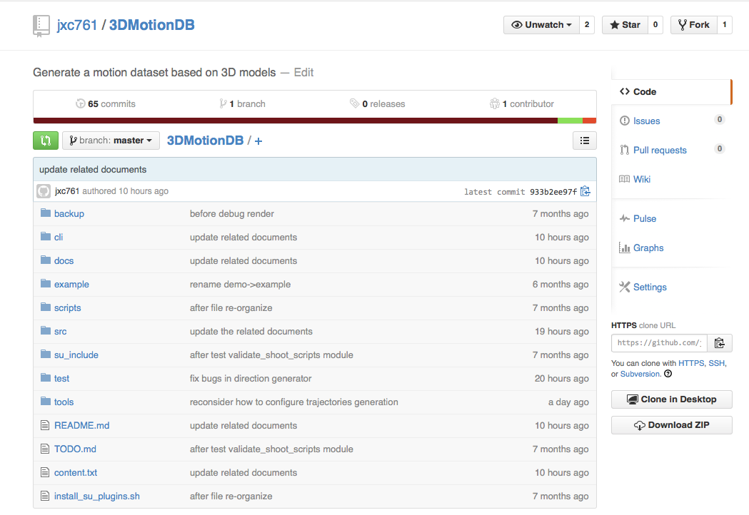
https://github.com/jxc761/3DMotionDB.git
Notes:
I have developed a Sketchup plugin that can help us build the motion dataset. You can get it from my github account. And Here is the link to the repository.
I only test it on MAC with Sketchup 2013. Most parts should be able to work on windows or other sketchup version. But I haven't test it. And at least, I know in the scripts under this "cli" folder, 'cli' stands for command line interface, I use some MAC-Special commands. So don't surprise, if it doesn't work on windows. Of course, it would be appreciated if you guys can make it work on windows and other sketchup version.
I hope the folder's name has explains what it is. For example, "src" folder contains the source codes. the "docs" folder contains the documents. And the "example" is an example to show how to generate the image sequences using this plugin. More detailed descriptions can be found in this file "content.txt". By the way, you can find how to install this plugin, how to run the example from the "readme" file.

Slide 2
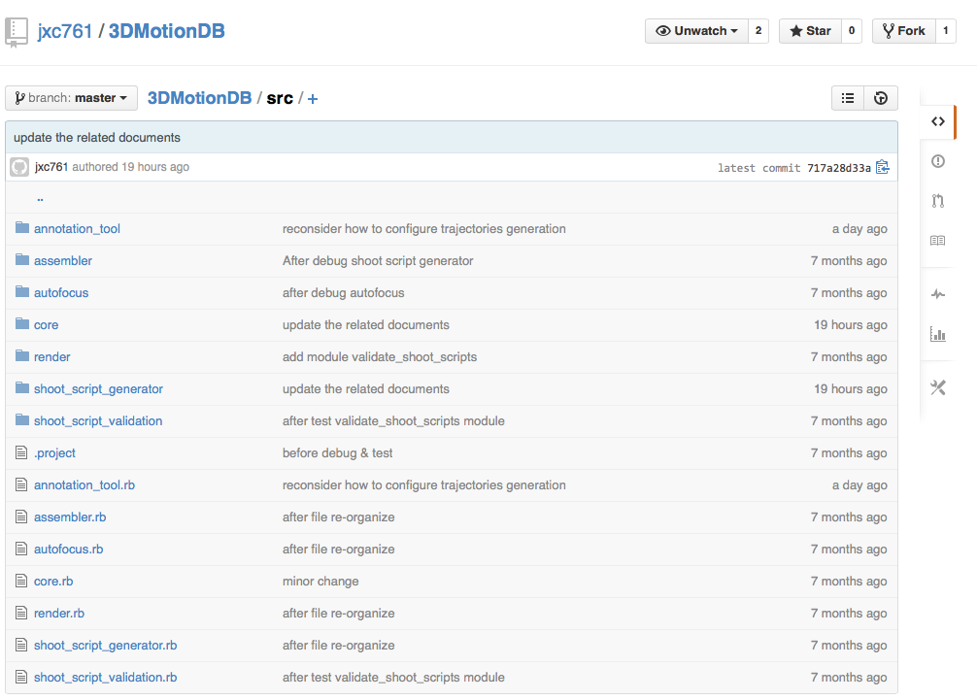
https://github.com/jxc761/3DMotionDB.git
Notes:
Maybe the source code is more complex than you expect. But the internal work flow is not so complex. By and large, I separate the whole process into three steps.

Slide 3
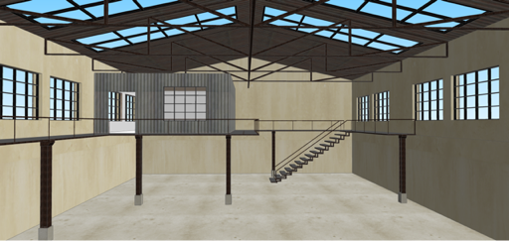



Work flow
Set up camera-target
Generate trajectories
Render
Notes:
First, we need to set-up the camera. Then, we generate the trajectories based on the camera setting. Finally, taking the model and camera trajectories, we can render the image sequences. I will explain them step by step. Next I will explain them step by step.

Slide 4
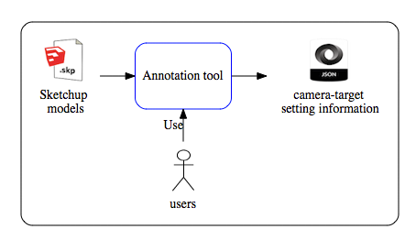
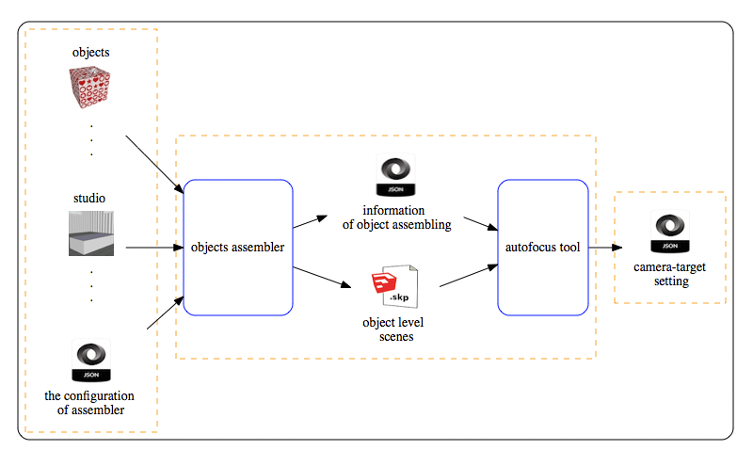
Scene-level scene
Object-level scene
Set up camera-target
Notes:
Basically we have two ways to set up the camera. One way is to setup it by hand using the annotation tool. This is how we handle the 3D models collected from the website. I think, you guys have watch this video before. Right? The second way is for the object-level scene. I developed a tool, I call it assembler, that can automatcially assemble differrent objects in to a pre-set scene. Here, I call it studio. For this kind of scene, the tool can automatically set up the camera and the focal points.

Slide 5
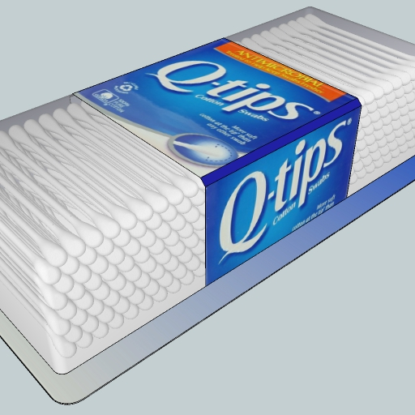
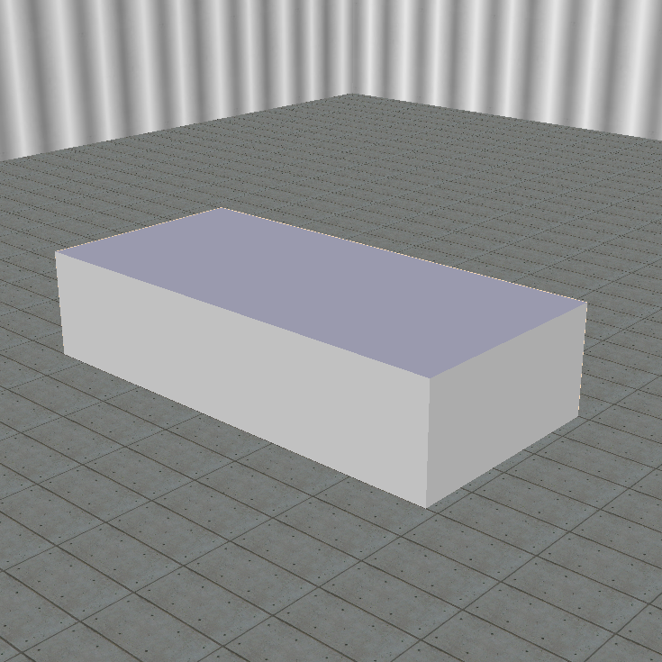
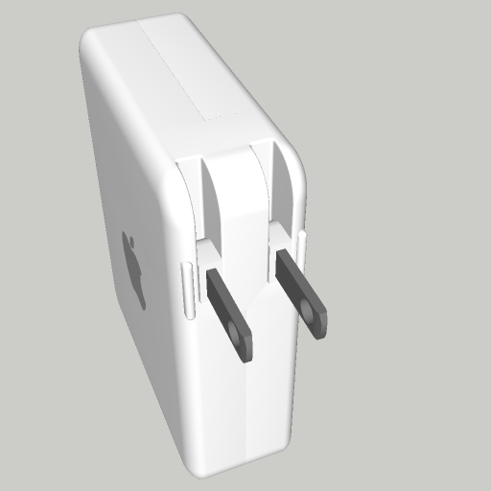
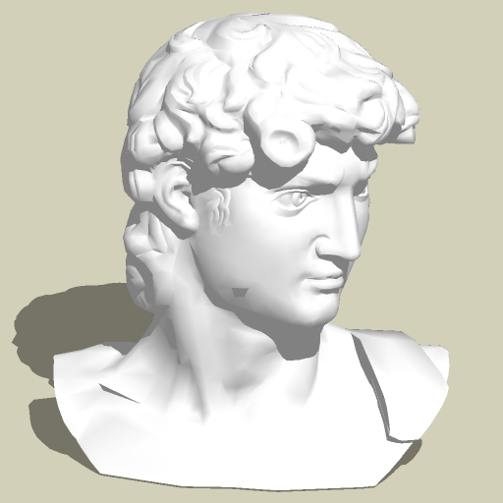
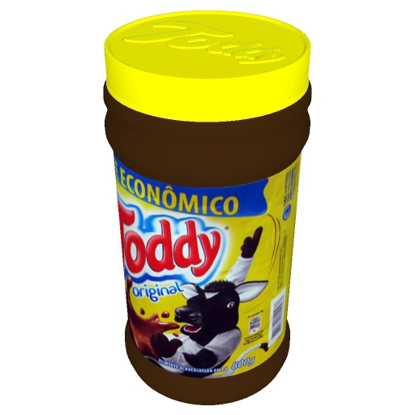


Slide 6
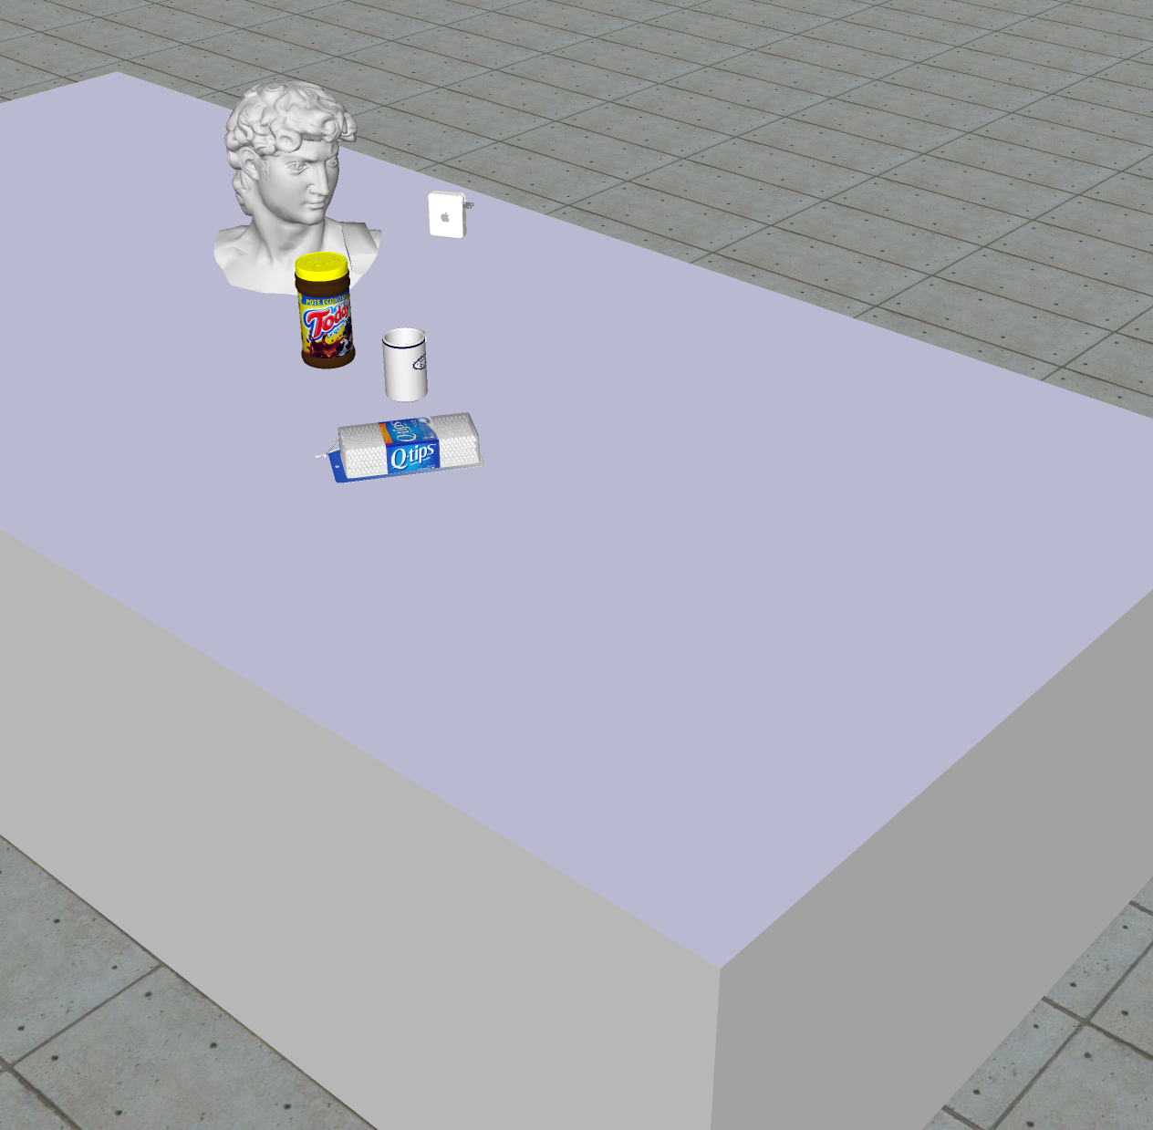

Slide 7
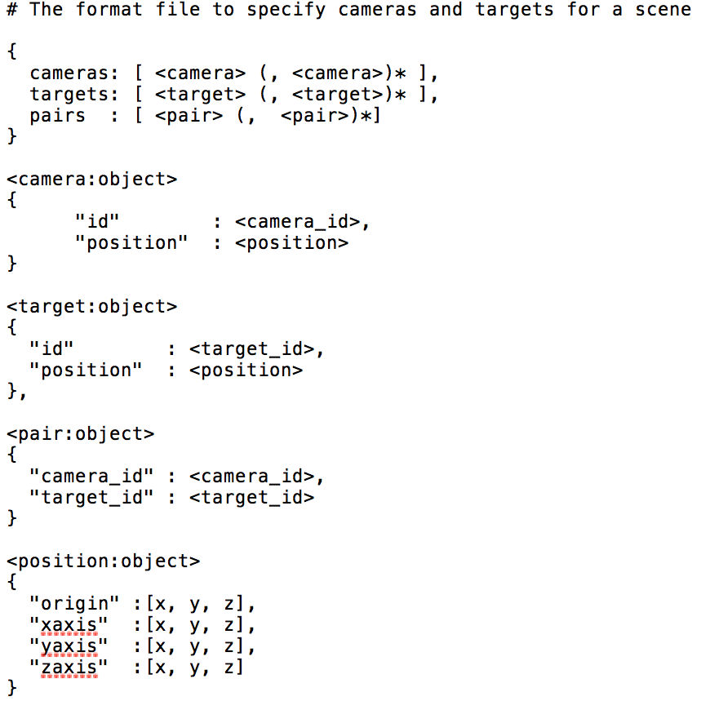
{
"targets" : [
{
"id" : "1401843338",
"position" : {
“zaxis” : [ 0.0, 0.0, 1.0],
"origin" : [ 1547.36,-3781.29,194.1875],
“xaxis” : [ 1.0, 0.0, 0.0],
“yaxis” : [ 0.0, 1.0, 0.0]}},
{
"id" : "1401843356",
"position" : {
“zaxis” : [ 0, 0.71, 0.69],
“origin” : [ 1333.14, -3795.49, 232.89],
“xaxis” : [ -1.0, 1.03, 0.0],
“yaxis” : [ -0.0, -0.69, 0.71]}}],
"pairs" : [
{ "target_id" : "1401843338","camera_id" : "1401843287"},
{ "target_id" : "1401843356", "camera_id" : "1401843287"}],
"cameras" : [
{
"id" : "1401843287",
"position" : {
“zaxis” : [ 0.0, 0.0, 1.0],
“origin” : [ 1388.28, -3626.33, 261.11],
“xaxis” : [ 1.0, 0.0, 0.0],
“yaxis” : [ 0.0, 1.0,0.0]}}]}

Slide 8
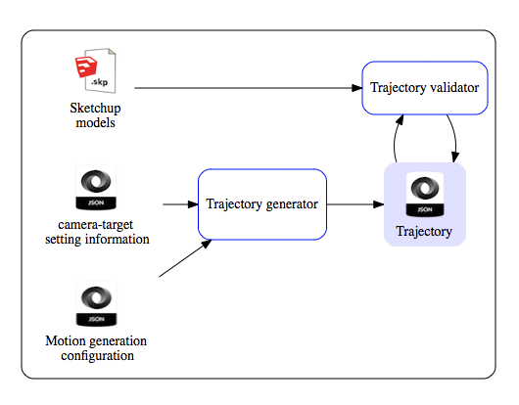
Generate trajectories
Notes:
No matter how we get the camera-target-setting, after that, we can move to the second step, "generate the trajectory".

Slide 9
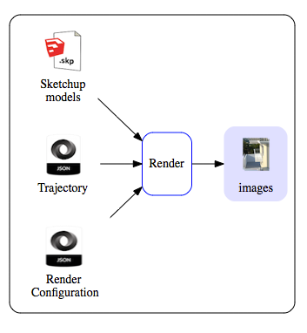
Render

Slide 10

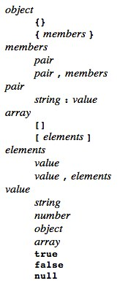
JSON
XML vs. JSON vs. YAML
JSON (JavaScript Object Notation) is a lightweight data-interchange format.
It is easy for humans to read and write. It is easy for machines to parse and generate.
JSON is built on two structures:
A collection of name/value pairs. In various languages, this is realized as an object, record, struct, dictionary, hash table, keyed list, or associative array.
An ordered list of values. In most languages, this is realized as an array, vector, list, or sequence.
C, C++, C#, Java, JavaScript, Perl, Python, Ruby, Matlab
http://json.org/

