Slide 1
Motion
Linear Motion
Rotation about an axis
Rotation about a point
Vertical direction
Camera
Focal point

Slide 2
Direction
UVW Coordinate System
υ
ϖ
ω
Vertical direction
Camera
Focal point

Slide 3
Direction
XYZ Coordinate System
ψ
ξ
ζ
ω
Vertical direction
Camera
Focal point

Slide 4
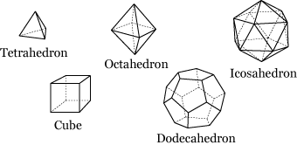
Direction
Linear Motion
υ
ϖ
ω
Sample motion directions in space

Slide 5
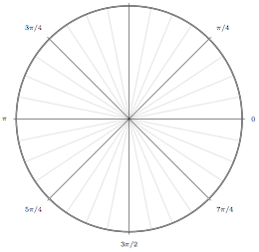
Direction
Linear Motion
on plane
uv, vw, wu
xy, yz, zx
υ
ψ
ξ
ϖ
ζ
ω
ω
ex. Walking. Sample directions on zx-plane

Slide 6
Direction
Linear Motion
Special
±u, ±v, ±w
±x, ±y, ±z
ψ
υ
ξ
ζ
ϖ
ω
ω
Upward, Downward
Right, Left
Forward, Backward

Slide 7
Direction
Rotation about an axis
ψ
ξ
ζ
ω
Clockwise(special direction: x)
Counterclockwise(special direction: -x)
Both

Slide 8
Direction
Rotation about a point
υ
ϖ
ω
Sample on the tangent plane(uv plane)
Special: ±u, ±v

