Slide 1
Work flow
Set up camera-target
Generate trajectories
Render

Slide 2
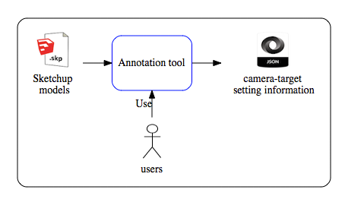
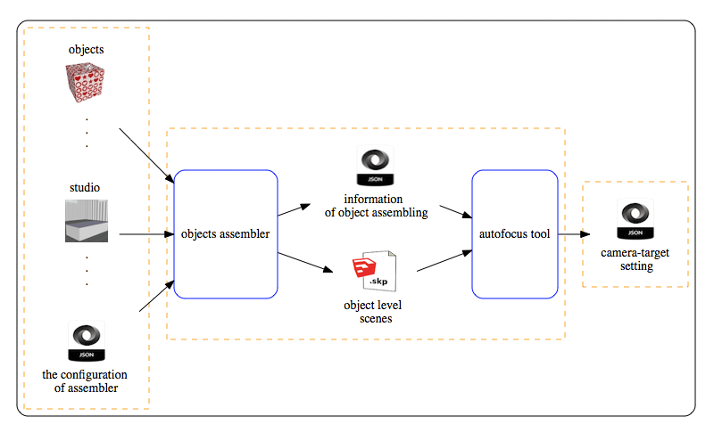
Work flow
Set up camera-target
Generate trajectories
Render

Slide 3
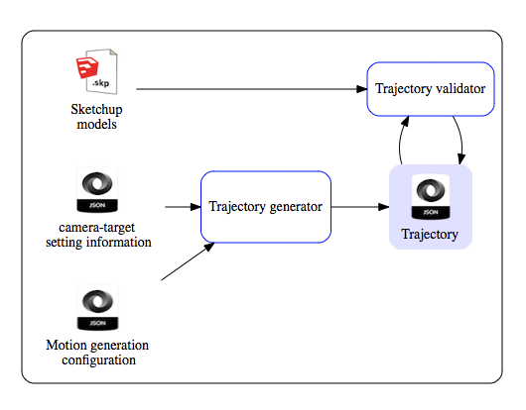
Generate trajectories

Slide 4
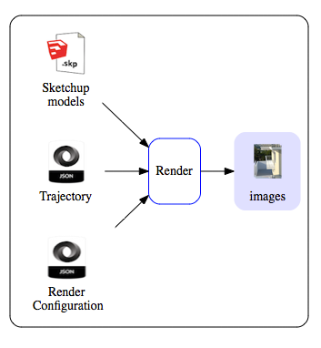
Render

Slide 5

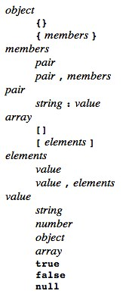
JSON
XML vs. JSON vs. YAML
JSON (JavaScript Object Notation) is a lightweight data-interchange format.
It is easy for humans to read and write. It is easy for machines to parse and generate.
JSON is built on two structures:
A collection of name/value pairs. In various languages, this is realized as an object, record, struct, dictionary, hash table, keyed list, or associative array.
An ordered list of values. In most languages, this is realized as an array, vector, list, or sequence.
C, C++, C#, Java, JavaScript, Perl, Python, Ruby, Matlab
http://json.org/

