Slide 1
Motion
Linear Motion
Rotation about an axis
Rotation about a point
Vertical direction
Camera
Focal point

Slide 2
Direction
UVW Coordinate System
υ
ϖ
ω
Vertical direction
Camera
Focal point

Slide 3
Direction
XYZ Coordinate System
ψ
ζ
ξ
ω
Vertical direction
Camera
Focal point

Slide 4
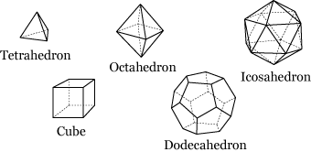
Direction
Linear Motion
In space

Slide 5
Direction
Linear Motion
ψ
ζ
ξ
ω
In space

Slide 6
Direction
Linear Motion
on plane
uv, vw, wu
xy, yz, zx
υ
ψ
ζ
ϖ
ω
ξ
ω

Slide 7
Direction
Linear Motion
Special
±u, ±v, ±w
±x, ±y, ±z
υ
ψ
ζ
ϖ
ω
ξ
ω
Upward | Downward
Forward| Backward
Left | Right

Slide 8
Direction
Rotation about an axis
Clockwise
Counterclockwise
Both

Slide 9
Direction
Rotation about a point
υ
ϖ
ω
Sample on uv plane
Special: ±u, ±v

